Slide 1


RADIOCHEMISTRY
for Nuclear Medicine
AYAGOZ Baimukhanova, PhD

Slide 2
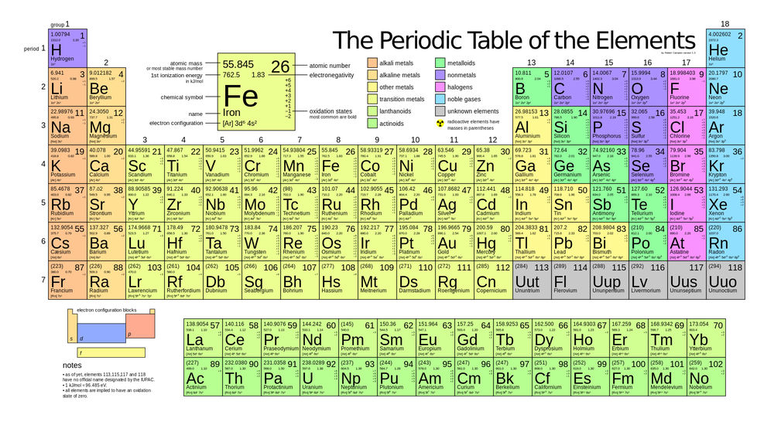
https://www.popsci.com/four-new-elements-added-to-periodic-table

Slide 3
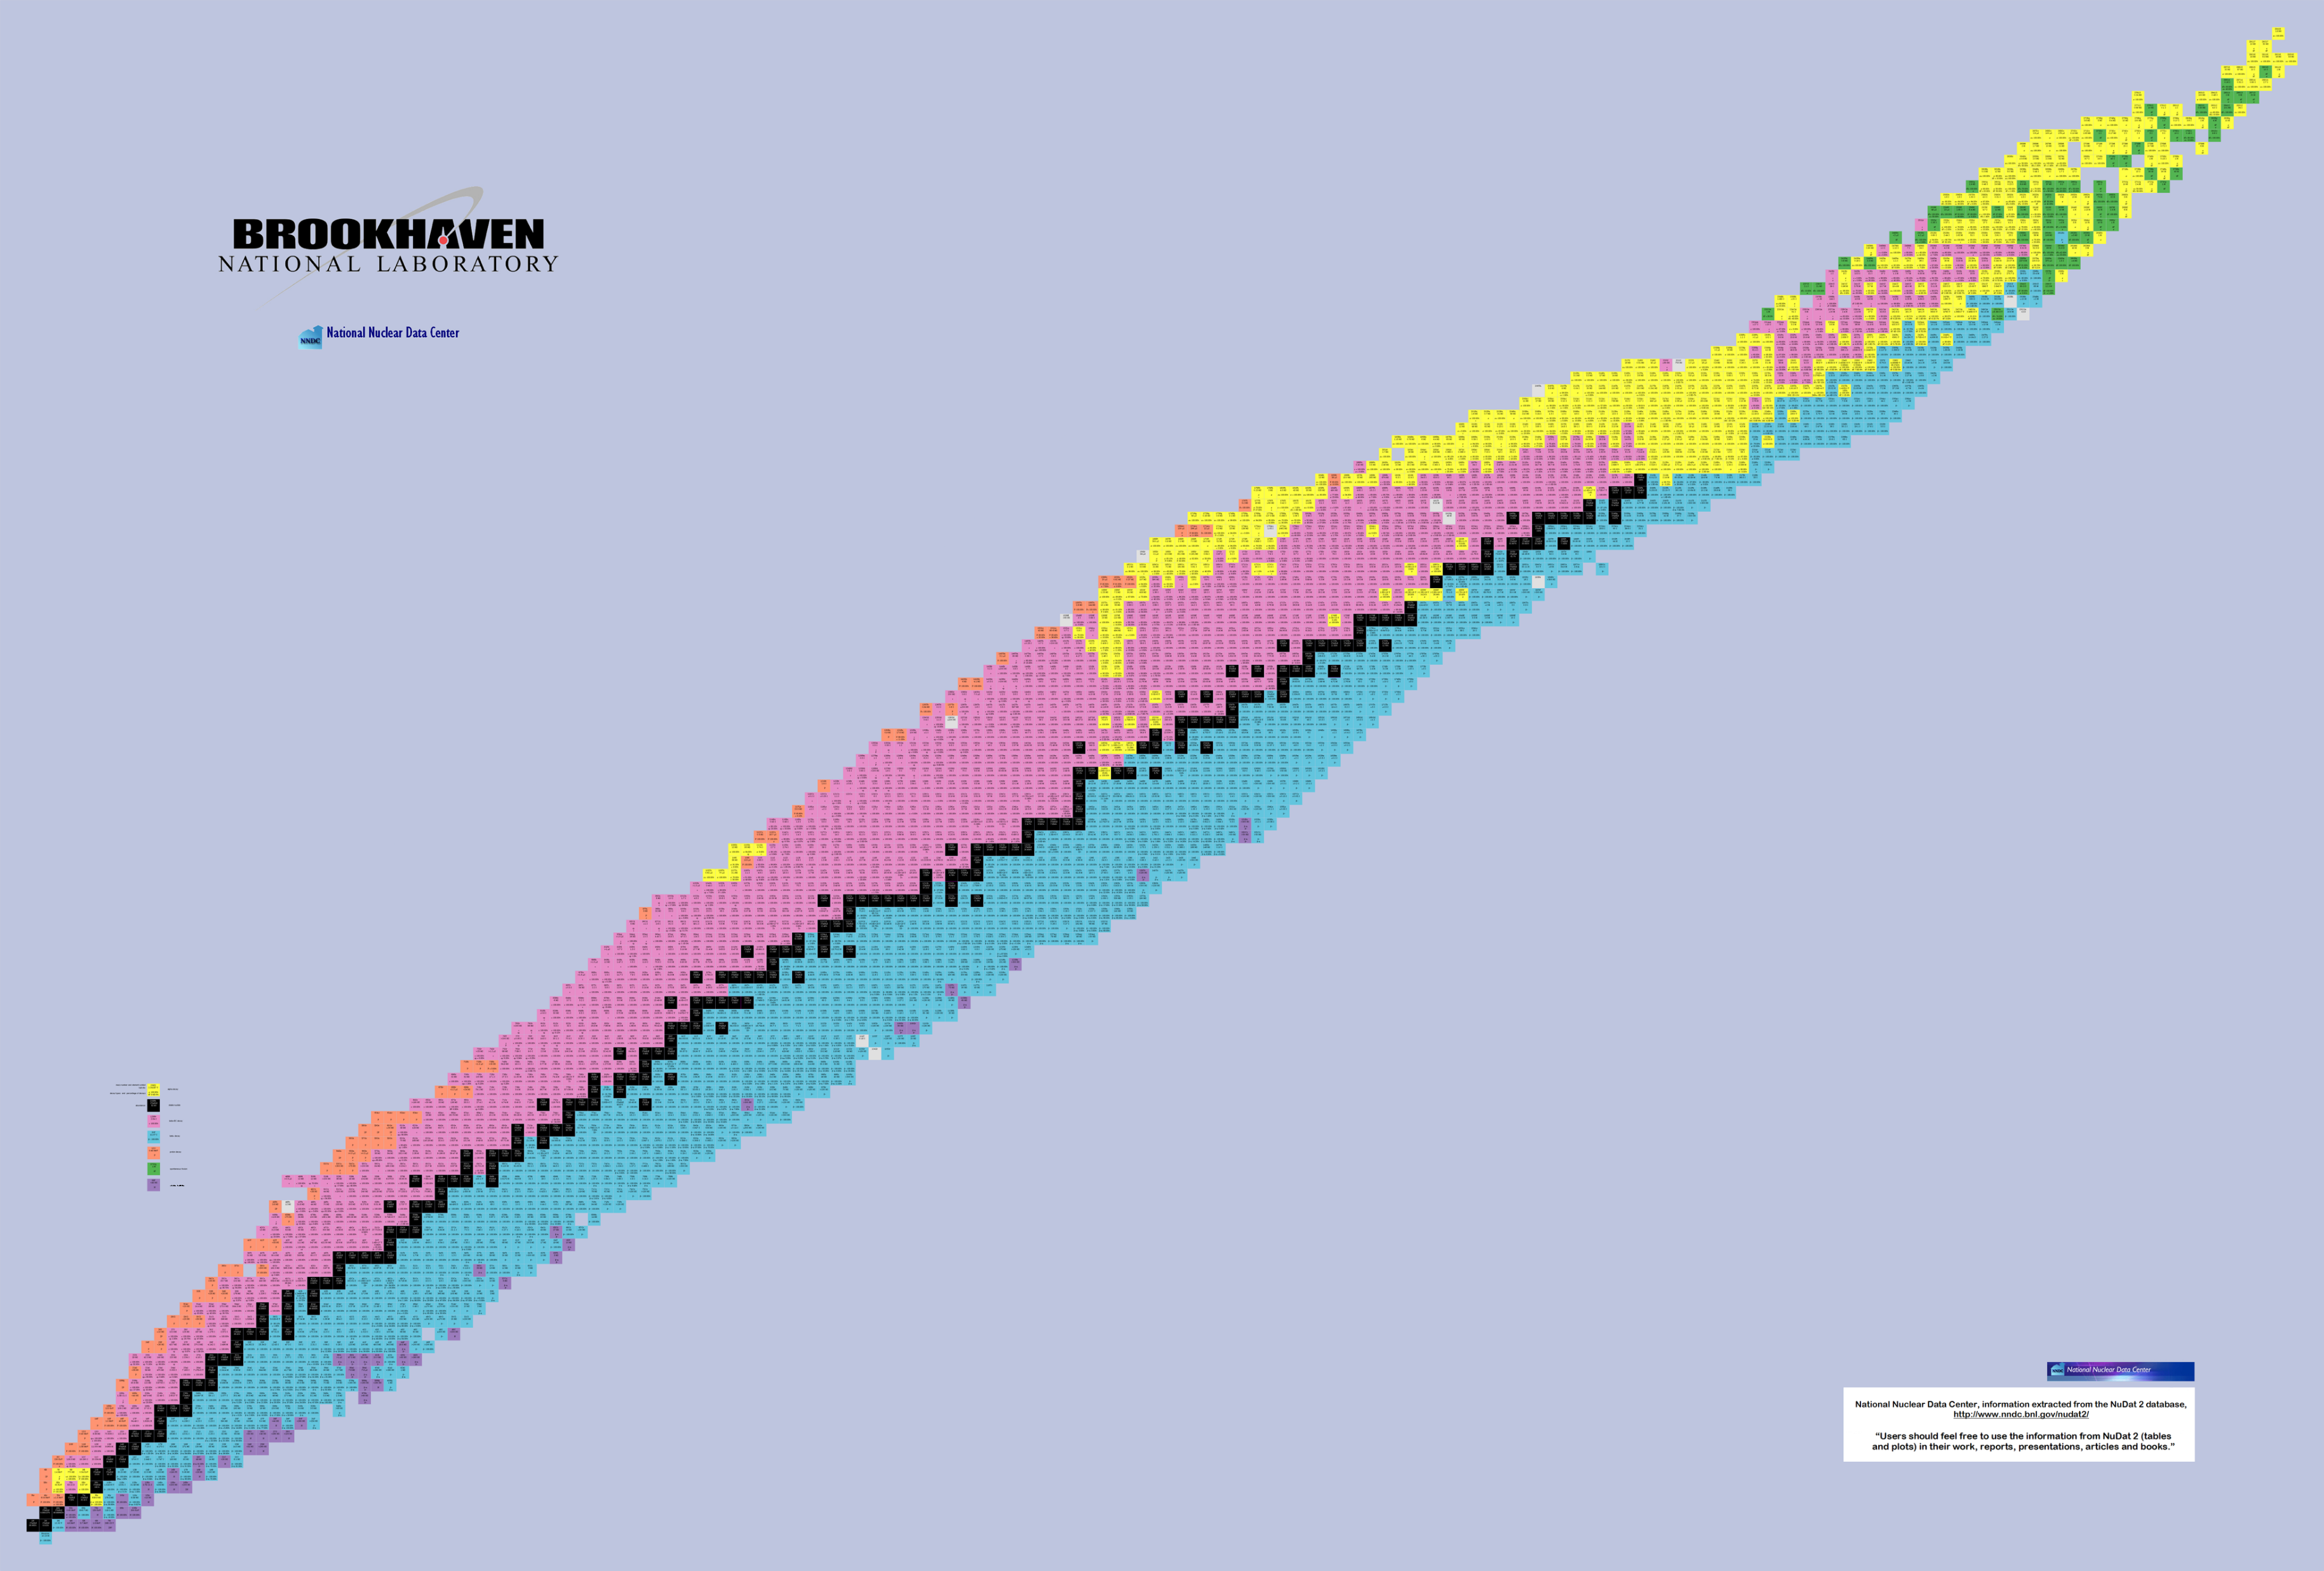
protons
neutrons
https://www.nndc.bnl.gov/nudat2/

Slide 4
Radiochemistry for Nuclear Medicine
Targeted Radionuclide Diagnostic
SPECT
PET
Targeted Radionuclide Therapy
β - particles
α - particles
Auger electrons
Theranostics
Production of radionuclides

Slide 5
Producing Preparations and Sources of Radionuclides
Applications
I. Nuclear medicine
- Synthesis of radiopharmaceuticals
- Studying kinetic properties of complexes with metal ions
- Development of radiolabelling based on chelators with "slow" kinetics
III. Radioactive tracers
- Studying sorption in various solution-sorbent systems
- Studying local environment of nuclei via methods of hyperfine interactions
- Development of isolation and separation methods
High specific activity
Radionuclide purity
Radiochemical purity
Chemical purity
II. Nuclear spectroscopy
and neutrino physics
- Obtaining experimental data
- Manufacturing calibration sources

Slide 6
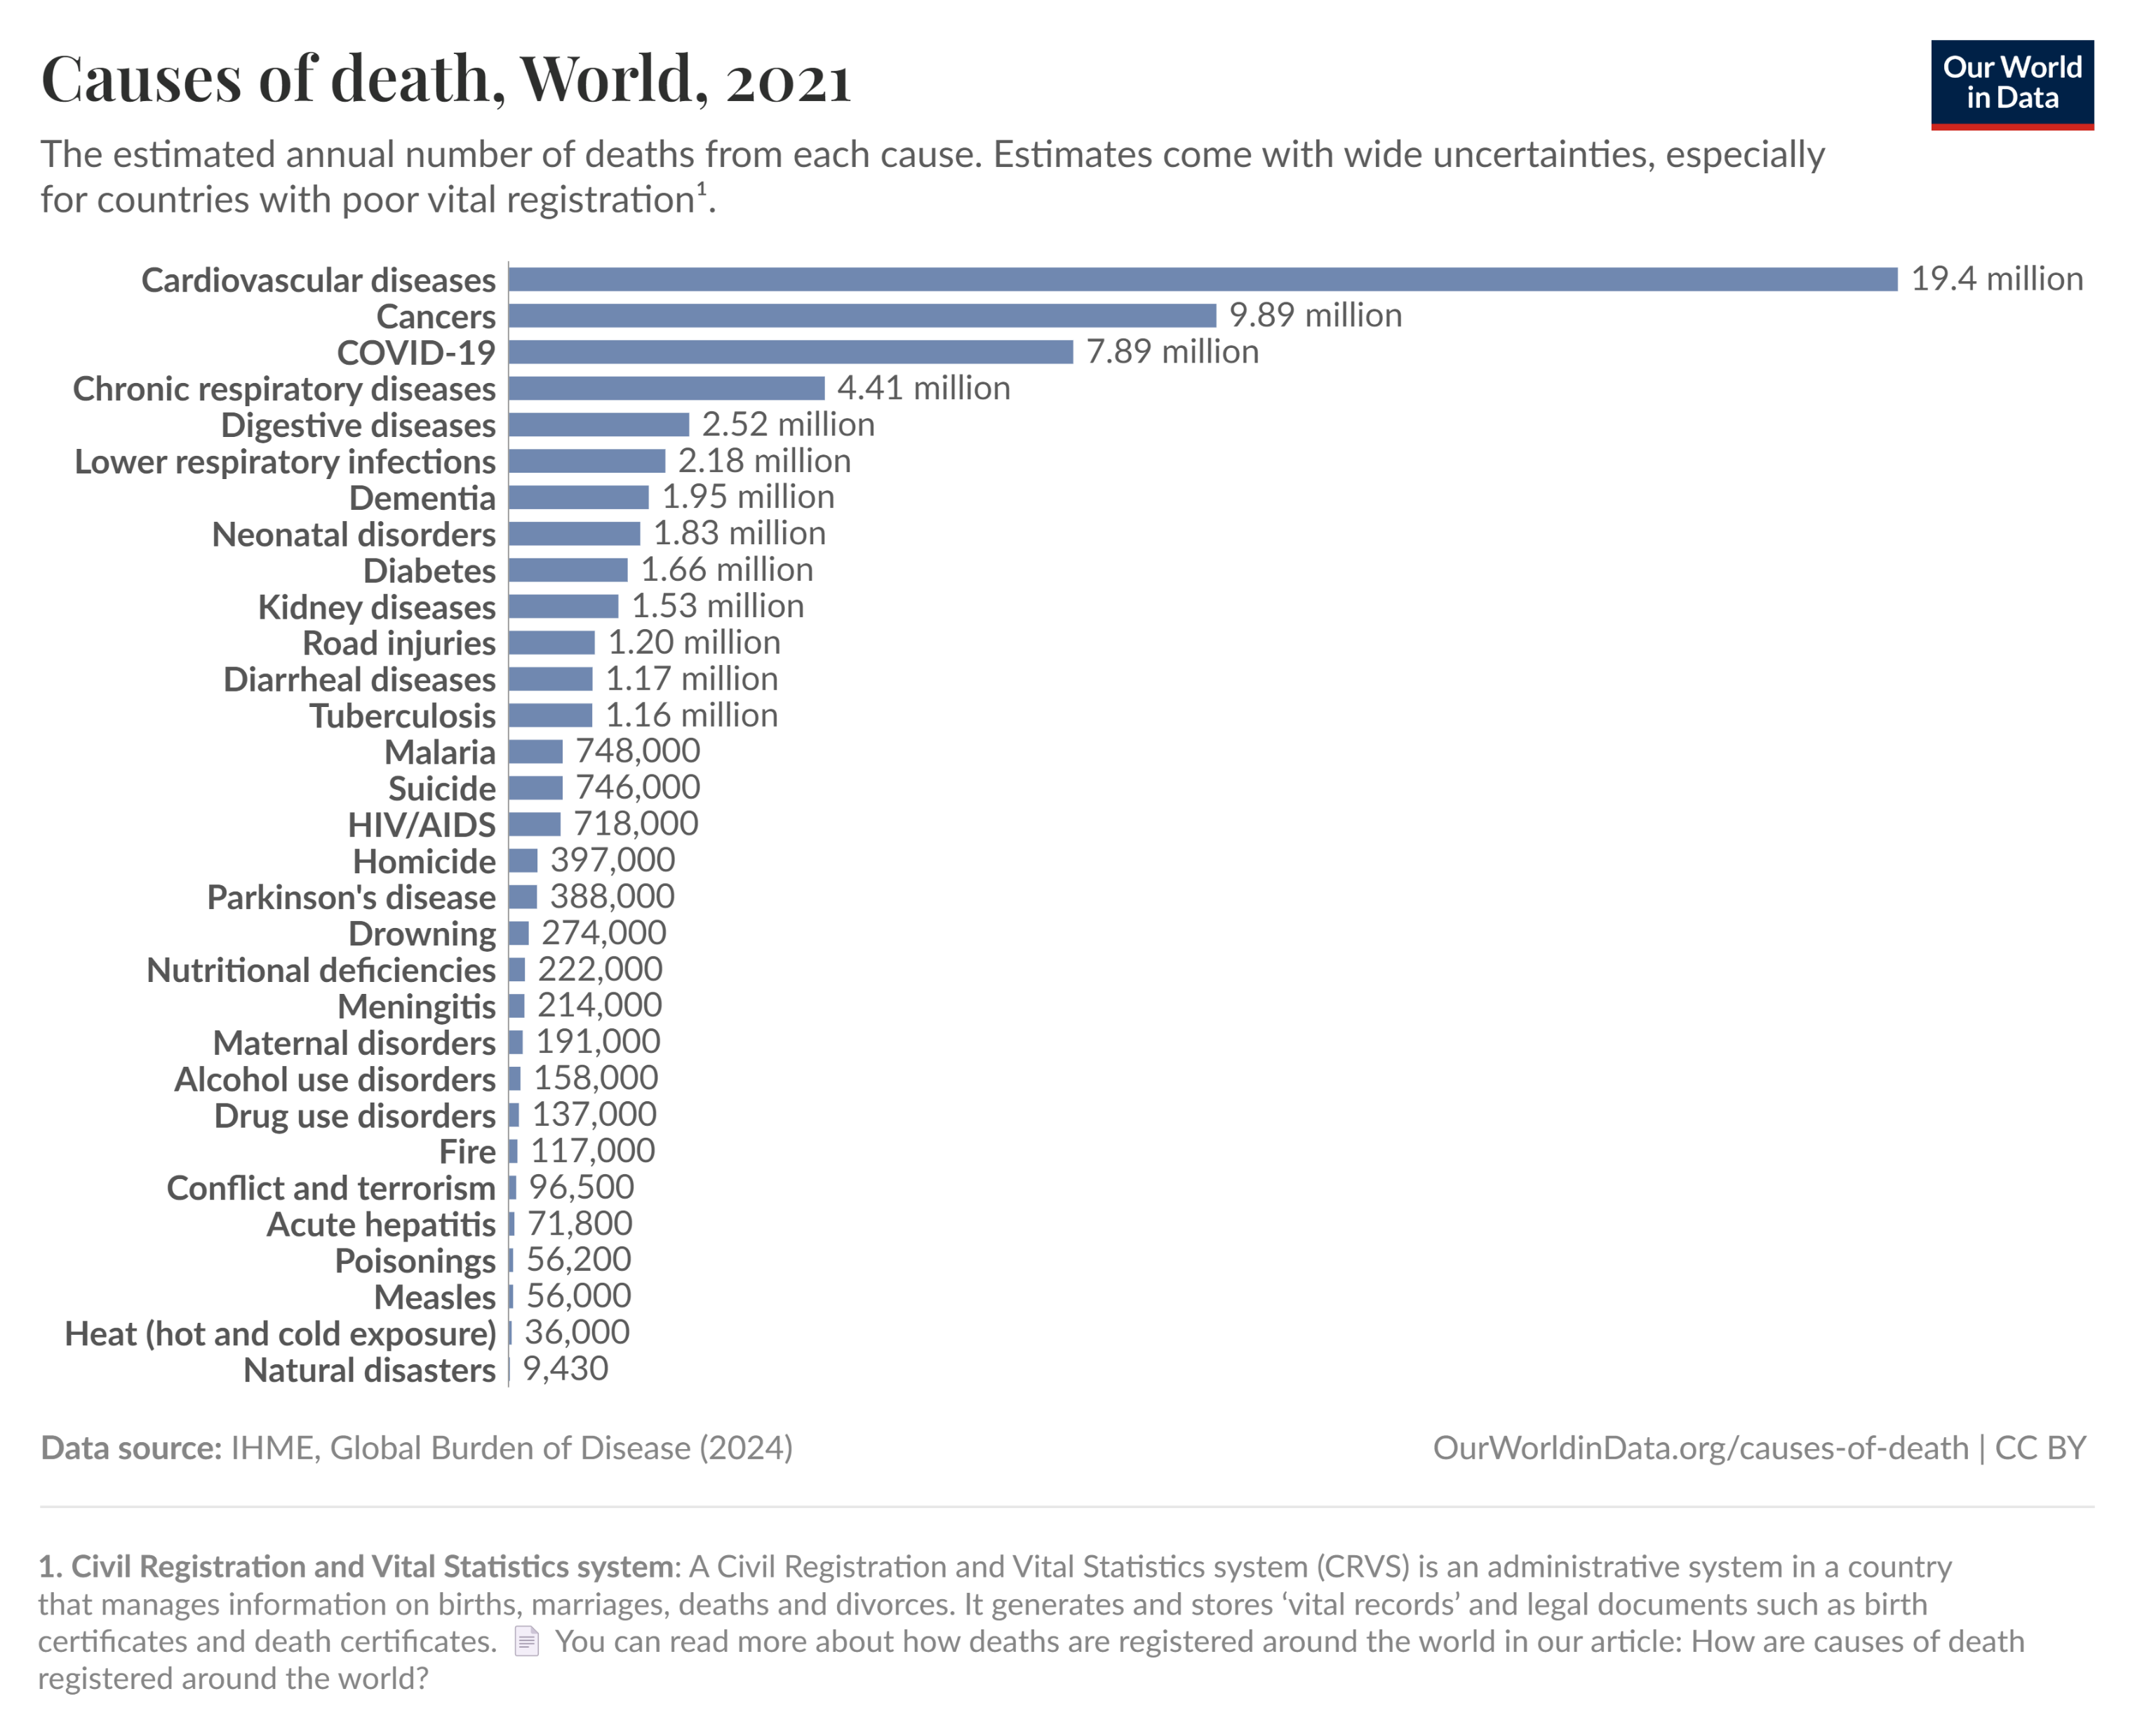
All types
https://ourworldindata.org/

Slide 7
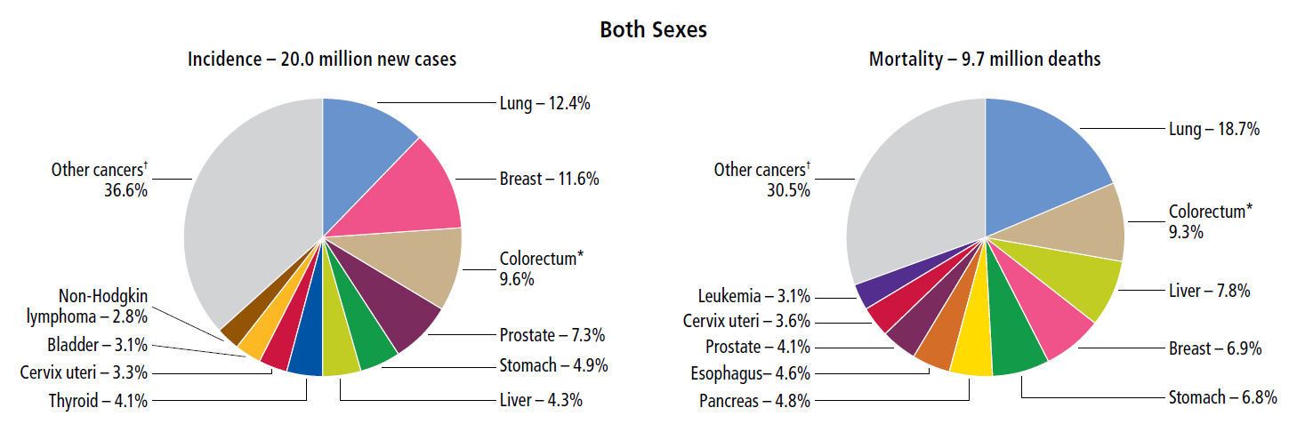
Distribution of Cases and Deaths for the 10 Most Common Cancers (2022)
https://www.cancer.org/

Slide 8
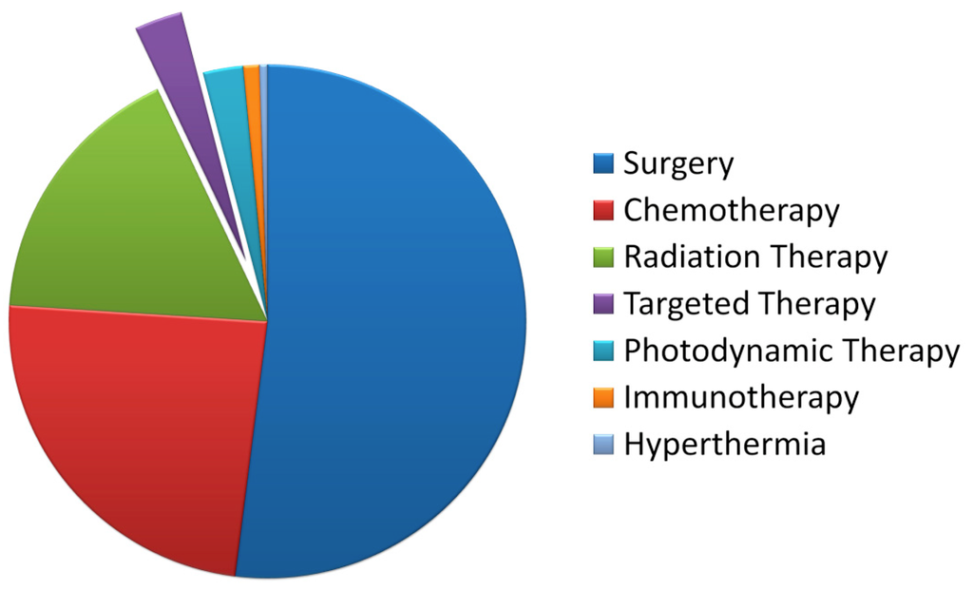
Treatment of Cancers
Gudkov et al. Int. J. Mol. Sci. 2016, 17(1), 33

Slide 9
Nuclear Medicine
is a part of clinical medicine involving the application of radioactive substances (RADIOPHARMACEUTICALS) in the diagnosis and treatment of disease
Nuclear medicine
(radiopharmaceuticals)
Radiology
(external irradiation)
10⁻⁷
10⁻⁶
10⁻⁵
10⁻⁴
10⁻³
10⁻²
10⁻¹
10⁰
м

Slide 10
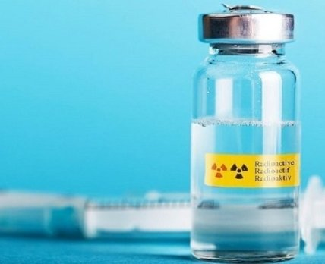
Types of Radiopharmaceuticals
the radionuclide is in free form
I, Xe, Rb
the radionuclide is in the form of an organic compound
C, N, O, F, J
the radionuclide is in the form of an inorganic compound
RaCl₂, [TcO₄]⁻
the radionuclide is in a complex linked to a pharmaceutical molecule

Slide 11
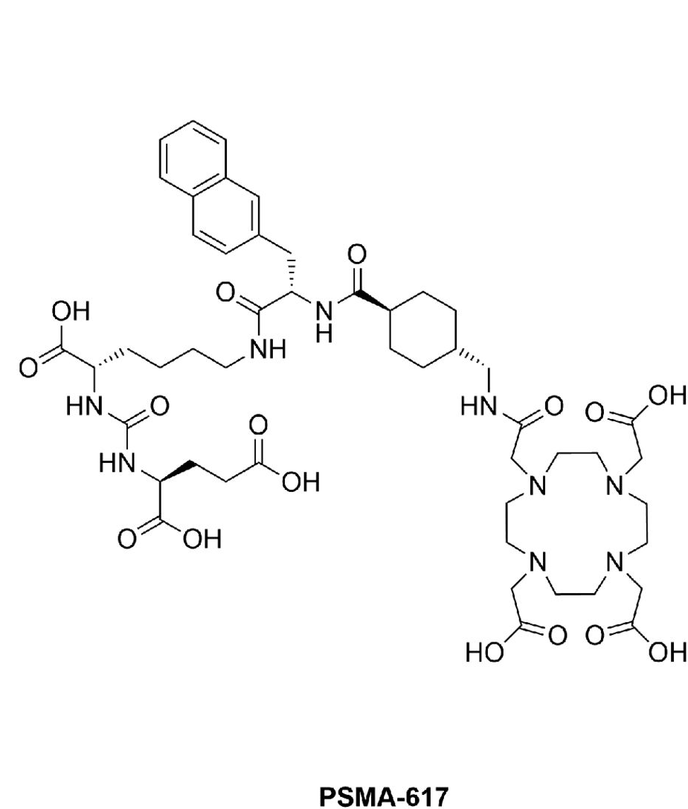
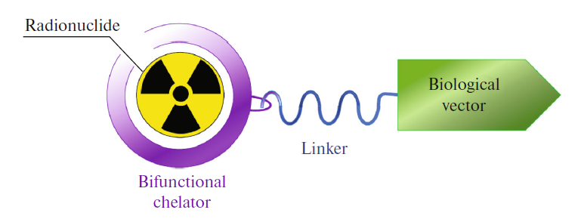
Modern Radiopharmaceuticals
PSMA-617 structure:
Radionuclide – ¹⁷⁷Lu, ²²⁵Ac, ⁶⁸Ga
Chelator – DOTA
Biological vector - PSA

Slide 12
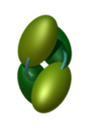
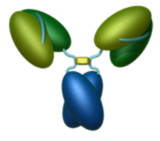
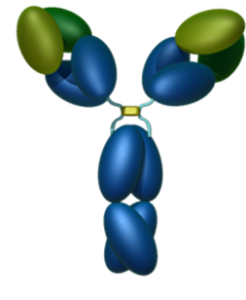
Modern Radiopharmaceuticals
⁶⁸Ga
Т_{1/2} 67.7 min
⁴⁴Sc
Т_{1/2} 3.9 h
⁸⁶Y
Т_{1/2} 14.7 h
⁸⁹Zr
Т_{1/2} 78.4 h
0.1 -50 KDa
50 -100 KDa
100 -150 KDa
hours days
Biological half-life

Slide 13
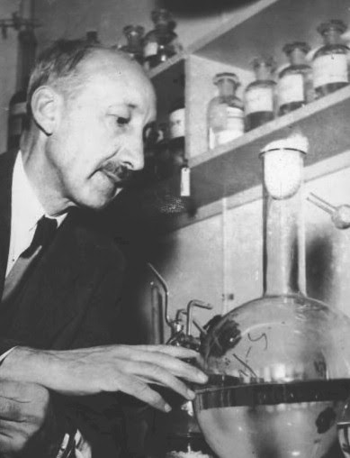
Nuclear Medicine. History
George Charles de Hevesy
1885-1966
«father of nuclear medicine»
together with F. Paneth, proposed the method of radioactive tracers in 1913
Nobel Prize winner in 1943
conducted the first study of the movement of lead atoms (²¹⁰Pb as a label) in plants
first used ³²P to study phosphorus metabolism in rats

Slide 14
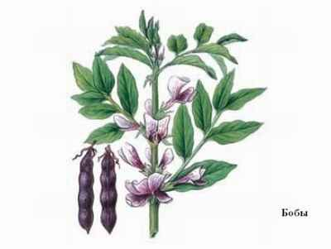
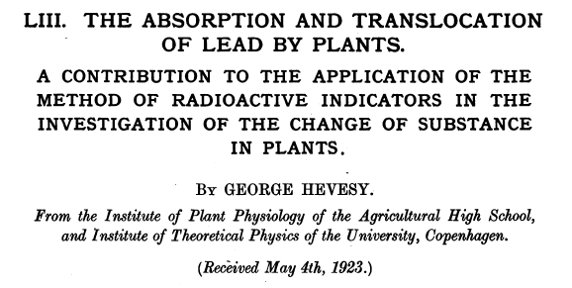
Isotope Exchange
Isotope exchange is a spontaneous redistribution of isotope atoms of a given element within a molecule, between molecules or phases, which does not lead to other changes in the qualitative and quantitative composition of the system.
Observation became possible after the discovery of radioactive isotopes:
1923 - First observation of isotope exchange using RaD (²¹⁰Pb). Hevesy and Zeichmester
The reason for isotope exchange is the entropy
Solution
Pb(NO₃)₂
²¹⁰PbCl₂
Solid phase
Vicia Faba

Slide 15
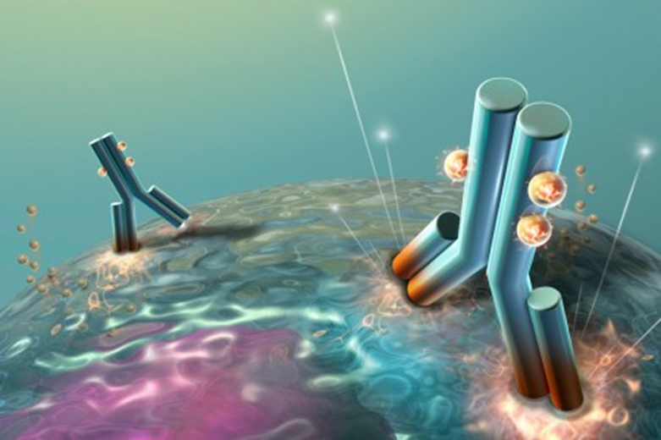
Nuclear Medicine
Therapy
Alpha
Beta
Auger
Diagnostics
Positron emission tomography (PET)
Single photon emission computed tomography (SPECT)
THERANOSTICS

Slide 16
Radionuclides for Theranostics
β–
⁹⁰Y
64.0 h
β⁺
⁸⁶Y
14.7 h
Targeted β⁻- therapy
Targeted α - therapy
Positron emission tomography
Single photon emission computed tomography
β–
⁴⁷Sc
3.3 d
β⁺
⁴⁴Sc
3.9 h
β–
¹⁷⁷Lu
6.6 d
β⁺
⁶⁸Ga
67.7 min
β⁺
^{110m}In
69.1 min
α
²²⁵Ac
9.9 d
γ
⁶⁷Ga
3.3 d
γ
¹¹¹In
2.8 d

Slide 17
β⁺
⁶⁸Ga
67.7 min
Application of Theranostics
α
²²⁵Ac
9.9 d
PET diagnostics with ⁶⁸Ga-PSMA after 2 cycles of therapy with ²²⁵Ac-PSMA
PET diagnostics with ⁶⁸Ga-PSMA before 2 cycles of therapy with ²²⁵Ac-PSMA
Patient with prostate cancer with bone metastases
Advances in ¹⁷⁷Lu-PSMA and ²²⁵Ac-PSMA Radionuclide Therapy for Metastatic Castration-Resistant Prostate Cancer. Pharmaceutics 2022, V 14, P 2166. https://doi.org/10.3390/pharmaceutics14102166

Slide 18
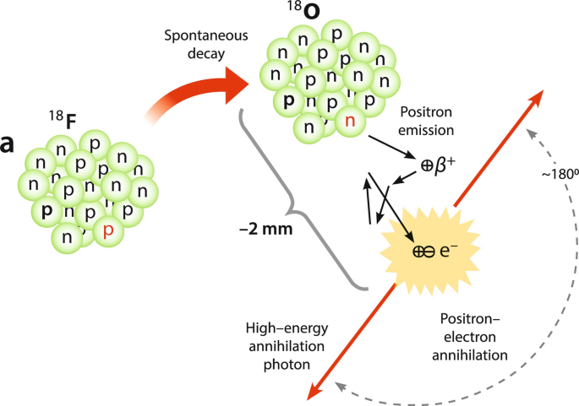
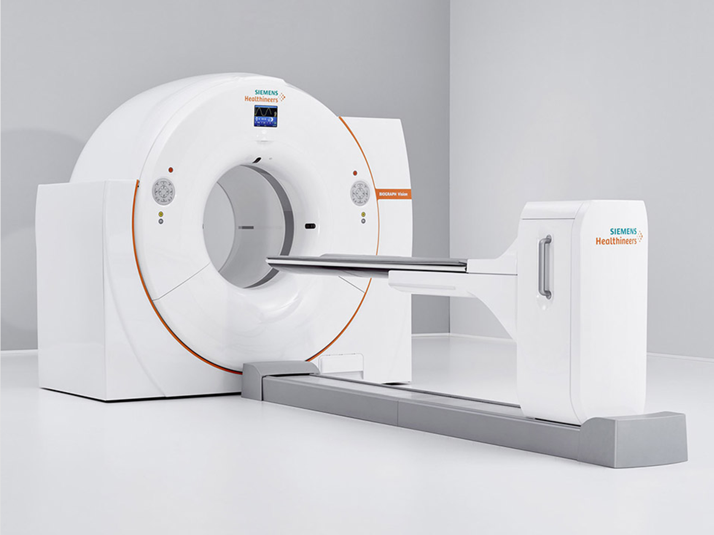
Methods of Diagnostics
Positron emission tomography
PET
¹¹C
Т_{1/2} 20.4 min
¹³N
Т_{1/2} 9.9 min
¹⁵O
Т_{1/2} 122 s
¹⁸F
Т_{1/2} 109.8 min
⁶⁸Ga
Т_{1/2} 67.7 min
⁸²Rb
Т_{1/2} 1.3 min

Slide 19
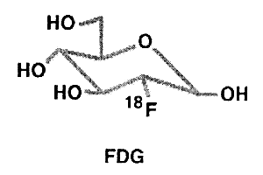
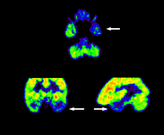
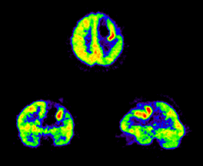
Methods of Diagnostics
Positron emission tomography with
FDG (¹⁸F) - glucose analogue
Decreased glucose metabolism
Increased glucose metabolism
Patient with epilepsy
Brain tumor

Slide 20
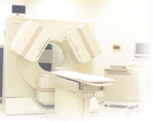
Methods of Diagnostics
Single-Photon Emission Computed Tomography
⁶⁷Ga
Т_{1/2} 3.3 d
^{99m}Tc
Т_{1/2} 6.0 h
¹¹¹In
Т_{1/2} 2.8 d
¹²³I
Т_{1/2} 13.2 h
²⁰¹Tl
Т_{1/2} 3.0 d

Slide 21
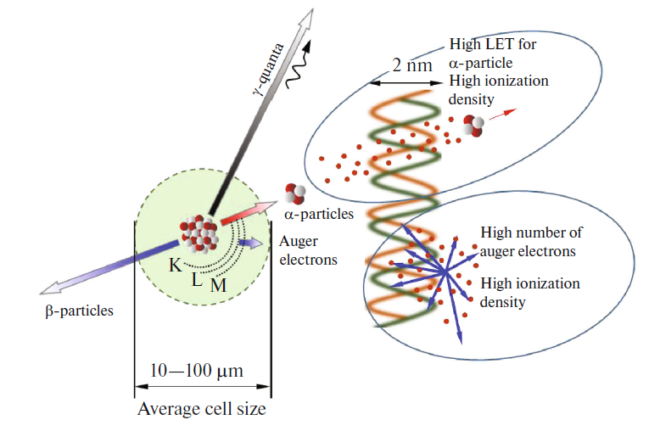
Targeted Radionuclide Therapy
Particles | Decay characteristics |  |  | Clinical application
 | Emission energy for decay | Range | LET
α | 5-9 MeV | 40-100 μm | 50-230 keV/μm | Prostate cancer, non-Hodgkin's lymphoma, acute myeloid leukemia, neuroendocrine tumors, ovarian carcinoma, gliomas, intralesional and systemic melanoma, colon cancer, bone metastases
β | 0.05-2.3 MeV | 0.05-12 mm | 0.2 keV/μm | Metastatic prostate cancer, acute myeloid leukemia, neuroendocrine tumors, acute lymphocytic leukemia, ovarian carcinomas, gliomas, metastatic melanoma, colon cancer, bone metastases
Auger electrons | 0.2-100 keV | 2-500 nm | 4-26 keV/μm | Pancreatic cancer, neuroendocrine and liver malignancies, breast cancer, glioblastoma multiforme

Slide 22
Radiobiological Effects
Possible damage to DNA structure
J Nucl Med 2010. 15;51(2):311–328. doi: 10.2967/jnumed.108.058651

Slide 23
Radiobiological Effects
1-4 α-particles
5-8 X-rays
For particles with low LET
For particles with high LET
Survival curves
J Nucl Med 2010. 15;51(2):311–328. doi: 10.2967/jnumed.108.058651

Slide 24
Relative Biological Effectiveness
$$RBE (x)=\frac{\left.D_{r}(x\right)}{\left.D_{t}(x\right)}$$
Dependence of relative biological effectiveness on linear energy transfer

Slide 25
Clinical Trials α – emitting Radionuclides
10.5 GBq
12 GBq
13.4 MBq
Patient with prostate cancer with bone metastases
Zacherl M. et.al. J Nucl Med. 2020. DOI: 10.2967/jnumed.120.251017

Slide 26
Decay Chain of Actinium-225
9.92 d
²²⁵Ac
α
4.9 min
²²¹Fr
α
32.6 µs
²¹⁷At
α
3.706 µs
45.59 min
²¹³Bi
²¹³Po
β⁻, 97.9%
α, 2.1%
α
²⁰⁹Tl
²⁰⁹Pb
²⁰⁹Bi
2.01·10¹⁹ a
β⁻
β⁻
2.162 min
3.234 h
α
²⁰⁵Tl
stable

Slide 27
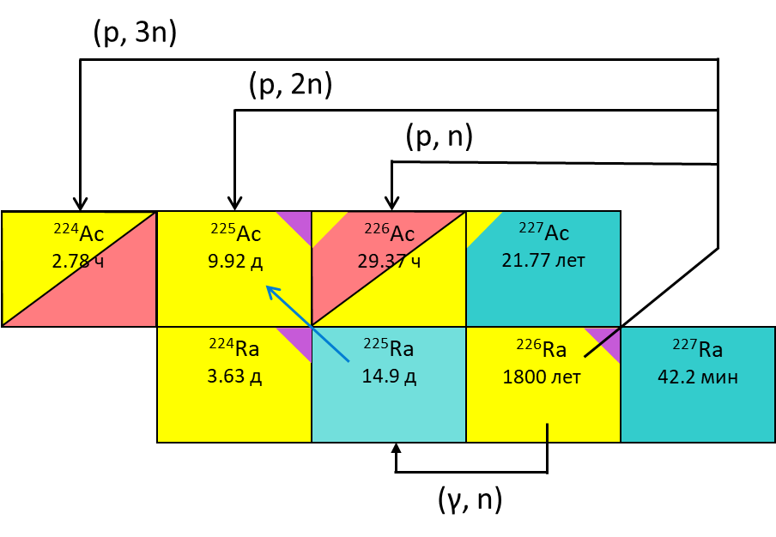
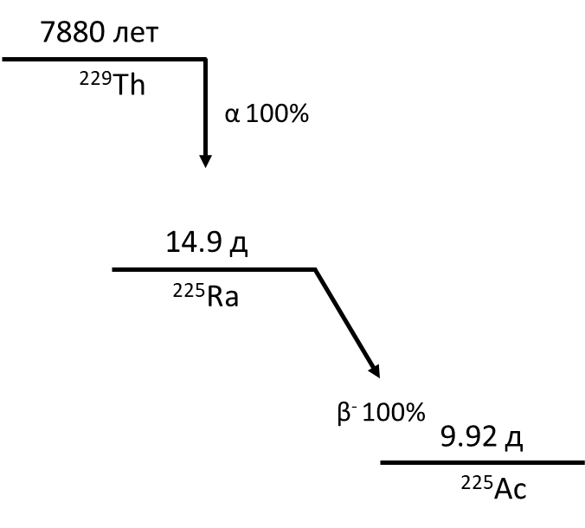
Production routes of Actinium-225
Irradiation of thorium targets with proton (E_{p}>100 MeV)
Irradiation of radium targets with protons or gammas
Radionuclide generator
Landolt-Bornstein. Numerical Data and Functional Relationships in Science and Technology. Production of radionuclides at intermediate energies/ Springer. Geneva, 1993

Slide 28
α – emitting Radionuclides
²²⁵Ac
²²³Ra
Production challenges
Generator ²²⁹Th →²²⁵Ra(β⁻),
reactions ²²⁶Ra (p, 2n) and ²²⁶Ra (γ, n) ²²⁵Ra(β⁻), spallation reaction on ^{nat}Th – ²²⁷Ac, spallation reaction on ^{nat}Th → ²²⁵Ra(β⁻) – 5-10 mb
Large 2⁺ cation –
lack of chelator
²¹¹At
²¹²Pb
Poorly developed chemistry –
lack of chelator
Aftereffects of decay ²¹²Pb(β⁻)²¹²Bi – lack of chelator

Slide 29
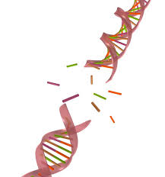
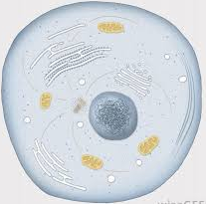
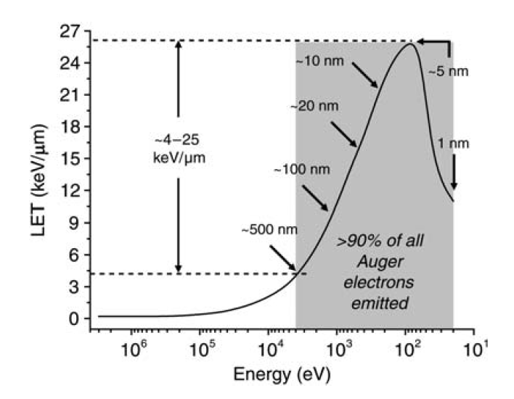
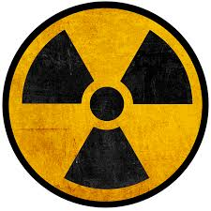
Auger emitters for targeted therapy
?
= auger emitters
LET of electrons as function of their energy
A.I. Kassis, Rad. Prot. Dosimetry 2011;143:241.
Cancer cell
The slide is provided by Dr Valery Radchenko

Slide 30

Auger emitters for targeted therapy
Radionuclide | Half-life | Energy* γ(X)+e⁻, keV | Energy* γ(X), keV | Energy* e⁻, keV | Number of electrons
 |  |  |  |  | 0.1 - 1.5 keV | 1.5 - 5 keV | > 5 keV
¹¹¹In | 2.8 d | 440 | 405 | 35 | 1.91 | 1.02 | 0.31
^{103m}Rh | 56.1 min | 39.8 | 1.8 | 38 | 1.49 | 0.79 | 0.99
¹¹⁹Sb | 38.5 h | 48.8 | 23.1 | 25.7 | 2.77 | 1.47 | 0.96
¹²⁵I | 59.4 d | 61.4 | 42 | 19.4 | 2.99 | 2.40 | 0.33
⁶⁷Ga | 78.3 h | 193 | 158 | 35 | 1.69 | - | 0.95
^{197m}Hg | 23.8 h | 308 | 94 | 214 | ? | 1.90 | 2.40
¹⁹⁷Hg | 64.1 h | 136.3 | 69.9 | 66.4 | ? | 2.07 | 1.70
¹¹¹In / ^{103m}Rh / ¹¹⁹Sb / ¹²⁵I / ⁶⁷Ga / ^{197m+g}Hg
Appropriate chelation
system
Free form
Biomolecules (e.g., mAb)
Peptides (e.g., PSMA)
e.g. nanontransporters
The slide is provided by Dr Valery Radchenko

Slide 31
Criteria for Selecting Radionuclide for Targeted Diagnostic and Therapy
Physical
Half-life
Emission type
Emission energy
Daughter radionuclides
Chemical
Production method
Radionuclide purity
Chemical purity
Suitable chelator
Biological
Suitable vector
In vivo stability
Toxicity

Slide 32
Radionuclides for Nuclear Medicine
Sc 47
Ga 67
Ga 68
Green – PET
Grey - SPECT
Yellow – β-emitter
Orange – α-emitter
Blue – Auger emitter
Y 86
Y 90
Sc 44
C 11
N 13
O 15
F 18
P 32
Cu 67
I 123
Rb 82
Tc 99m
Rh 103m
In 111
Sb 119
I 125
Lu 177
Re 186
Tl 201
Pb 212
Bi 213
At 211
Ra 223
Ra 224
Sm 153
Tb 149
Ac 225
Th 226
Th 226
Hg 197m
Hg 197

Slide 33
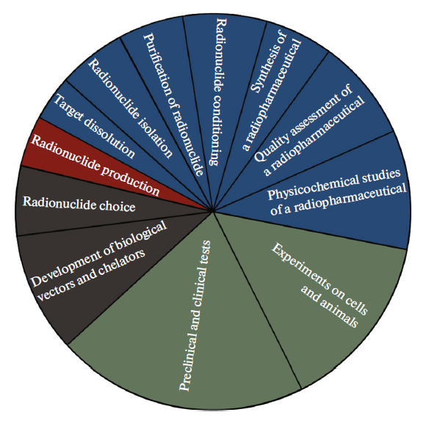
Stages of Radiopharmaceuticals Development
START

Slide 34
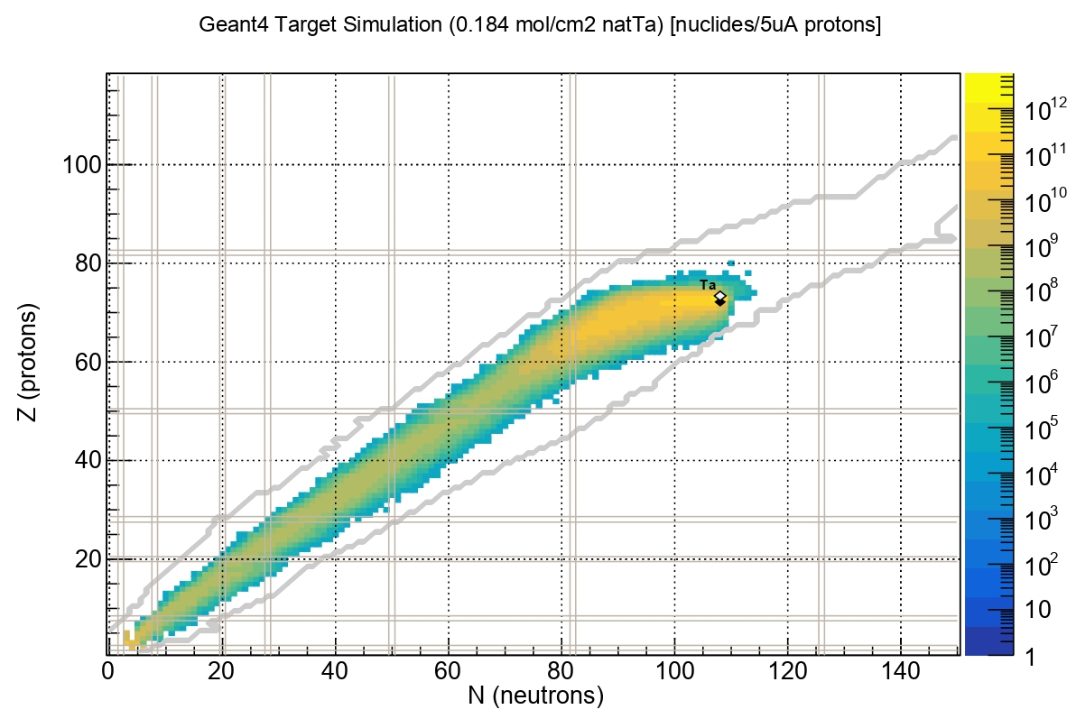
Producing Radionuclides
Cyclotron
Reactor
Generator
Selecting a radionuclide
Choosing a production method
Design a target
Irradiating a target
Theoretical calculation of radionuclide yields upon irradiation of a tantalum target (target thickness is 0.184 mol/cm²) with 660-MeV protons, current is 5 μA (Geant4)

Slide 35
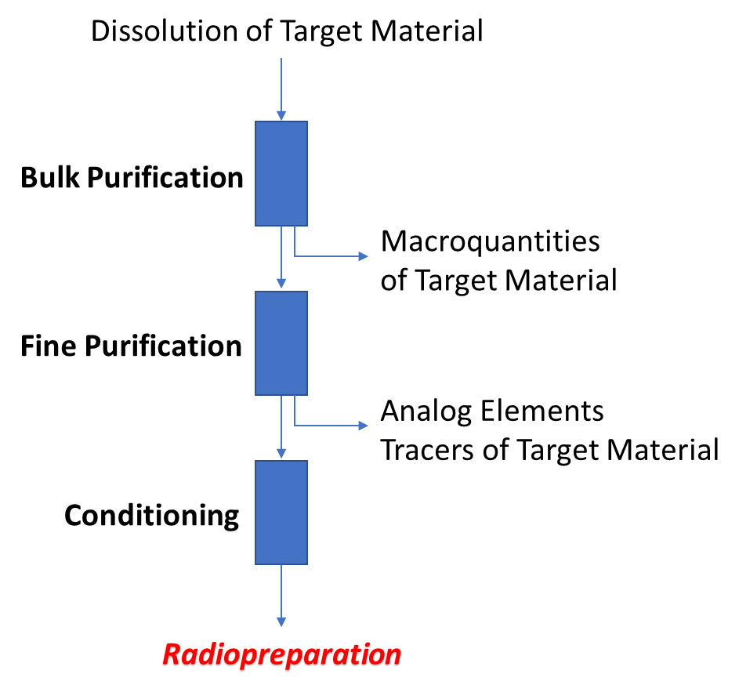
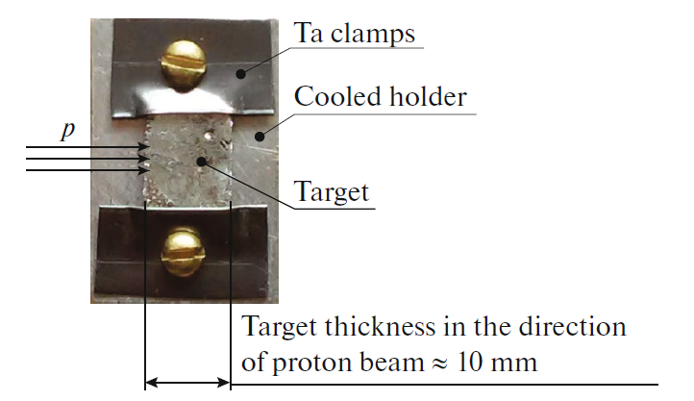
Producing Preparations and Sources of Radionuclides
Radiochemical methods for isolation and separation of radionuclides
Typical metal target
Ion exchange chromatography
Liquid-Liquid extraction
Solid phase extraction
Precipitation
Electrochemistry
Distillation
Termochromatography

Slide 36
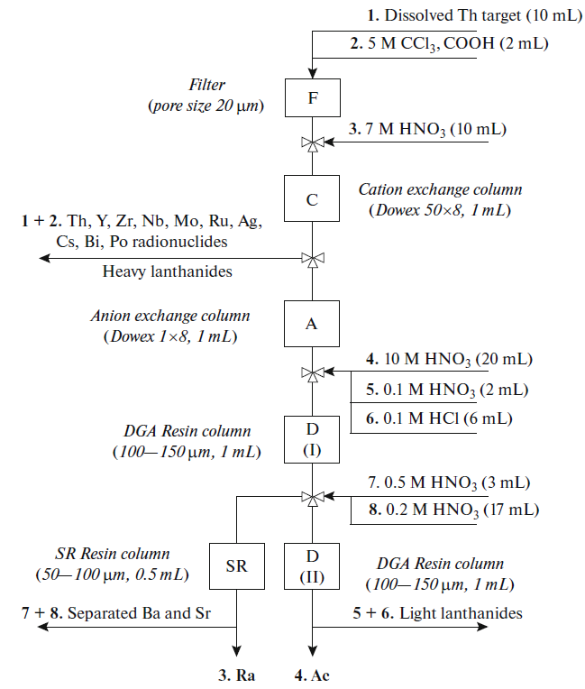
Producing Preparations and Sources of Radionuclides
Radiochemical methods for isolation and separation of radionuclides
Production of radionuclides at accelerators:
¹⁷⁷Lu from Yb target
²²⁵Ac from Th target
⁴⁴Sc from Ca target
⁸⁶Zr from Y target
⁹⁰Nb from Mo, Zr targets
¹¹¹In from Ag, Sb targets
Lanthanides from Ta target
Radionuclides from Th target

Slide 37

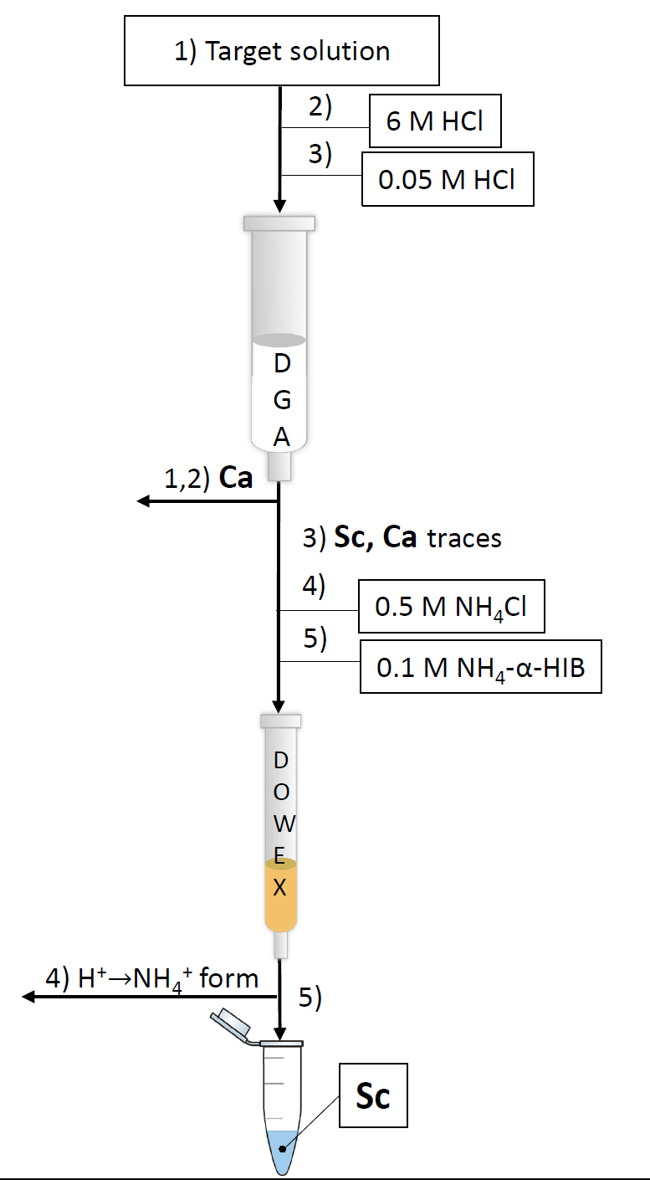
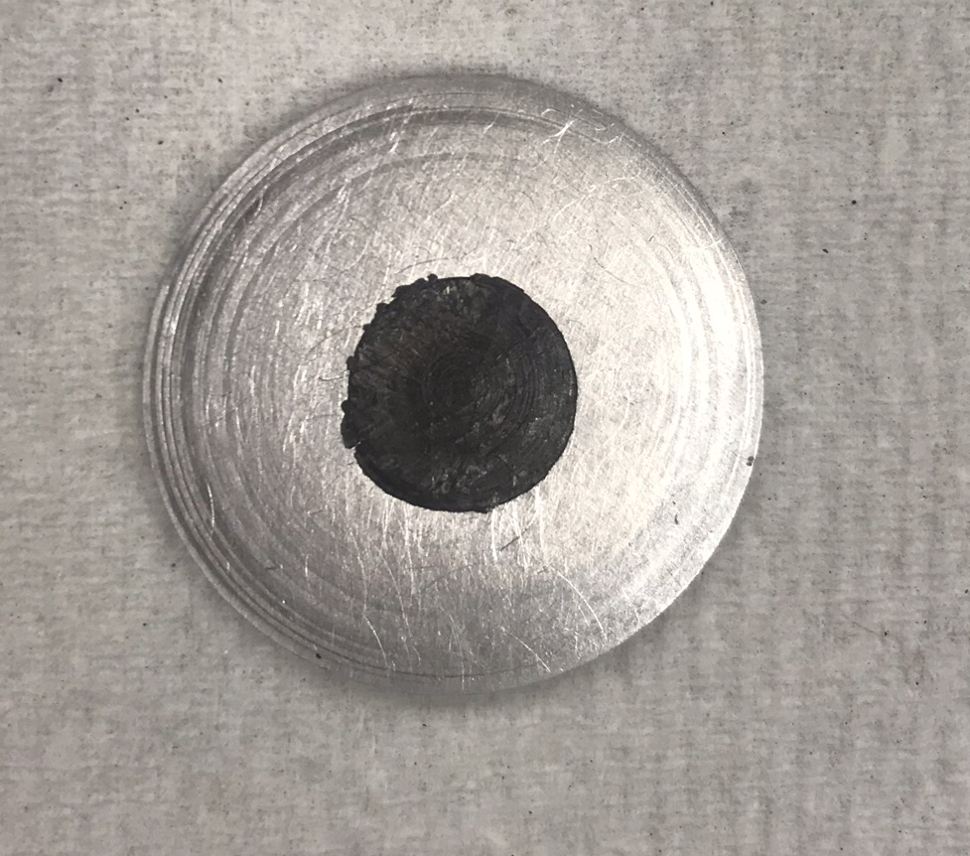
⁴⁴Sc production
Target: metallic ^{nat}Ca
Reaction: ⁴⁴Ca(p, n)⁴⁴Sc
Irradiation: E_{p}= 12.8 MeV, 10 μA, 1 h
Advantages:
Radionuclide | EOB, MBq
⁴³Sc | 2.63±0.44
^{44g}Sc | 100±7
^{44m}Sc | 0.61±0.07
⁴⁷Sc | 0.38±0.04
⁴⁸Sc | 0.73±0.12
Two-step separation scheme;
High radiochemical yield (RCY) 95±3%
High chemical purity
Suitable final fraction medium (NH₄-α-HIB)
for further radiolabeling
Separation time ≈ 15 mins
^{nat}Ca target
The slide is provided by Elena Kurakina

Slide 38

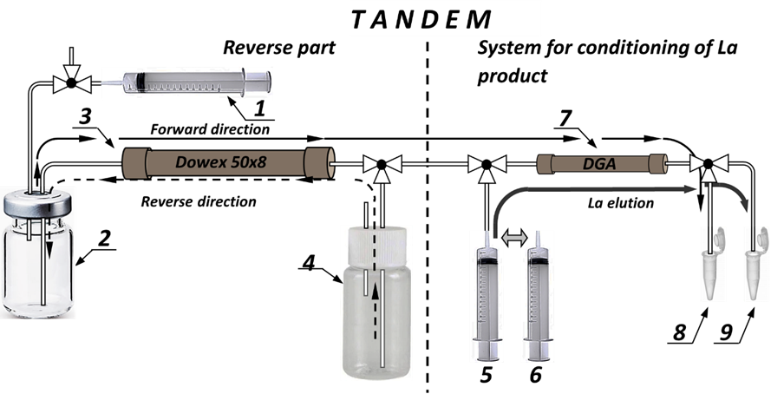
Producing Preparations and Sources of Radionuclides
Radionuclide generators
⁴⁴Ti → ⁴⁴Sc
⁶⁸Ge → ⁶⁸Ga
⁷²Se → ⁷²As
⁸⁶Zr → ⁸⁶Y
⁹⁰Sr → ⁹⁰Y
¹¹¹In → ^{111m}Cd
¹⁷²Hf → ¹⁷²Lu
²²⁹Th → ²²⁵Ra → ²²⁵Ac, etc.
Reverse-tandem scheme of the generator
(1) – syringe for maintaining pressure/underpressure, (2) – reverse storage vessel, (3) – main column , (4) – solution for elution of daughter radionuclide from main column, (5) – solution for conditioning the tandem column, (6) – solutions for elution of daughter radionuclide from tandem column, (7) – tandem column, (8) – waste vial, (9) – vial with radiopreparation
Classic generator scheme

Slide 39
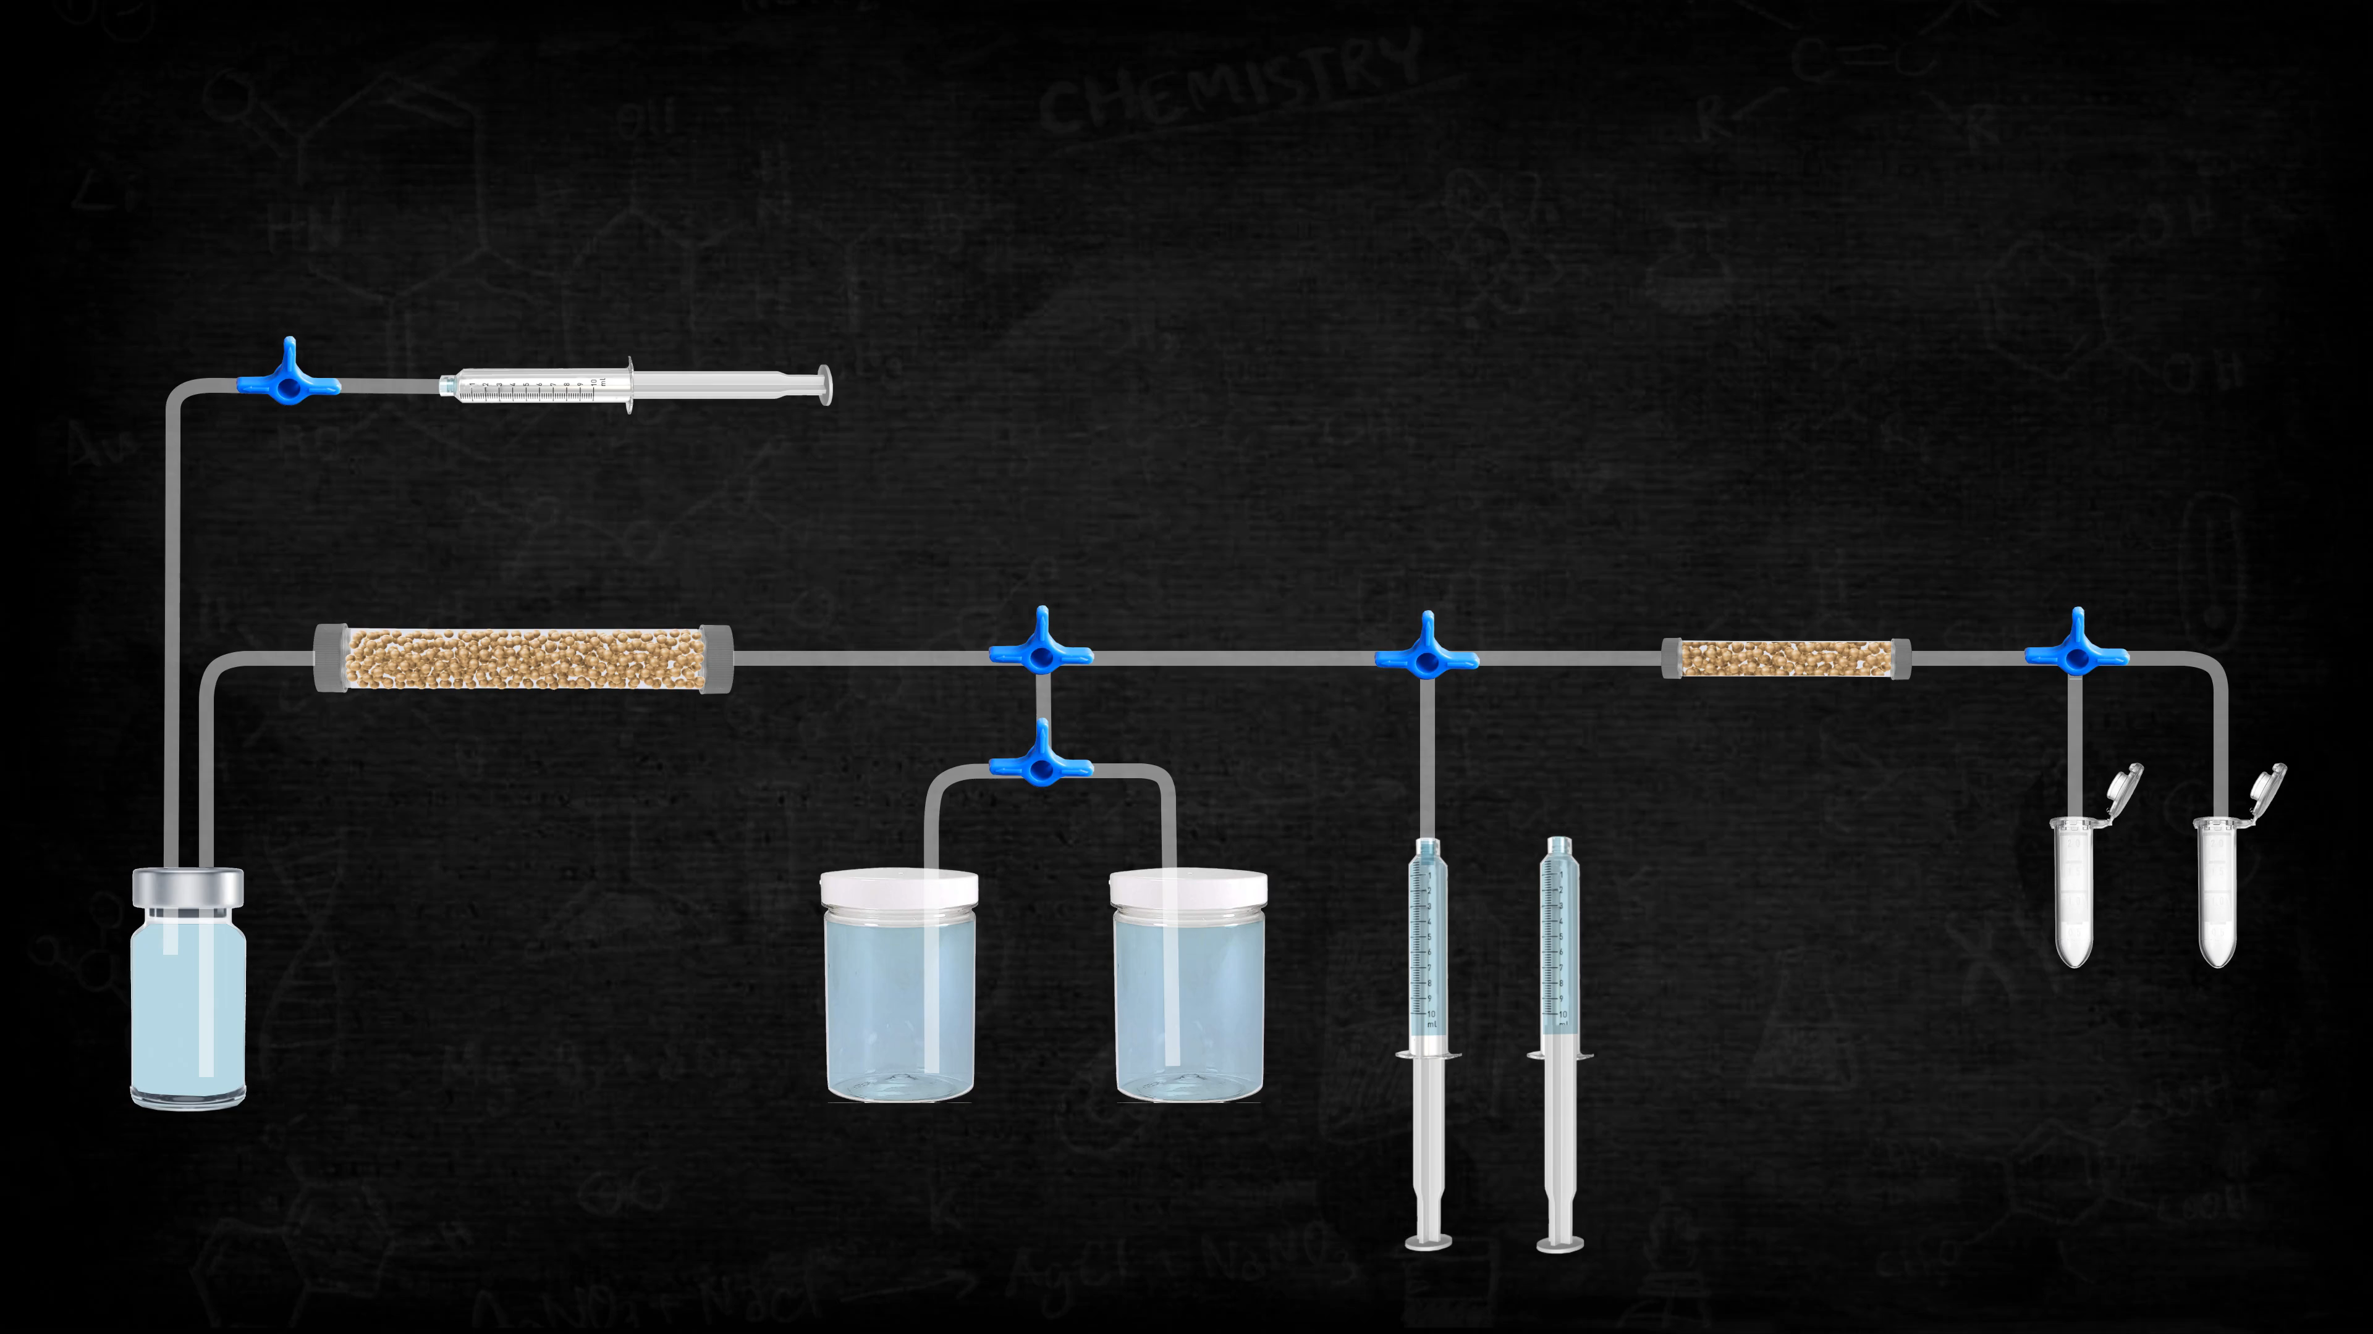
Reverse-Tandem Scheme of Radionuclide Generator
The animation is made by Semen Gurskiy

Slide 40
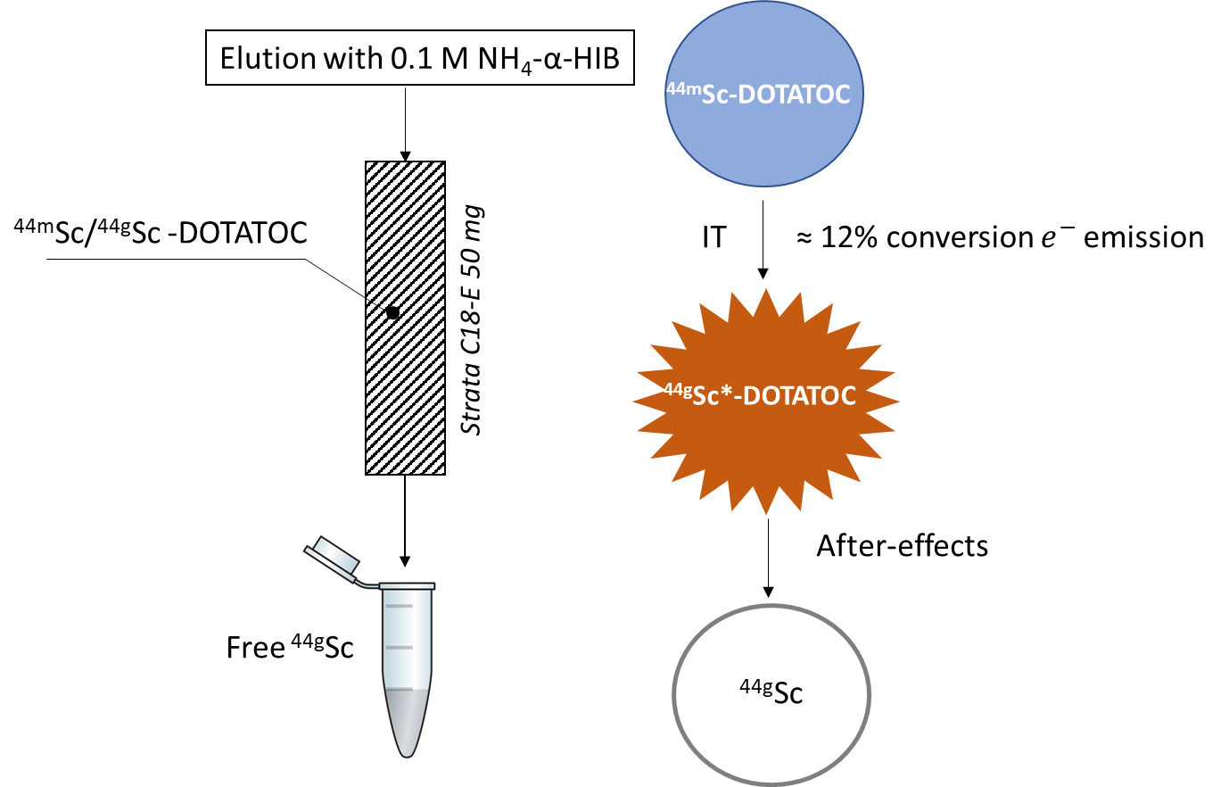
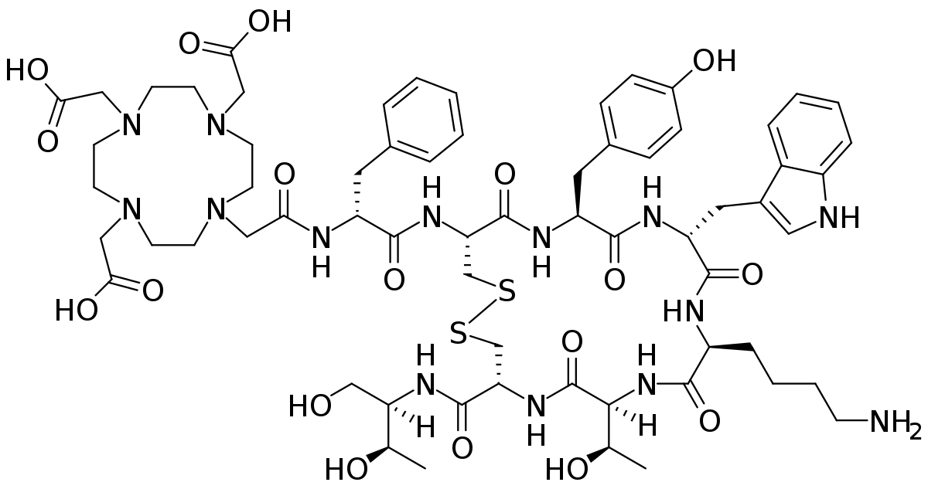
^{44m}Sc/^{44g}Sc generator
DOTATOC
Elution | ^{44g}Sc yield (%) | ^{44m}Sc breakthrough (%)
1 | 10.5 | 3.0
2 | 10.5 | 0.5
3 | 9.7 | 0.15
4 | 9.3 | 0.2
5 | 8.8 | 0.03
The slide is provided by Elena Kurakina

Slide 41
Conclusions
We develop the radiochemical methods:
for production of radionuclide sources and preparation
for separation of radionuclides
for purification of radionuclides
for design of radionuclide generators

