Slide 1
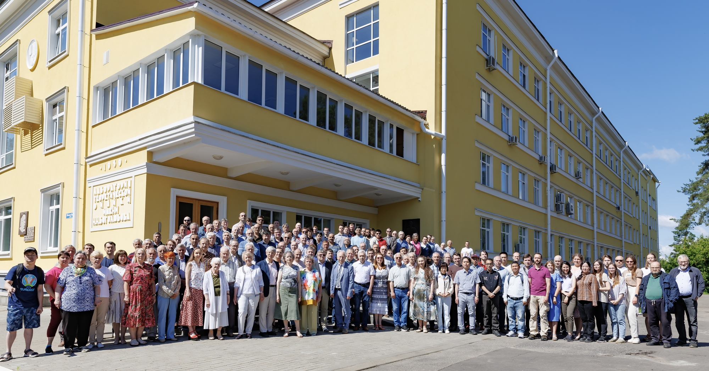
BOGOLIUBOV LABORATORY OF THEORETICAL PHYSICS
Notes:
1
The Bogoliubov Laboratory of Theoretical Physics carried out research in several fundamental areas of theoretical physics: quantum field theory and elementary particle physics, theory of atomic nuclei, condensed matter physics and methods of mathematical physics.
Distinctive features of research at BLTP are the interdisciplinary character of investigations, their direct integration into international projects in cooperation with scientists from the world leading research centres, c lose coordination of theoretical investigations with experimental programs of JINR.
The Laboratory played also the role of the training centre for young scientists and students from many countries. In particular young scientists from Armenia, Belarus, Bulgaria, China, Czechia, Egypt, France, Germany, Greece,, Khazakhstan, Moldova, Poland, Portugal, Romania, Russia, Slovakia, South Africa, Ukraine participated in the DIAS-TH schools and seminars. The number of the scientists from different countries working at BLTP on the basis of the longterm contracts has increased, including young scientists from Egypt, Korea, Serbia. Recently concluded framework agreement between BLTP and IOP VAST (Institute of Physics VAST, Vietnam) has boosted scientific contacts of BLTP and Vietnamese scientists.
Traditionally, the rate and quality of BLTP publications during the last several months were at high level.

Slide 2


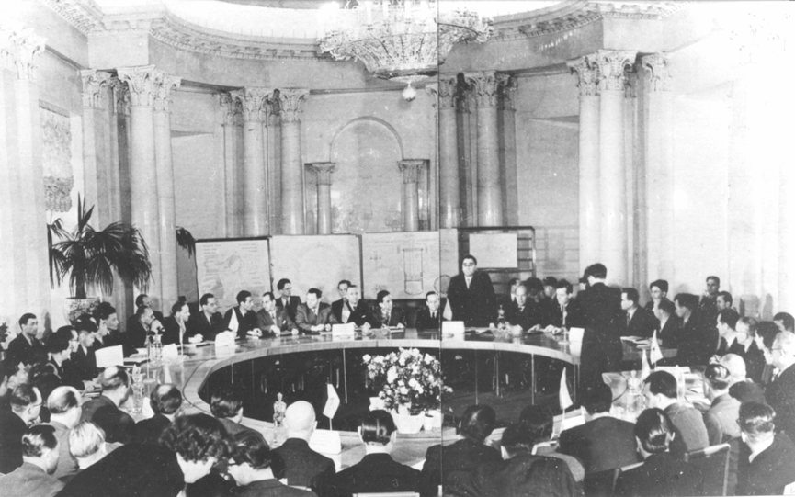
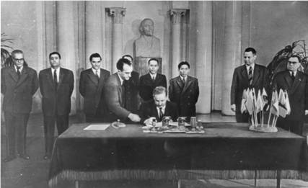
Albania
Bulgaria
China
Czechoslovakia
GDR
Hungary
DPRK
Mongolia
Poland
Romania
USSR
The agreement on the establishment of JINR
was signed on 26 March 1956 in Moscow
Notes:
2

Slide 3
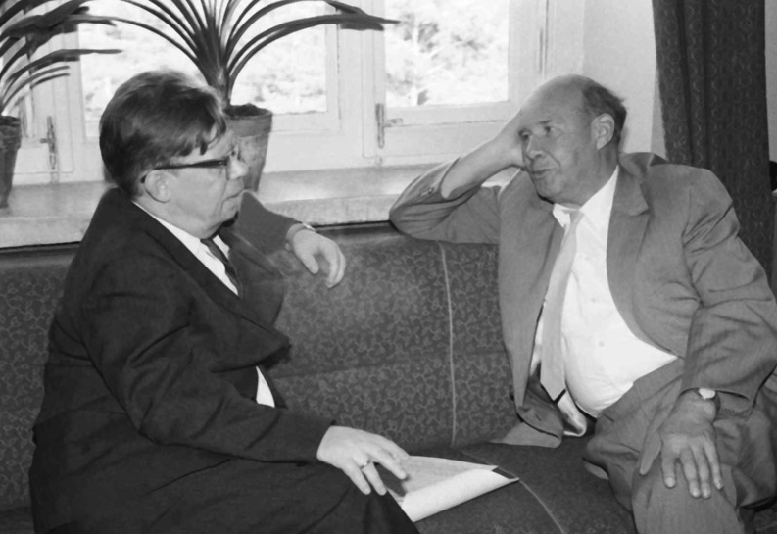
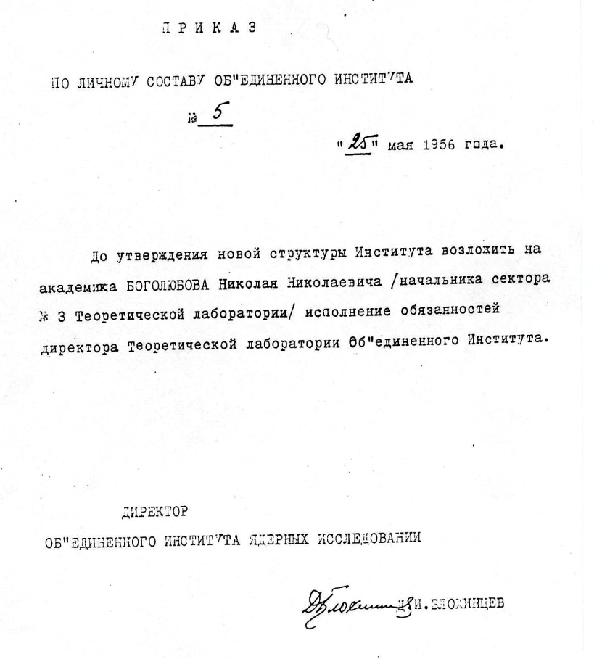
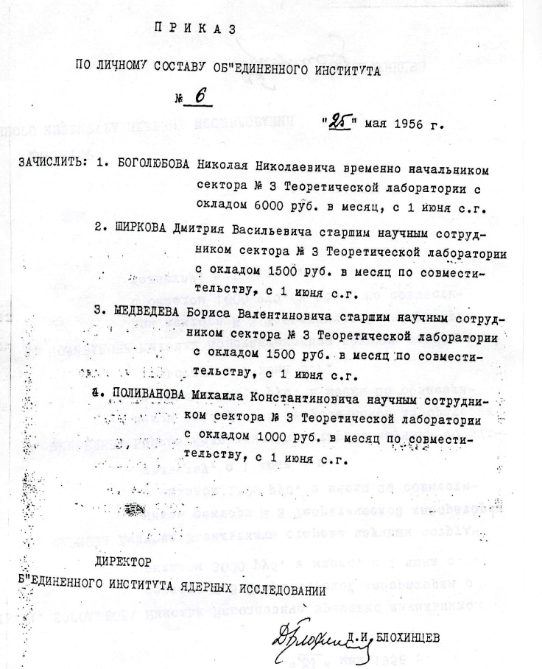
Laboratory of Theoretical Physics, JINR
May 25, 1956
Notes:
3

Slide 4
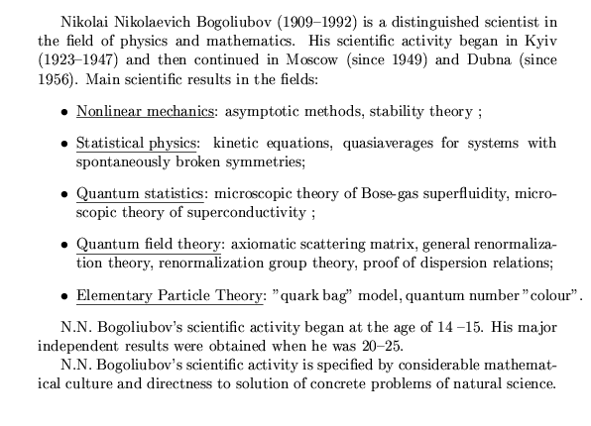
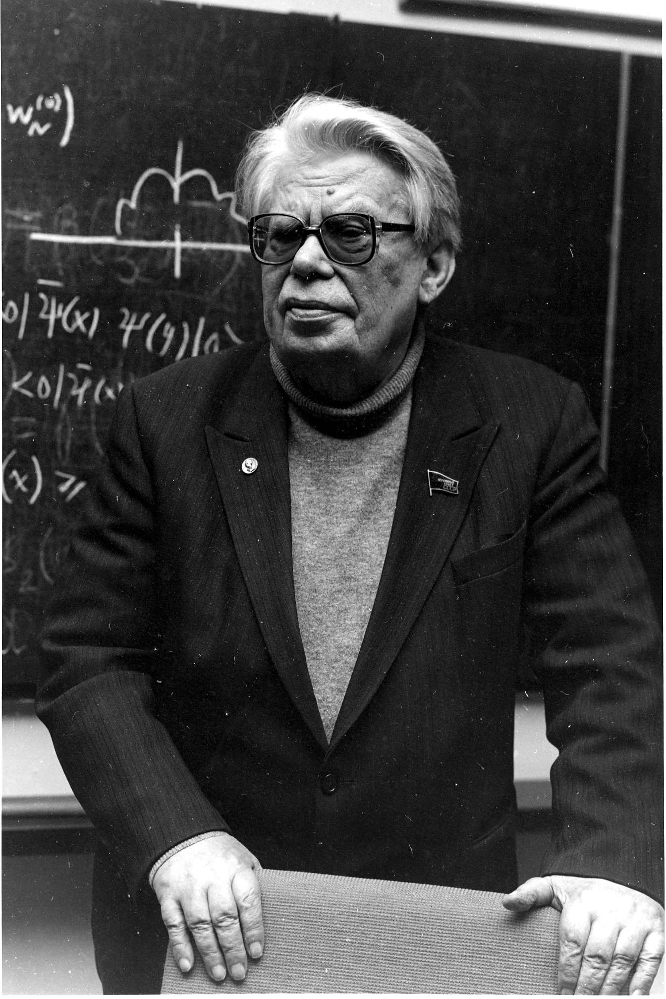
Notes:
4

Slide 5
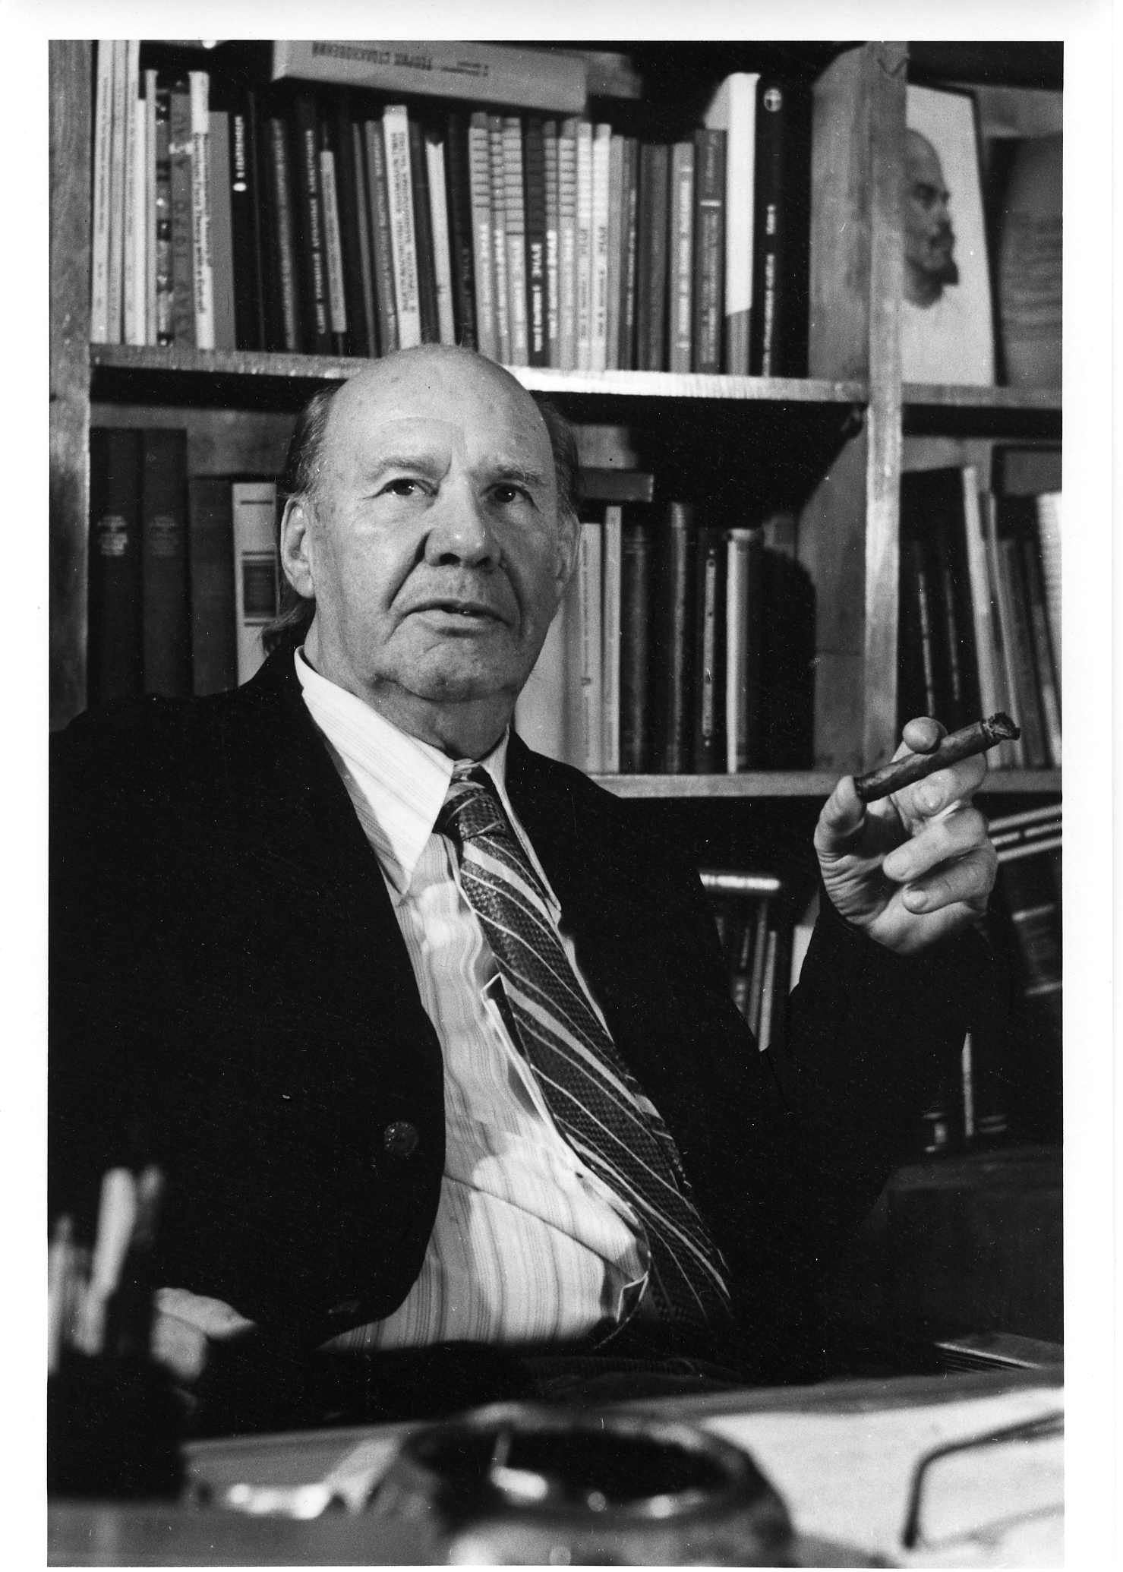
Dmitrii Ivanovich Blokhintsev (11.01. 1908 – 27.01.1979), one of the pioneers of atomic science and technology in USSR, the organizer and the first director of the JINR.
Main scientific results in the fields:
Quantum mechanics
Acoustics of an inhomogeneous moving medium
Neutron physics
Quantum field theory
Particle physics
1954 – the scientific supervisor of creation and putting into operation of the world first atomic power station.
Initiated work on the creation of a nuclear rocket engine for space flights with S. P. Korolev
1960 – first pulsed reactor on fast neutrons
1956- 1965 – the JINR Director
1965 – 1979 – Director of Lab of Theoretical Physics
Notes:
5

Slide 6
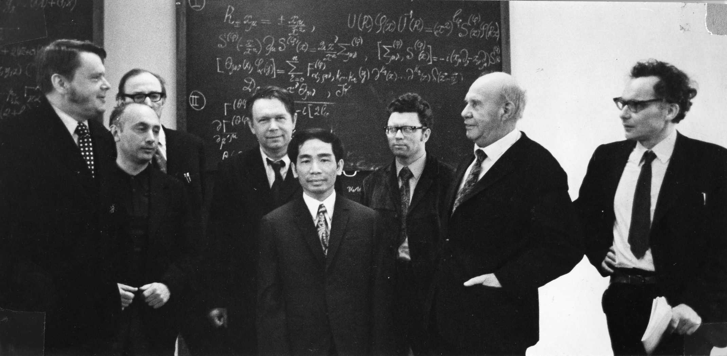
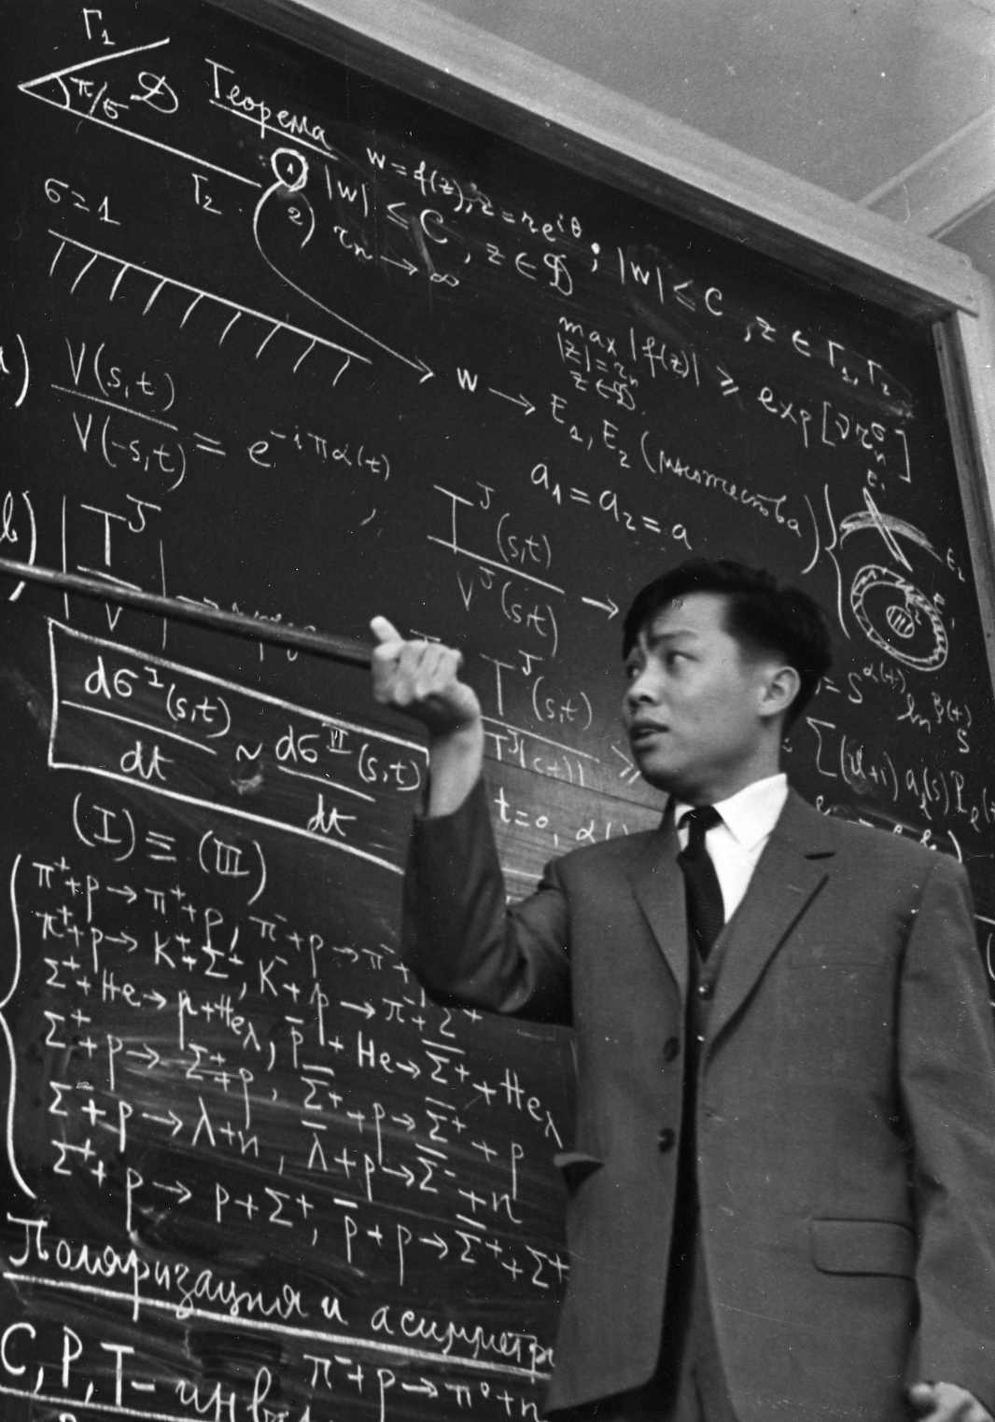
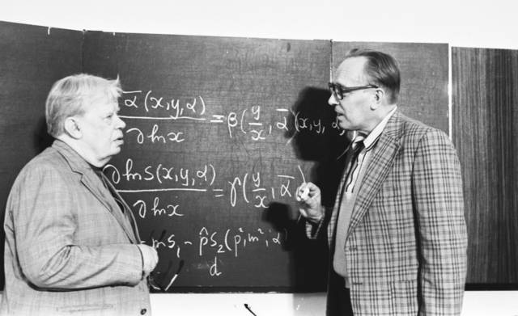
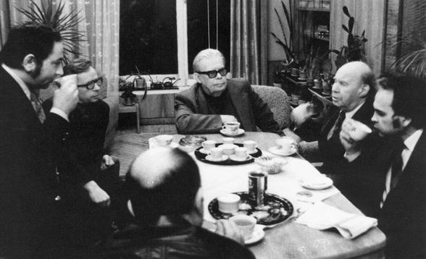
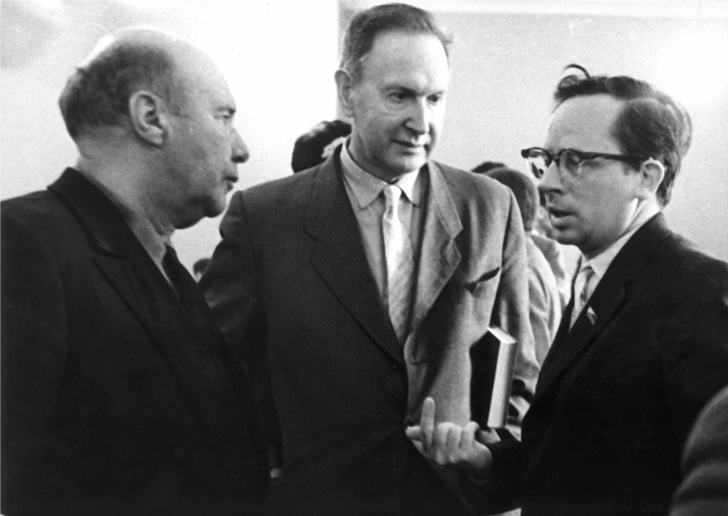
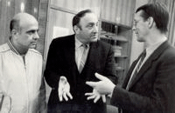
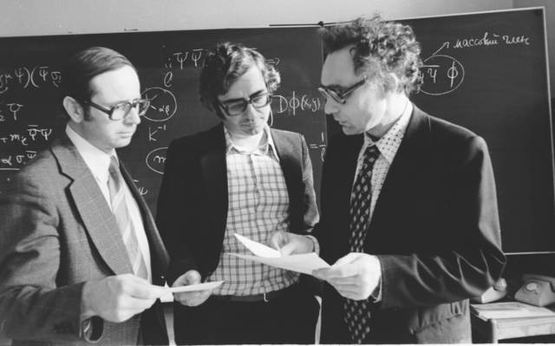
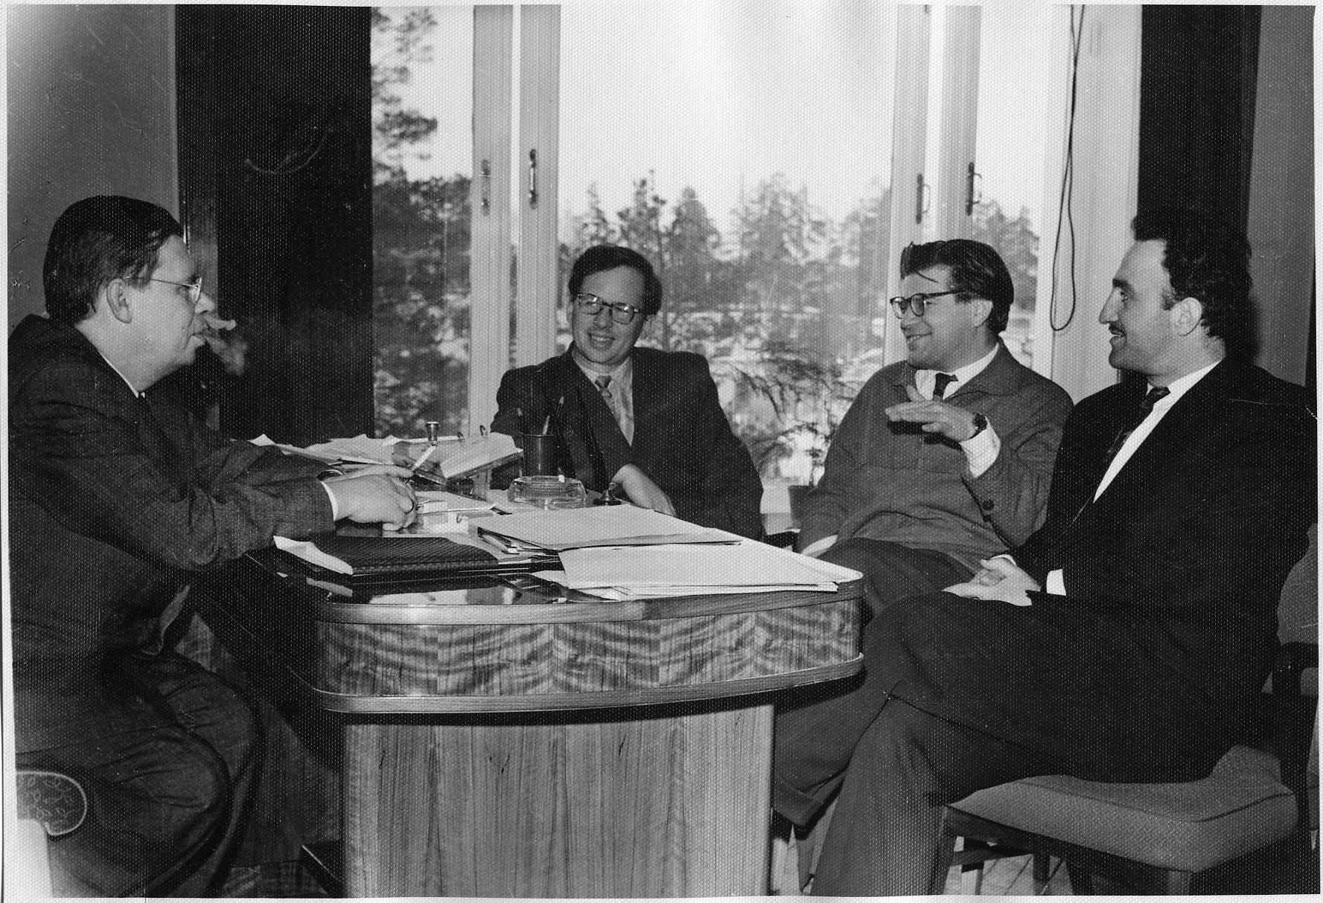
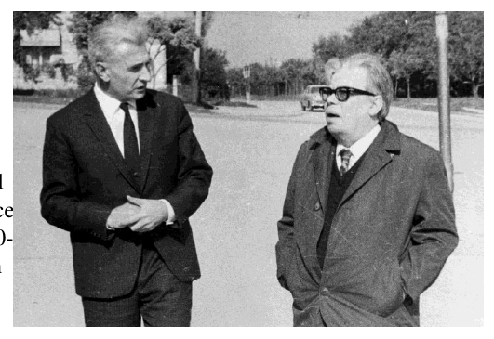
Notes:
6

Slide 7
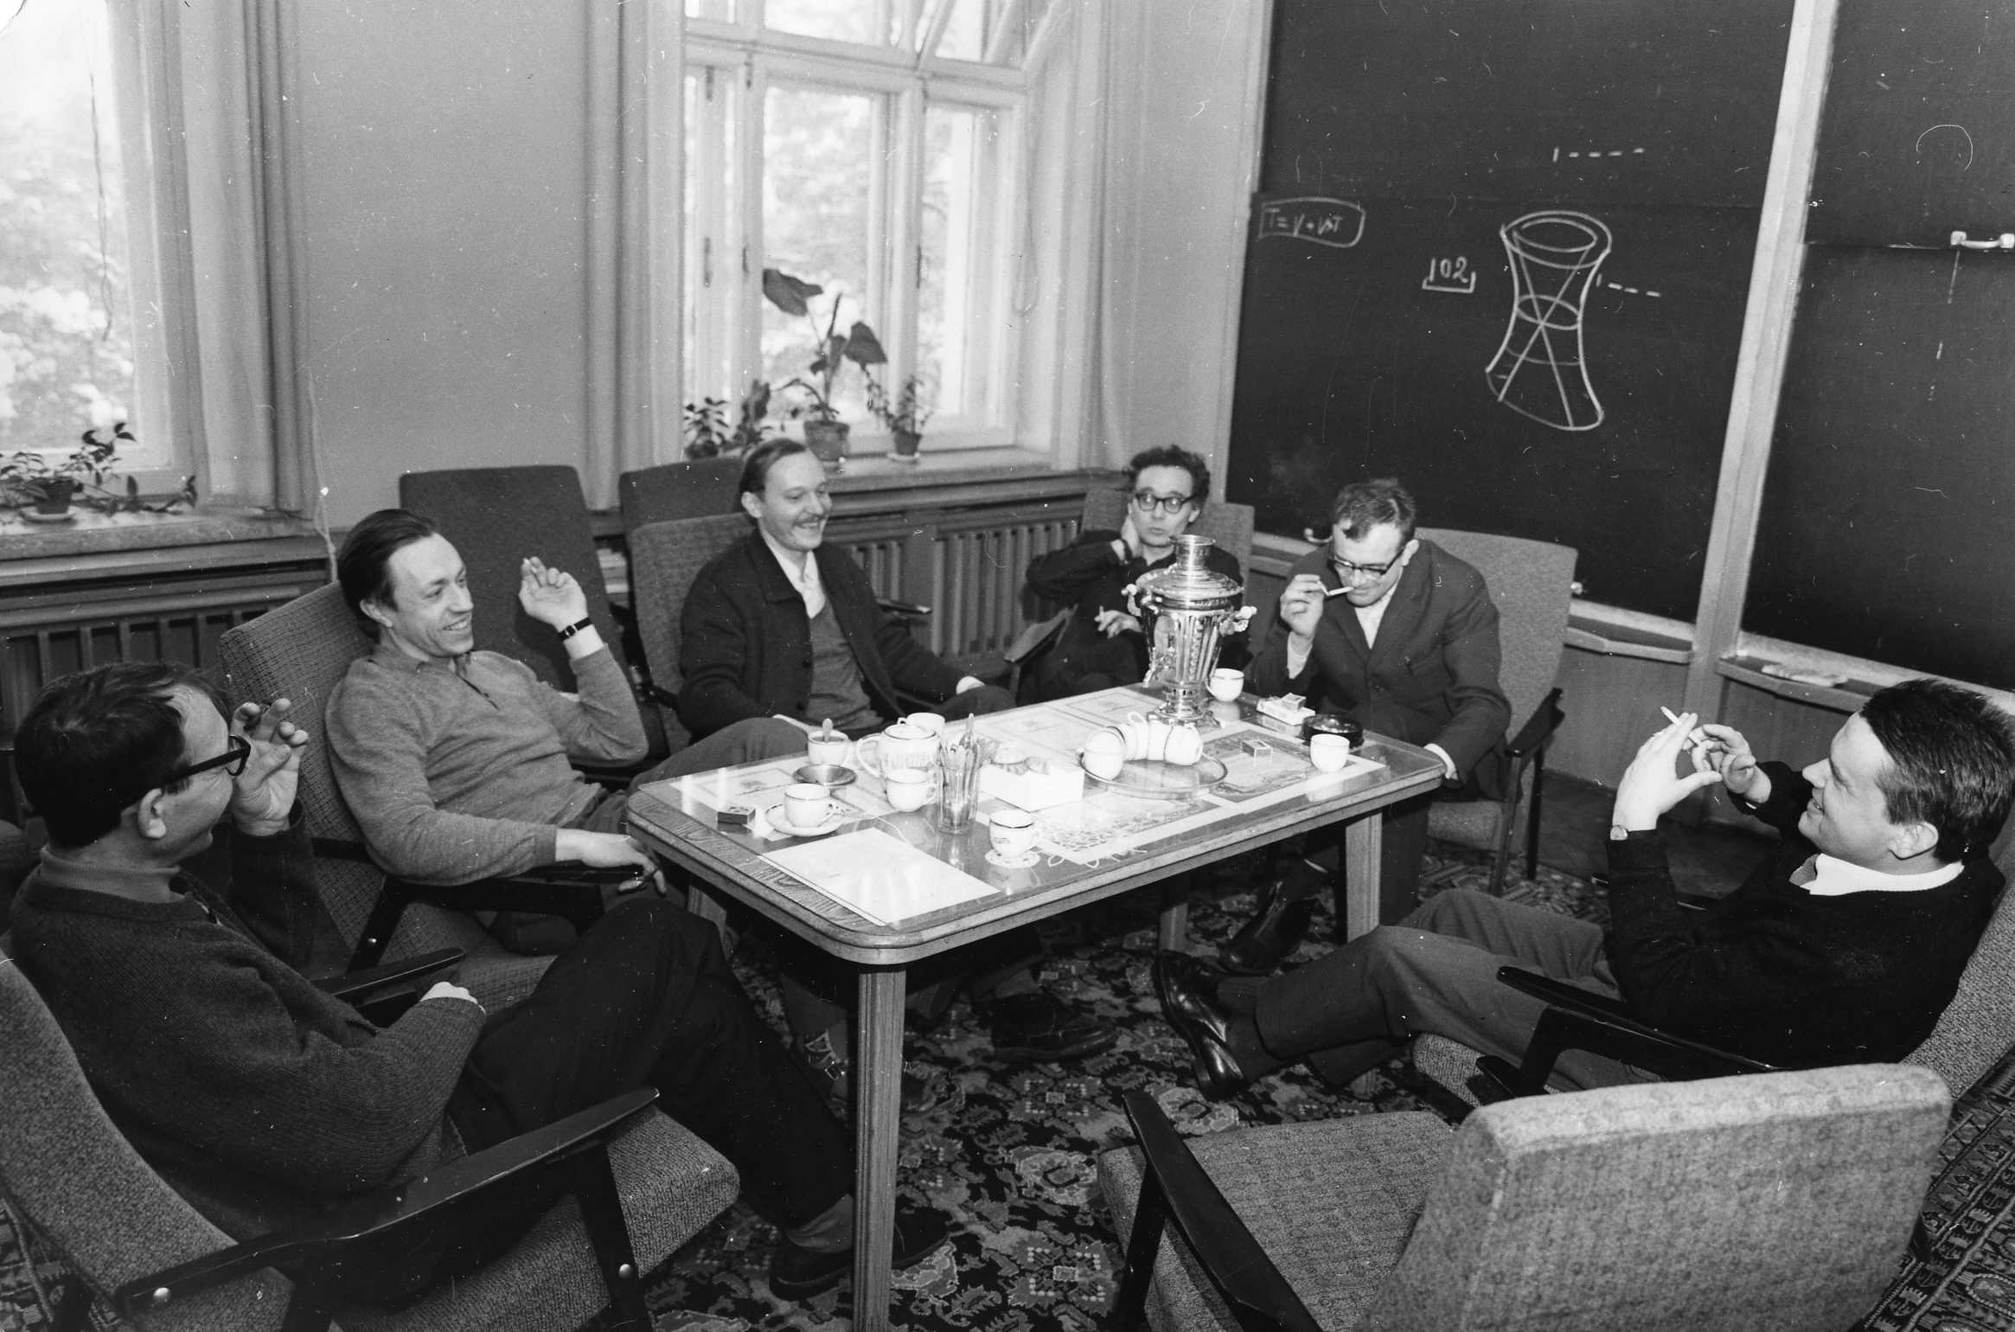
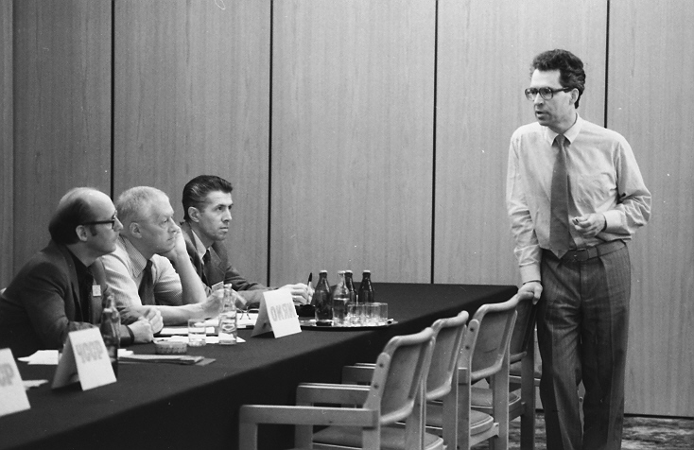
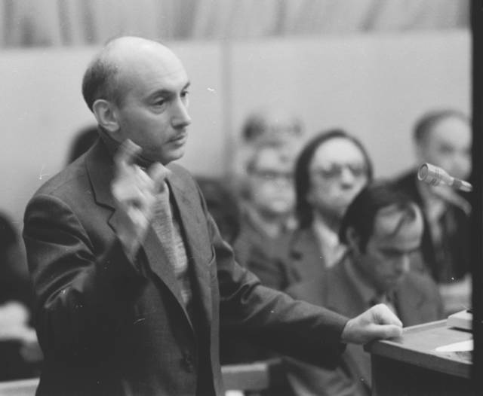
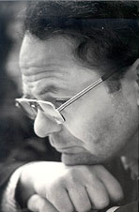
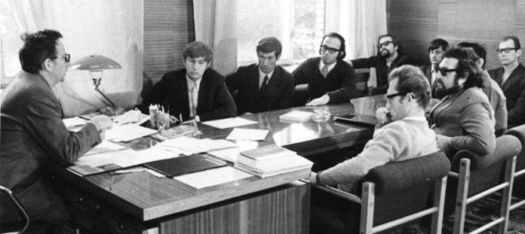
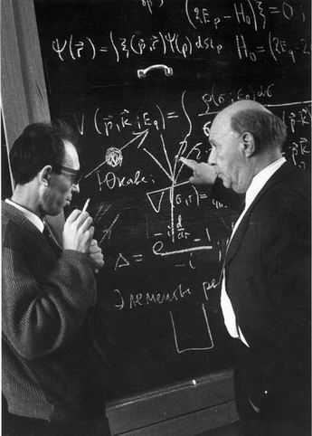
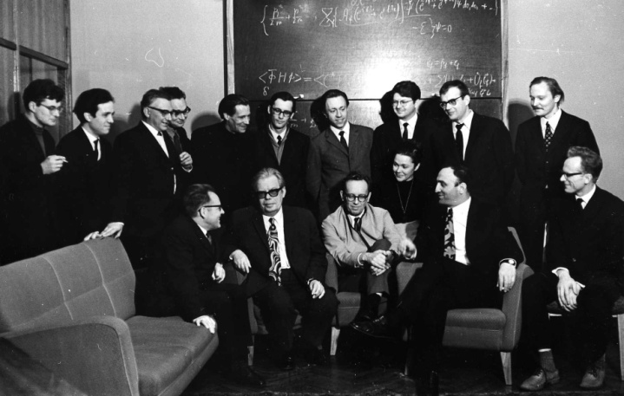


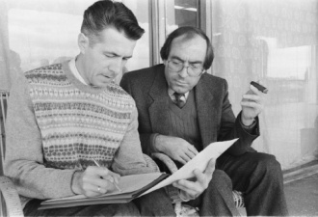
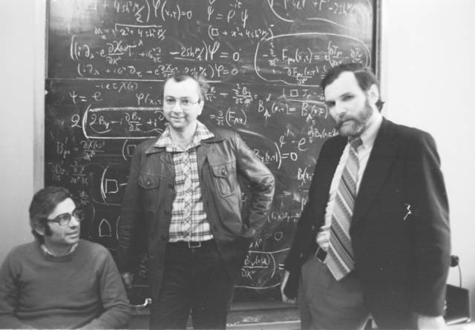
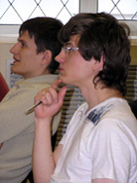
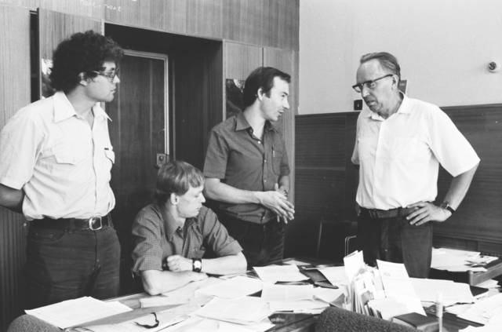
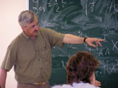
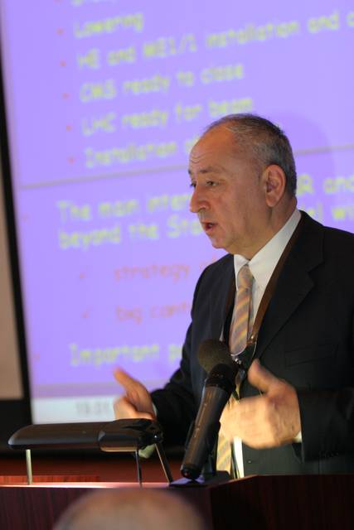
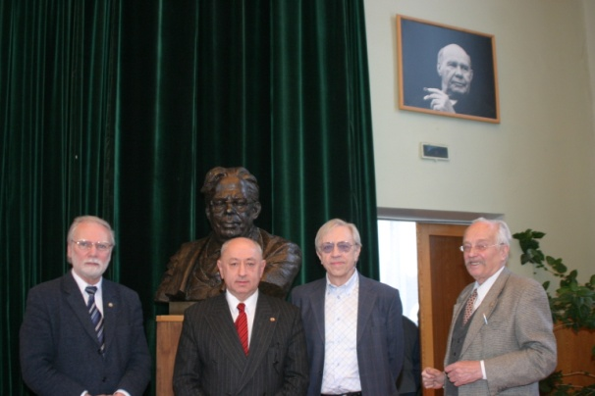
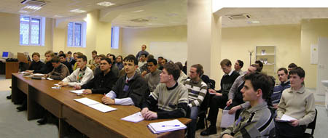
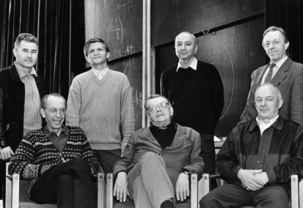
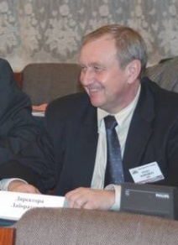
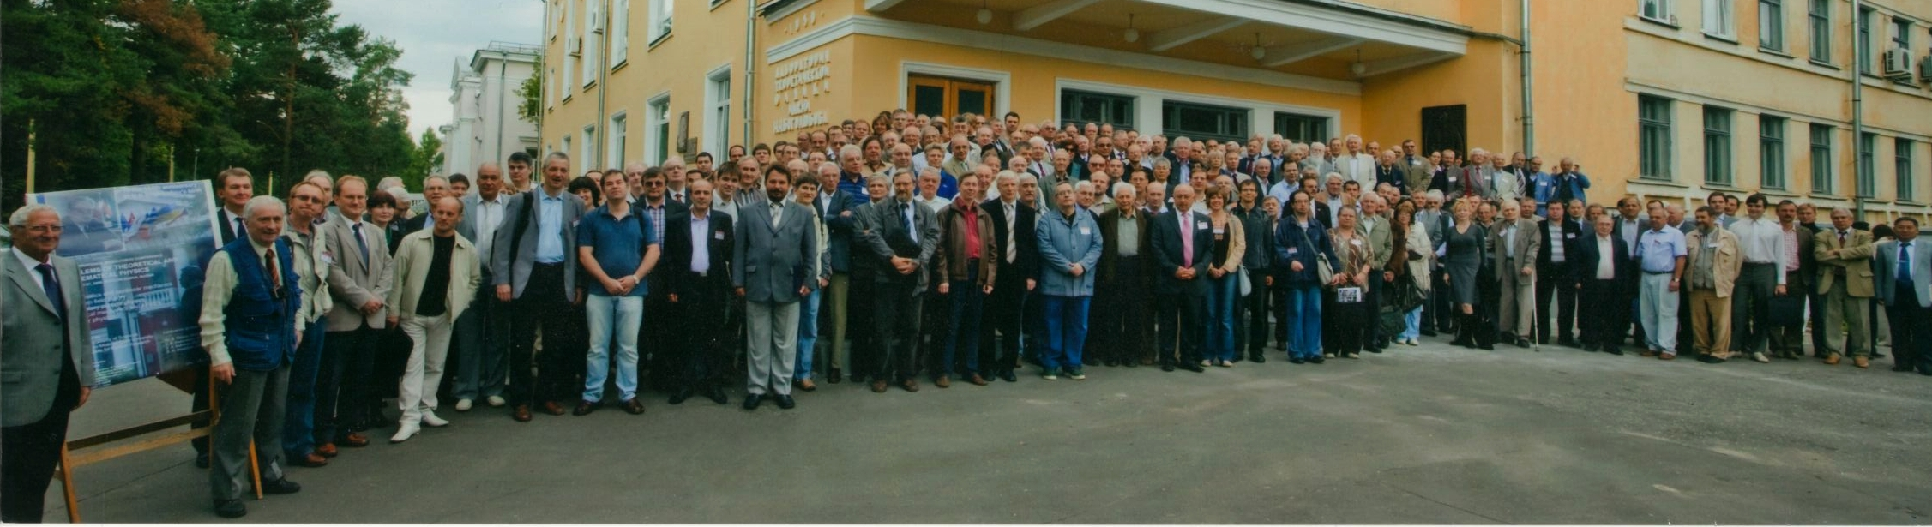
BLTP:
Fundamental Science
International Cooperation,
Education
Notes:
7

Slide 8
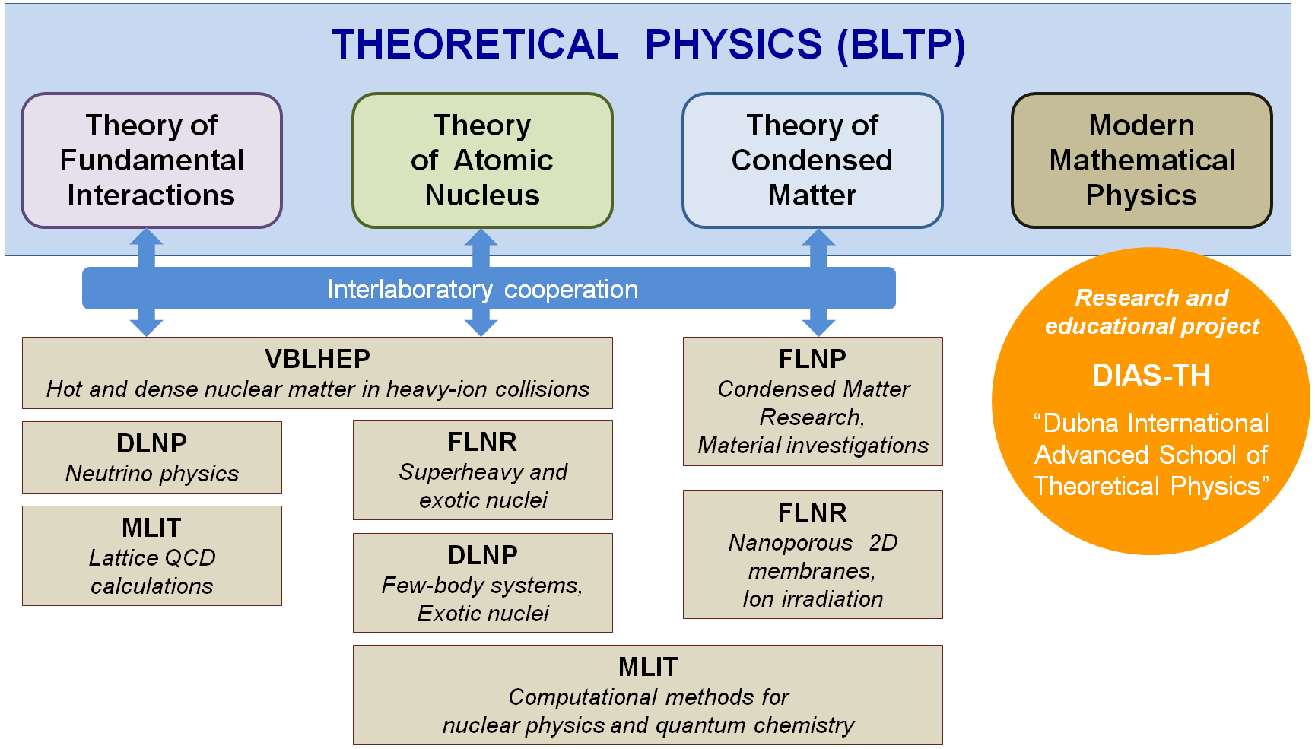
BLTP Director ─ Dmitry Kazakov

Slide 9
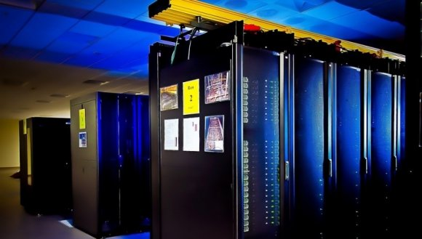
The supercomputer “Govorun”
is a joint project implemented by the Laboratory of Theoretical Physics and the Laboratory of Information Technologies, aimed at significantly accelerating complex theoretical and experimental research in the field of nuclear physics and condensed matter physics, primarily on the subject of the NICA project.

Slide 10
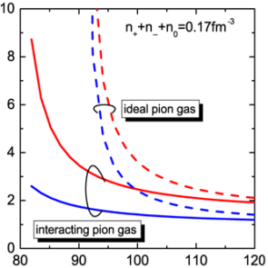
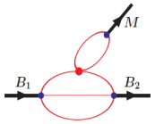
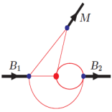
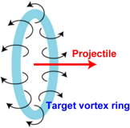
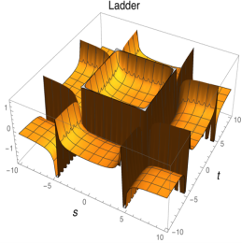
Theory of fundamental interactions
Development of quantum field formalism of gauge and supersymmetric theories. Construction and study of particle physics models beyond the Standard Model. Theoretical calculations for experiments at the Large Hadron Collider to search for new physics and study the properties of the Higgs boson. Calculation of radiative and power corrections to particle production processes within the Standard Model and its extensions. Cosmological problems, vacuum instability, dark matter and dark energy.
Study of neutrino properties and neutrino oscillations.
Record-precision calculations for atomic and molecular physics effects related to the measurement of fundamental constants.
Study of hadron properties in the framework of quantum chromodynamics and phenomenological quark models. Study of heavy quark and exotic hadron properties. Study of hadron spin structure using generalized and transverse momentum-dependent parton distributions.
Lattice QCD, analytical quantum field models, kinetic and hydrodynamic models for studying hot dense hadronic matter in the presence of strong electromagnetic fields.

Slide 11
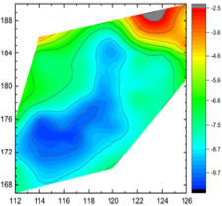
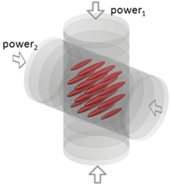
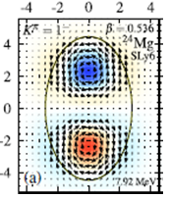
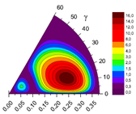
Theory of atomic nucleus
Description and prediction of properties of unstable nuclei and exotic nuclear systems, models for explaining the mechanisms of reactions of nuclei with particles and nuclei at low and intermediate energies; study of the dynamics of nuclear collisions with the formation of stable and radioactive nuclei; theoretical analysis of aspects of the synthesis of superheavy nuclei.
Study of the fundamental properties of few-body systems, development of rigorous mathematical methods for describing their characteristics; study of the behavioral features of few-body systems at ultra-low energies.
Models of nucleus-nucleus collisions at relativistic energies; properties of nuclear matter and phase transitions at extreme values ​​of temperature and density; study of nonlinear quantum processes in the interaction of photons with ultrashort high-frequency laser pulses.

Slide 12
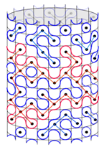
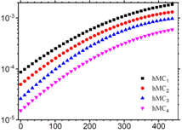
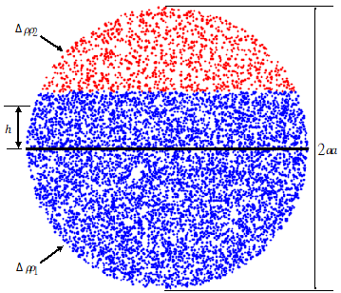




Condensed matter theory
Development of analytical and numerical methods for studying complex multiparticle systems that are of current interest in modern condensed matter physics, development of mathematical models of such systems and identification of universal regularities. Analysis of both lattice and field models of equilibrium and nonequilibrium systems of statistical mechanics and modeling of a wide class of new materials, including nanostructured materials, which are of great practical importance. Study of a wide range of universal phenomena in complex systems - phase transitions in condensed matter and high-energy physics, scaling in (magneto) hydrodynamic turbulence, chemical reactions, percolation, etc. by methods of quantum field theory, including the functional renormalization group.
The results obtained are used in experimental studies of condensed matter.
It is important to note the recently noticeably increasing interdisciplinary nature of research, where condensed matter physics and statistical physics closely intersect with atomic and nuclear physics, particle physics, astrophysics, mathematical physics and biology.

Slide 13




Modern mathematical physics
Development of mathematical methods for solving the most important problems of modern theoretical physics:
● development of new mathematical methods for studying and describing a wide class of classical and quantum integrable systems and their exact solutions;
● analysis and search for solutions to a wide range of problems in supersymmetric theories, including models of strings and other extended objects;
● study of non-perturbative regimes in supersymmetric gauge theories;
● development of cosmological models of the early Universe, gravitational waves and black holes.
Objectives:
● Elucidation of the nature of fundamental interactions and their symmetries;
● Construction of effective field models arising from string theory and other extended objects;
● Disclosure of the geometric description of quantum symmetries and their spontaneous breaking in the context of the search for a unified theory of all interactions, including quantum gravity;
● Identification and effective use of integrability properties in various areas of mathematical physics;
● Application of powerful mathematical methods of quantum groups, supersymmetry and non-commutative geometry to both quantum theories of fundamental interactions and classical models.

Slide 14


JINR University Centre
http://uc.jinr.ru
About 50 lecture courses
at JINR University Centre,
DIAS-TH, Moscow U., Dubna U., MIPT, etc.

Slide 15
Scientific Personnel
 | D | C | O | Total
Fundamental Interactions | 35 | 40 | 25 | 100
Nuclear Physics | 30 | 24 | 18 | 72
Condensed Matter | 19 | 22 | 2 | 43
Mathematical Physics | 14 | 16 | 3 | 33
Total | 94 | 97 | 48 | 248
Including: 22 Aspirants (PhD students)
13 Students
D – Doctor of Science (2nd degree)
C – Candidate of Science (PhD)
O – Other (no degree)
Notes:
15

Slide 16
Scientific Personnel by Age
50
40
30
20
10
0
<30
30-40
40-50
50-60
60-70
70-80
>80
30% are young scientists (below 35)
Notes:
16

Slide 17





BLTP PUBLICATIONS (2020-2024)
BLTP produces ~1/3 of JINR publications
 | 2020 | 2021 | 2022 | 2023 | 2024 | Total
Journal publications | 370 | 285 | 280 | 340 | 350 | 1625
Conference proceedings | 155 | 90 | 70 | 90 | 85 | 490
Total | 525 | 375 | 350 | 430 | 435 | 2115
Notes:
17

Slide 18
AGREEMENTS
BLTP – Romania (since XII ’03)
Titeica-Markov Program
BLTP – APCTP, Pohang (since ’07)
BLTP – Bulgaria (since ’09)
Soloviev-Khristov Program
BLTP – ITP CAS, China (since VII ’10)
BLTP – IOP VAST, Vietnam (since VIII ’11)
BLTP – Physical Inst., NAS, Armenia (since ’09)
Smorodinsky - Ter-Antonyan Program
BLTP- IMSc India (since 2016)
BLTP – ICTP (since ’88)
BLTP – Germany (since ’91)
Heisenberg-Landau Program
BLTP – INFN (since XII ’95)
6 month visits to Italy
BLTP – CERN-TH (since XII ’95)
3 month visits to CERN
BLTP – Poland (since XII ’98)
Bogoliubov-Infeld Program
BLTP – Czech Republic (since XII ’99)
Blokhintsev-Votruba Program
Notes:
18

Slide 19


Slide 20


Slide 21


Slide 22


Slide 23


Slide 24


B meson decays
Aidos Issadykov
JINR days in Kazakhstan
Astana, 2026

Slide 25
Outline:
Introduction – Motivation
b-d(u) transitions
b-s transitions
b-c transitions
Conclusion

Slide 26





Splitting the atom
Democritus
(460 – 370) BCE
Dalton 1808
Cathode rays – Thomson
1897
Rutherford
1906-1920
Nucleus of
Hydrogen Atom
Rutherford
Proton - 1920
Bohr 1913
@Adnan Bashir
at NCP, Islamabad, 2026

Slide 27



Proton’s twin brother
Bombarding Beryllium with alpha particles:
discovery of neutrons.
Heisenberg 1932
Wigner 1937
Isospin
Chadwick 1932
@Adnan Bashir
at NCP, Islamabad, 2026

Slide 28


Historical preview
1930 Birth of the Strong Interaction following Chadwick's 1932 neutron discovery, it became clear that a new, powerful force was needed to hold protons and neutrons together in the nucleus
1935 Hideki Yukawa proposed that strong interaction was generated by the exchange of the pion
1961 Sheldon Glashow has discovered a way to combine the electromagnetic and weak interactions – first step towards the SM
1967 Abdus Salam and Steven Weinberg unified the electromagnetic force and the weak nuclear force into a single "electroweak" force
1964 Murray Gell-Mann and George Zweig independently proposed that hadrons (like protons and neutrons) are composed of smaller, fundamental constituents called quarks inspired of "Three quarks for Muster Mark!“ by James Joyce (“quorks” and “aces”)

Slide 29


Historical preview
1970 Discovery of tau lepton by group of Martin Perl at SLAC
1973 Makoto Kobayashi and Toshihide Maskawa predicted the existence of a third generation of quarks (bottom and top) to explain observed CP violation in the Kaon system

Slide 30


Historical preview
1974 the “November Revolution” the observation of J/ψ (c$\overline{c}$ meson) (Richter and Ting)
1977 Observation of Y (b$\overline{b}$ meson) at DORIS, DESY

Slide 31


Why B physics?

Slide 32

2018*

Slide 33

2018*

Slide 34

28.04.2026*

Slide 35

28.04.2026*

Slide 36


The “B” family
* particlezoo.net

Slide 37


B-factory: Belle exp. at KEKB

Slide 38


B-factory: Belle II exp. at SuperKEKB

Slide 39


B-factory: BaBar exp. at SLAC

Slide 40


LHCb exp. at LHC

Slide 41
b-d transitions

Slide 42

b-d transitions

Slide 43

b-d transitions
* 1412.7515

Slide 44


b-d transitions
*R. Aaij et al. (LHCb Collaboration), JHEP 07, 020 (2018), arXiv:1804.07167 [hep-ex].

Slide 45

* EPJ A 2022, 58(3), 39

Slide 46

* EPJ A 2022, 58(3), 39

Slide 47
$\text{b}\text{ → }\text{s} \text{transition}$

Slide 48


THE LHCB COLLABORATION REPORT IN 2013
3.7 σ
~ 3 σ
*Phys.Rev.Lett. 111 (2013) 191801

Slide 49

$\text{b}\text{ → }\text{s} \text{transition}$
Loop-level decays b → sℓ⁺ℓ⁻:
forbidden at tree-level in SM
sensitive to NP contributions in loops

Slide 50


$$R_{K^{}}$$

Slide 51

Angular observables
LHCb measurement differs by 3.4σ from the SM prediction
Can be explained by
- SM charm-loop effects (cannot explain tension in R_{K*})
- New Physics??

Slide 52

SCHEMATIC VIEW OF $\text{В→}\text{K}\text{π}\text{ + ℓ}\text{+}\text{ℓ}\text{−}$ DECAY
* Phys.Rev. D91 (2015) no.7, 074007

Slide 53


IMPACT OF S WAVE CONTRIBUTION
14 %
~ 6 %
* Phys.Rev. D91 (2015) no.7, 074007

Slide 54


$$\text{b}\text{ → }\text{s} υ υ$$
* Modern Physics Letters A, 2023, 2350006

Slide 55

Experiment
Exp.
Theory
Theory

Slide 56

$$\text{B}\text{ → }K υ υ$$
* Belle-II Collaboration, Phys.Rev.D 109 (2024) 11, 112006, arxiv: 2311.14647

Slide 57


Slide 58

~ 3.1 σ
*

Slide 59

THE VALUES OF BRANCHING FRACTIONS
Our
Exp
* Phys.Rev. D93 (2016) no.9, 094022 and arXiv:2510.03739

Slide 60

CC-RESONANCE CONTRIBUTIONS

Slide 61

ANGULAR OBSERVABLES AND DIFFERENTIAL BRANCHING

Slide 62


ANGULAR OBSERVABLES AND DIFFERENTIAL BRANCHING

Slide 63

b-s anomaly
В→K* 𝜇⁺𝜇⁻
В_{s}→ $φ$𝜇⁺𝜇⁻
В_{s}→𝜇⁺𝜇⁻
up to 3.7 σ
up to 3.1 σ
???
2015*

Slide 64
b-s anomaly
В→K* 𝜇⁺𝜇⁻
В_{s}→ $φ$𝜇⁺𝜇⁻
В_{s}→𝜇⁺𝜇⁻
up to 3.1 σ
about 2.2 σ
less than 2 σ
Now*

Slide 65
b-s anomaly
В→K* 𝜇⁺𝜇⁻
В_{s}→ $φ$𝜇⁺𝜇⁻
В_{s}→𝜇⁺𝜇⁻
up to 3.1 σ ??
about 2.2 σ
less than 2 σ
Now*

Slide 66


b-c transition
2.3 σ discreapancy
3.0 σ discreapancy
* https://hflav-eos.web.cern.ch/hflav-eos/semi/summer18/RDRDs.html

Slide 67

b-c transition
(One of ) the largest discrepancies between SM and measurement
Up to 4.1 σ disagreement

Slide 68

Experimental data

Slide 69



Semileptonic decays of B_{c} meson
*R. Aaij et al. Phys.Rev.Lett. 120 (2018) no.12, 121801
arXiv:1711.05623

Slide 70

Branching ratios of semileptonic $B_{c}$ decays
*Phys.Lett. B783 (2018) 178-182

Slide 71

New Physics effects in semileptonic $B_{c}$ decays
*Tran, Ivanov, Körner, Santorelli, Phys.Rev. D97 (2018) no.5, 054014
arXiv:1801.06927

Slide 72



Nonleptonic decays of B_{c} meson
LHCb collaboration(nonleptonic):
*R. Aaij et al. [LHCb Collaboration], JHEP 1309 (2013) 075
*R. Aaij et al. [LHCb Collaboration], JHEP 1609 (2016) 153

Slide 73

Ratios of branching fractions
*Phys.Lett. B783 (2018) 178-182

Slide 74

Ratios of branching fractions
*Phys.Lett. B783 (2018) 178-182

Slide 75

Nonleptonic decays of B_{c} meson
*G. Aad et al. (ATLAS Collaboration), Eur. Phys. J. C 76, 4 (2016).

Slide 76


Ratios of branching fractions
* Phys.Rev. D96 (2017) no.7, 076017

Slide 77

*ATLAS, Phys.Rept. 1116 (2025) 57-126

Slide 78

Semileptonic B_{s} →D*_{s} decay

Slide 79


Slide 80

*European Physical Journal Plus, 2023, 138(2), 163

Slide 81
Conclusion
b-d(u) transitions ok!
b-s transitions - R_{K} and R_{K*} problem
b-c transitions R_{D} and R_{D*} , R_{J/ψ} problem

