Slide 1

Scientific Research Infrastructure of the FLNP:
For Conducting
Applied and Fundamental Research
Bagdaulet Mukhametuly
Frank Laboratory of Neutron Physics
at Joint Institute for Nuclear Research in Dubna

Slide 2

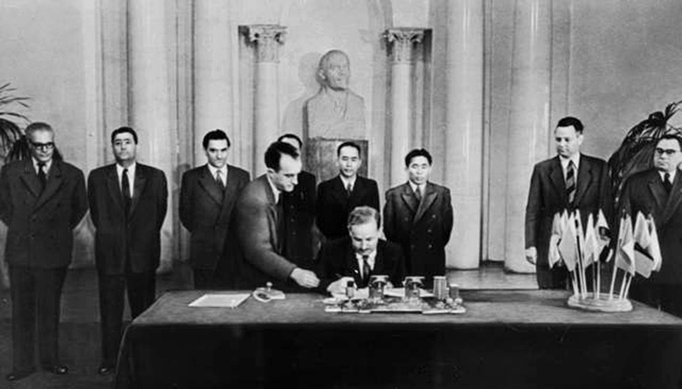









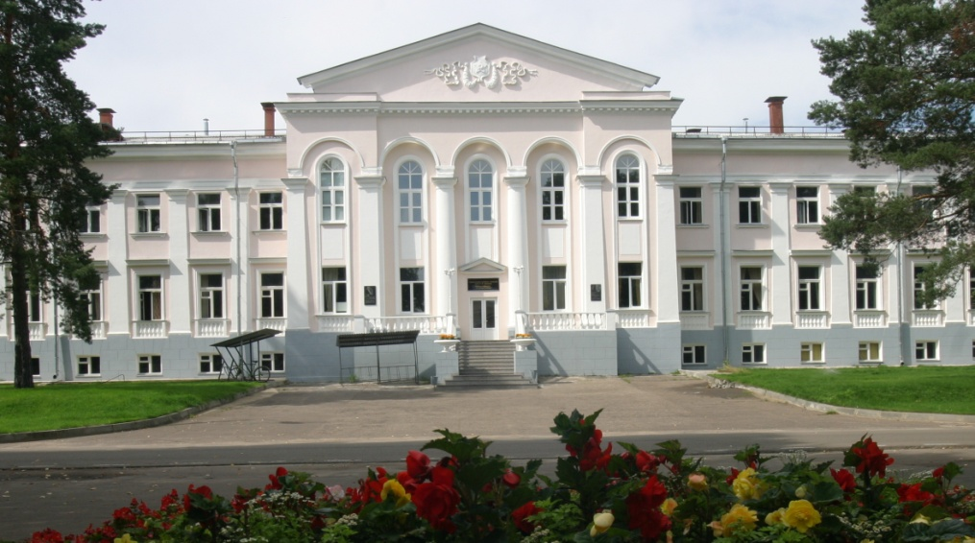
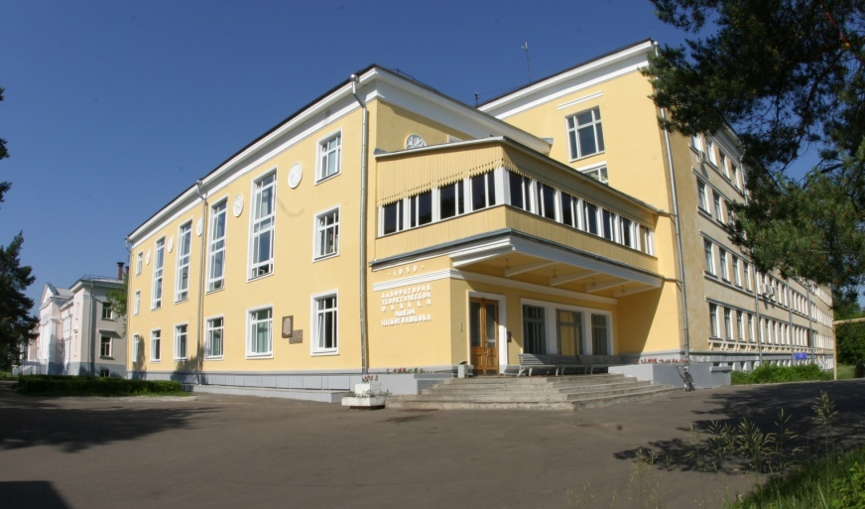
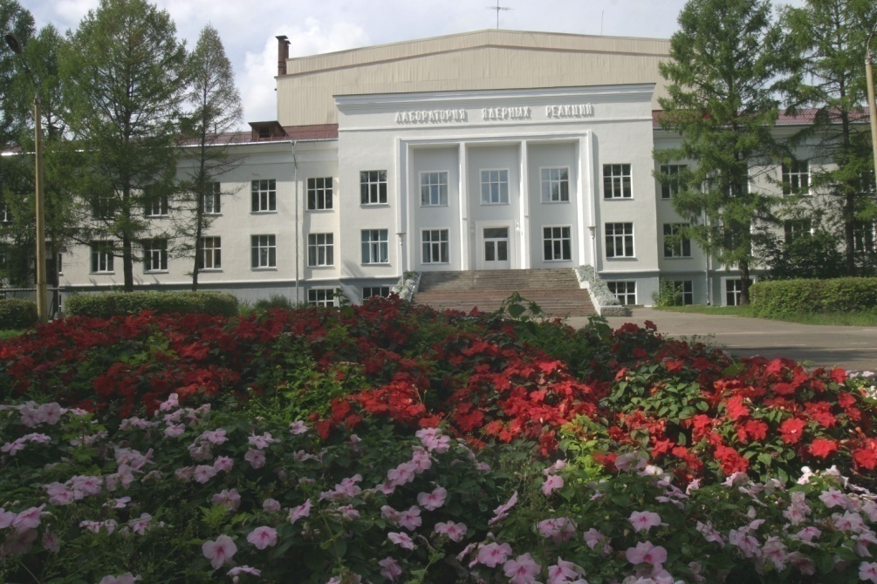
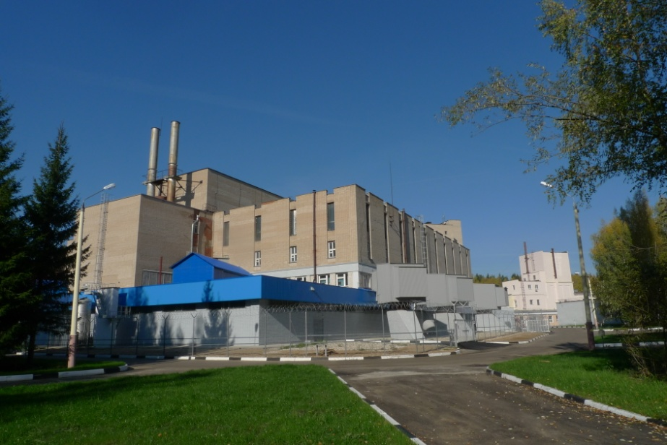
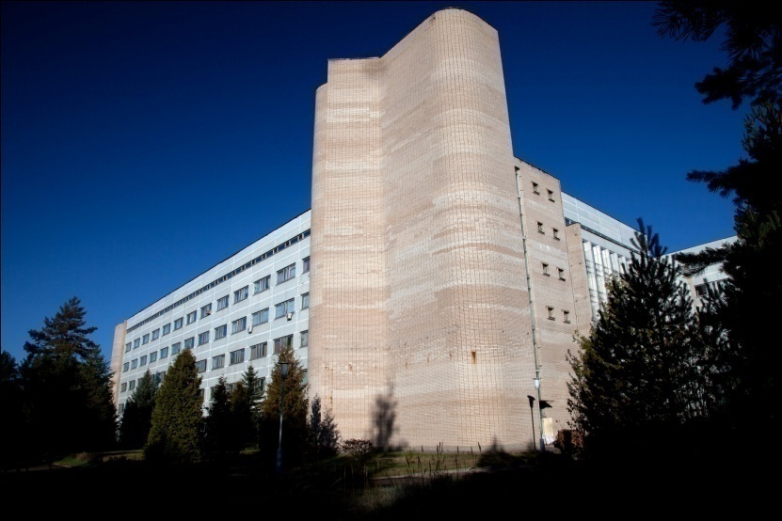
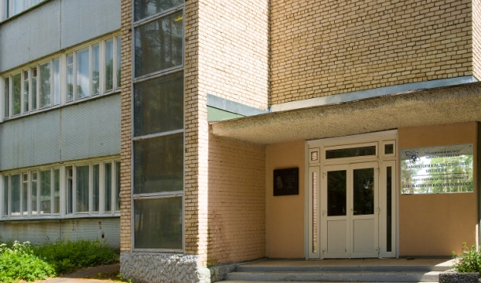
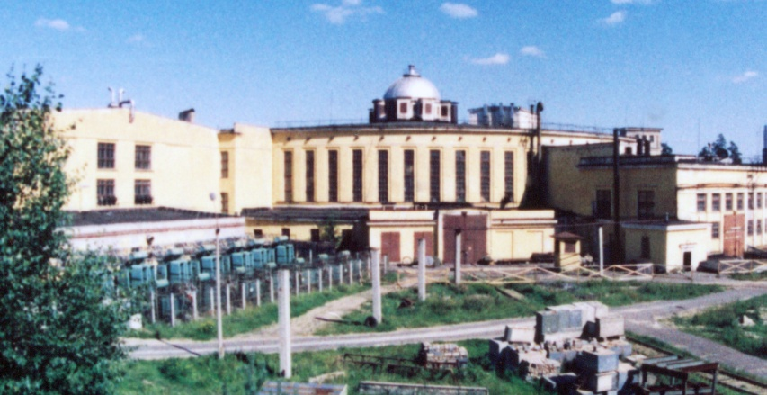
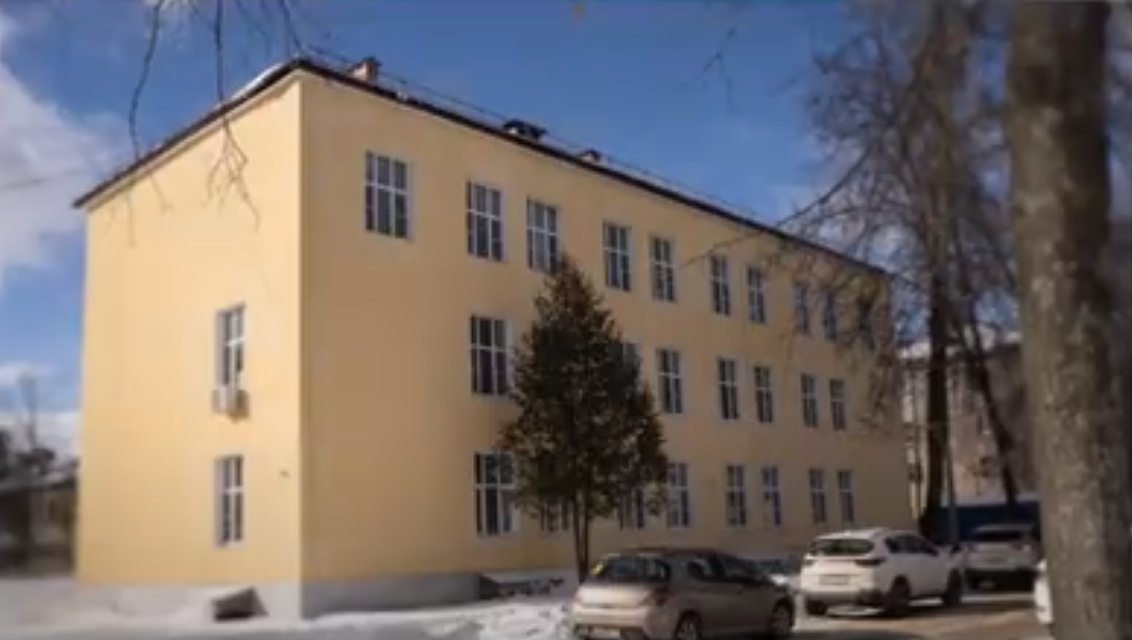
JINR is a large multidisciplinary inter­na­ti­onal scien­ti­fic center incor­po­rating ba­sic re­search in the field of
mo­dern nuc­lear physics, develop­ment and ap­plica­tion of high tech­no­logies, and univer­sity edu­cation
1956
2026
established on March 26,1956 by eleven founding States
registered with the United Nations on February 1,1957
Member States
Armenia Cuba Kazakhstan Slovakia
Azerbaijan DPRK Mongolia Uzbekistan
Belarus Egypt Romania Vietnam
Bulgaria Georgia Russia
Associate Members
Germany
Hungary
Italy
The Republic of South Africa
Serbia
Joint Coordinating Committee
Expert Working Group
China Mexico Brazil
JINR comprises 7 Laboratories, each being comparable with a large institute in the scale and scope of investigations performed
+ university center
~1000 partner research organizations and universities from ~70 countries
DLNP BLTP FLNR FLNP MLIT LRB VBLHEP UNC

Slide 3
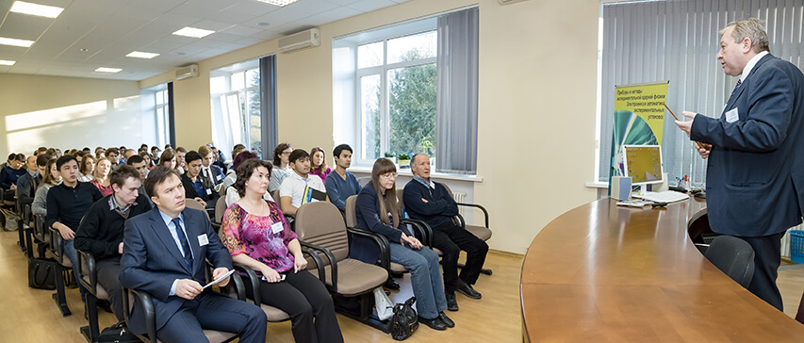
FLNP staff breakdown:
Total | 557
Scientists | 202
Engineers and specialists | 152
Workers | 171
Administrative staff | 32
Average age – 48.1 years
Women – 27 %
Doctors – 29 persons
PhD – 108 persons
Foreigners – 96 persons
THREE MAIN SCIENTIFIC DEPARTMENTS of FLNP:
Department of nuclear physics (139 persons)
Department of Neutron Investigations of Condensed Matter (99 persons)
Department of Spectrometers Complex IBR-2 (51 persons)
+ Raman spectroscopy sector (10 persons)
Sector of a new source and complex of moderators (26 persons)

Slide 4
Neutrons:
Historical Background, Main Properties.

Slide 5
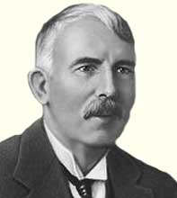

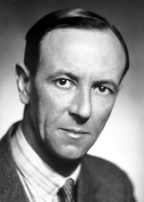
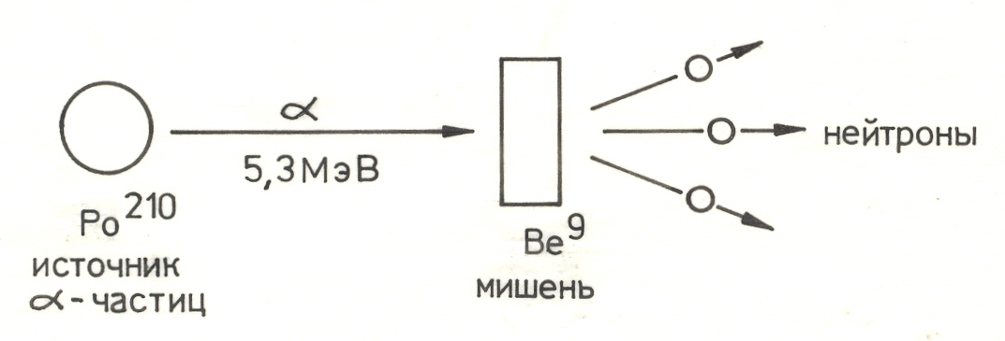
Discovery of the neutron
1919
Artificial splitting of nuclei by α-particles, hypothesis of a massive nucleus
Neutron as a combination of a proton and an electron.
Ernest Rutherford
30.08.1871, NZ
19.10.1937, UK
1932
Discovery by J. Chadwick in experiments on irradiation of beryllium with alpha particles of penetrating radiation of particles with a mass close to the mass of a proton and zero charge.
James Chadwick
20.10.1891, UK
24.07.1974, UK
Be⁹ + He⁴ → C¹² + n + 5,7 МэВ

Slide 6
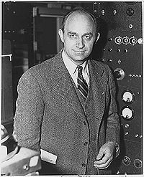
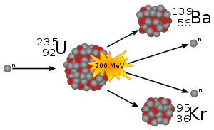
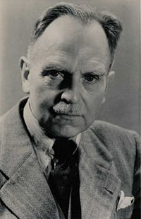
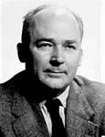
Properties of the Neutron
Year 1934
Slowing down of neutrons by hydrogen-containing substances (H2O, paraffin) to thermal energies.
On average, a fast neutron collides 19 times in water before slowing down.
Year 1938
Fission of uranium under the action of thermal neutrons.
Enrico Fermi
29.09.1901, Italy 28.11.1954, USА
Otto Hahn;
1879 – 1968
Fritz Straßmann; 1902 -1980

Slide 7
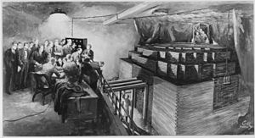
The first nuclear reactor in ANL (Chicago)
Enrico Fermi
29.09.1901, Italy
28.11.1954, USA
Year 1942
“The Chicago Pile” – a drawing depicting the launch of the first nuclear reactor. Graphite blocks, between which are spheres of natural uranium. The chain reaction occurs on ²³⁵U, the nuclei of which are split by thermal neutrons.

Slide 8
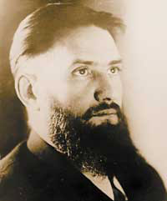
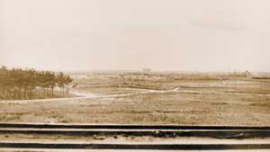
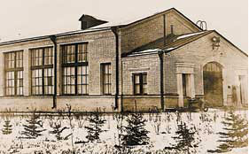
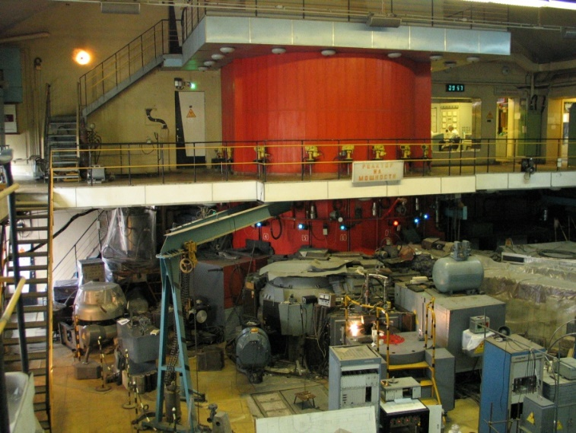
Development of Neutronography in the USSR
1946 – the first reactor in the USSR (Kurchatov Institute, Moscow)
On this wasteland in 1943, the future "Kurchatov Institute" was built.
I.V. Kurchatov
30.12.1902, USSR
07.02.1960, USSR
In this building in 1946, the first chain reaction in Europe/Asia was carried out.
1957 – IRT – the first research reactor in the USSR

Slide 9
Neutron scattering
Neutron scattering - is a set of experimental methods for studying the structure and dynamic properties of condensed media at the atomic or molecular level using low-energy neutron scattering (thermal neutrons with a characteristic energy of ~ 0.02 eV, a wavelength of ~ 2 Å)
Main sections:
structural neutron scattering
(atomic structure)
magnetic neutron scattering (magnetic structure)
neutron spectroscopy (atomic and magnetic dynamics)
Main techniques:
diffraction,
small-angle scattering
reflectometry,
inelastic scattering.

Slide 10
Structural Neutron scattering
Determination using a neutron diffraction experiment of the main characteristics of the atomic structure of the crystal, which include:
spatial symmetry
parameters of the elementary cell
coordinates of atoms
thermal parameters of atoms
position filling factors
Determination of the characteristics of the microstructure of the crystal, which include:
size of crystallites (coherent blocks)
macro and micro stresses
crystallographic texture
phase composition

Slide 11
Magnetic Neutron scattering
Determination using a neutron diffraction experiment of the main characteristics of the magnetic structure of the crystal, which include:
parameters of the magnetic elementary cell
wave vector of the magnetic structure
coordinates of the magnetic atoms
magnitude of the magnetic moments
direction of the magnetic moments

Slide 12
Neutron spectroscopy
Determination using inelastic scattering of neutrons of the main characteristics of the dynamic movements of atoms or magnetic moments of the substance, which include:
phonon spectrum of the crystal
requencies of local oscillations
dispersion curves
diffusion movements
effects of the electric field

Slide 13
Basic techniques in neutron scattering
Neutron diffraction on crystals – structure analysis with a resolution of 0.01 Å.
Neutron diffraction on amorphous solids – analysis of radial distribution with a resolution at the level of 1 Å.
Small-angle neutron scattering (SANS) - is an analysis of the geometric characteristics of large (10 – 1000 Å) inhomogeneities.
Neutron reflectometry - is an analysis of the distribution of scattering density along the normal to the interface between media, external or internal.
Polarized neutron scattering - is the analysis of the distribution of spin density or magnetization in a medium.

Slide 14
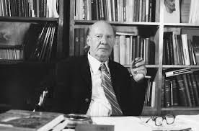
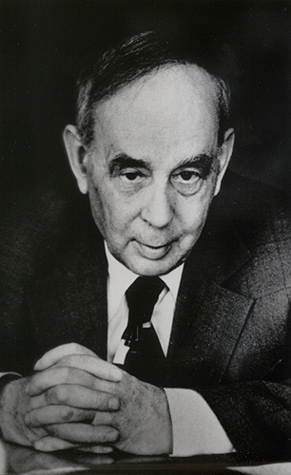
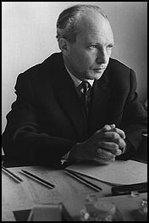
Neutron scattering in Dubna
Dmitry Ivanovich Blokhintsev
1908 - 1979
1955 – Dimitry I. Blokhintsev (first director of JINR) - the idea of pulsed reactor
1960-1968-2001 – Ilya M. Frank & Fyodor L. Shapiro – the pulsed reactor IBR, IBR-30
1984-2010-204x – IBR-2, IBR-2M
Ilya Mikhailovich Frank
1908 - 1990
Fedor Lvovich Shapiro
1915 - 1973

Slide 15
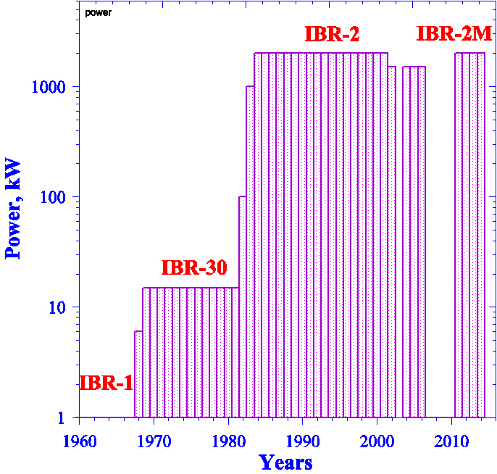
Pulsed reactors at the JINR Laboratory of Neutron Physics
1961 – 1968 IBR-1 (1 – 6 kW)
1969 – 1980 IBR-30 (15 kW)
1981 – 1983 IBR-2 (100 – 1000 kW)
1984 – 2006 IBR-2 (1500 – 2000 kW)
2007 – 2010 IBR-2 conversion
2011 – 204х IBR-2M (2000 kW)
W = 1 kW
Commissioned in June 1960.
https://flnp.jinr.int/en-us/main/about-laboratory/flnp-history

Slide 16
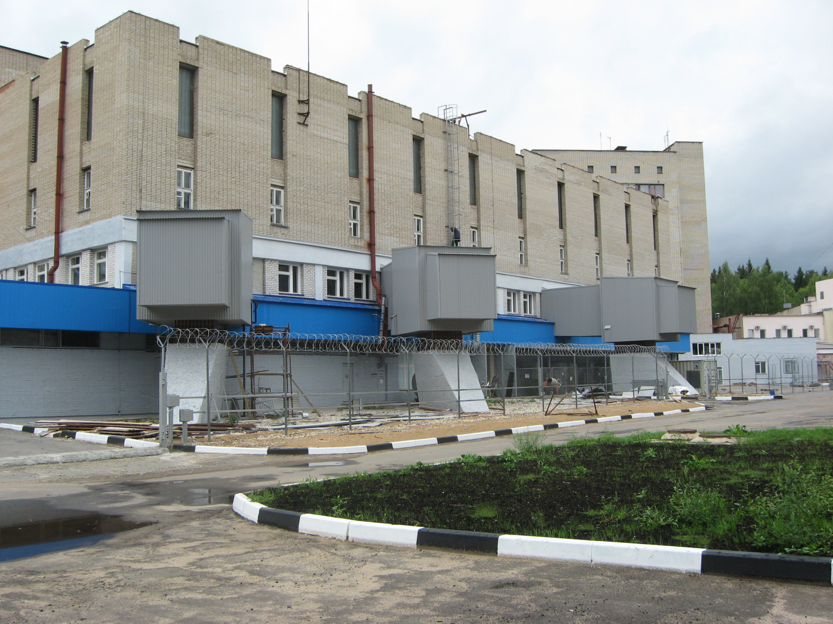
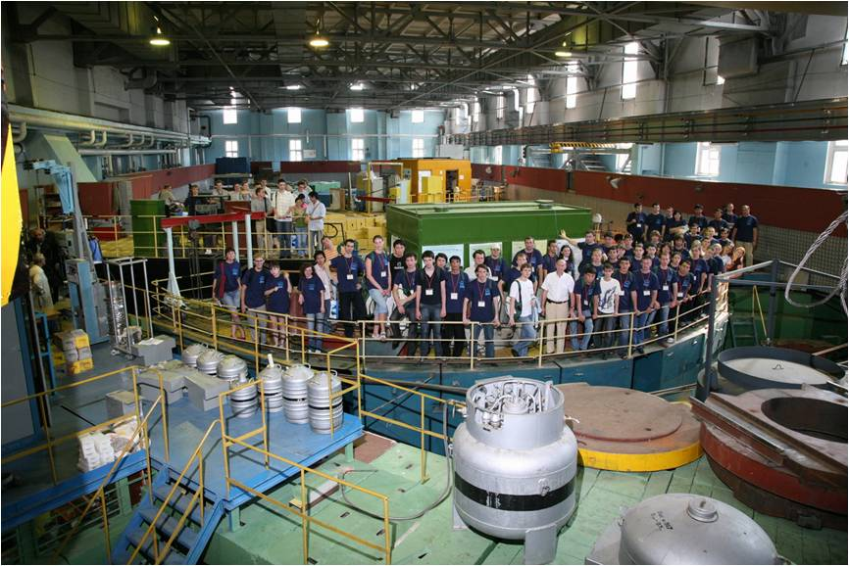
The building of the IBR-2 reactor
Experimental hall at the IBR-2 reactor

Slide 17

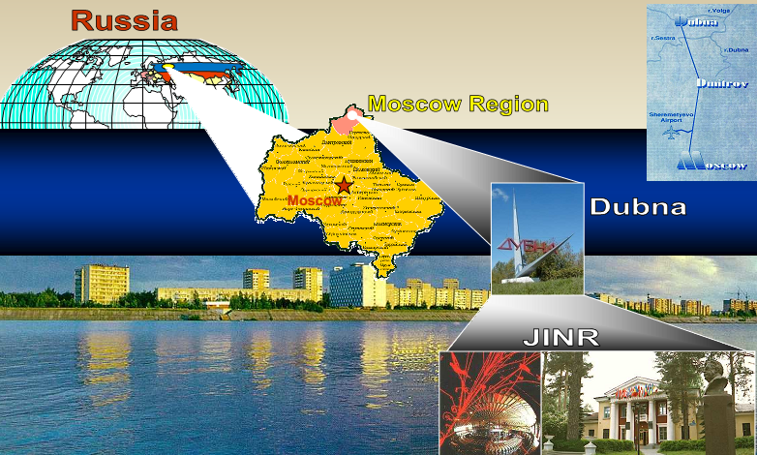
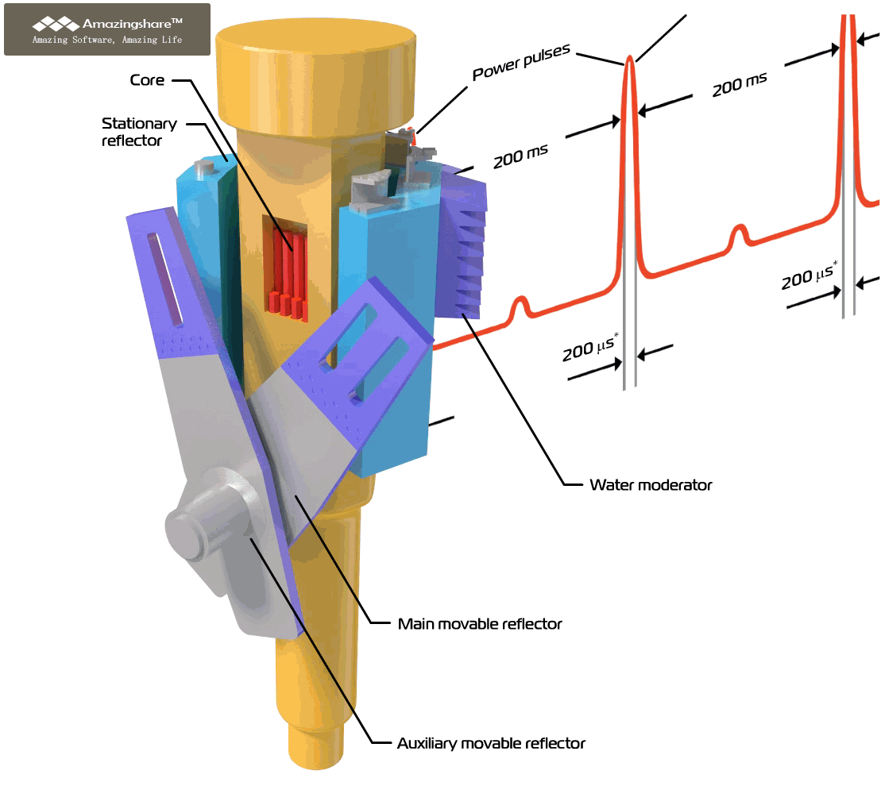
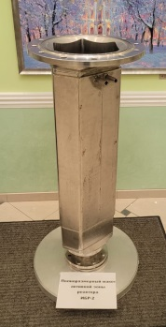
IBR-2 Pulsed Reactor
Operating since 1984
Average power, MW | 2
Fuel | PuO₂
Pulse repetition rate, Hz | 5
Pulse half-width, µs: fast neutrons thermal neutrons | 200* 340
Rotation rate, rev/min Main reflector Auxiliary reflector | 600 300
Background, % | 7.5
Thermal neutron flux density from the surface of the moderator Time average Burst maximum | ~10¹³ n/cm² s ~10¹⁶ n/cm² s
Deep modernization was carried out in 2006-2010
V_{AC}<20 l
October 16, 2021 - February 17, 2025 – reactor shutdown
Resumption of operation was done in March 2025
* at reactor power of 2MW
prepared by Dr. D. Chudoba

Slide 18

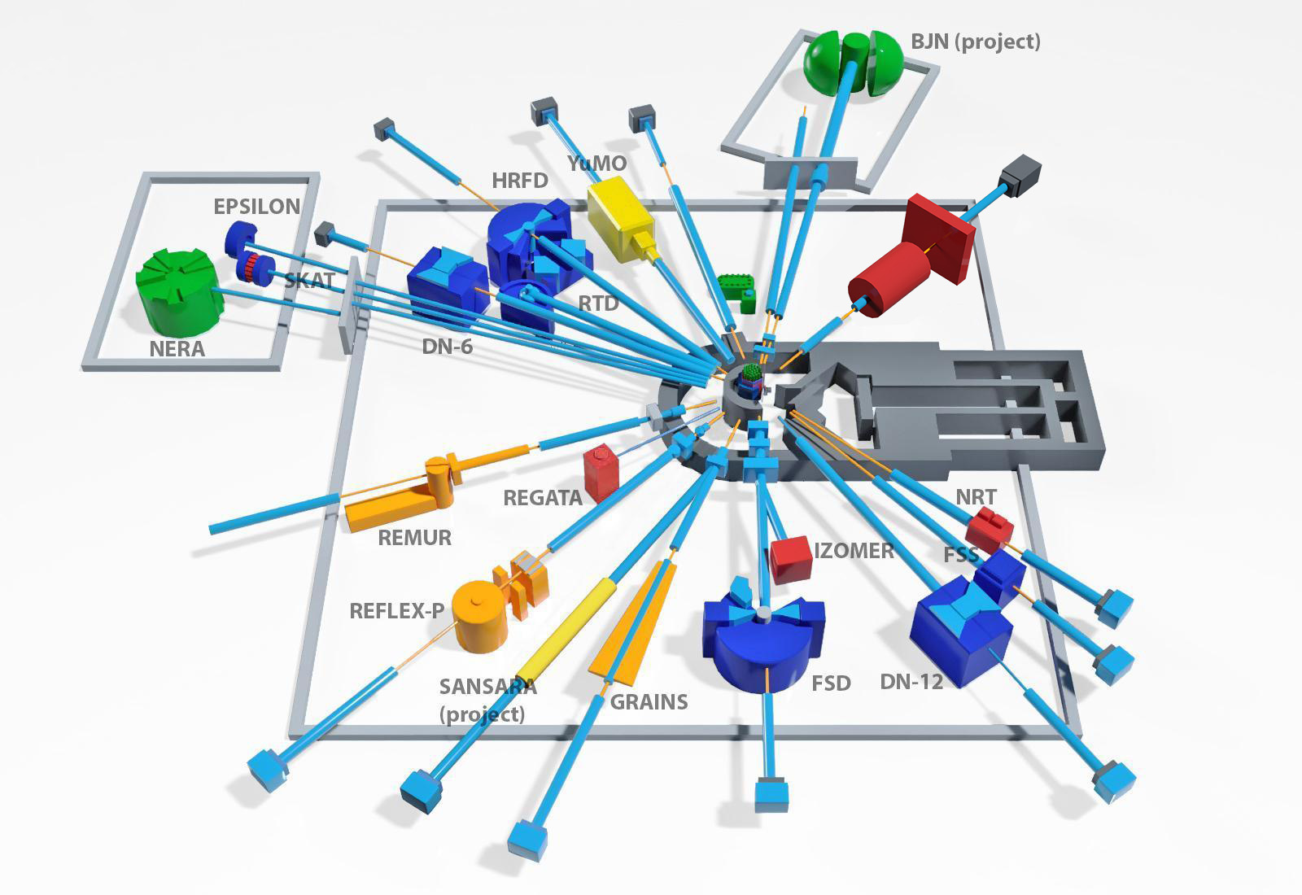


Neutron Instruments
17-14 INSTRUMENTS INCLUDED IN USER PROGRAM
Diffraction:
HRFD
RTD
DN-6
EPSILON
SKAT
DN-12
FSD
Small-Angle
YuMo
Reflectometry:
GRAINS
REMUR
REFLEX
Inelastic scattering:
NERA
NAA:
REGATA
Under construction:
SANSARA – small angle + imaging (2026)
BJN – inelastic scattering (2027)
Length of neutron guides – up to ~30 m in the experimental halls and up to ~100 m in two pavilions.
Typical neutron flux density on the sample – ~10⁶ cm⁻²s¹ (up to 4 x 10⁷ cm⁻²s¹)

Slide 19
FLNP User Program
Distribution of the beam time
In the FLNP JINR the neutron beam time at the high flux pulsed IBR-2 reactor is distributed between internal users (FLNP) and general science community (GSC) in the ratio of
35% (internal proposals)
55% (external regular proposals)
10% (external urgent beam time requests)
Who can apply for beam time?
Scientists from any country of the world
can apply for beam time.
Scientists from member states of JINR
get additional financial support.
https://ibr-2.jinr.int
I. Regular access applications
II. Fast access applications
NO DEADLINE
Submission – via FLNP scientific secretary
 | First round | Second round
Period for proposal submission | September 1 - October 15 | March 1 – April 15
Experiments time | 1 half-year | 2 half-year

Slide 20


FLNP User Program
The proposals are evaluated by Experts Committees (technical and scientific) and beam time for experiments is granted upon possibility of technical implementation and scientific merit of the proposal.
Scientific Experts Committees:
Nanosystems and Soft Matter (YuMO, GRAINS, REFLEX, REMUR, NRT)
Atomic and Magnetic Structure
(RTD, DN-6, DN-12, SKAT, EPSILON, FSD, HRFD)
Lattice and Molecular Dynamics (NERA)
Neutron Activation Analysis (REGATA)
Detailed information could be found at:
Sidorov N.E., Chudoba D.M., Gorshkova Yu.E., Kochnev P.O., Sadovsky D.A. “User program for the neutron source reactor IBR-2 (FLNP JINR)” Physics of Particles and Nuclei Letters, ISSN 1547-4771, 2024, Vol. 21, No. 3, pp. 553–559.

Slide 21
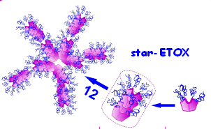
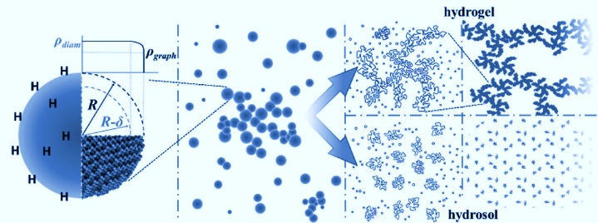
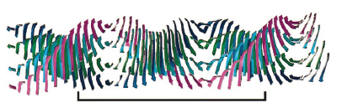
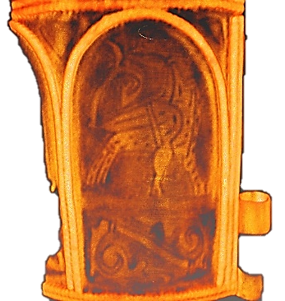
The priority research directions at the IBR-2 instruments:
Condensed Matter Physics and Materials Science;
Physics of Nanosystems and Nanoscale Phenomena;
Physics of Complex Liquids and Polymers;
Biophysics and Pharmacology;
Applied Materials and Engineering Sciences.

Slide 22

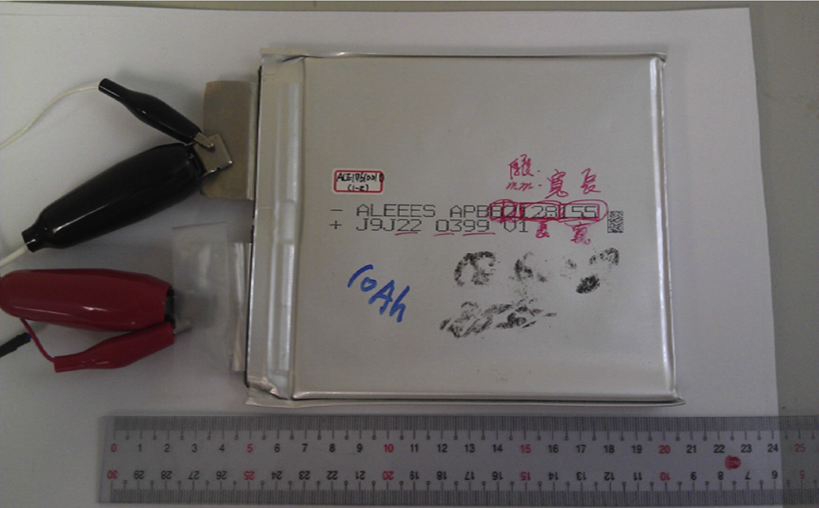
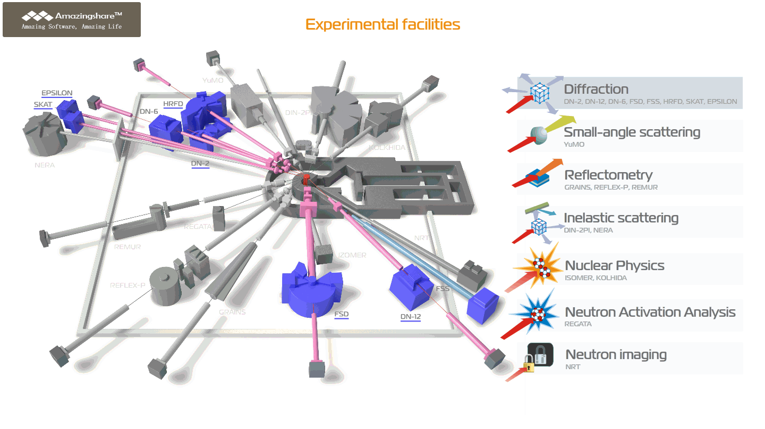
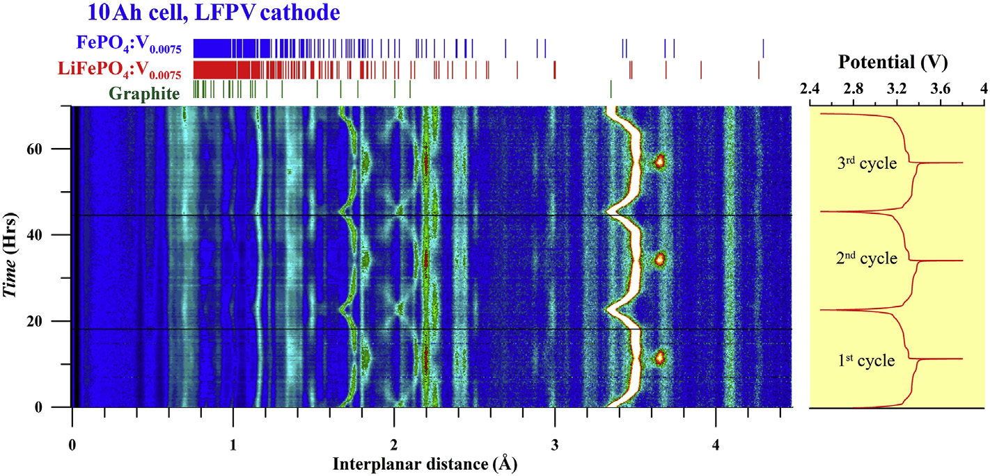
Neutron scattering in condensed matter physics
Diffraction
Crystal and magnetic structure of novel materials under ambient and extreme conditions
Real-time studies of Li-based accumulators
Phase transitions of H-based storage alloys
Crystallographic texture of metals, rocks and biological objects
Strain measurements in structural materials
2D van der Waals magnetic materials
Diffractometers equipped with Fourier choppers to achieve high resolution at short beamlines with long pulse of the reactor

Slide 23
Experimental possibilities of IBR-2 spectrometers complex спектрометров
Spectrometer, Instrument | Applications | Basic parameters | Specific features
Neutron diffraction
HRFD | Investigations of crystalline and magnetic structures of polycrystalline samples, as well as their microstructure under external influences | High resolution mode: d_{hkl} range – 0.4 - 5 Å, resolution Δd_{hkl}/d_{hkl} ≈ 0.0015 Medium resolution mode: d_{hkl} range – 0.5 - 14 Å, resolution Δd_{hkl}/d_{hkl} ≈ 0. 015 Temperature range: 5 - 1350 К | Sample volume: 0.1÷4 cm³
RTD | Analysis of crystalline and magnetic structures of materials, investigation of biological samples, kinetics of chemical reactions, structural and magnetic phase transitions in real time mode, diffuse scattering in defective crystals | d_{hkl} range: 0.6 – 30 Å, resolution Δd_{hkl}/d_{hkl} ≈ 0.01 Temperature range: 2.5 - 1400 К | Minimum sample volume: polycrystal – 0.3 cm³, single crystal – 0.1 mm³. Characteristic spectrum measurement time in real time mode – from 1 s to 10 min (depending on sample volume)
DN-6 | Determination of parameters of atomic and magnetic structure of functional materials under ultra-high pressures and low temperatures | d_{hkl} range: 1.0 – 12 Å, resolution Δd_{hkl}/d_{hkl} ≈ 0.025 Pressure range: 0 - 9 GPa (high-pressure cells with sapphire anvils), 0 - 35 GPa (high-pressure cells with diamond anvils) Temperature range: 5 - 300 К | Investigations of microsamples with a volume of about 2-3 mm³ (high-pressure cells with sapphire anvils), 0.05-0.1 mm³ (high-pressure cells with diamond anvils)
DN-12 | Determination of parameters of atomic and magnetic structure of functional materials under high pressures and low temperatures | d_{hkl} range: 1.0 - 12 Å, resolution Δd_{hkl}/d_{hkl} ≈ 0.02 Pressure range: 0 - 5 GPa (high-pressure cells with sapphire anvils) Temperature range: 15-300 К | Investigations of microsamples with a volume of about 2-3 mm³ (high-pressure cells with sapphire anvils)
FSD | Non-destructive testing of internal mechanical stresses in industrial products, study of mechanical properties, deformations and microdeformations in crystalline materials | d_{hkl} range: 0.5 - 4 Å, resolution Δd_{hkl}/d_{hkl} ≈ 0.0023 Testing machine LM-29 for in situ sample studies under external load (up to 29 kN) and high temperatures (up to 800°С) | Scanning of residual stresses in bulk samples with a minimum gauge volume of 2х2х2 mm Linear size of samples – up to 0.3 m
SKAT | Measurements of crystallographic texture in specimens of structural materials, as well as geological and biological samples | d_{hkl} range: 0.7 - 5 Å, resolution Δd_{hkl}/d_{hkl} ≈ 0.005 | Sample volume: 8÷100 cm³
Epsilon | Investigation of stresses, strains, and textures in geological, metallic, and ceramic samples | d_{hkl} range: 0.7 - 6.5 Å, resolution Δd_{hkl}/d_{hkl} ≈ 0.004 Uniaxial compression machine with F_{max} = 100 kN (150 MPa) | Sample volume: 2÷42 cm³

Slide 24
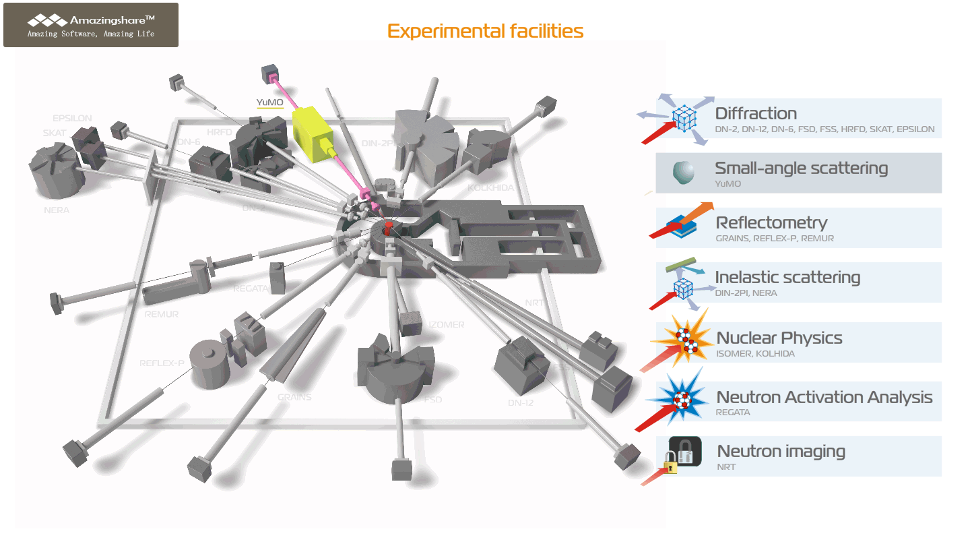
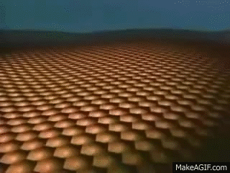
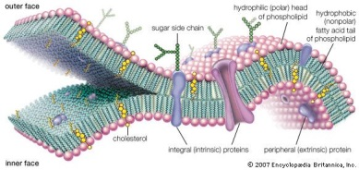
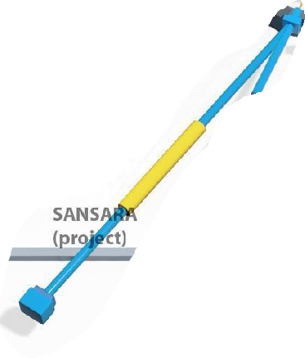
Neutron scattering in condensed matter physics
Small Angle Scattering
Small Angle Scattering
BLSs
SULVs
EULVs
Structural organization and aggregation of nanoparticles and composite systems
Interactions of nanoparticles with bio-macromolecules
Nanopores for magnetic and biomedical applications
Applications | Basic parameters | Specific features
Determination of sizes, shapes, spatial correlations of particles, agglomerates, pores, as well as fractal dimension in nanomaterials, biological objects, polymers, colloidal solutions | Q-range: 7x10⁻³ - 0.5 Å⁻¹ Temperature range: 10-180°С | Characteristic particle size that can be identified: 1-500 nm Minimum sample volume: 500 µl Characteristic sample size is up to 1.4 cm in diameter

Slide 25
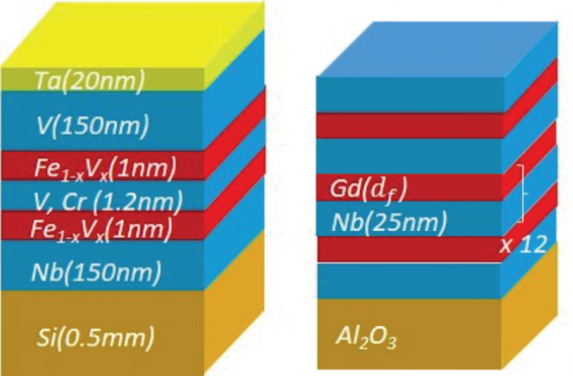
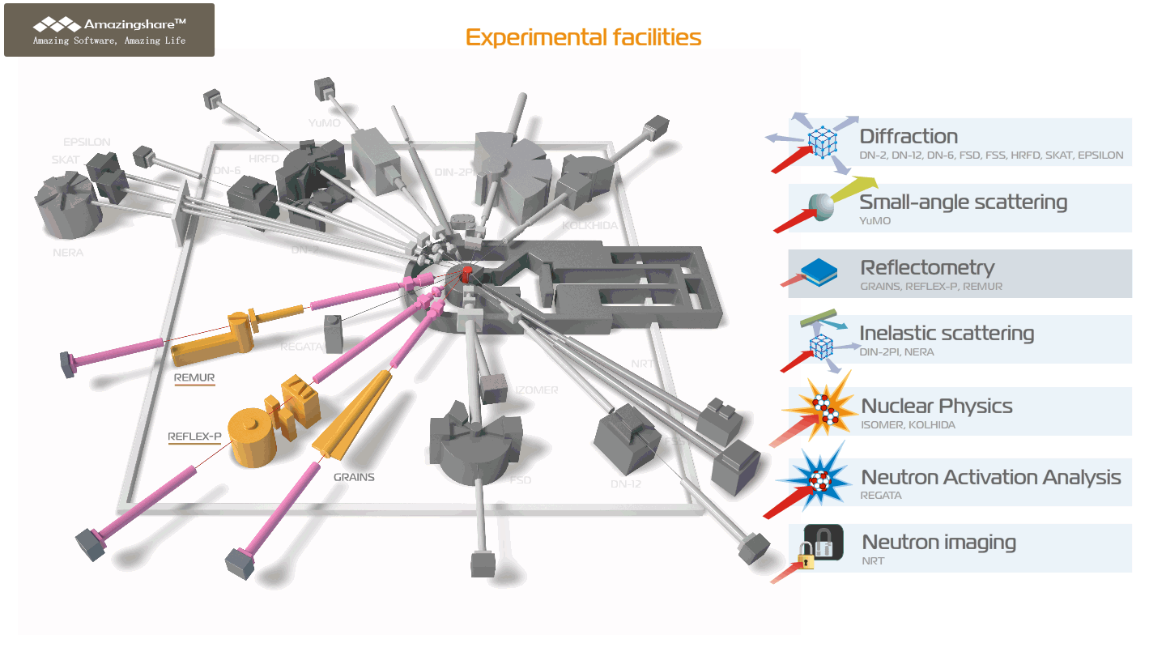
Neutron scattering in condensed matter physics
Reflectometry
Thin films and surfaces
Surface adsorption of magnetic nanoparticles
Superconducting and magnetic properties of the complex layered heterostructures
Spectrometer, Instrument | Applications | Basic parameters | Specific features
REMUR | Determination of parameters of magnetic and superconducting heterostructures, nonmetallic thin films | Q-range: 0.001 - 2 nm⁻¹, resolution ΔQ/Q ≈ 1 % Temperature range: 1.5 - 300 К Magnetic field on the sample: up to 1.5 T | Minimum surface area of ​​the sample – 5x5 mm², thickness of layers accessible for research – 0.5-500 nm, roughness – ~1 nm
REFLEX | Determination of structural parameters of thin-film nanostructures | Q-range: 0.01 - 1.3 nm⁻¹, resolution ΔQ/Q ≈ 1 - 15 % Temperature range: 1.5 - 300 К Magnetic field on the sample: up to 0.5 T | Minimum surface area of ​​the sample – 20x20 mm², thickness of layers accessible for research – 2-500 nm, roughness – ~3 nm
GRAINS | Determination of structural parameters of interfaces with “soft” and liquid media | Q-range: 0.05 - 1.0 nm⁻¹, resolution ΔQ/Q ≈ 5 %. Temperature range: 10 - 150°С | Minimum surface area of ​​the sample – 5x5 cm, maximum interface thickness – 100 nm, roughness – up to 5 nm (at a thickness of 100 nm)

Slide 26
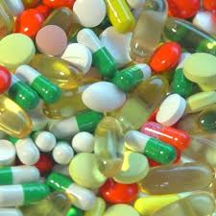
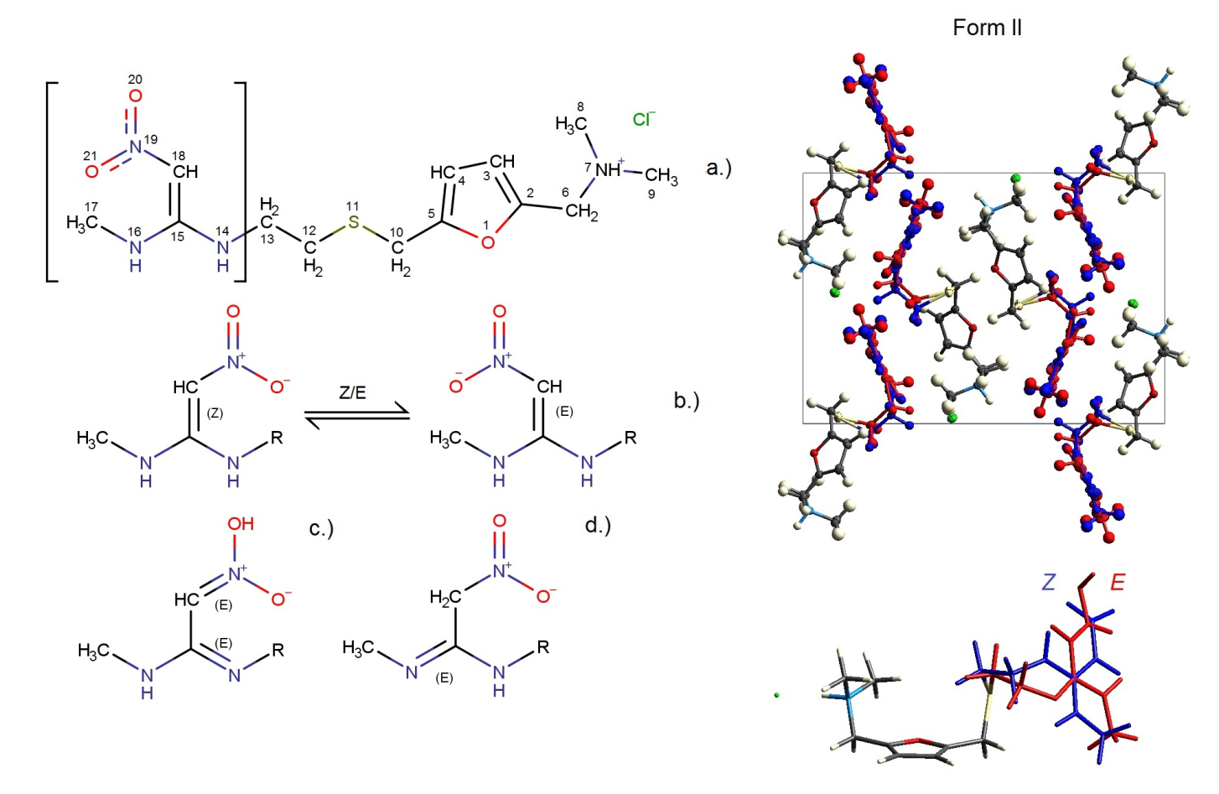
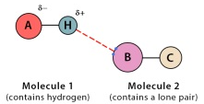
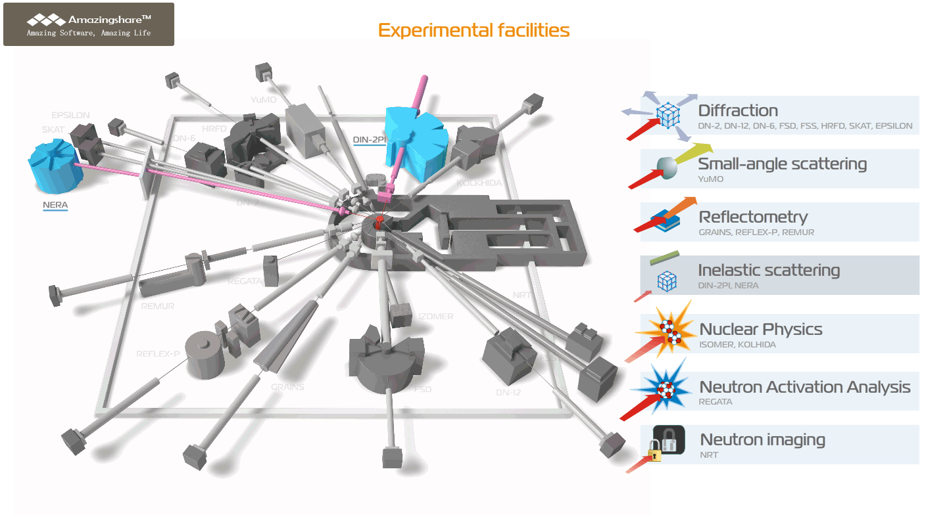
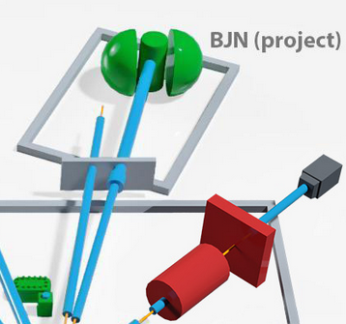




Neutron scattering in condensed matter physics
Inelastic Scattering
Molecular structure and dynamics
Isomeric forms of drugs
Drug delivery systems
Applications | Basic parameters | Specific features
Investigation of atomic and molecular dynamics of hydrogen-containing compounds, including pharmacological substances, analysis of the effect of phase polymorphism | Energy transfer range: 1 - 160 meV Resolution ΔE/E ≈ 2- 4% Temperature range: 4 - 300 К | Sample volume is about 4-5 cm³

Slide 27




Neutron radiography and tomography station (NRT)
Research of internal structure of objects
Processes of water penetration into materials
NRT

Slide 28










Nuclear analytical method
Neutron Activation Analysis
Elemental composition analysis of air, water, and soil or objects of cultural heritage
blood
brain
liver
lungs
kidneys

Slide 29

FLNP offers a large suite of equipment for comprehensive study of samples by complementary techniques
It includes:
Xeuss 3.0 X-ray scattering station;
X-ray Diffractometer EMPYREAN
(PANalytical);
Coherent Anti-Stokes Raman Spectrometer
Raman spectrometers;
IR and UV spectrometers;
RFA;
ICP-MS
Chromatography System
NGC Quest™ 10 Plus
AFMs
…etc.
https://flnp.jinr.int/images/box-slider/Laboratory_Equipment_DNICM_FLNP_JINR_2021.pdf

Slide 30
Main activities in the field of nuclear physics with neutrons:
Investigations of the neutron induced nuclear reactions:
fundamental symmetries;
highly excited states of the nuclei;
nuclear fission;
nuclear data.
Investigations of the fundamental properties of the neutron, ultra-cold neutrons:
tests of quantum mechanics;
search for new type of interactions;
neutron lifetime measurement.
Applied and methodical research:
neutron activation analysis and others nuclear technics for isotope analysis;
neutron in space;
Ion beam analysis:
IREN developing.

Slide 31

Source of resonance neutrons IREN based at lineal electron accelerator
https://flnp.jinr.int/en-us/main/facilities/iren
The linear electron accelerator LUE-200 used as a driver for the intense resonance neutron source IREN. The accelerator is positioned vertically. It consists of a pulsed electron gun, an accelerating system, microwave power sources based on 10-cm klystrons with modulators, a focusing-beam transport system, a diagnostics system with a broadband magnetic spectrometer and a vacuum system.
Peak current (A) | 3
Repetition rate (Hz) | 50
Electron pulse duration (ns) | 100
Electron energy (MeV) | 110
Beam power (kW) | 1.5
Multiplication | 1
Neutron intensity (n/s) | ~3x10¹¹
1200 hours/year

Slide 32






  D-T generator for tagged neutron technique (TANGRA Project)
https://flnp.jinr.int/en-us/main/facilities/tangra-project-en
In 2024 γ-ray emission cross sections for light elements was measured: B, C, N, O, F, Na, Mg, Al, Si, P, S, Cl, K, Ca, Ti, V, Cr, Mn, Fe, Co, Ni, Cu, Zn, Sn.
yield up to 10⁸ c⁻¹
Set of NaI(Tl) detectors
Set of BGO detectors
Set of LaBr detectors
Set of detectors based on different plastics
HPGe detector
Gamma-spectra and angular distributions of gamma ray have been measured in inelastic neutron scattering reactions for 20 nuclei.
32

Slide 33


EG-5
https://flnp.jinr.int/en-us/main/facilities/eg-5
Electrostatic Van de Graaff accelerator, was built in 1965.
The installation remains in demand today.
The characteristics of EG-5 Accelerator:
Energy region | 0.9 – 3.5 MeV
Beam intensity for 𝐻+ | 30 μA
Beam intensity for 𝐻𝑒+ | 10 μA
Energy spread | < 500 eV
Number of beam lines | 6
600 hours/year
Plan of modernization 2023-2026:
Before modernization | After modernization
Terminal voltage - 2,5 MV Beam current – 100nA Ion Energy – 2,5 MeV | Terminal voltage - 4,1 MV Beam current – 50-100mkA Ion Energy – 4,1 MeV

Slide 34









Development of neutron instruments elements :
Neutron detectors:
gaseous and scintillator neutron detectors;
development of the technology of thin film B₄C coverage;
detector electronics.
Tools for instrument development and optimization:
simulation of instruments;
sample environment systems
software.
Developing of cold moderators:
developing of exist moderators' cryogenic system ;
developing of methane-based moderator.

Slide 35






New back scattering detector
Experimental site for neutron detector production
New large aperture ZnS scintillator detector system covering scattering angles range 2θ = 133-175°, installed at the HRFD diffractometer.
Spattering machine for B₄C coverage
Ferry Vatt company, Kazan, Russia
Max. coverage square 400х1200 mm²
Modern equipment and engineer systems
Ω, sr2
The surface of scintillator S > ${\text{10} m}^{2}$
The approximate length of fibers L=36000 m
Photomultipliers : 216

Slide 36
Thank you for attention
and
we invite you to joint research

