Slide 1
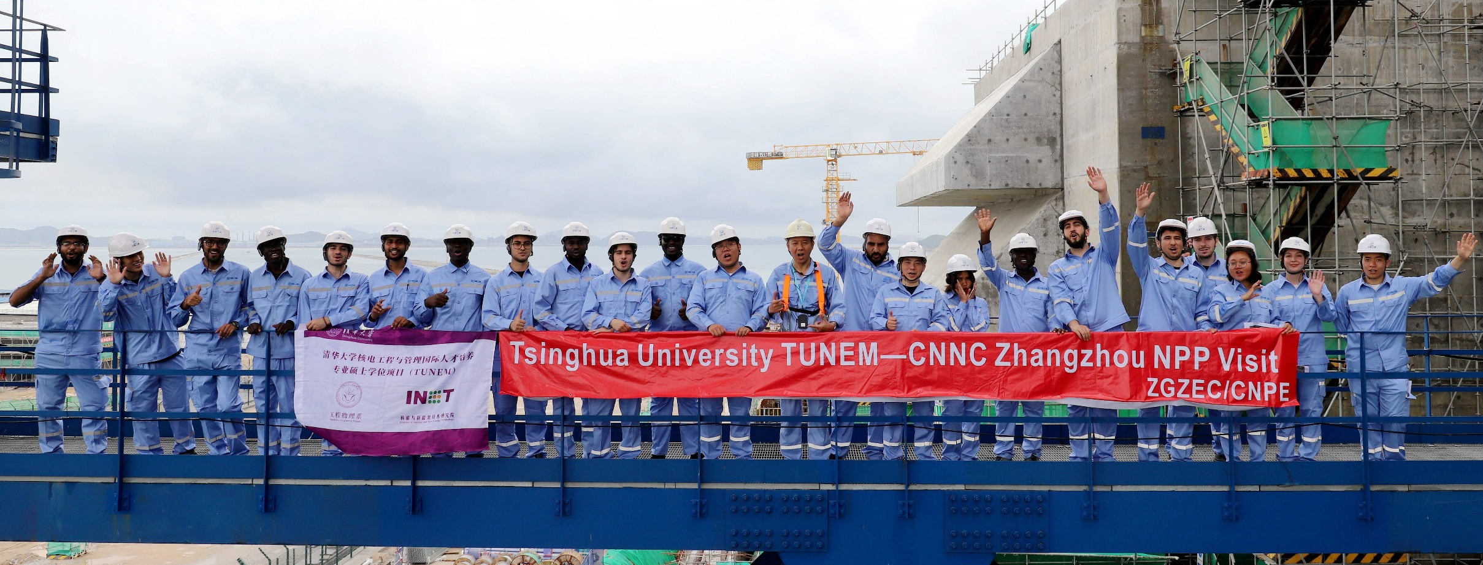
Introduction to
2025
TSINGHUA UNIVERSITY INTERNATIONAL MASTER’S PROGRAM
IN NUCLEAR ENGINEERING AND MANAGEMENT (TUNEM)

Slide 2

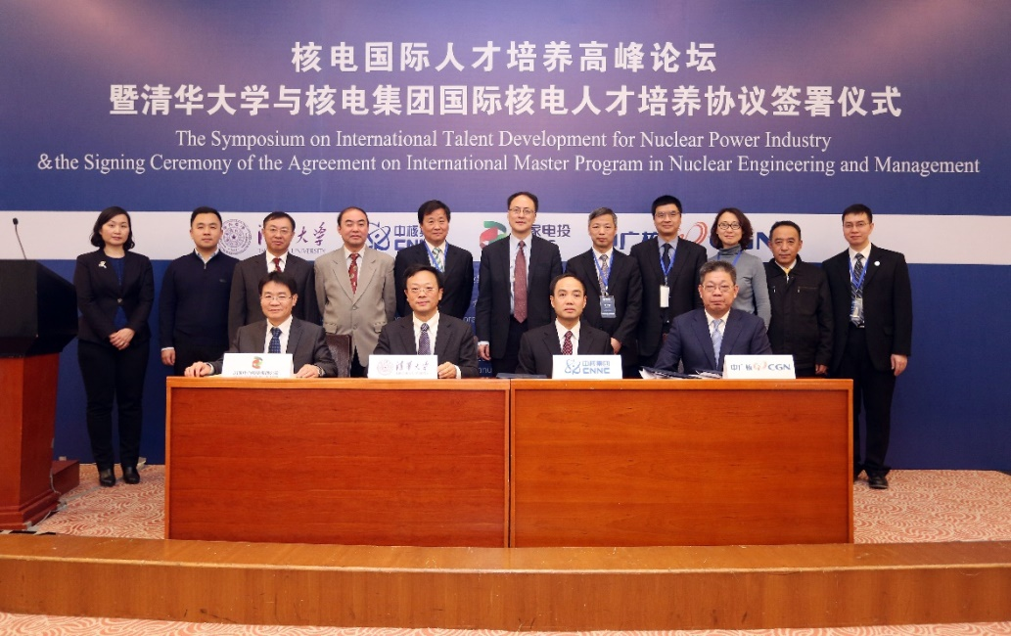

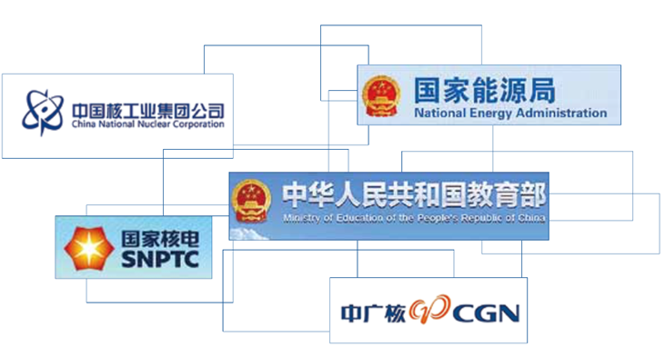


What is TUNEM
TUNEM is a 2-year international master’s program for training high-level engineering and management talents in the field of nuclear power.
Launched on Jan. 16, 2017

Slide 3
Features
Co-supported
by Tsinghua University and three nuclear power corporations
Job opportunity
Research project from nuclear corporation supervised by dual supervisors
A
F
Full scholarship
Chinese Government Scholarship, IAEA MSCFP honor & IAEA Fellowship
1/2 year internship
in China’s leading nuclear power corporations
B
E
C
D
Unique Cultural Experience
in China and with TUNEMers
from all over the world
Courses in English
Specially designed

Slide 4
Features
Co-supported
by Tsinghua University and three nuclear power corporations
Job opportunity
Research project from nuclear corporation supervised by dual supervisors
A
F
Full scholarship
Chinese Government Scholarship, IAEA MSCFP honor & IAEA Fellowship
1/2 year internship
in China’s leading nuclear power corporations
B
E
C
D
Unique Cultural Experience
in China and with TUNEMers
from all over the world
Courses in English
Specially designed

Slide 5
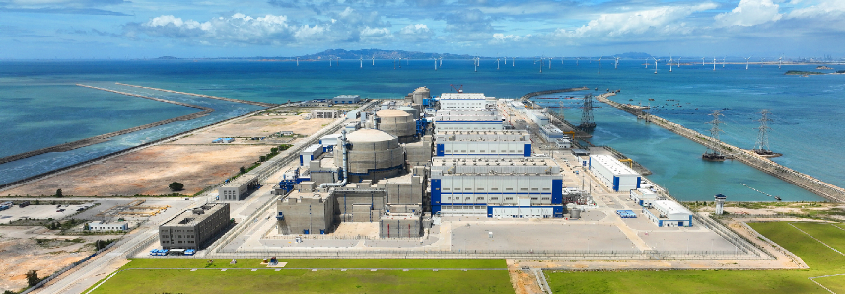


TUNEM
Support from nuclear power corporations
The three major nuclear power groups in China, i.e. China National Nuclear Corporation (CNNC), State Power Investment Corporation (SPIC) and China General Nuclear Power Corporation (CGN), represent the highest level of the use of Nuclear Power technology of China even of the world, by signing the Strategic Cooperation Agreement with them, TUNEM is able to bring its students to the forefront of the application of nuclear power technology.
With 30+ years’ experience of continuous NPP construction, CNNC becomes the main investor and the biggest owner of nuclear power plants in China.
SPIC is committed to global businesses. It has presence in 47 countries, with businesses covering power project investment, technical cooperation, EPC, etc.
CGN, the third largest nuclear power company of the world, has been participated actively in the nuclear power collaboration program with UK.
Notes:
原主文字因与第6页有重合，替换成新的表述

Slide 6
Features
Co-supported
by Tsinghua University and three nuclear power corporations
Job opportunity
Research project from nuclear corporation supervised by dual supervisors
A
F
Full scholarship
Chinese Government Scholarship, IAEA MSCFP honor & IAEA Fellowship
1/2 year internship
in China’s leading nuclear power corporations
B
E
C
D
Unique Cultural Experience
in China and with TUNEMers
from all over the world
Courses in English
Specially designed

Slide 7
TUNEM
Full scholarship
Tuition fees 78,000 RMB
Accommodation 27,400 RMB
Living expenses 108,000 RMB
Insurance 4,000 RMB
Chinese Government Scholarship (CGS) by China Scholarship Council
The three major nuclear power corporations in China also provide great support
Total (2-year): 217,400 RMB
about 30,299 USD/ 27,720 EUR
according to current exchange rate, the amount may subject to the CSC policy
Notes:
汇率已更新

Slide 8
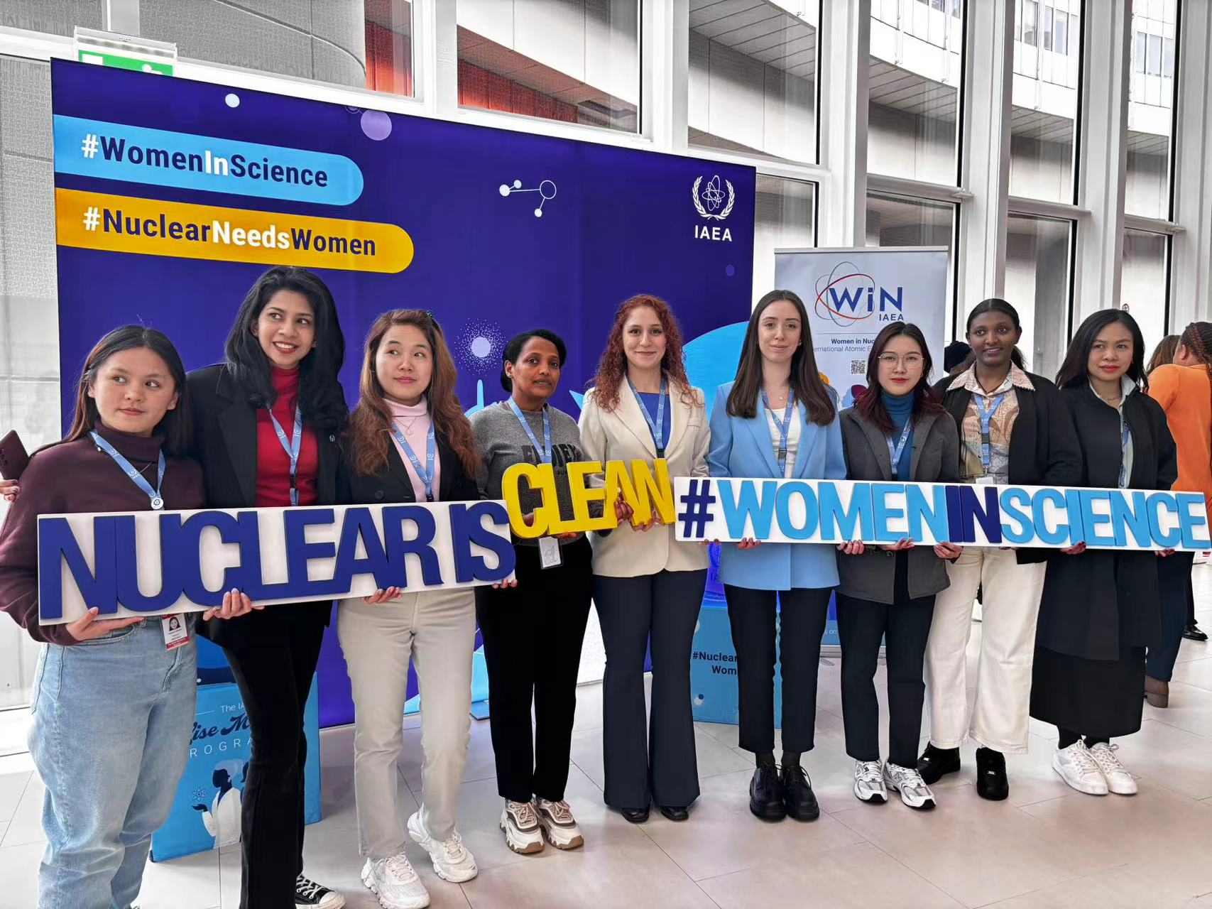
TUNEM
IAEA MSCFP
ABOUT IAEA Marie Sklodowska-Curie Fellowship Programme
Named after pioneer physicist and twice Nobel Prize laureate Marie Sklodowska-Curie, the Marie Sklodowska-Curie Fellowship Programme (MSCFP) aims to inspire and encourage young women to pursue a career in the nuclear field. Scholarships are awarded annually, with 150 female students selected per year.
Every year, China contributes 10 seats to MSCFP for international female students who pursue their master study in China. TUNEM is authorized to nominate its students to MSCFP. 15 students have been selected as the MSCFP recipients over the past 3 years.
Having been granted the Chinese Government Scholarship, TUNEM students who receive the MSCFP scholarship will not get extra financial support from the IAEA, but opportunities to pursue an internship facilitated by the IAEA for up to 12 months.
2022 & 2023 TUNEM IAEA MSCFP recipients
in the headquarter of IAEA
Notes:
汇率已更新

Slide 9
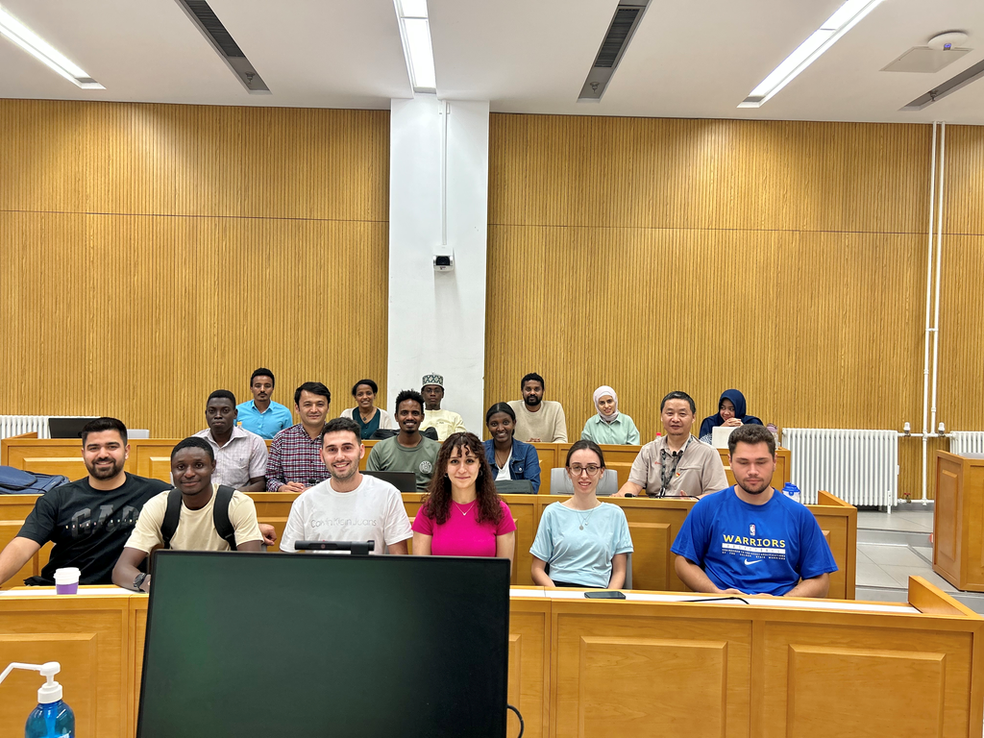
IAEA TECHNICAL
COOPERATION INT2025 FELLOWSHIP
TUNEM
Starting from 2024, TUNEM is authorized to recommend the admitted students from member states of IAEA TC projects for an IAEA fellowship aiming at contributing to reserving manpower for nuclear power projects for the member States.
The fellowship covers:
1. Return prepaid economy class e-tickets,
2. High-end medical insurance
All students from IAEA list countries, with their consent, are eligible to be nominated by Tsinghua University to IAEA.
There were 12 students in the class of 2024 and 15 students in the class of 2025 who have received the fellowship.
Notes:
汇率已更新

Slide 10
Features
Co-supported
by Tsinghua University and three nuclear power corporations
Job opportunity
Research project from nuclear corporation supervised by dual supervisors
A
F
Full scholarship
Chinese Government Scholarship, IAEA MSCFP honor & IAEA Fellowship
1/2 year internship
in China’s leading nuclear power corporations
B
E
C
D
Unique Cultural Experience
in China and with TUNEMers
from all over the world
Courses in English
Specially designed

Slide 11
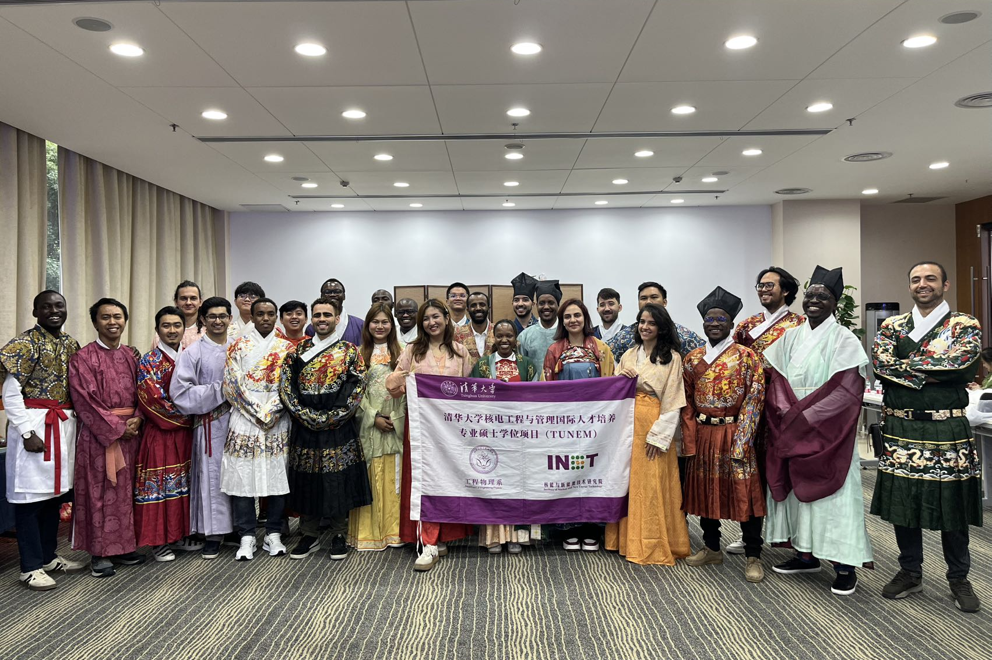

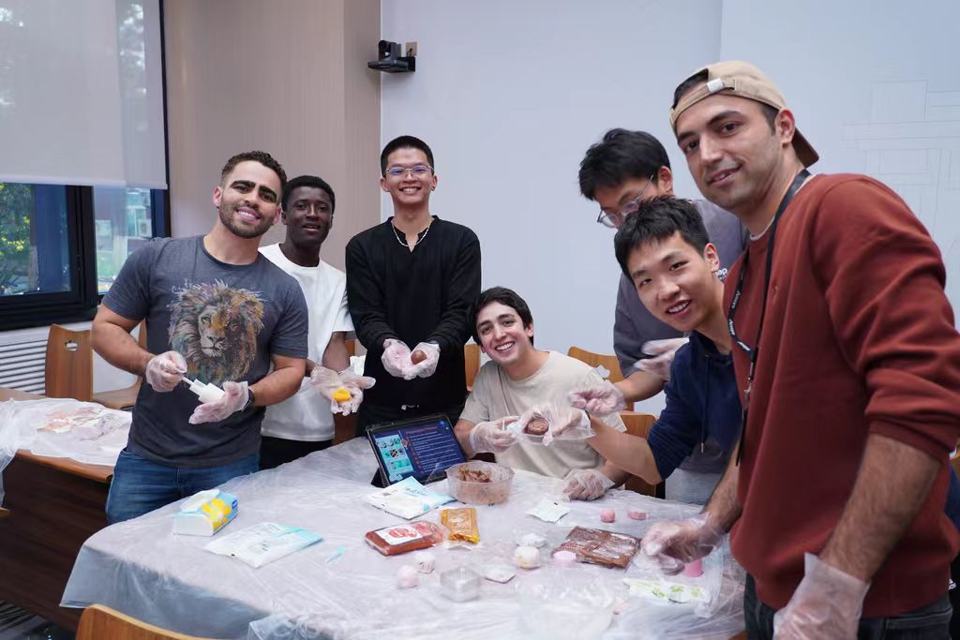
TUNEM
Unique cultural experience in China
The program specially designs Chinese language and culture courses though it’s an English program, Chinese knowledge and culture will be helpful for students’ career development.
In order to well understand Chinese culture, the program provides on-spot investigation and various exchange activities.
Ancient Chinese Traditional Dress
International Cultural Festival
Mid-Autumn Festival

Slide 12

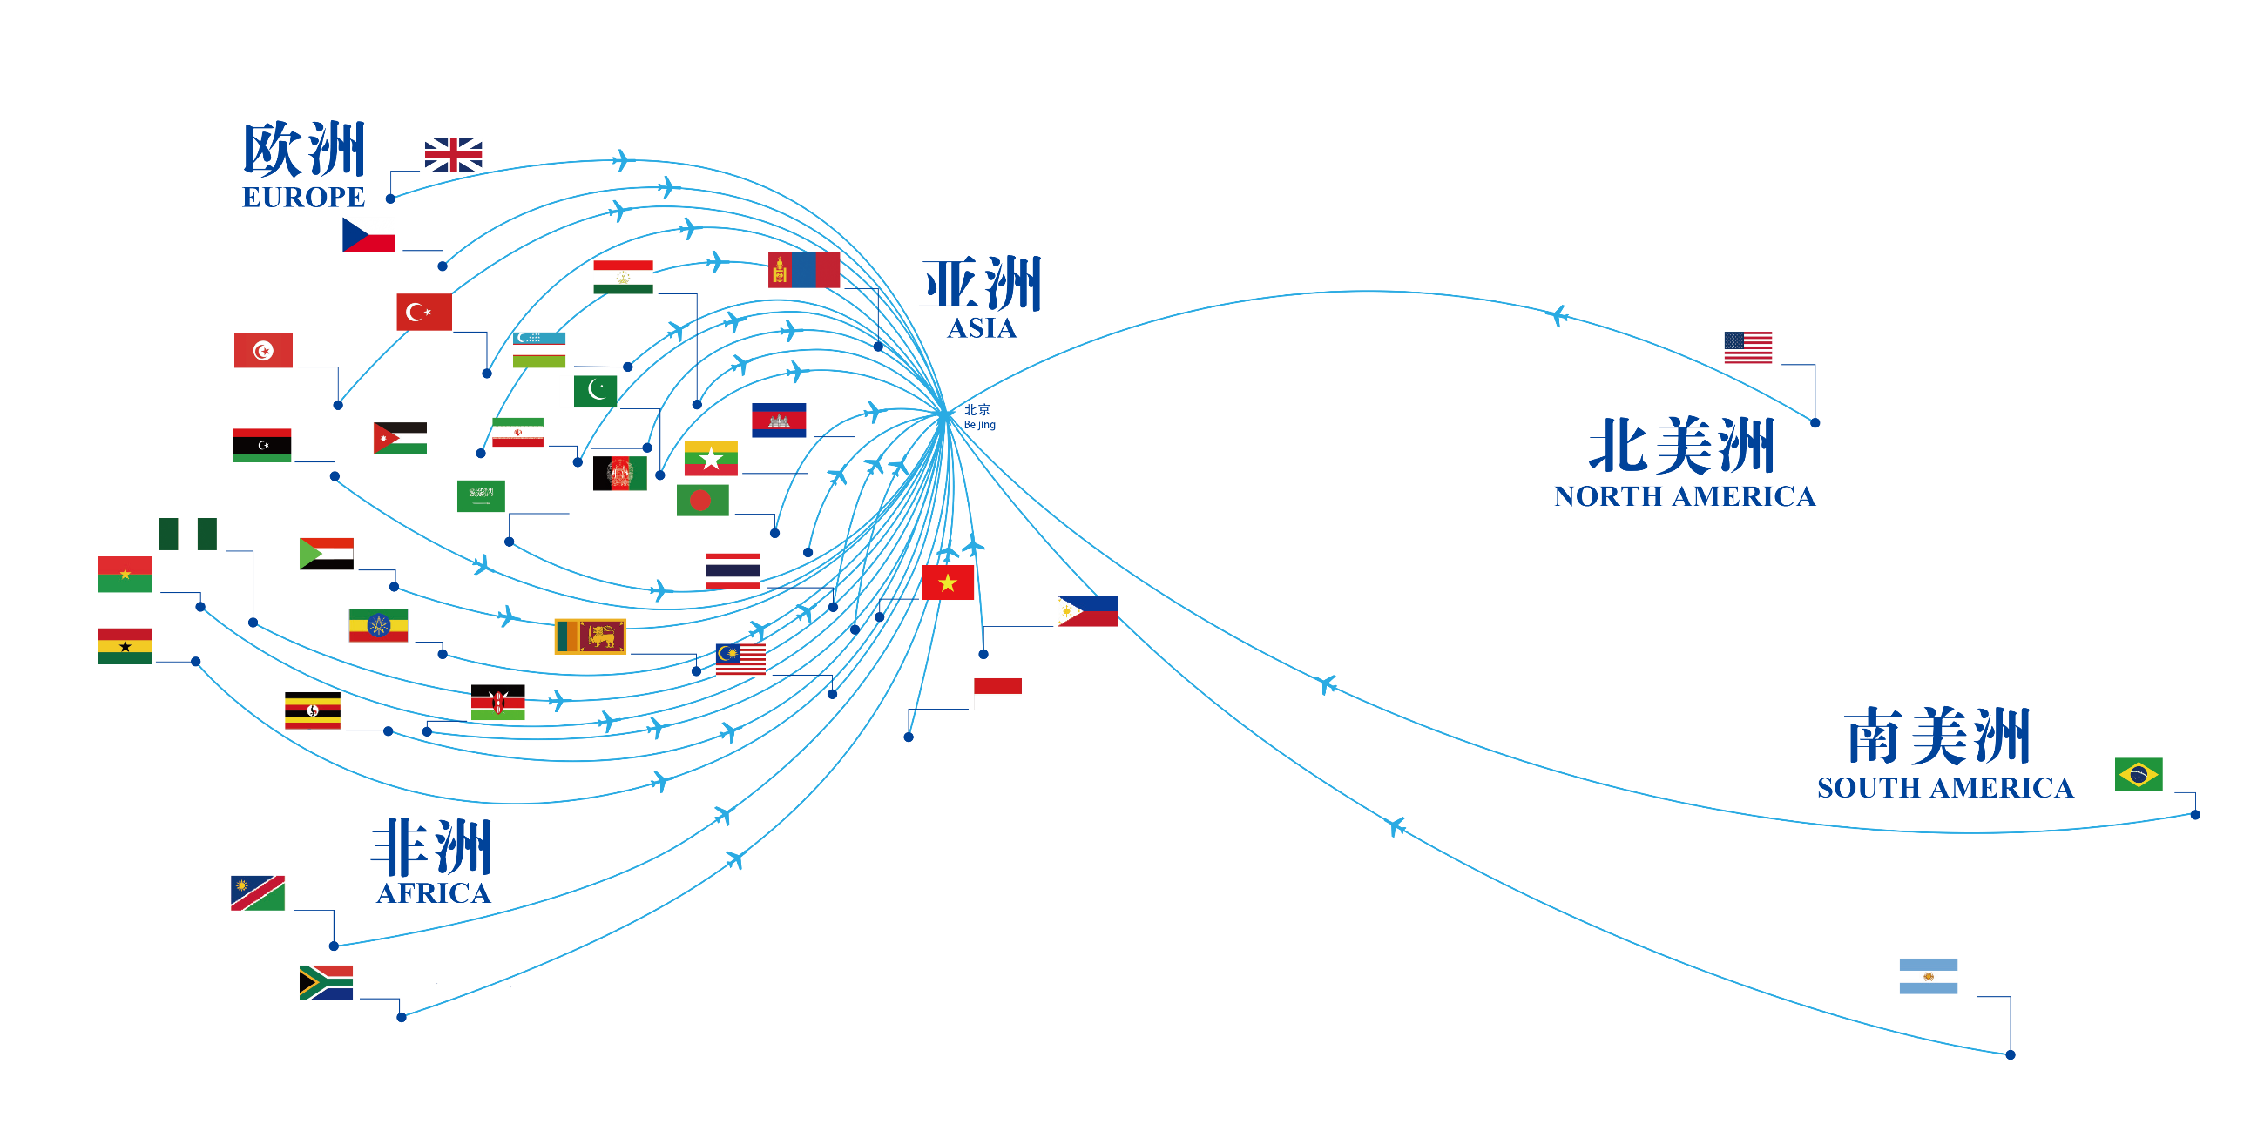
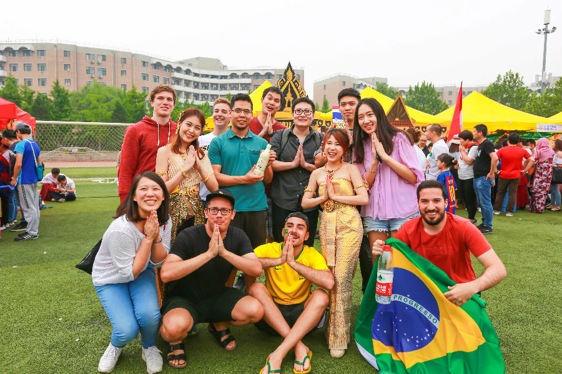
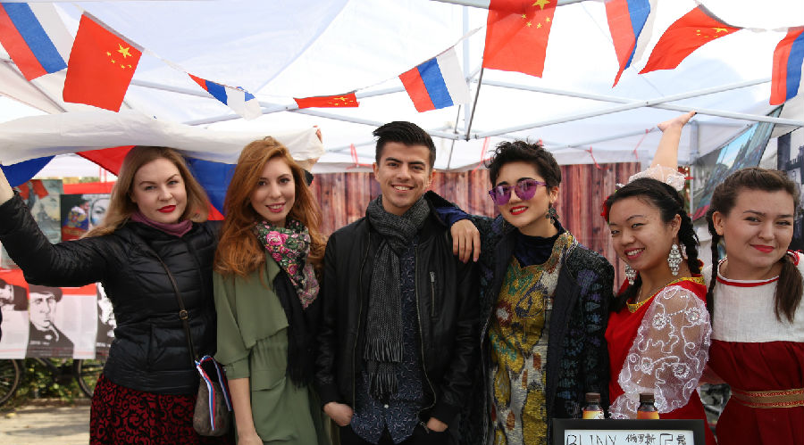
Cultural exchange with TUNEMers
from different countries
TUNEM
In the last 9 years, there were 219 TUNMers from 37 countries.

Slide 13
Features
Co-supported
by Tsinghua University and three nuclear power corporations
Job opportunity
Research project from nuclear corporation supervised by dual supervisors
A
F
Full scholarship
Chinese Government Scholarship, IAEA MSCFP honor & IAEA Fellowship
1/2 year internship
in China’s leading nuclear power corporations
B
E
C
D
Unique Cultural Experience
in China and with TUNEMers
from all over the world
Courses in English
Specially designed

Slide 14
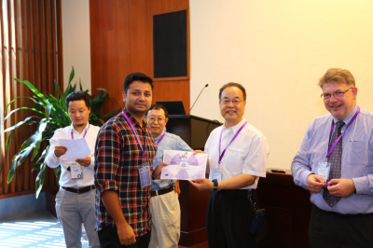
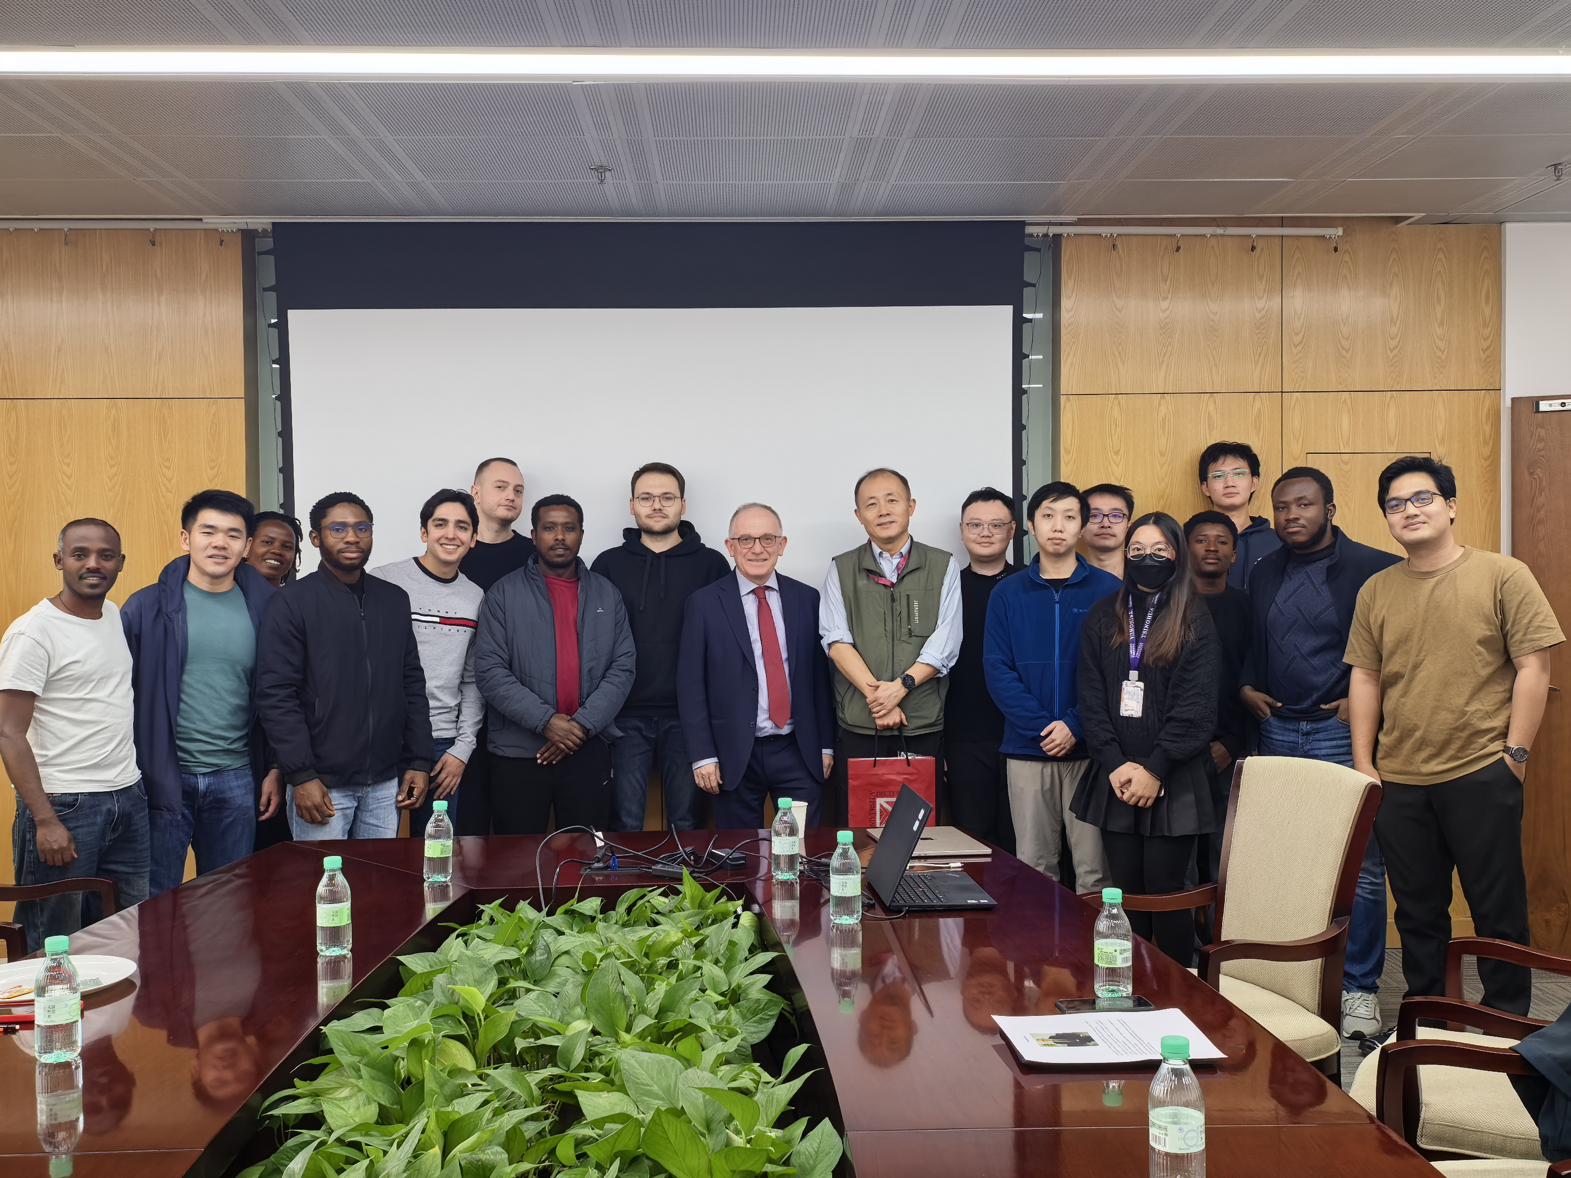
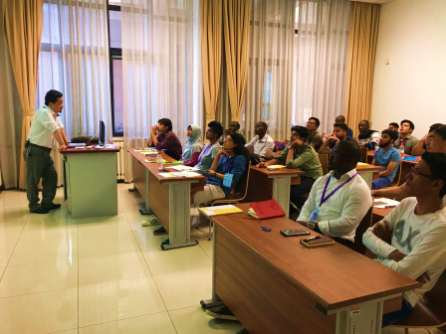
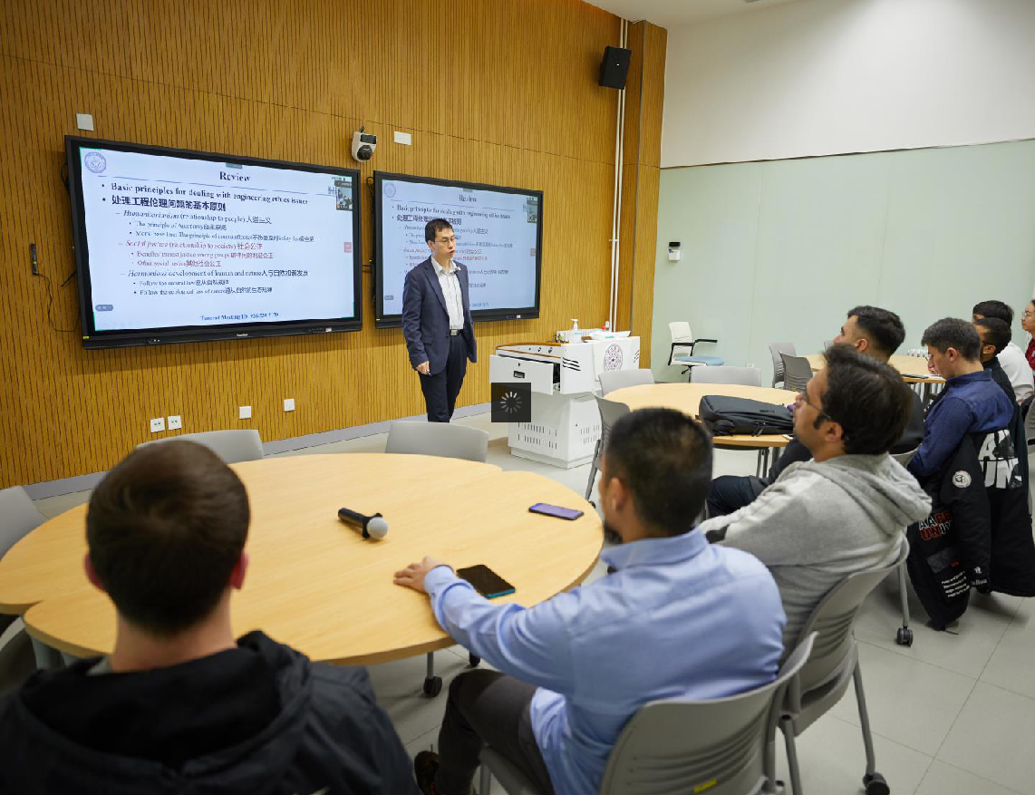
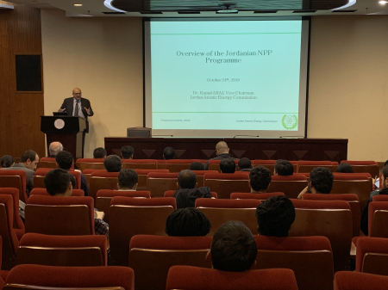
TUNEM
Professional Courses in English
Principle of Nuclear Reactor Engineering
Nuclear Physics and Reactor Theory
Introduction to Nuclear Reactor Engineering
Principles and Engineering Applications of Radiation Protection
Nuclear Safety and Public Communication
Safety Analysis of Nuclear Power Plant
Computational Fluid Dynamics in Nuclear Engineering
Advanced Nuclear Energy System, Design and Management
Management Information System
High Temperature Gas Cooled Reactor Technology
Ethics in Nuclear Engineering

Slide 15
Features
Co-supported
by Tsinghua University and three nuclear power corporations
Job opportunity
Research project from nuclear corporation supervised by dual supervisors
A
F
Full scholarship
Chinese Government Scholarship, IAEA MSCFP honor & IAEA Fellowship
1/2 year internship
in China’s leading nuclear power corporations
B
E
C
D
Unique Cultural Experience
in China and with TUNEMers
from all over the world
Courses in English
Specially designed

Slide 16
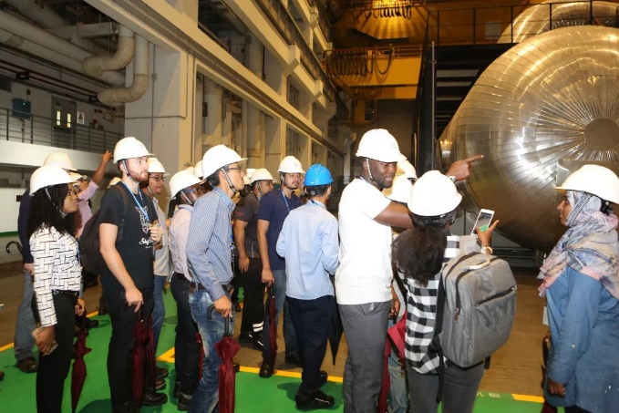
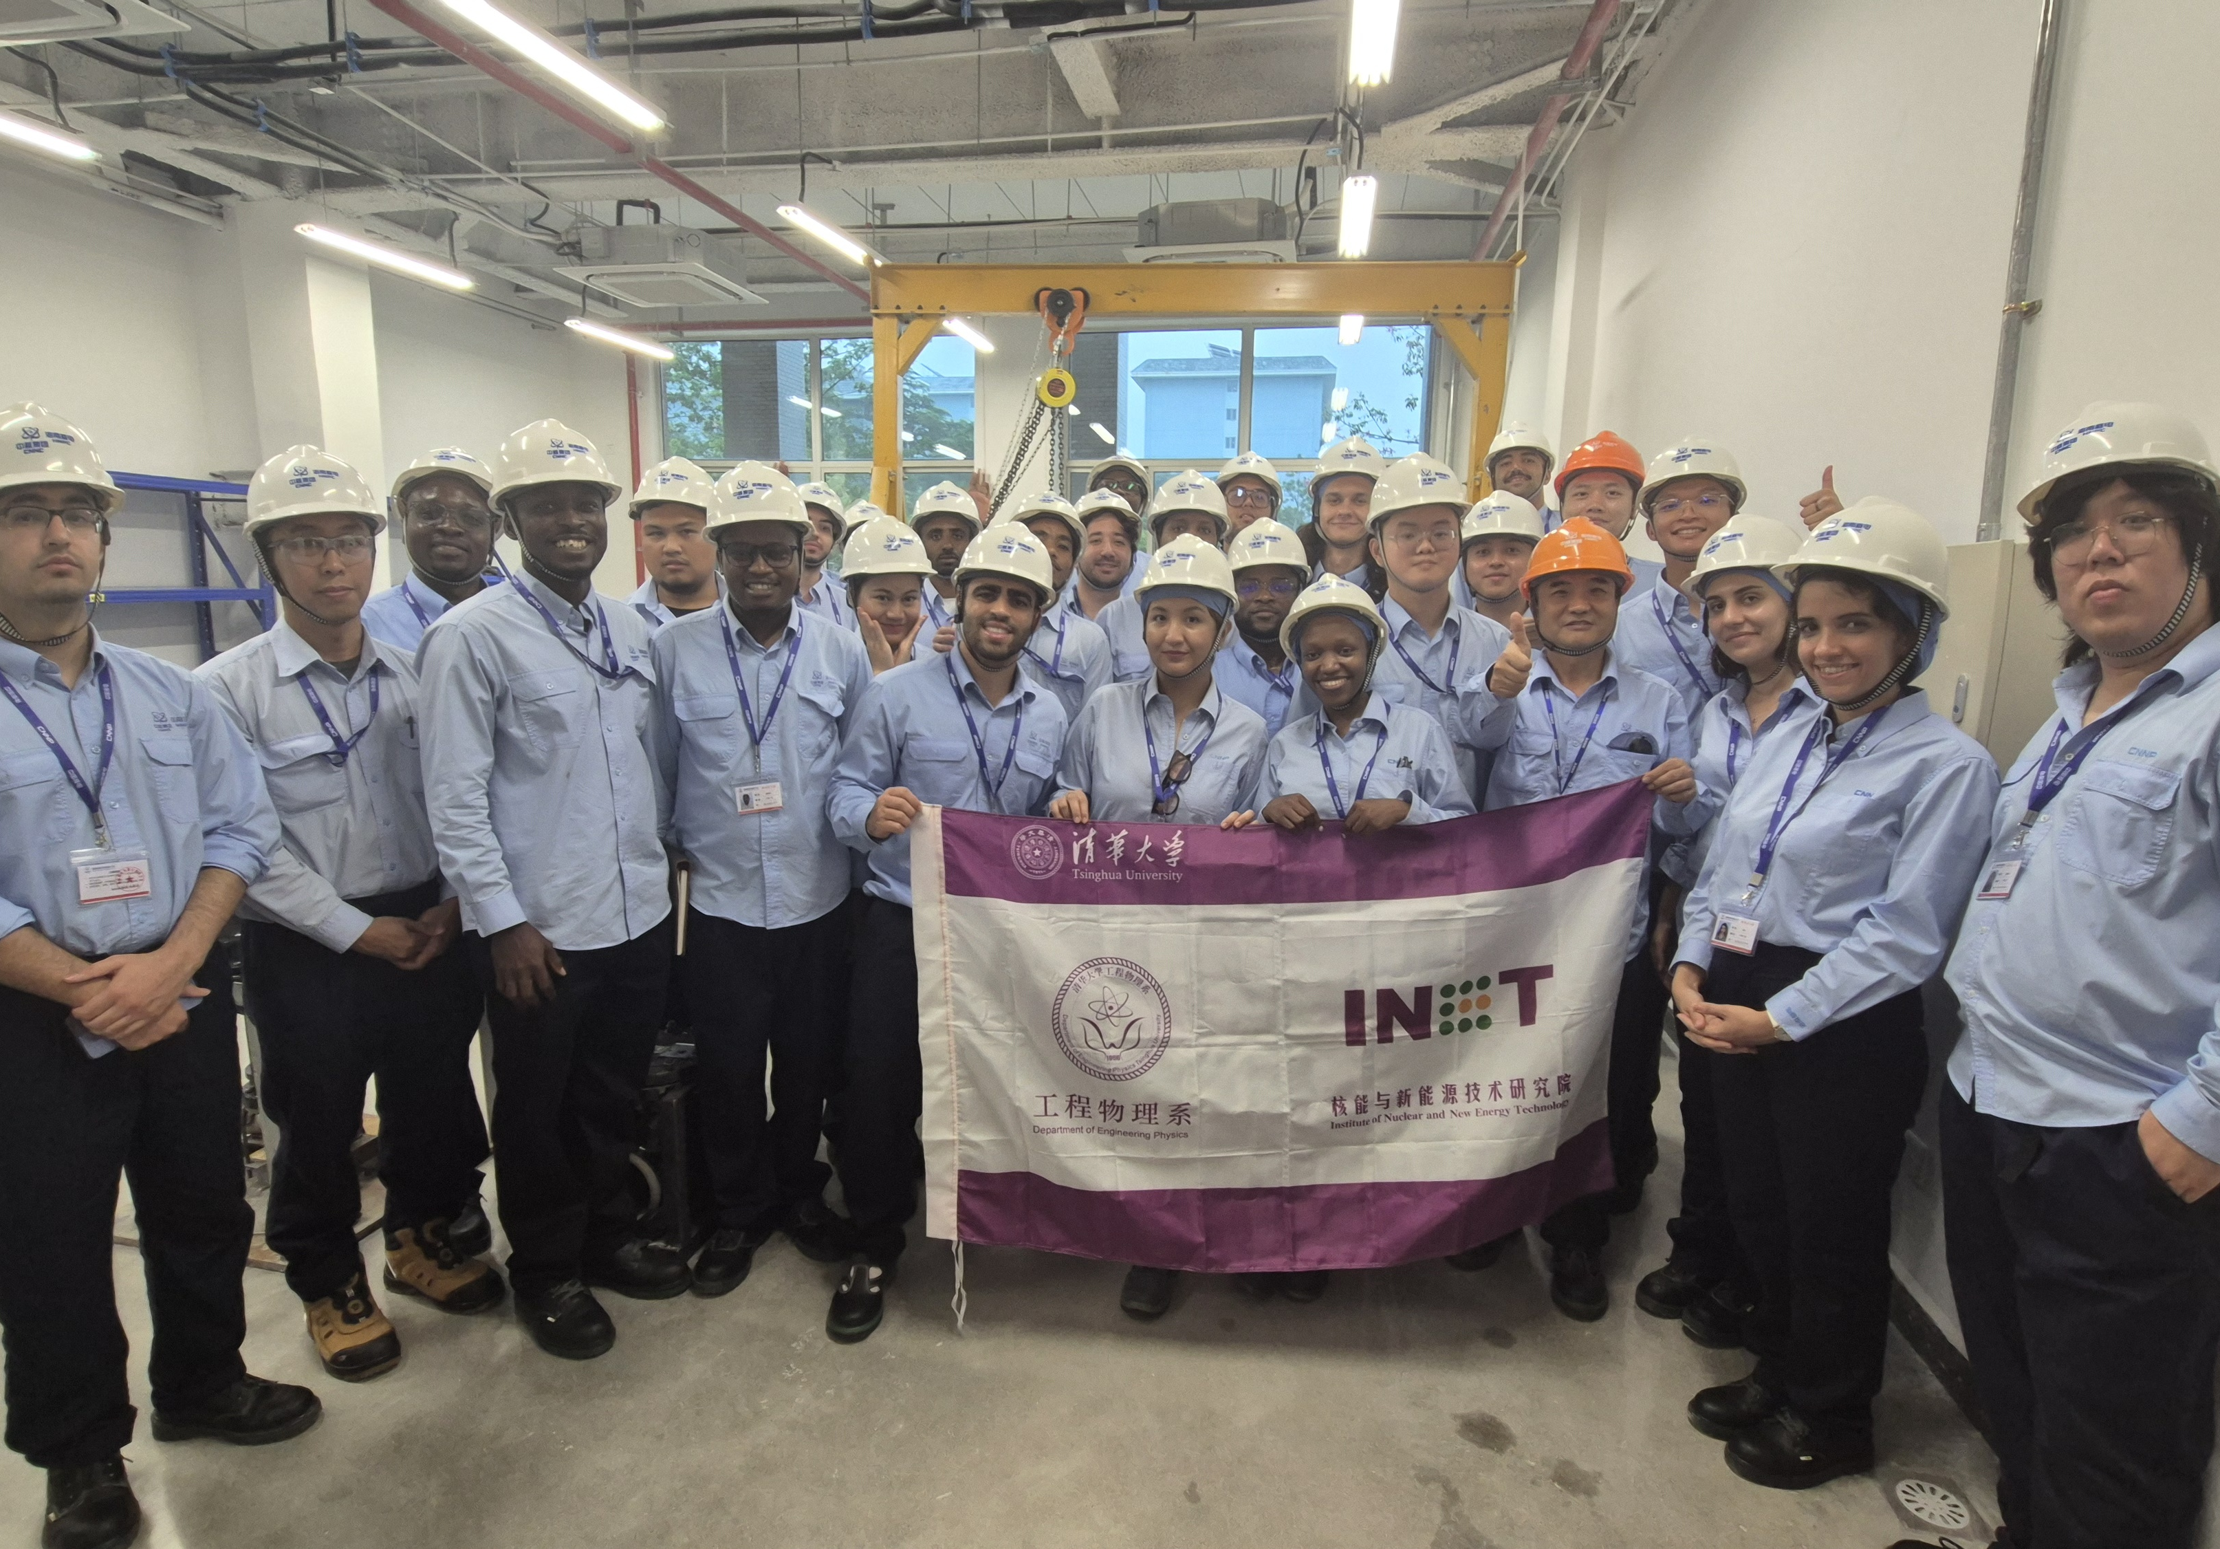
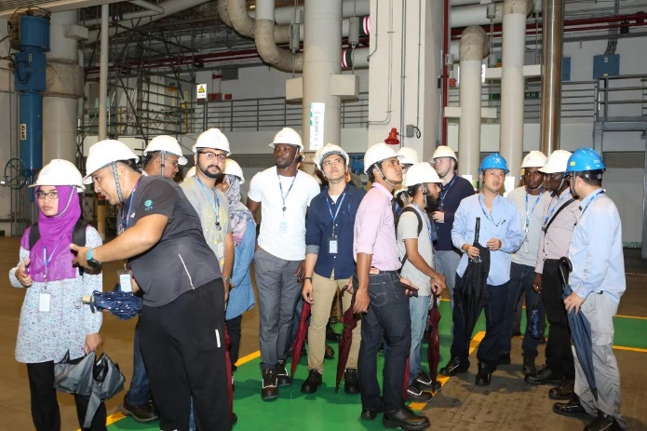

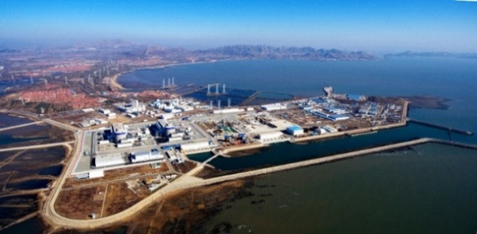
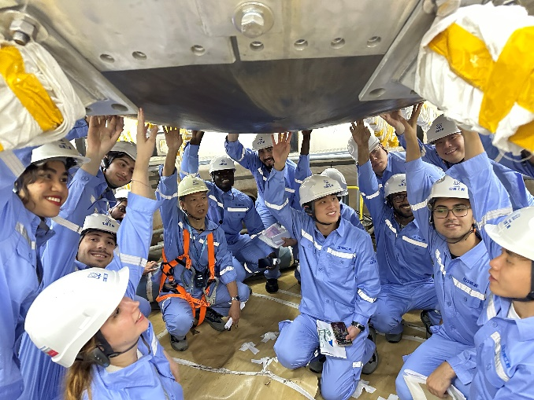
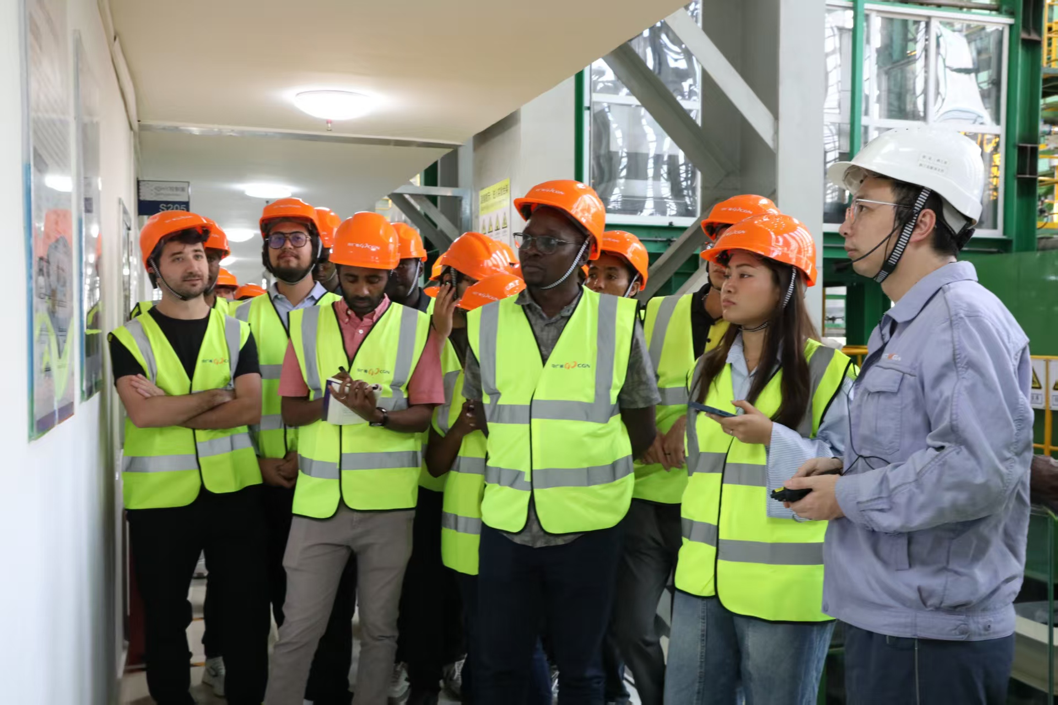
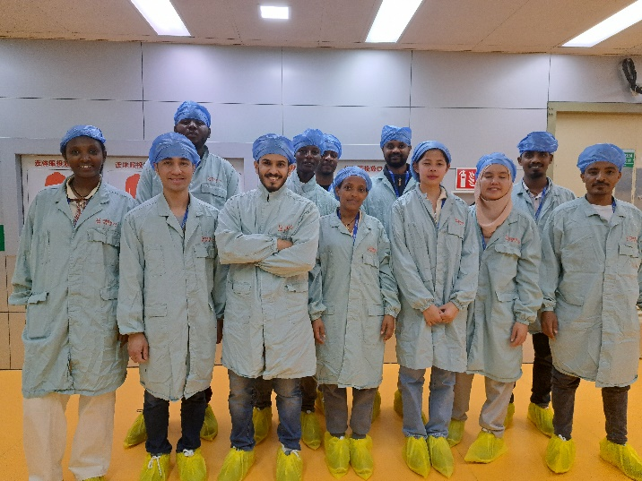
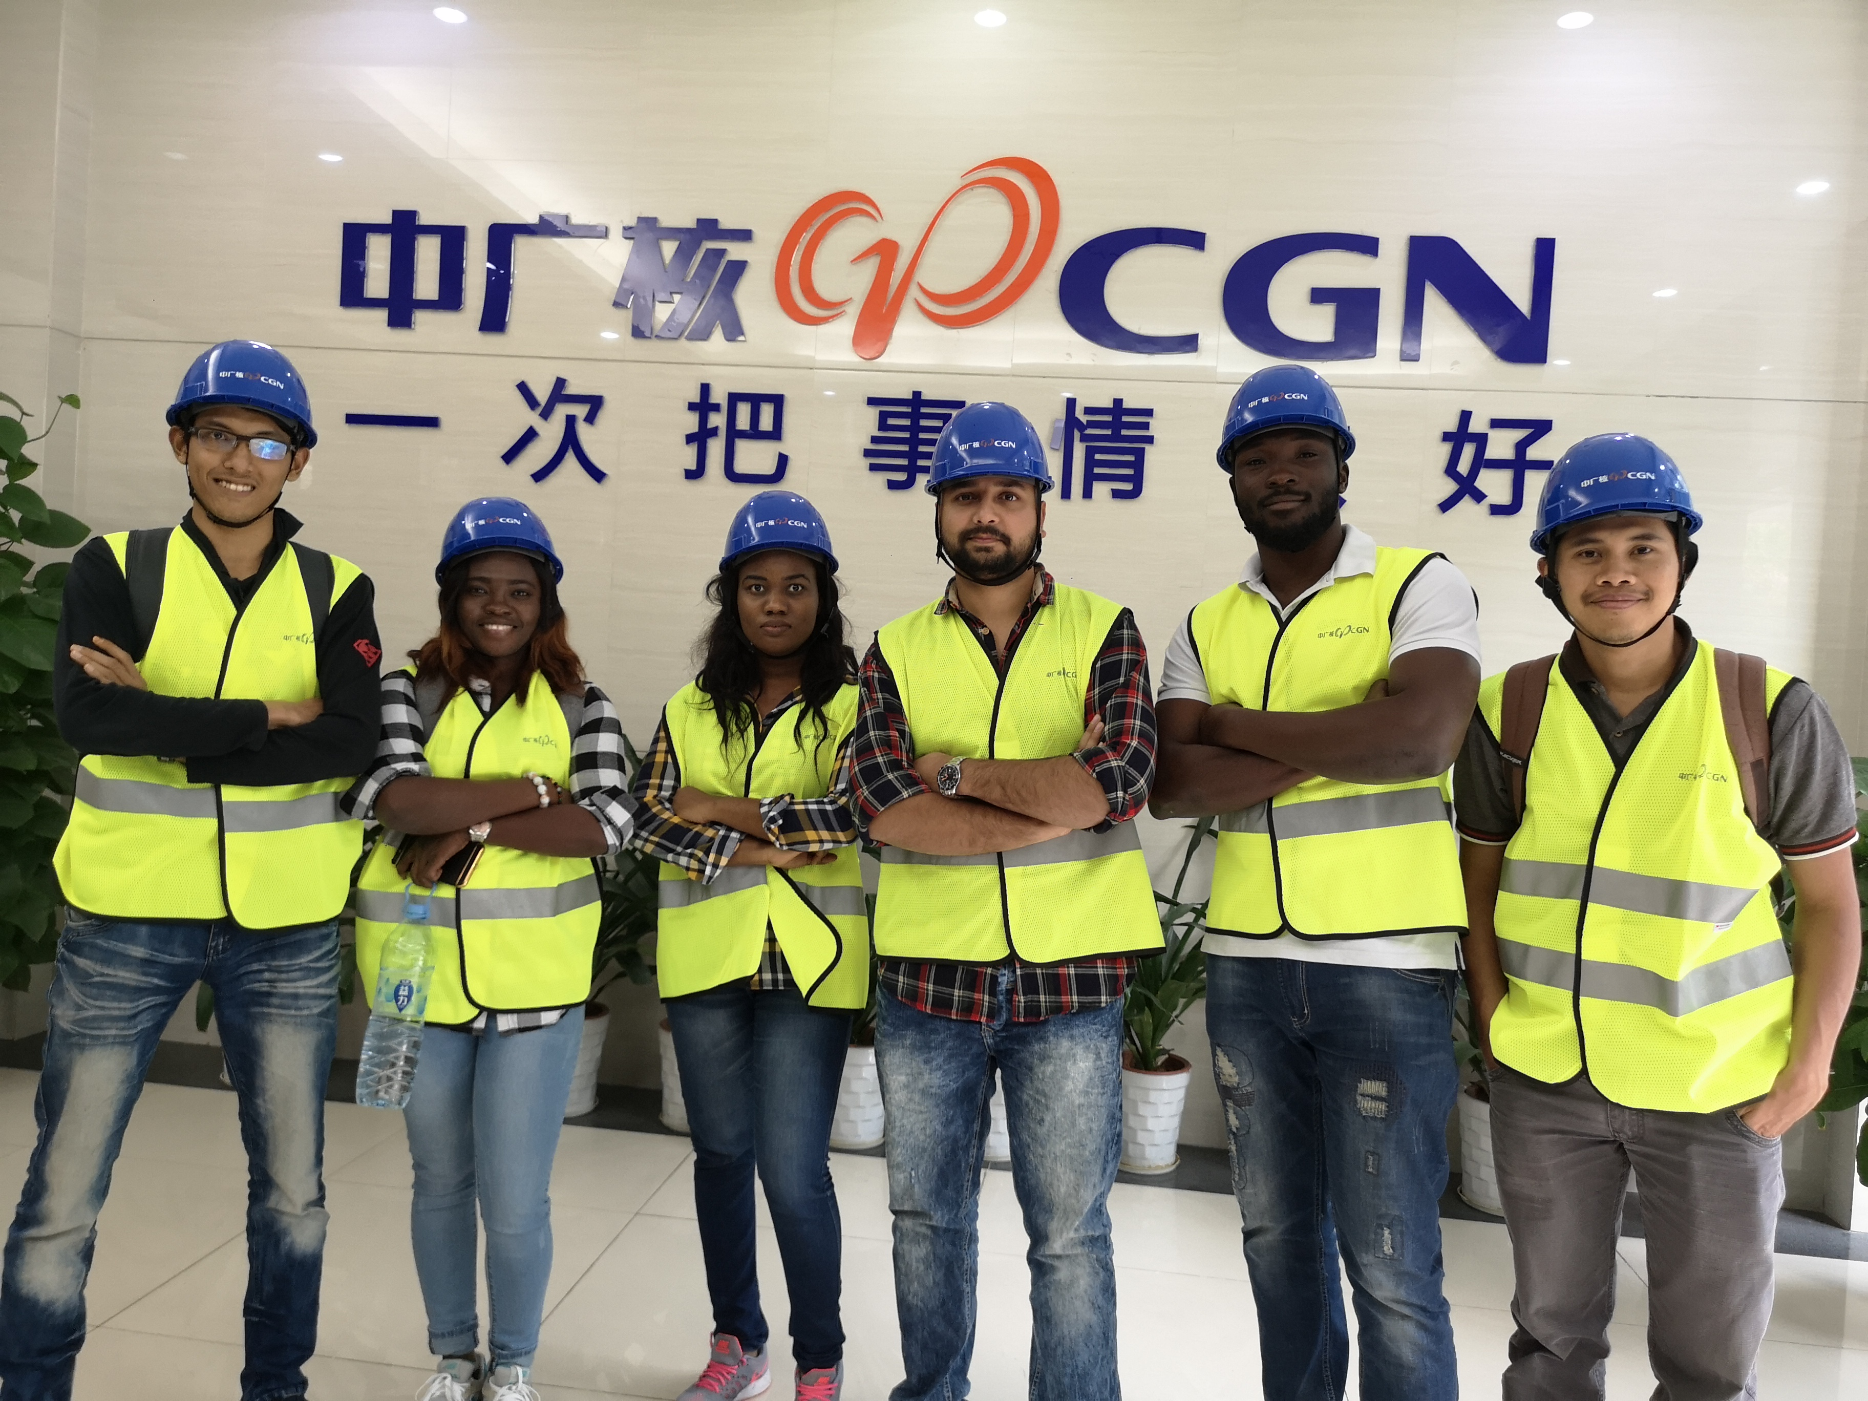

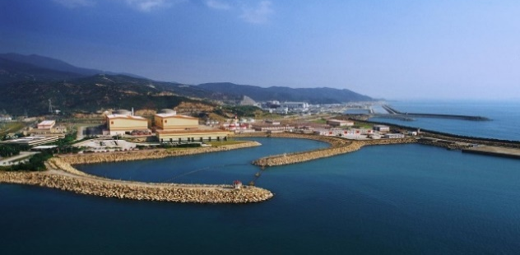
Professional practice and internship
TUNEM
The program provides half a year professional practice and internship mainly organized by CNNC, SPIC or CGN.

Slide 17

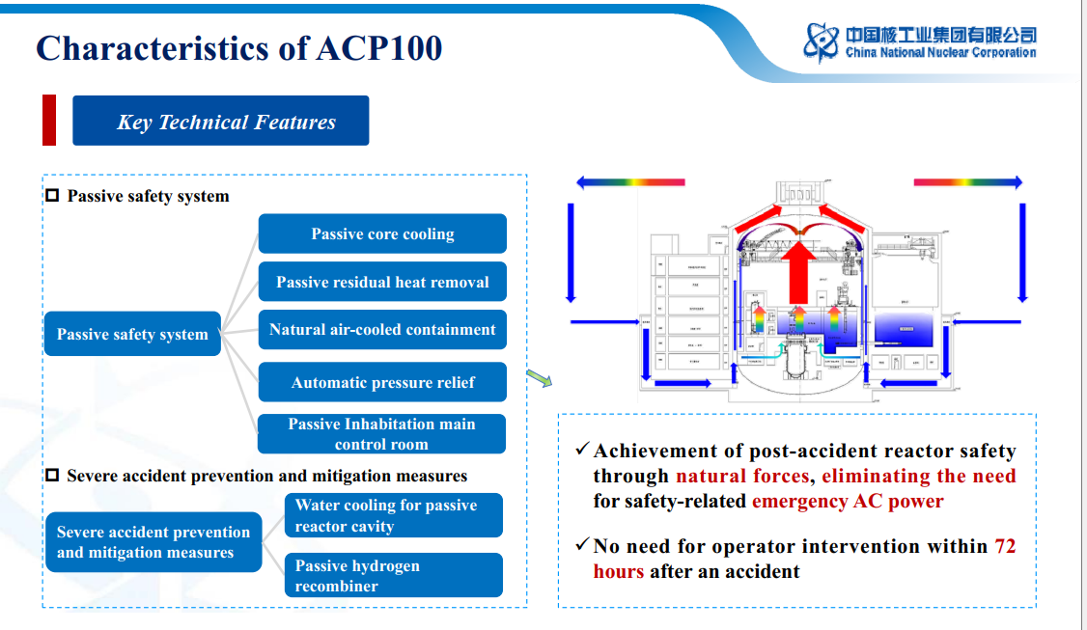
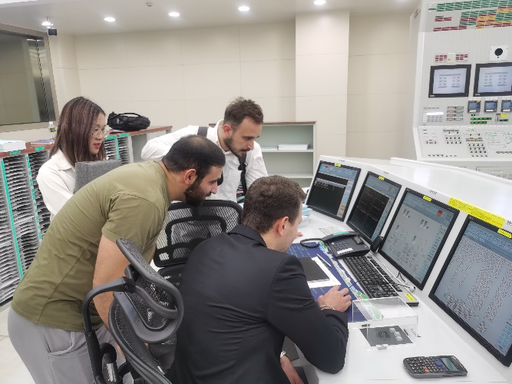
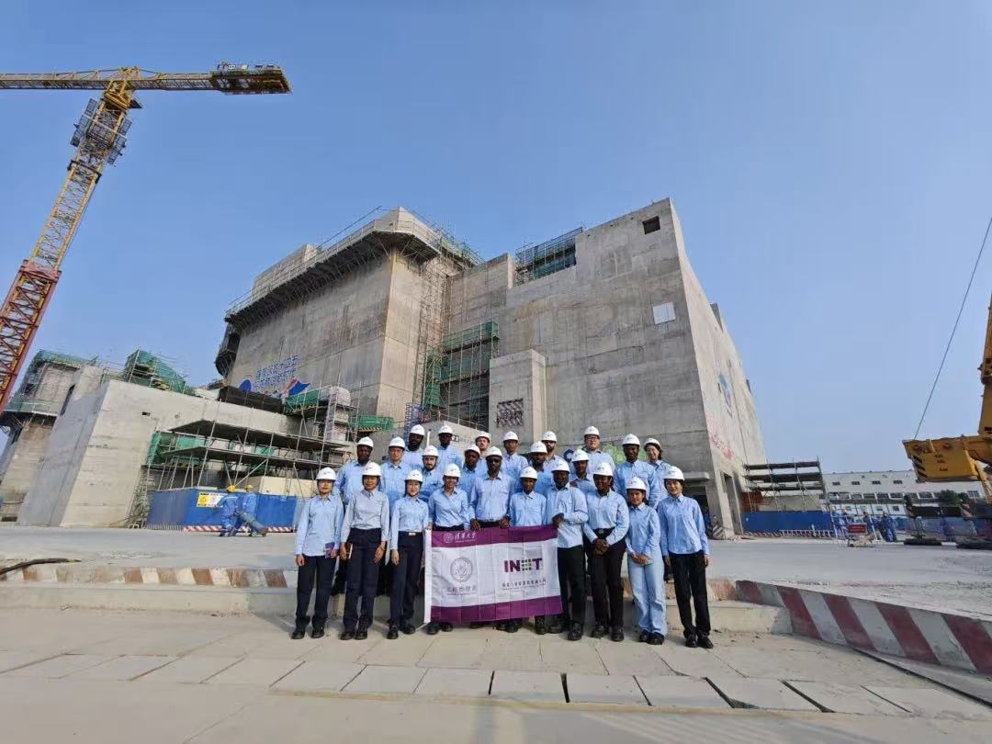
ACP100-Linglong One
ACP100
The world's first land-based commercial modular small reactor
One of the professional practice site of TUNEM
Notes:
时间有限，精简介绍

Slide 18
Features
Co-supported
by Tsinghua University and three nuclear power corporations
Job opportunity
Research project from nuclear corporation supervised by dual supervisors
A
F
Full scholarship
Chinese Government Scholarship, IAEA MSCFP honor & IAEA Fellowship
1/2 year internship
in China’s leading nuclear power corporations
B
E
C
D
Unique Cultural Experience
in China and with TUNEMers
from all over the world
Courses in English
Specially designed

Slide 19
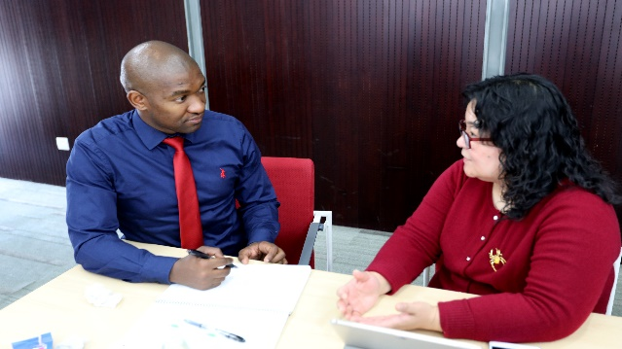
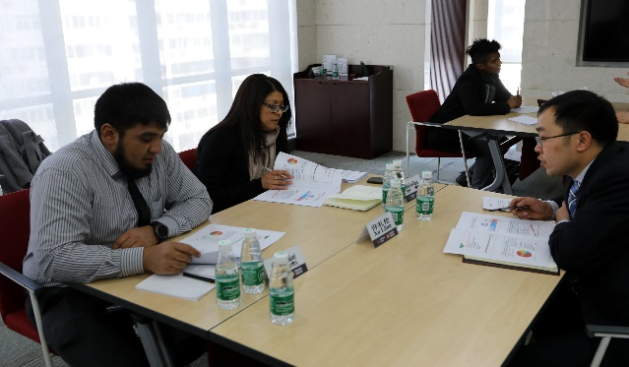
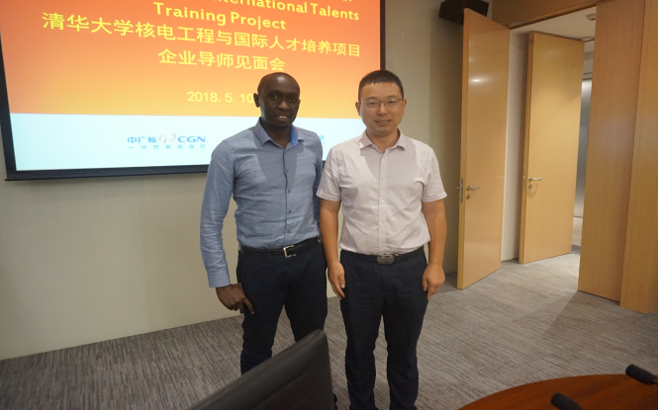
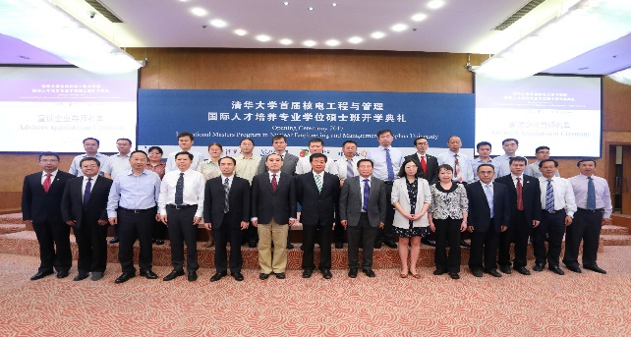
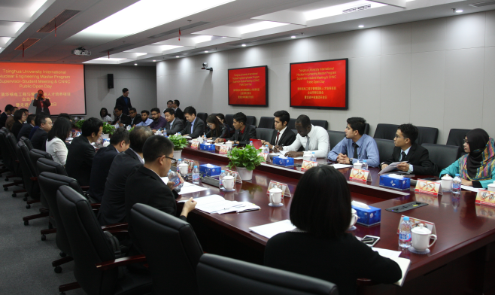
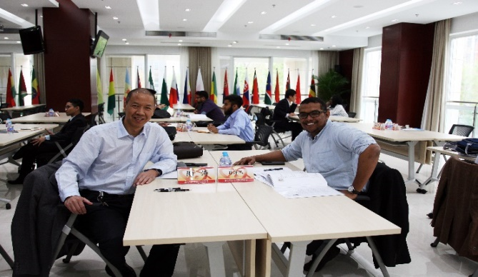
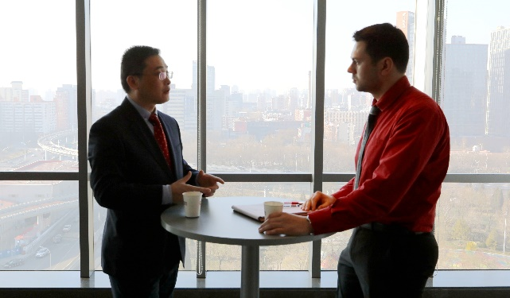
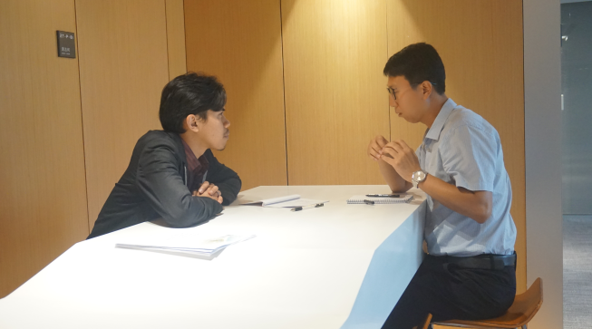
TUNEM
Research project and Job opportunity
 | Students are able to conduct an independent research project.
Co-supervised by Professors at Tsinghua University and experts from nuclear power corporations. |  | Master‘s degree thesis closely related to practice and students’ future job selection.

Slide 20

2026 Application Season

Slide 21
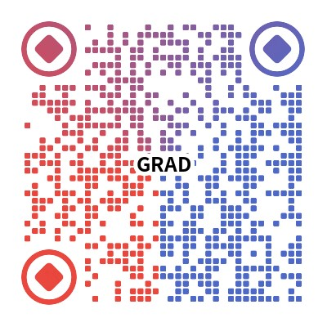
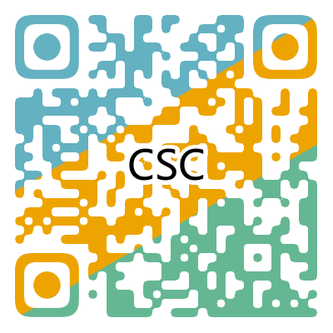

Application
TUNEM
When
Application Term&Schedule
Application: Now—23:59 Mar. 2, 2026 (Beijing Time) Comprehensive Assessment: April, 2026 Pre-admission: May 2026

Slide 22
Application
TUNEM
Where
The Catalog of Master's Programs for International Students 2026:
https://yzbm.tsinghua.edu.cn/publish/s05/s0503/list
For application details, please visit:
https://yzbm.tsinghua.edu.cn/intlLogin
For government scholarship, please visit:
^{http://www.campuschina.org}
Major: Energy and Power Engineering (Code: 0858)
Research Field: Nuclear Energy and Nuclear Technology Engineering(TUNEM)
Notes:
6-10 expected from UK

Slide 23
Application
TUNEM
How many&How much
Annual Intake: 30
Application fee: 800 RMB For those who only apply TUNEM, the application fee will be waived.

Slide 24
Qualification of Applicants
TUNEM
Non-Chinese citizen with a valid passport.
 | CNNC Ms. CHEN Linfeng, chenlinfeng@cnos.cn Mr. DING Qiang, dingqiang@cnos.cn Mr. FU Qiang, fuqiang@cnos.cn
 | SPIC Ms. WEI Kaiwen, weikaiwen@spic.com.cn Mr. FU Longfei, fulongfei@spic.com.cn
 | CGN Mr. MIAO Hongliang, miaohongliang@cgnpc.com.cn Mr. TANG Wenzhong, tangwz2002@aliyun.com
Applicants should hold a bachelor’s degree from an accredited college or university in Nuclear Engineering, Management or other relevant fields.
Related working experience in nuclear engineering is preferred.
Applicants who get the recommendation from CNNC, SPIC and CGN are preferred.

Slide 25

Application Procedure
TUNEM
1
Complete the Online Application
https://yzbm.tsinghua.edu.cn/intlLogin
Upload the scanned
application documents
2
Pay the application fee
3
For those who only apply TUNEM, the application fee will be waived

Slide 26
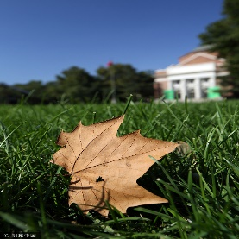
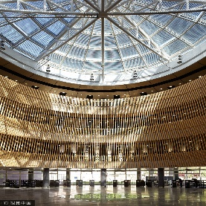
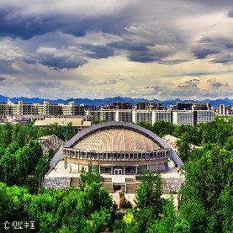
Application Procedure
TUNEM
Application Documents Evaluation
Comprehensive Assessment Generally Based On Interviews
(1)Pre-Admission
(2)Admission
(3)Admission Notice

Slide 27

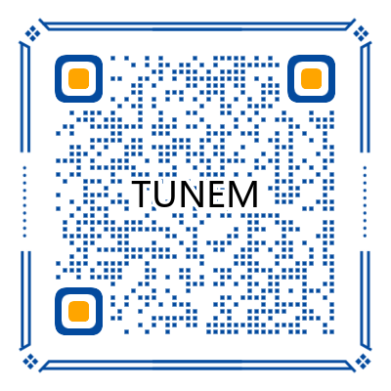

TUNEM
Thanks for Listening
(THU) gradadmission.tsinghua.edu.cn
(DEP) gwyjs@tsinghua.edu.cn
Scan the QR code to learn more about TUNEM
Scan the QR code to leave your information and learn more about TUNEM

