Slide 1




Development of a Helium Cryogenic System for the TUCAN
Shinsuke Kawasaki
KEK, IPNS
UCN and VCN Source at the Institute of Nuclear Physics, Kazakhstan and their applications.
Institute of Nuclear Physics, Almaty, Kazakhstan, 8–11 Apr 2024.

Slide 2
Contents
TUCAN Source
Comparison between ³He cryostat and ⁴He direct pumping
  Cooling power comparison
  Kapitza conductance
  heat conductance of superfluid ⁴He at low temperature
Helium cryogenic system for the TUCAN
  ³He cryostat
  Main heat exchanger development
  Current status
Summary

Slide 3
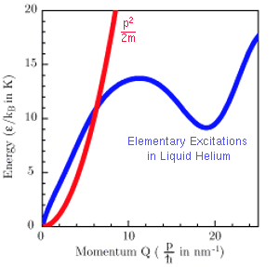
TUCAN Overview
UCN Source
nEDM Spectrometer
Magnetically Shielded Room
LD₂
superfluid helium
B
E
D₂O
W target
Polarized UCNs
Proton Beam
(480 MeV, 40 μA）
EDM cell
(Spin precession chamber)
Spin analysis &
UCN detection
Super-thermal Method

Slide 4
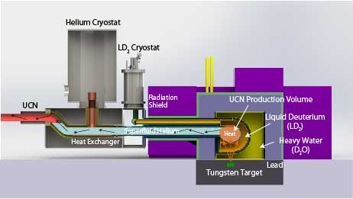
TUCAN Source Overview
TUCAN source
Combination of spallation neutron source and superfluid helium (He-II)UCN converter
Estimated Heat Load : 9.6 W
  8.1 W (beam) + 1.5 W (static)
Requirements
Isotopically pure 4He
  Purity ³He/⁴He < 10⁻¹¹
    τ_{up-scat} > 1000 sec
  available from Lancaster University
Temperature
  < 1.2 K for the heat load from proton beam
Liquid helium consumption
  < 40 liter/hour
    limited by liquefier at TRIUMF

Slide 5
Two options
+Pros.
- Cons.
³He pumping with a heat exchanger
  Higher cooling power
    Large vapor pressure of ³He
  Requires expensive ³He
  Heat exchanger is necessary
    ³He absorb neutron
    must be UCN friendly
  Large amount of isopure ⁴He
    fill isopure ⁴He up to the cryostat
Isopure ⁴He direct pumping
  No heat exchanger
    Simple
  Small amount of isopure ⁴He
    can pump though UCN guide
  Lower cooling power
    small vapor pressure of ⁴He
    huge pump is necessary
³He cryostat
LD₂ cryostat
Pumping duct
He-II
He-II
Heat exchanger
LD₂
D₂O

Slide 6
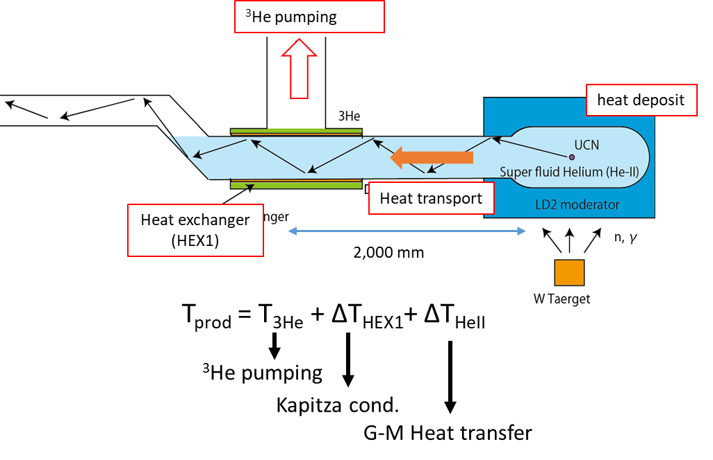
Performance comparison of the two schemes
Cooling power
  ∝P(T_{liq})×L(T_{liq})
  P(T_{liq}): Saturated vapor pressure
  L(T_{liq}): Latent heat
  Ideally, ³He cryostat has larger cooling power
  35 times higher at 1.0K
  100 times higher at 0.8K
In reality , Two effect reducing cooling power of ³He cryostat
  Kapitza resistance
    Heat exchanger is necessary
  Heat conductivity in the isopure helium-4
    Heat exchanger should be placed in low radiation area
P(T_{liq})×L(T_{liq}) as a function of liquid temperature

Slide 7
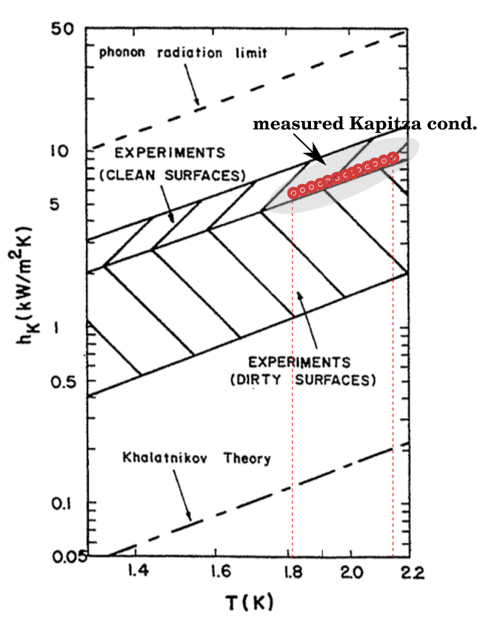
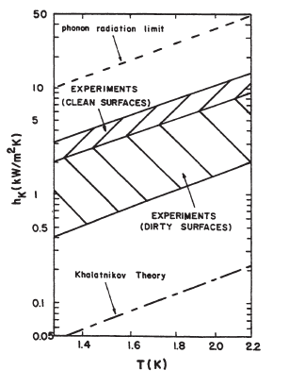
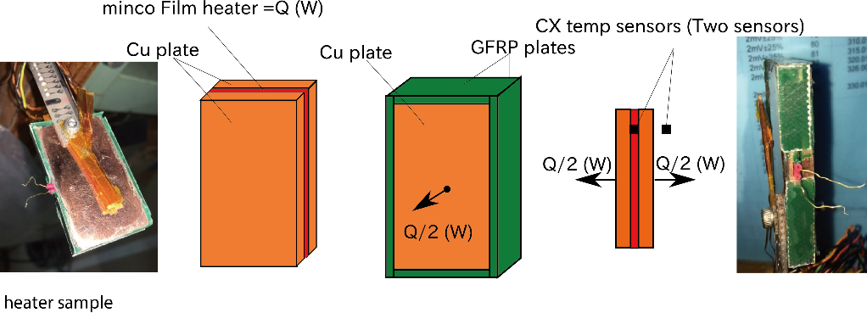
Kapitza Conductance
Phonon limit
Our measuerment
Kapitza conductance is Conductance at the surface between liquid and solid is small at low temperature
There are several theory on Kapitza conductance.
  Phonon limit
    h_{K}(T) ~ 4500 T³ [W/m²K]
      2 - 10 times larger than measured
  Khalatnikov theory
    h_{K}(T) ~ 20 T³ [W/m²K]
      10 - 100 times smaller than measured
Experimental data strongly depends on surface quality
Kapitza conductance between Cu and He-II
  h_{K}(T) ~ 20*K_{G}* T³ [W/m²K]
K_{G}: factor measured by experiment
Kapitza conductance between Ni and He-II
h_{K Ni} (T) = f*h_{K}(T) f = 0.61
Kapitza conductance between Cu and 3He
h_{K_3He}(T) = a*h_{K}(T) a = 1.2 – 2.6
experimental data
Helium cryogenics,
Steven W. Van Sciver
  Khalatnikov theory
Kapitza conductance measurement at KEK
Results
h_{K}(T)∝ T³
K_{G}＝45 – 48 (1.82 – 2.17 K)

Slide 8
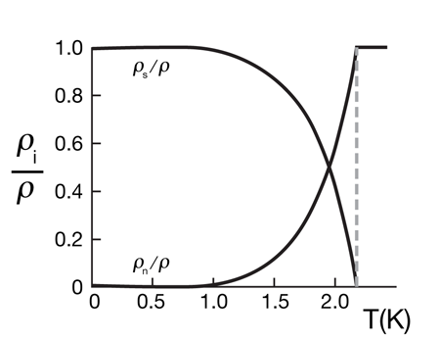
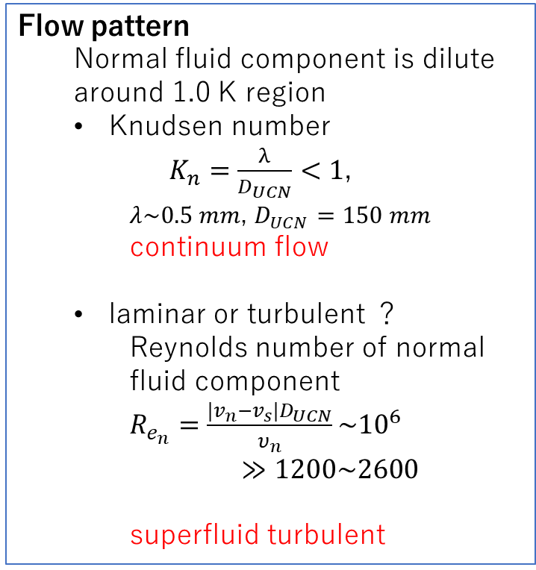
Superfluid Helium Heat transport
Two Fluid Model
Flow pattern
  Normal fluid component is dilute around 1.0 K region
  Knudsen number
    $K_{n}=\frac{λ}{D_{UCN}}<1$,
$λ\sim 0.5 mm$, $D_{UCN}=150 mm$
continuum flow
  laminar or turbulent ？
    Reynolds number of normal fluid component
$R_{e_{n}}=\frac{{|v}_{n}−v_{s}|D_{UCN}}{υ_{n}}\sim {10}^{6}$
$≫1200\sim 2600$
  superfluid turbulent
 | Normal fluid | Superfluid
Viscosity | Η_{n} | η_{s} = 0
Entropy | S_{n} | S_{s} = 0
Ratio of super/normal component depends on temperature
fraction of normal mode become small in low temperature.
10.1103/Physics.3.5
Heat transport
Since superfluid has no entropy, heat is transported only by normal fluid.
Heat transport in low temperature (< 1K) become small because of small fraction of normal fluid
velocity of normal component become fast
v_{n}
v_{s}
Heat source

Slide 9
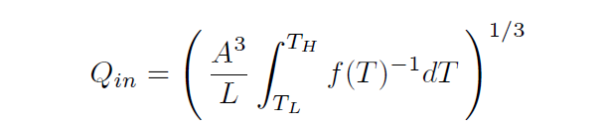
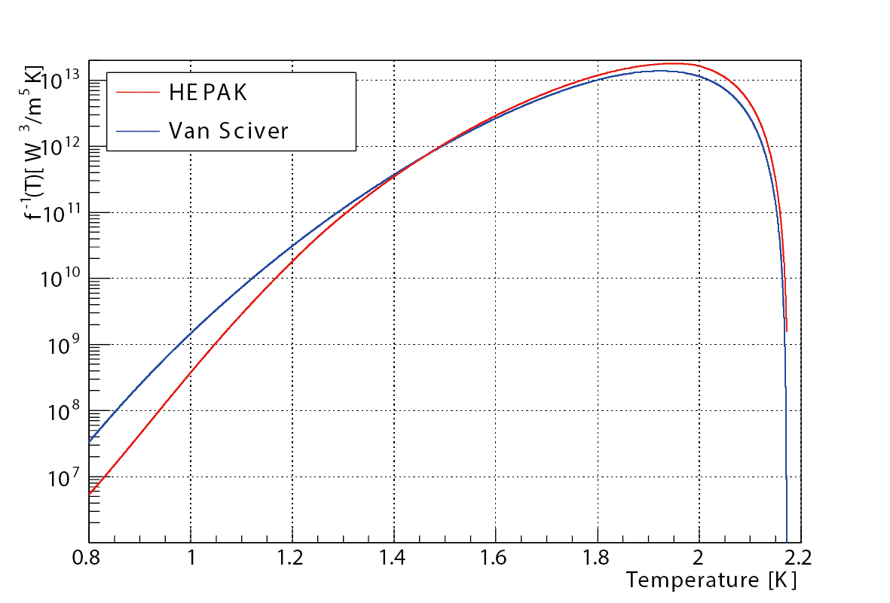
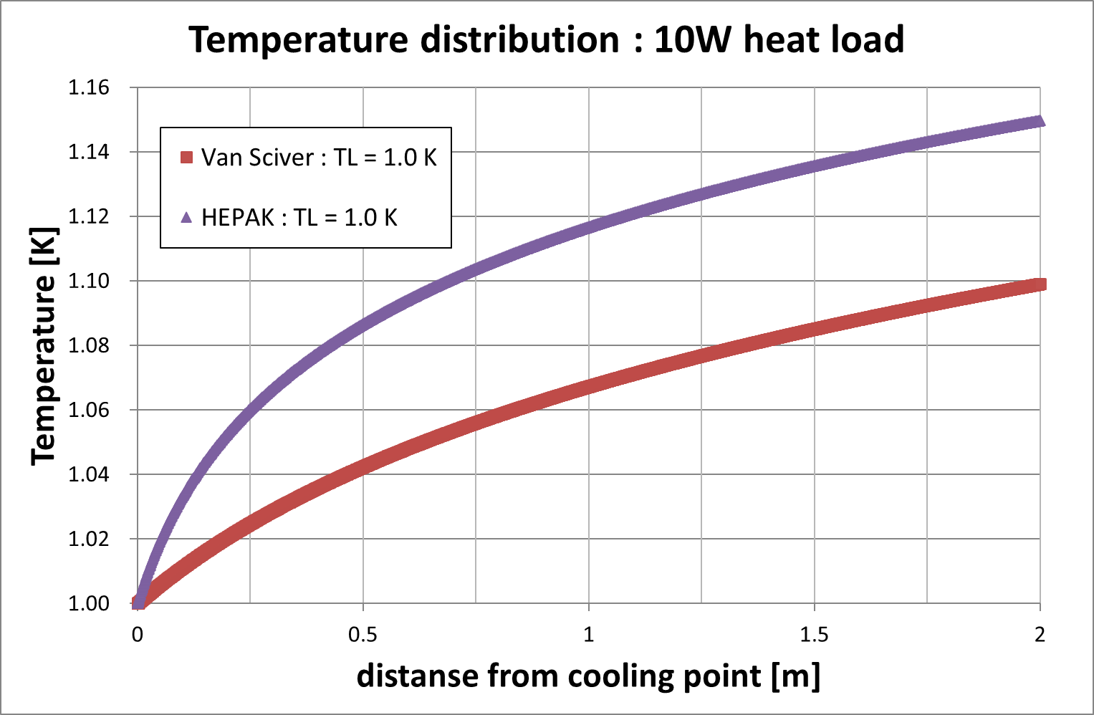
Gorter - Mellink Equation
Temperature difference in superfluid turbulence can be calculated numerically
using following Gorter-Mellink equation
T_{L} : He-II temperature at the heat exchanger
T_{H} : He-II temperature at the UCN production volume
A : cross section of He-II
diameter = 150 mm
L : distance of heat transfer (L = 2.0 m)
Uncertainty
from f(T)
Large ambiguity
・lack of data at low temperature
f(T) : Heat transfer function
temperature gradient in superfluid helium
Q = 10 W, Cooling point temperature T_{L} = 1.0 K
HEPAK: code to calculate thermophysical property of 4He
Van Sciver: empirical fit of experimental data

Slide 10
Cooling power
Theoretical cooling power
Temperature increase for 3He ctyostat
  Kapitza conductance:ΔT_{3HeCu}, ΔT_{Ni4He}
    Parameter
      Kapitza parameter
        K_{G} = 6.5 – 40
      Correction factor for 3He
      a : 1.2 – 2.6
  Temperature increase in super fluid: ΔT_{GM}
    Parameter
      HEPAK (conservative)
      Van Sciver
If Kapitza parameter K_{G} is larger than 20, 3He cryostat cooling power is larger than isopure 4He direct pumping even 3 times large pumping power.
It is the case for first Kapitza conductance measurement

Slide 11
Recommendation for Cryostat Design Choice
List of argument in favor of a ³He concept
Smaller pump system required
  easier to penetrate shielding with smaller ducts, less floor space for pumps, saves up to $0.3M.
Buffer volume in ⁴He system is not beneficial because of the relatively low UCN storage lifetime in helium vapor.
Uncertainty of pressure drop in long pumping duct for ⁴He system is large.
Temperature vs cooling power curves are less steep for ³He system:
  Lower base temperature achievable at lower current: higher yield compared to 4He system.
  Changing the converter vessel to beryllium or AlBeMet reduces the heat input and yields larger gains in isopure temperature Compatibility with potential upgrades
There is in-house experience with a ³He system, which reduces the risk of missing something important in the design
List of arguments in favor of a ⁴He cryostat
No ³He required: saves up to $0.6M.
No ³He gas system required which includes the risk of losing valuable gas.
No heat exchanger from ³He to ⁴He required: removes one complication and the need to design one.
Less isopure helium required: potentially shorter cooldown time, save around $0.15M.
Uncertainty of heat transport in superfluid helium around 1 K is removed: lower risk.
Uncertainty of Kapitza resistance is removed: lower risk.
We are confident that 3He cryostat has advantage because the first Kapitza conductance measurement shows Kapitza conductance is large enough. The last things to confirm is Kapitza conductance between Ni and He-II and the heat conductivity in He-II. We propose to continue towards technical and detailed design of the 3He system option. It is encouraging that there is a backup solution if there are any roadblocks for this system choice.
TUCAN decided to choose ³He option

Slide 12
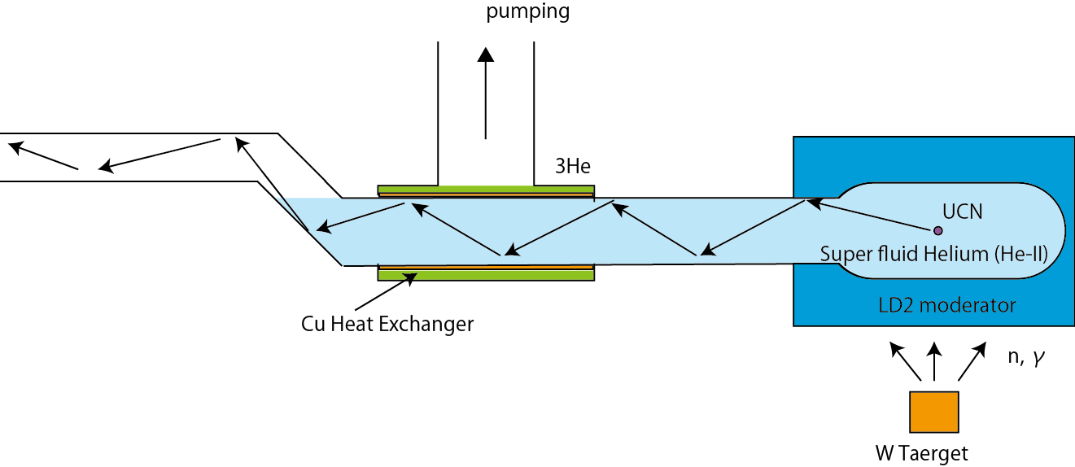
Superfluid helium UCN converter cooling by ³He
³He pumping
Components
Helium-3 cryostat
  Large cooling power : ～10 W @0.8 K
    8.1 W: beam,
    1.5 W: static
      Including safety margin
³He -⁴He Heat Exchanger design
  Kapitza conductance
Heat transport in superfluid helium
  Flow pattern：Superfluid turbulent
  Gorter-Millink heat transfer
Heat transport
heat deposit
D =150㎜
Heat exchanger
2,650 mm
W target
T_{prod} = T_{3He} + ΔT_{3He-Ni} + ΔT_{Cu-HeII} + ΔT_{HeII}
Kapitza cond.
(HEX1)
Heat transfer in He-II
³He Cryostat

Slide 13
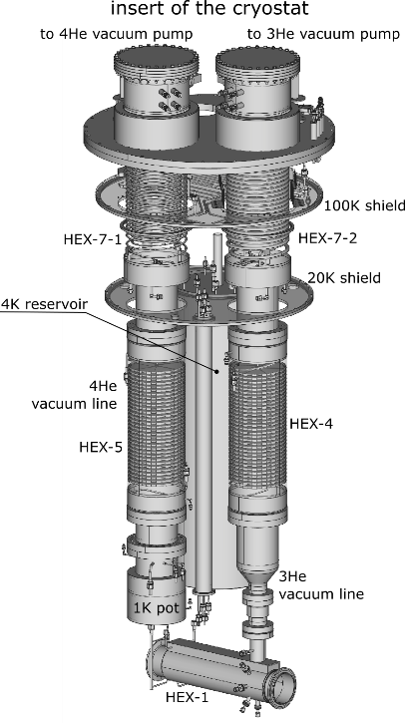
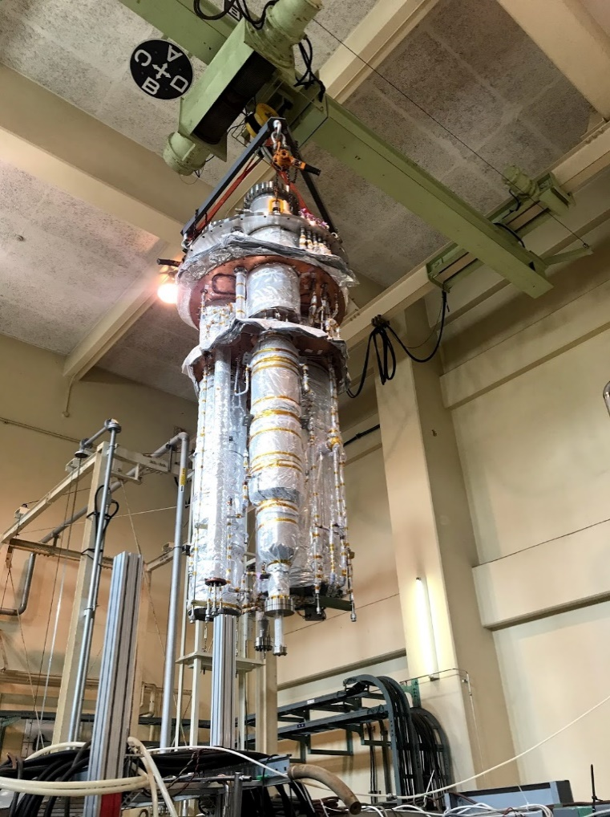
Helium Cryostat Development
Helium-3 cryostat
Requirements
  Cooling power: 10 W @ 0.8 K
    Heat load: 8.1 W from beam, 1.5 W from static
      Including safety margin
      Actual heat deposit: 8.1 W by beam
  Has to be placed behind radiation shield
    L = 2.65 m
  Minimize liquid helium consumption
    < 40 L/hour
Designed by KEK
Fabricated by JECC Torisha, Japan
Fabrication and test completed, shipped to TRIUMF
  Test at KEK
  use helium-4 instead of helium-3
  confirm designed performance
    minimum temperature 1.25 K (pumping speed: 2,000 m³/hour)
  no superleak

Slide 14
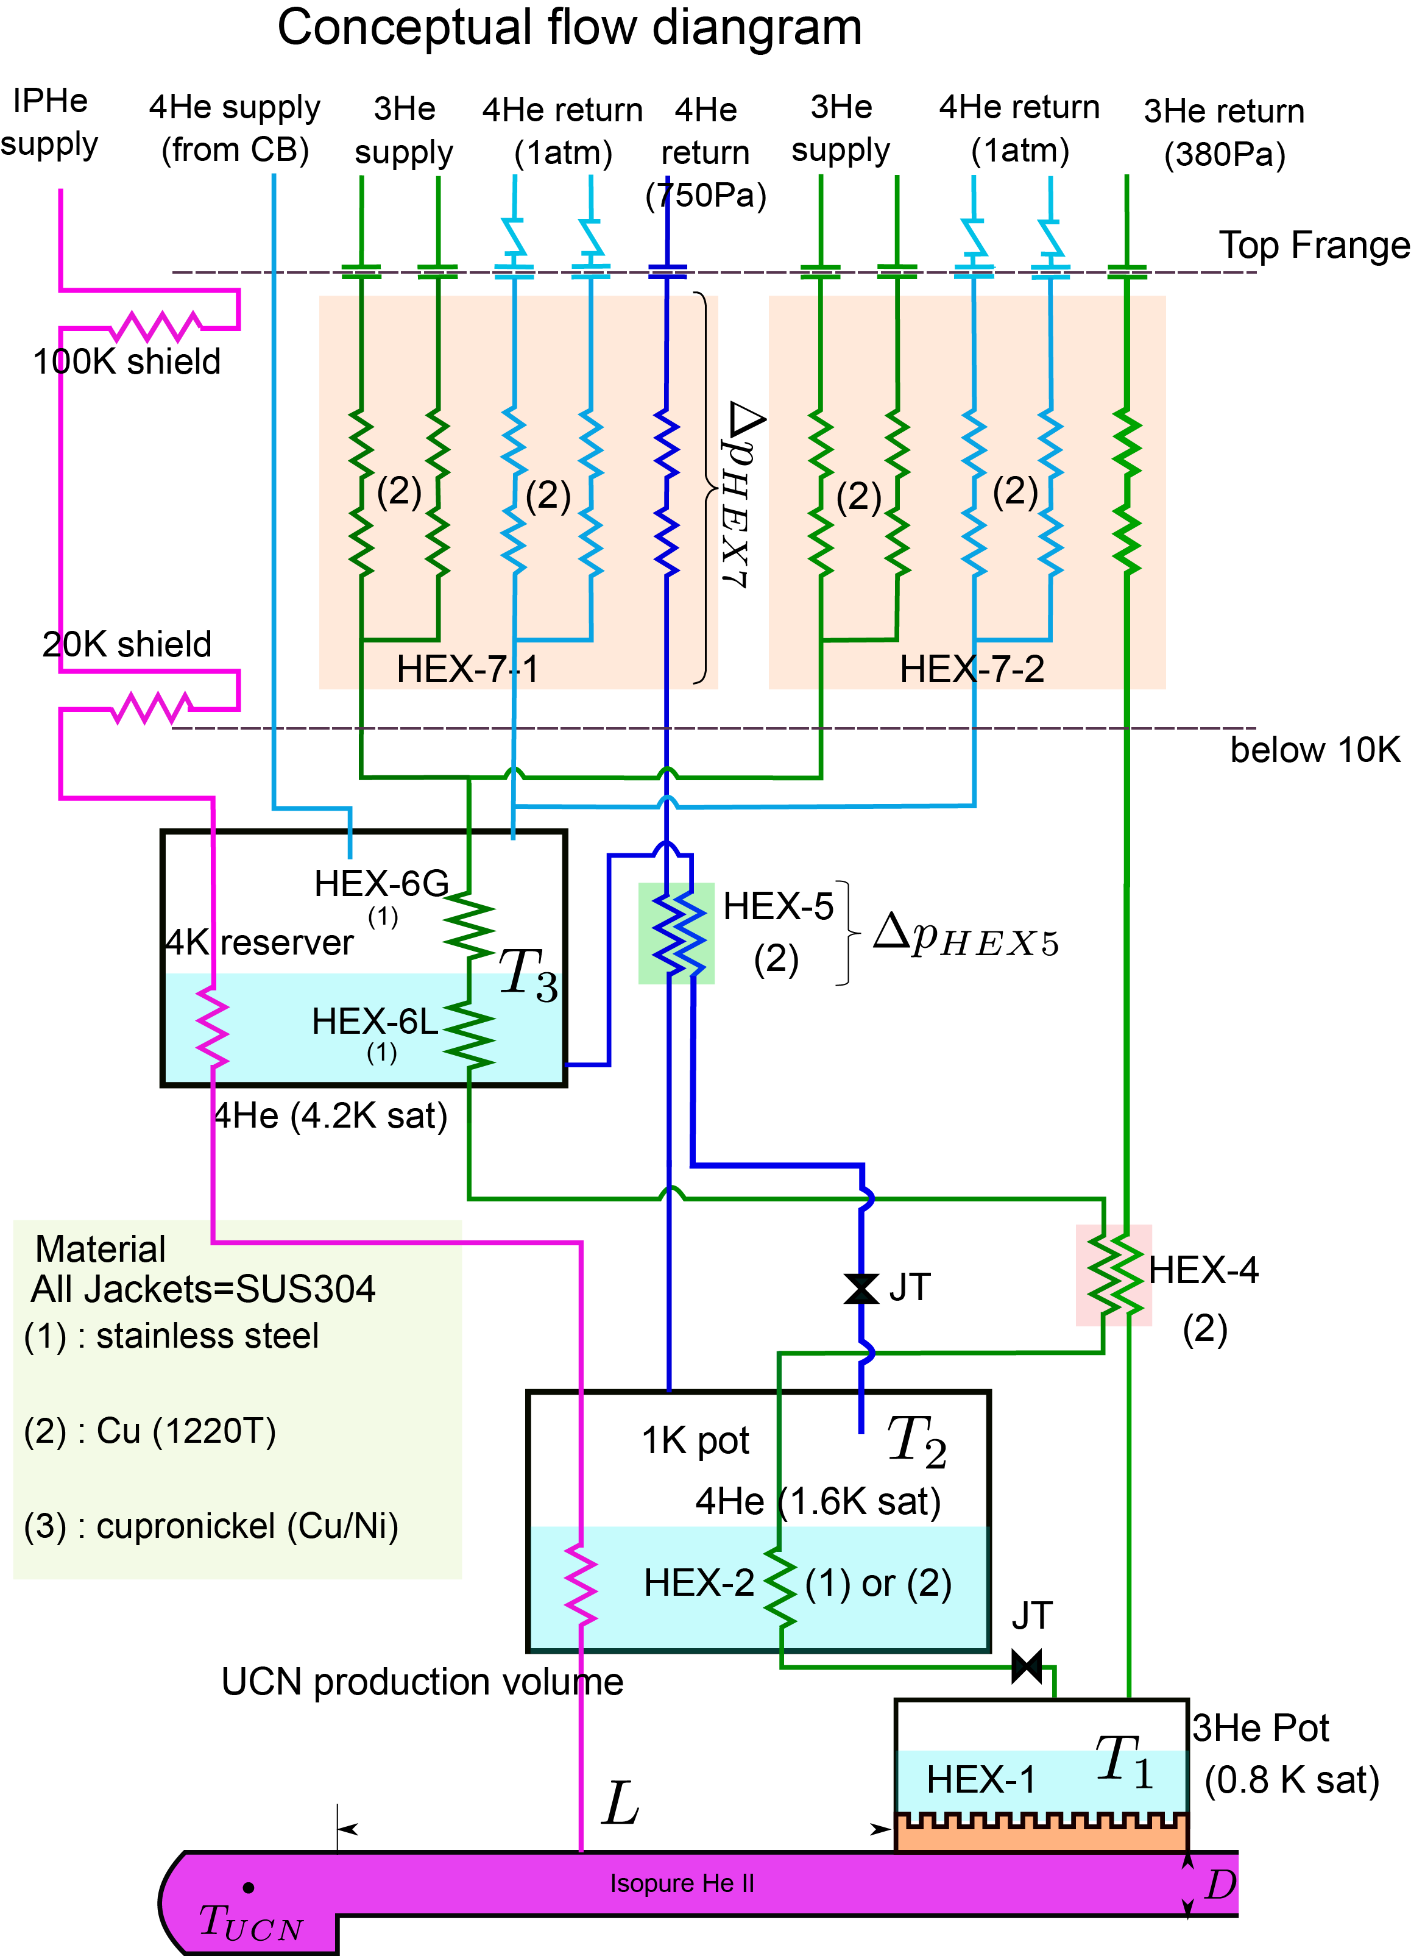
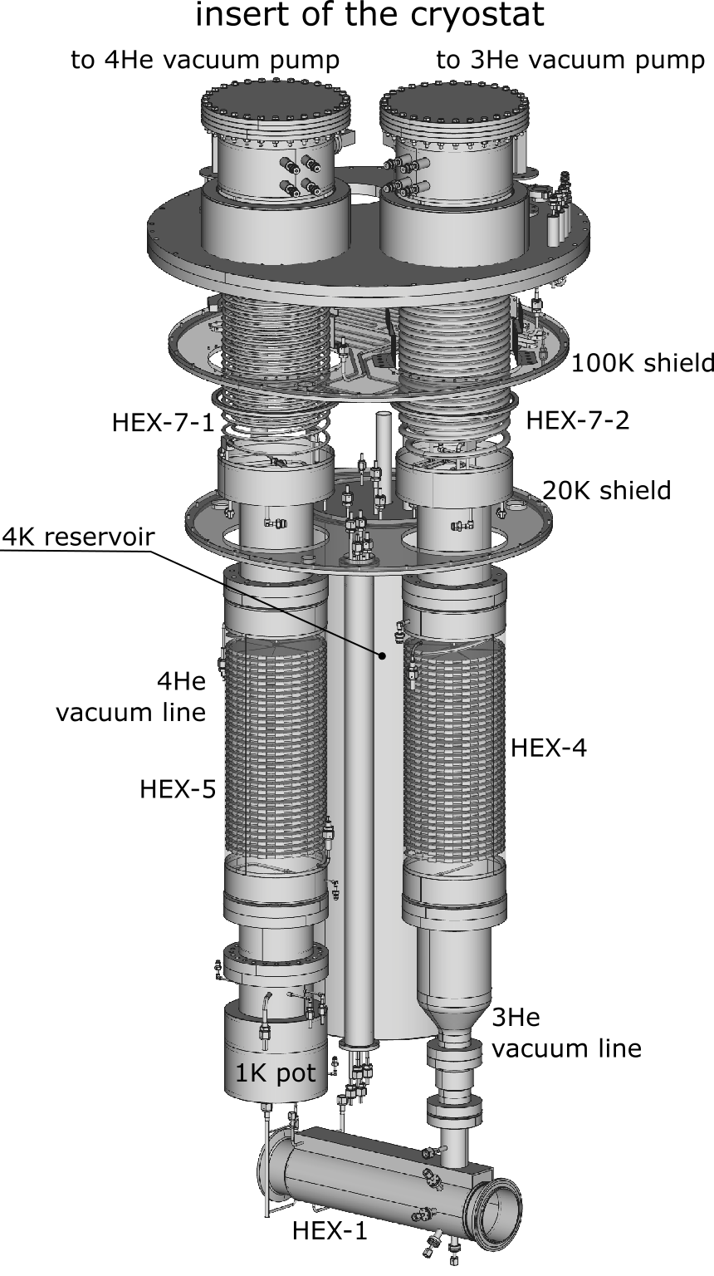
Flow Diagram and Schematic Drawing
Liquid bath condition
 | ³He pot | 1K pot | 4K reservoir
Bath temperature | 0.8 K | 1.6 K | 4.5 K
vapor pressure | 378 Pa | 746 Pa | 1 bar
Mass flow | 1.14 g/sec | 1.20 g/sec | 2.28 g/sec
Pumping speed | > 8,800 m³/hour | > 3,700 m³/hour | No pumping
10K
4.5 K
2.8 K
2.8 K
1.6 K
Heat Exchangers
0.8 K
Conceptual Flow diagram
Name | Type | Coolant | Cooling Target
HEX-1 | Pool cooling | Liquid ³He (0.8 K, 380 Pa) | Isopure helium-4
HEX-2 | Pool cooling | Liquid ⁴He (1.6 K, 740 Pa) | Supplied ³He (G/L, 2.6 K -> 1.6 K)
HEX-4 | Counter flow | Return gas from ³He pot | Supplied ³He (G, 4.5 K -> 2.6 K)
HEX-5 | Counter flow | Return gas from 1K pot | Supplied ⁴He (L, 4.5 K -> 2.8 K)
HEX-6 | Pool cooling | Liquid ⁴He (4.2 K, 1 bar) | Supplied ³He (G, 10 K -> 4.5 K)
HEX-7 | Counter flow | Return gas from 4K res. | Supplied ³He (G, 300 K -> 10 K)

Slide 15
A. Brossard, nEDM2023

Slide 16
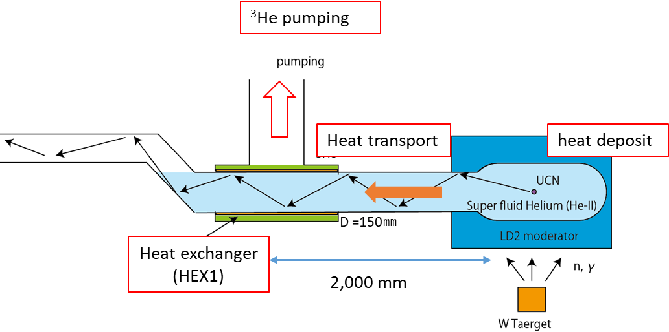
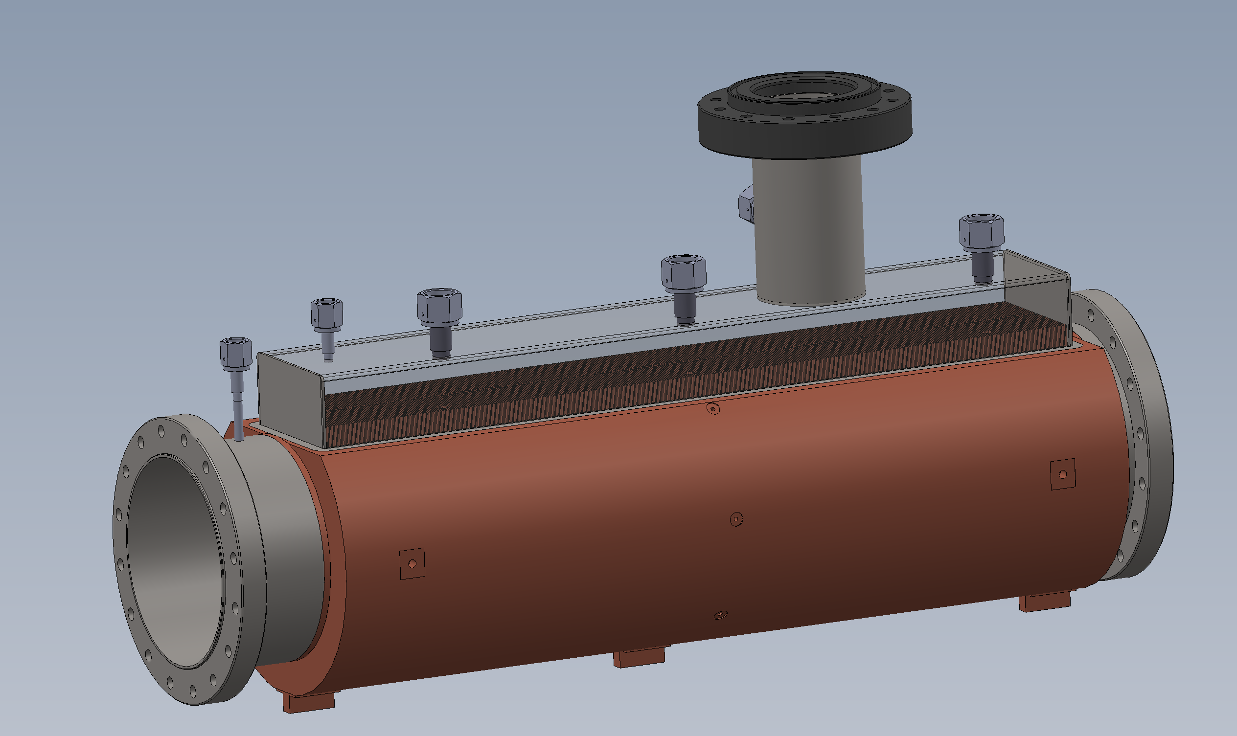
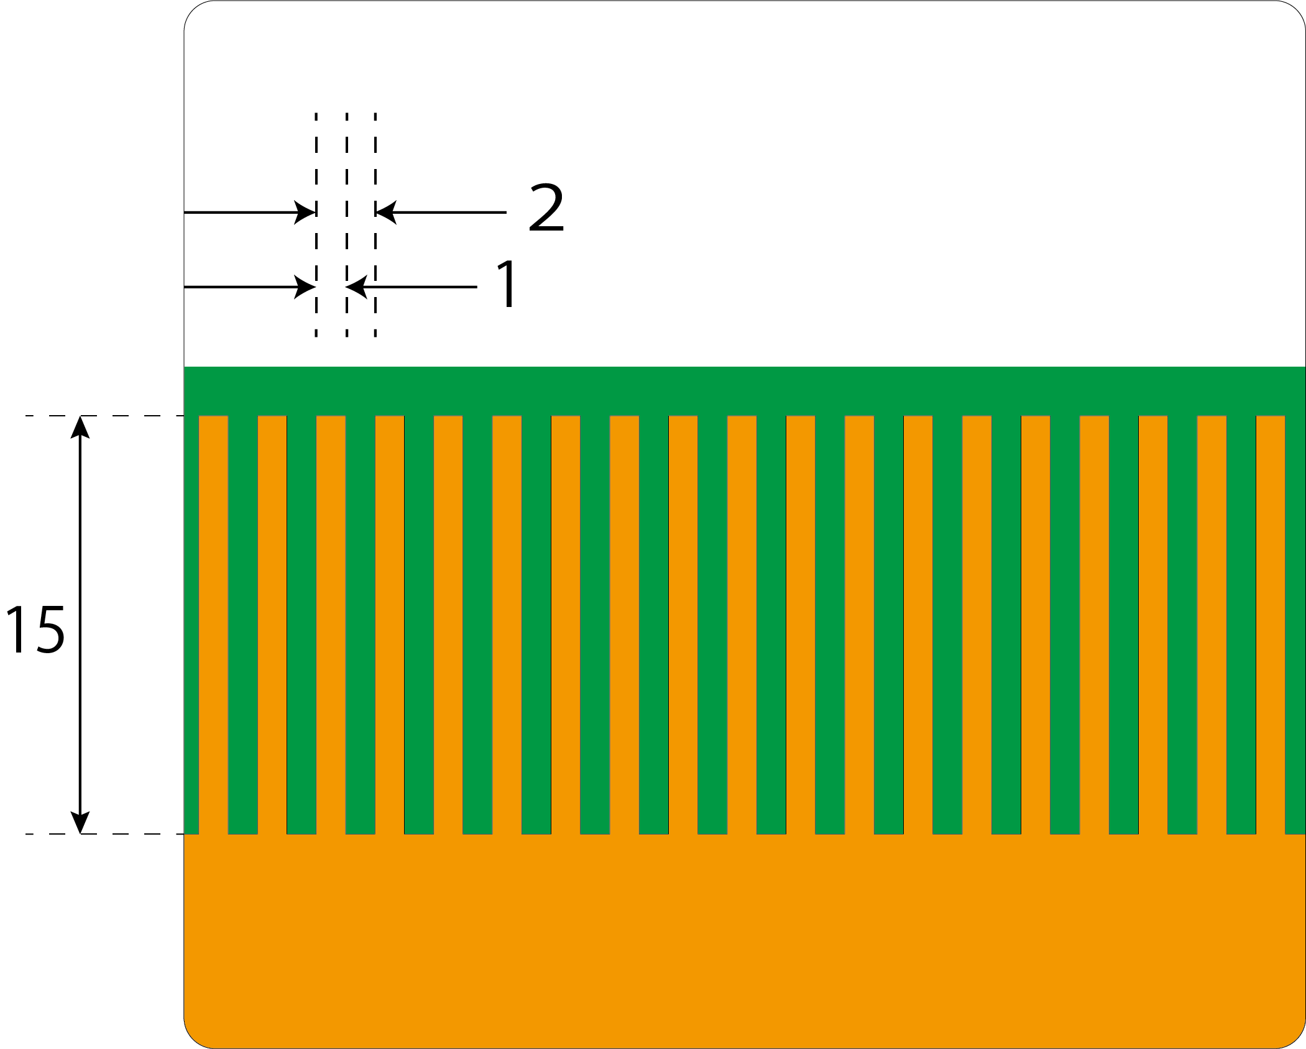
HEX1 development
HEX1: Main Heat Eｘchanhger
To cool superfluid helium UCN converter by liquid helium-3
  T_{He-II} ～ 1.0 K
    to suppress UCN up-scattering by phonon
  T_{3He} = 0.8 K
    maintain by the helium-3 cryostat
  Heat load: 9.6 W
Design
Main body
  Oxygen-Free High Conducting Copper (C1011)
    purity: > 99.99 %
  Vertical Fins
    Fin height: h = 15 mm
    Fin width: w = 1.0 mm
    Fin pitch: p = 2.0 mm
    Surface area: S = 0.90 m²
3He pumping
3He supply
3He pumping
IP He supply
Liq. ³He
Heaters
Cu
Temp. sensors (cernox)

Slide 17
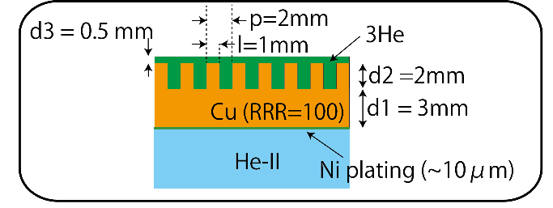
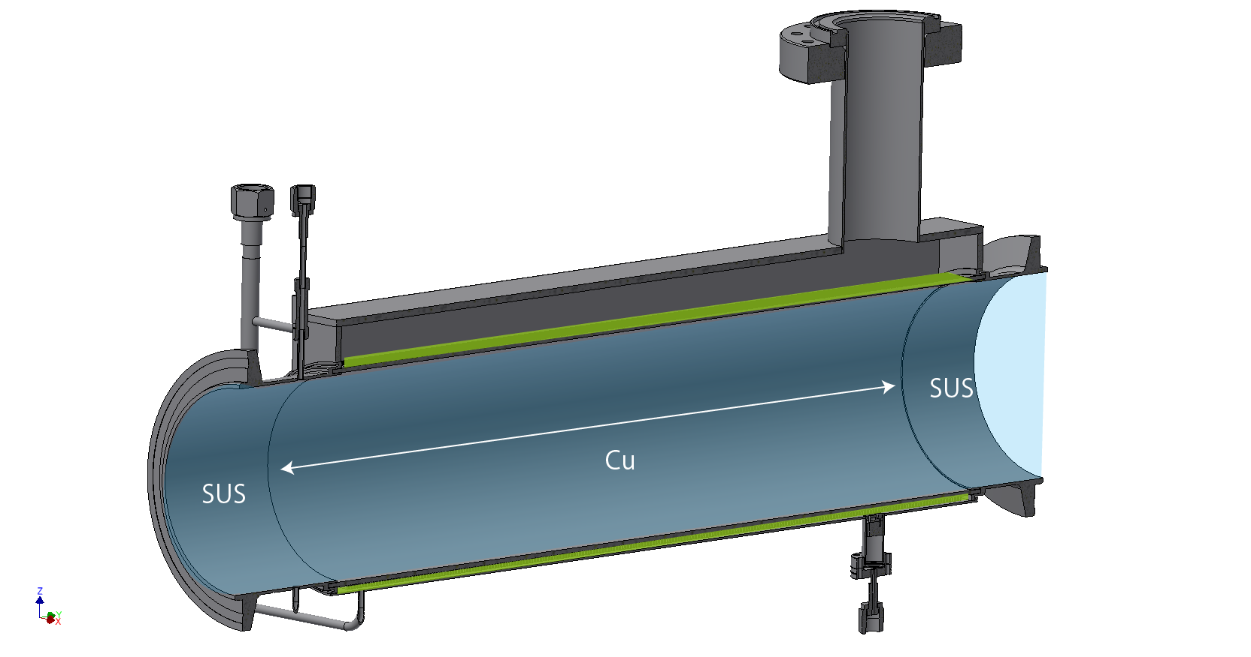
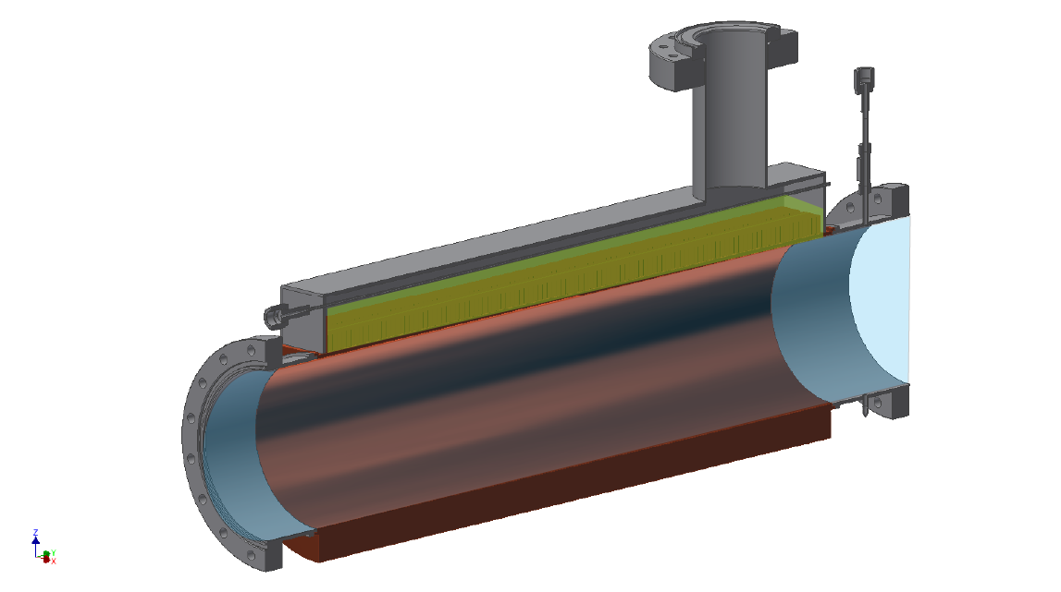
Heat Exchanger design
Cylindrical Fin Model
The necessary surface (assume K_{G} = 40)
³He side: 0.89 m² -> Δ³He – Cu = 0.07 K
He-II side: 0.28 m² -> ΔCu – He-II = 0.09 K
There are two option to make such a surface area
Cylindrical fin model
  Fin height: 2 mm
  Fin width: 1mm
  Fin gap : 1 mm
  Gap : 0.5 mm
Vertical Fin model
  Vertical Fins
  Fin height: 15 mm
  Fin width: 1 mm
  Fin gap: 1 mm
Liquid ³He
HeII
Vertical Fin Model
Liquid ³He

Slide 18
Pool boiling heat transfer
critical heat flux
convection
Pool boiling heat transfer
  natural convection
  nucleate boiling
  film boiling
Working condition of the heat exchanger should be below critical heat flux of film boiling transition
Heat Flux of ³He side: 1.1×10⁻³ W/cm²
  critical heat flux must be larger
Based on measurement of 3He boiling curve, it seems the critical heat is larger
However, the critical heat depends on strongly the geometry of the heat exchanger
nucleate
boiling
film boiling
Helium cryogenics,
Steven W. Van Sciver
Film boiling
Nucleate boiling
convection
Boing curve of helium-3 at 0.8 K

Slide 19
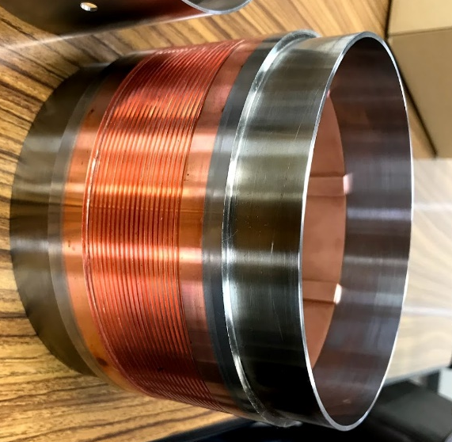
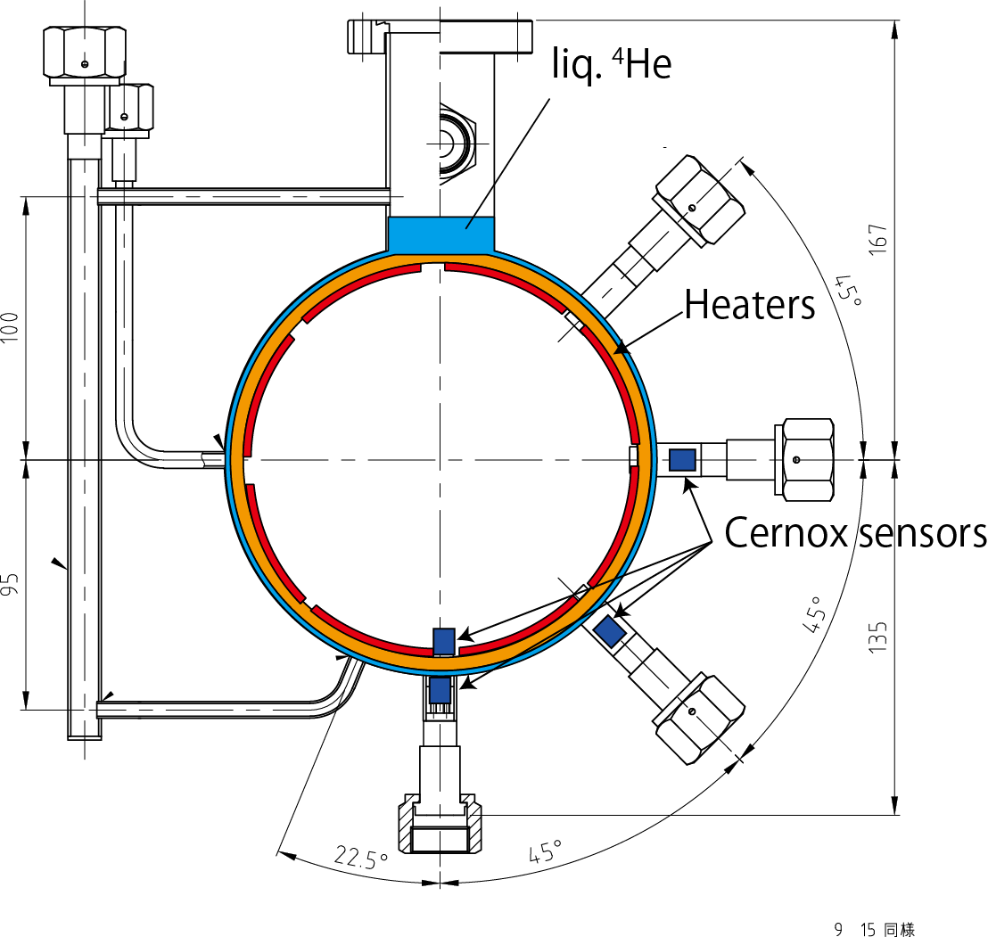
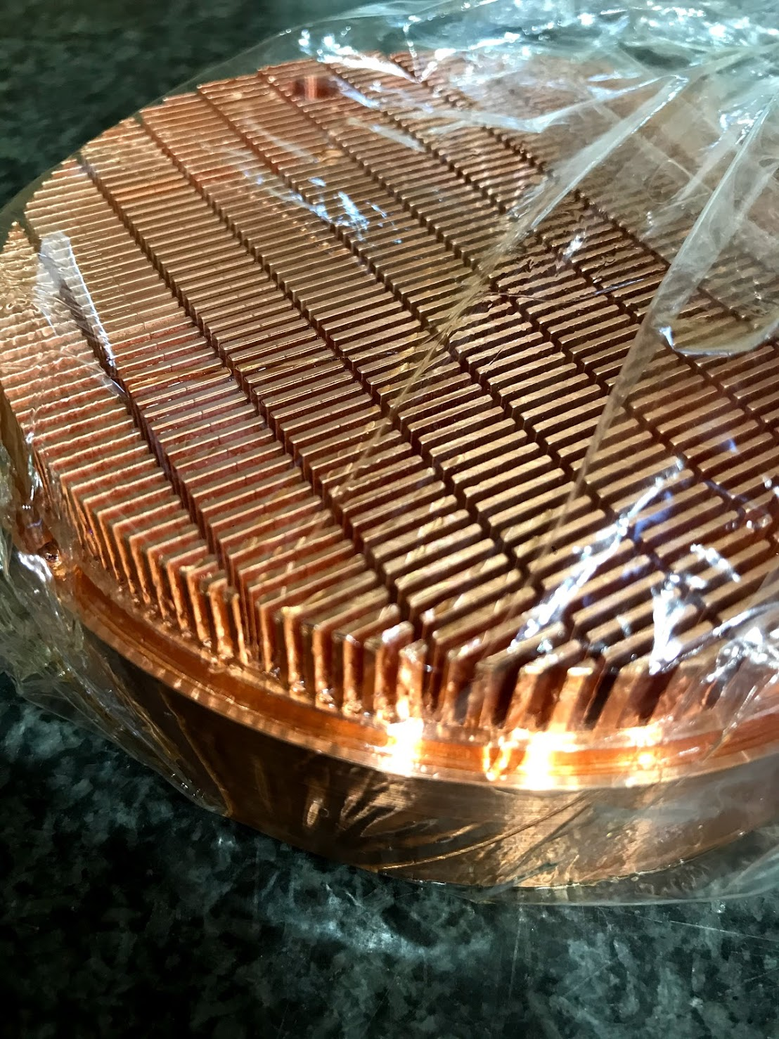
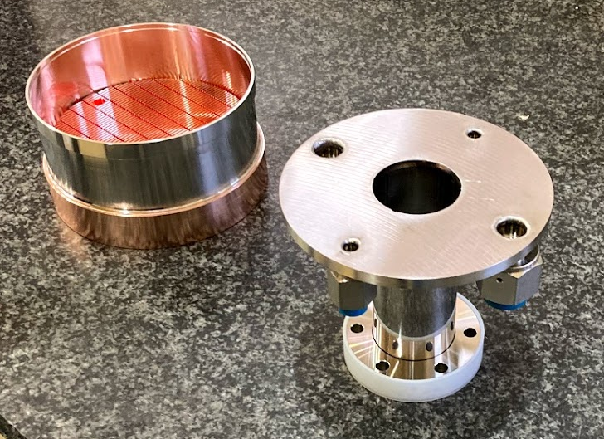
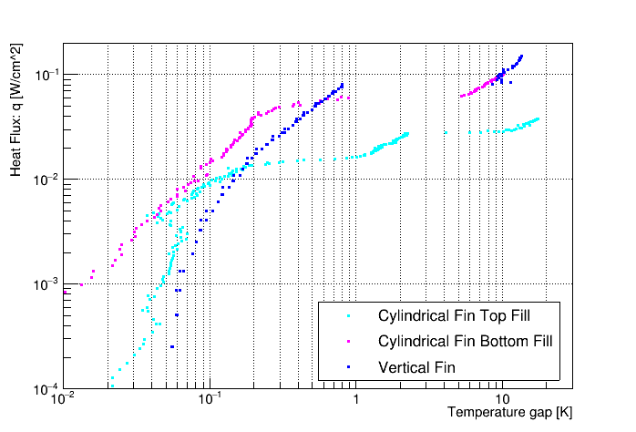
Boiling curve measurement
Cylindrical Fin model
top fill
Boiling Curve Measurements
Prototype
  cylindrical fin
    two supply path: bottom & top fill
  vertical fin
measure critical heat flux of film boiling
Condition
use helium-4
heat Cu of heater
See temperature gap (ΔT) between Cu and liq. helium
Results
Cylindrical Fin
  Top Fill: two jump
    first jump : push liquid upward
    0.01 W/cm²
  Bottom Fill:
    critical heat flux: 0.06 W/cm²
Vertical Vin
    critical heat flux: 0.08 W/cm²
bottom fill
Vertical Fin model
heater
boiling curve at 3.0 K
film boiling
2nd jump
1st jump

Slide 20
Actual Heat Exchanger design
Vertical fin model was selected
  larger critical heat flux
    for large safety margin
  low ³He operation is possible
    when there is not enough 3He to fill the fins, The vapor path of the cylindrical fin model becomes a narrow long channel.
  Heat flux : 1.1×10⁻³ W/cm²
Sensor and Heaters
  7 temperature sensors (Cernox)
    3 for liquid helium-3 (SD type)
    4 for HEX1 (CU type)
      2 optional mounts to see horizontal temperature gradient along the HEX
  Heater
    for baking & cryogenic test
    300 W
      3 × 100 W (25Ω) heater
    take 4 hours for heating up to 120 degree
3He pumping
3He supply
IP He supply
S-Bend
tail
optional
Heaters
Temp. sensors (cernox)

Slide 21
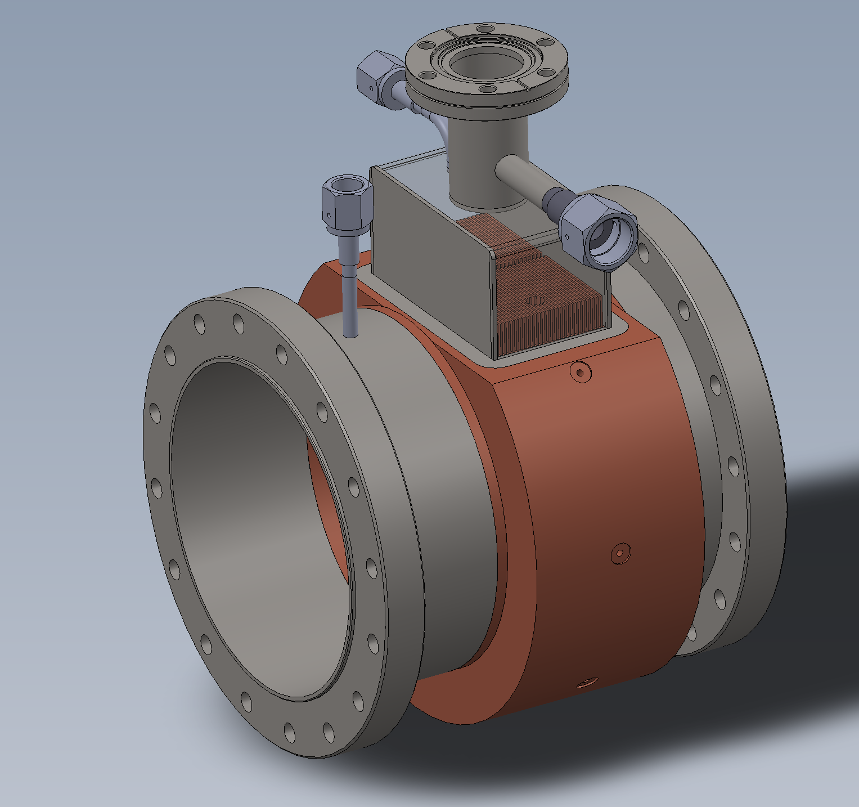
Short prototype model
Short prototype model
  test for fabrication process
    EBW for end flanges
    polishing
    NiP plating
    Fin machining
    top jacket EBW
  1/10 length model
    number of fins: 27
      cf) full model: 291 fins
    Can be useful for cryogenic test
      5 temperature sensors
        2 in 3He volume
          inside fin & above fin
        4 on Cu
      Heater is mounted for the boiling curve measuemrent
3He pumping
3He supply
IP He supply
4. fin machining
5. top jacket EBW
1. flange EBW
2. polishing
3. NiP plating

Slide 22
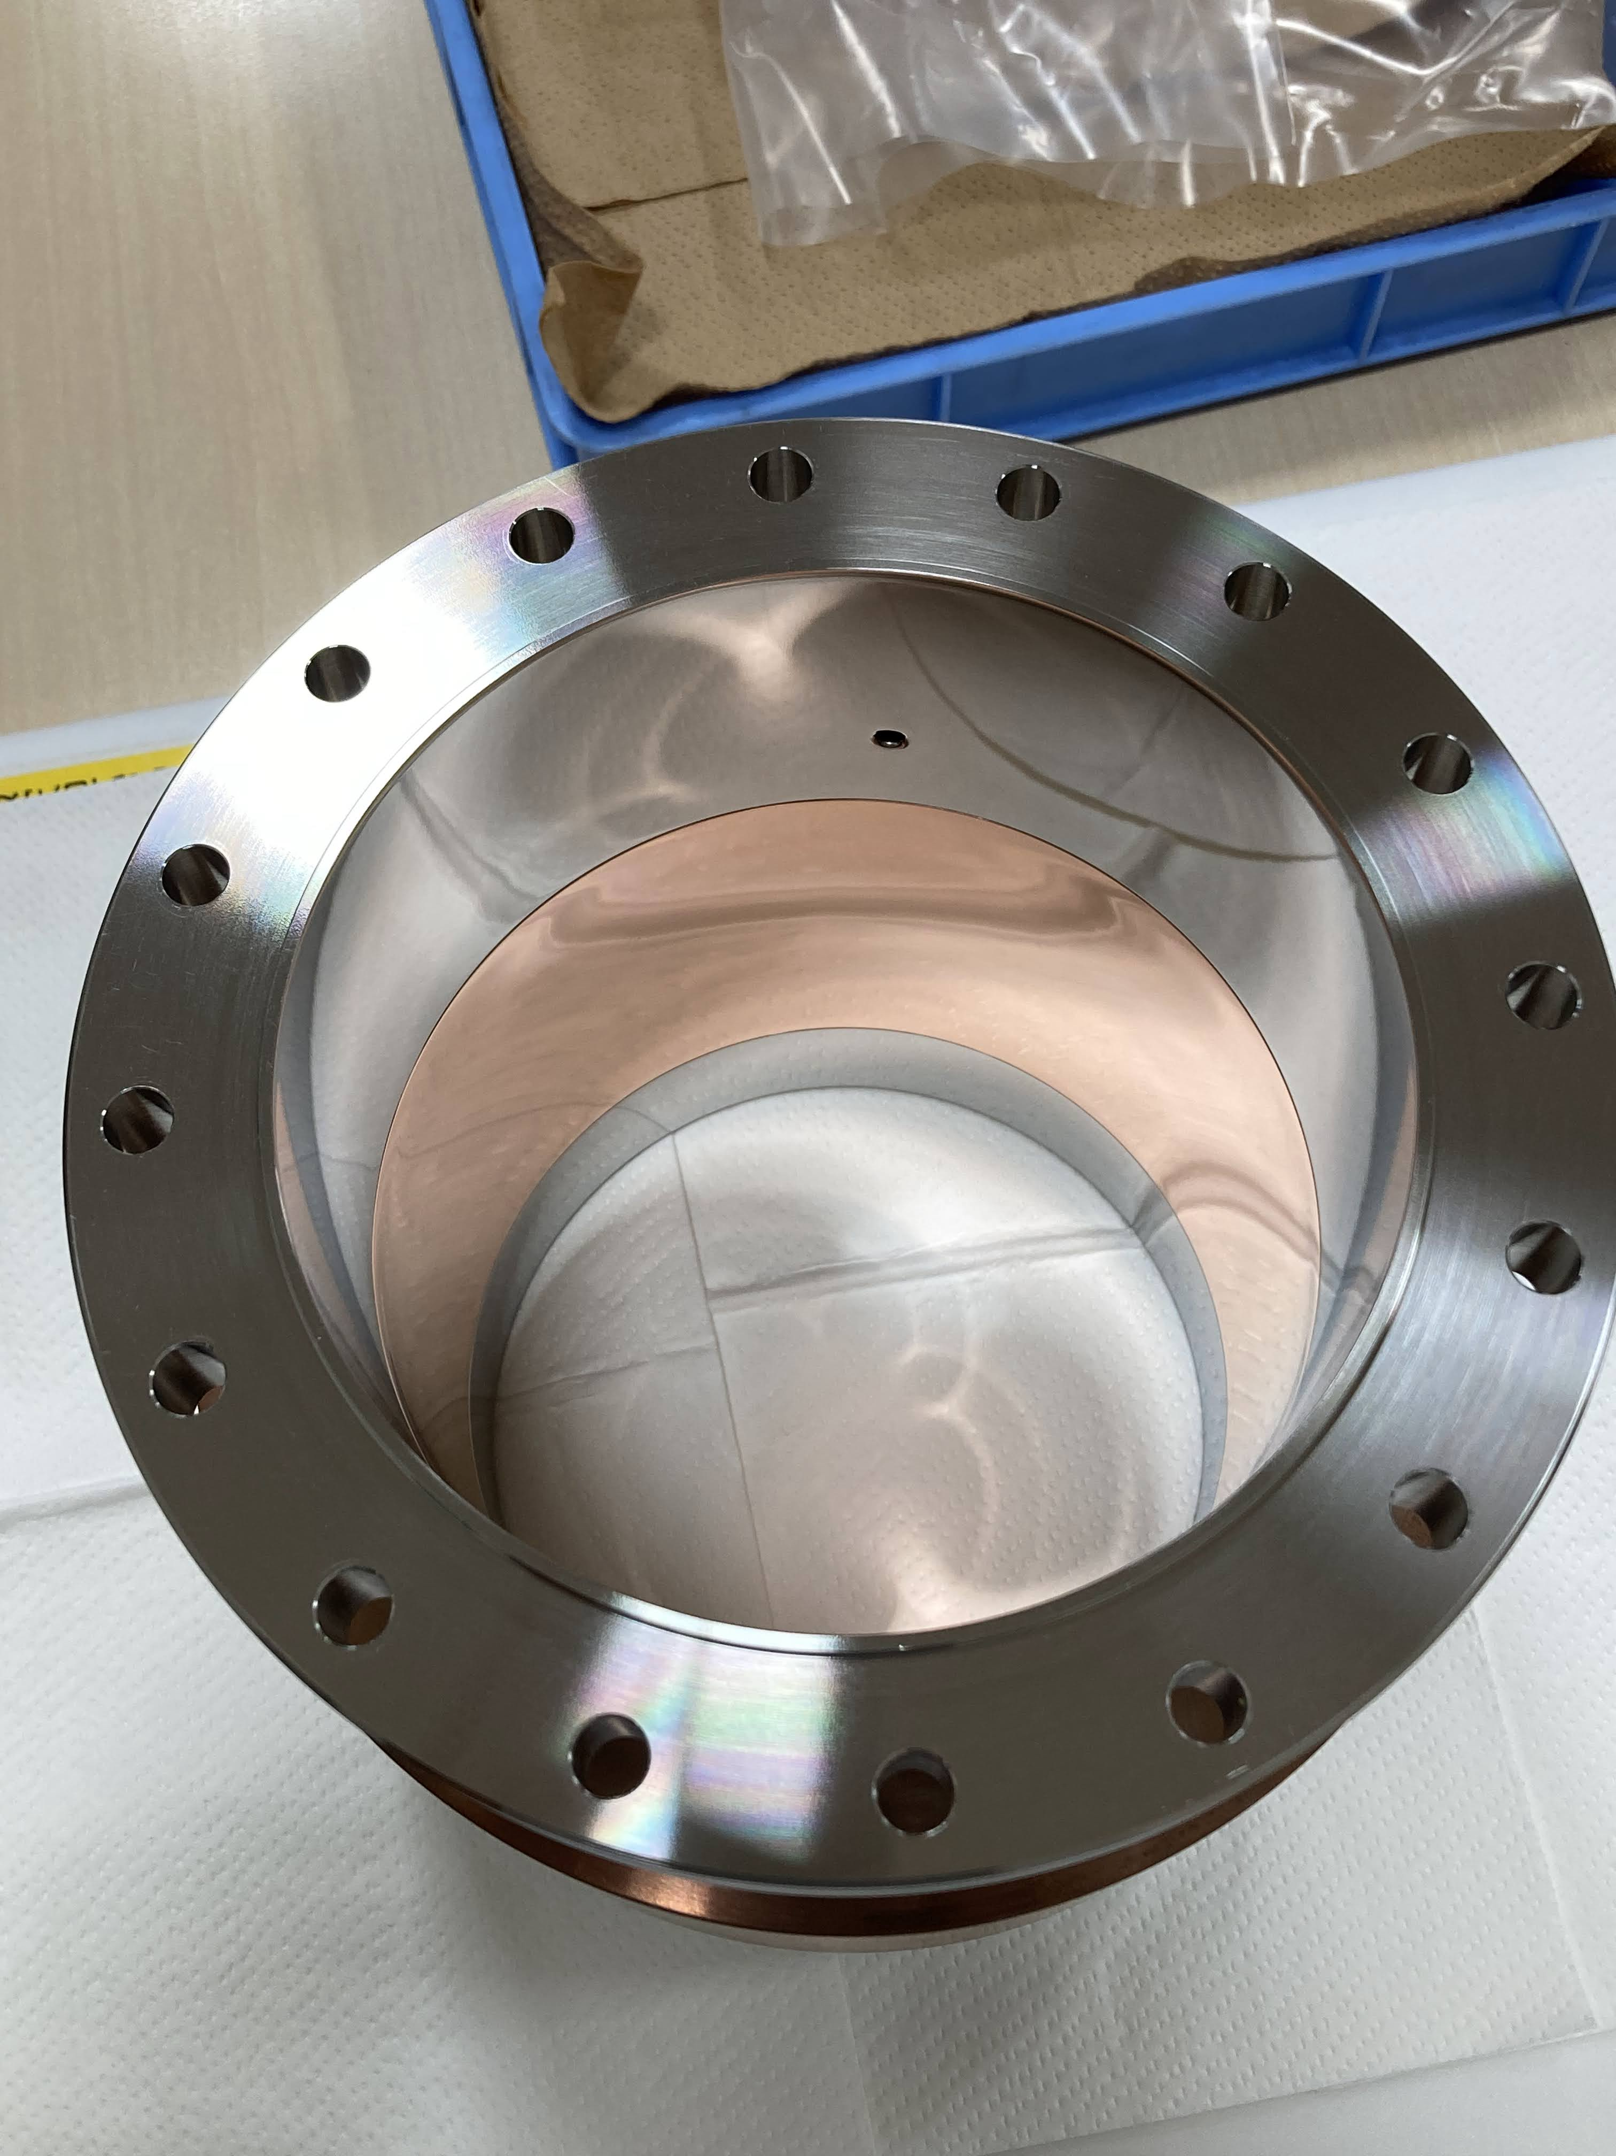
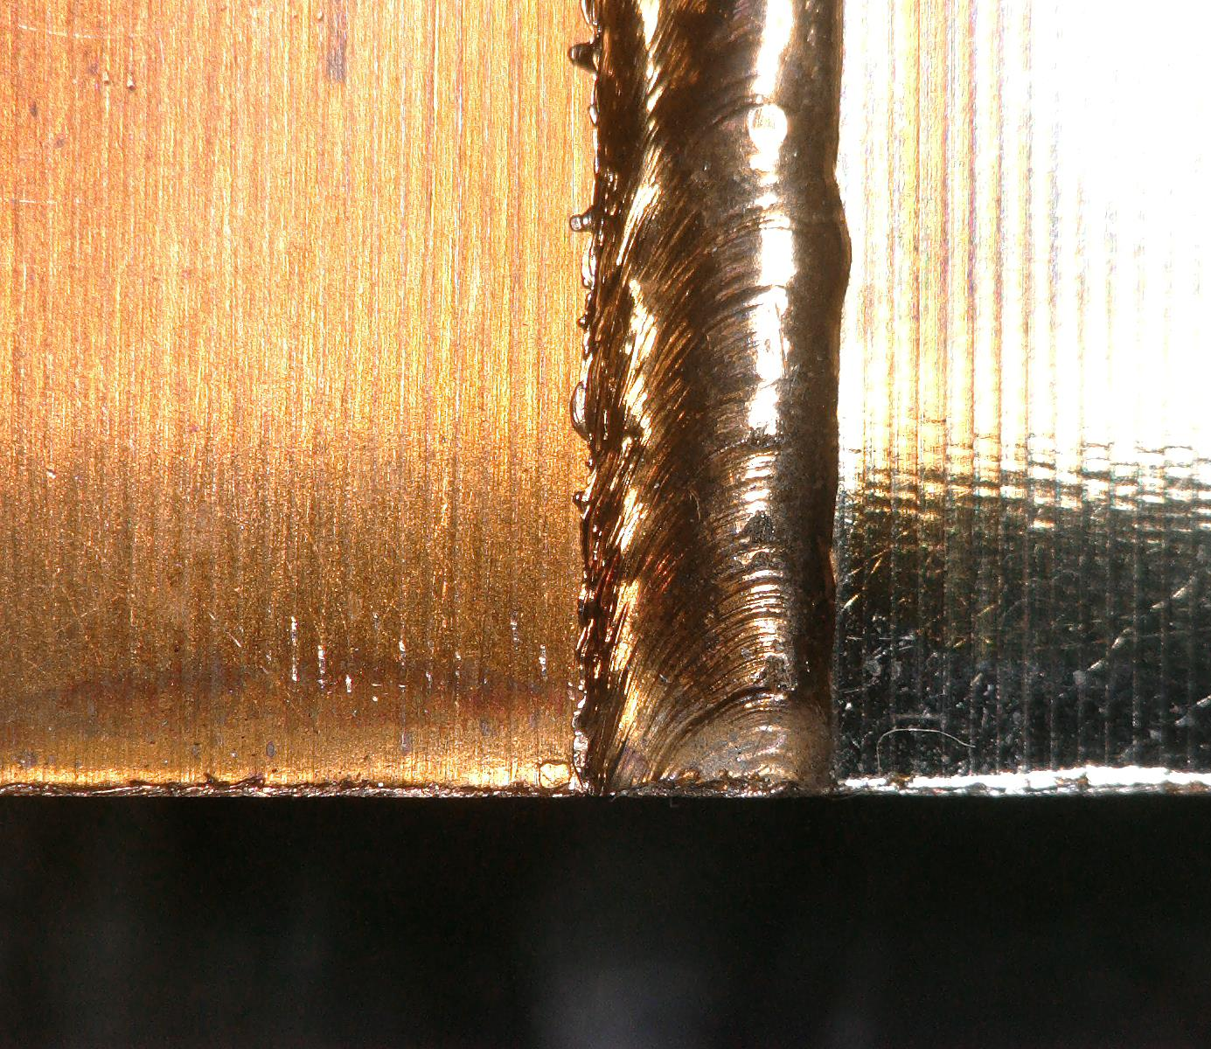
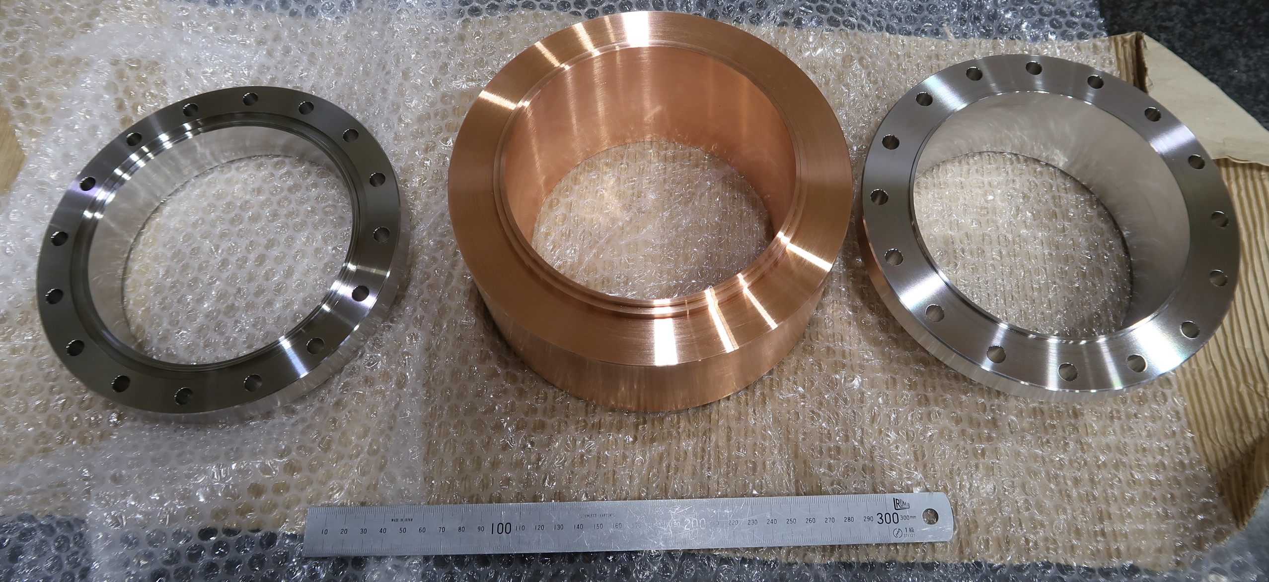
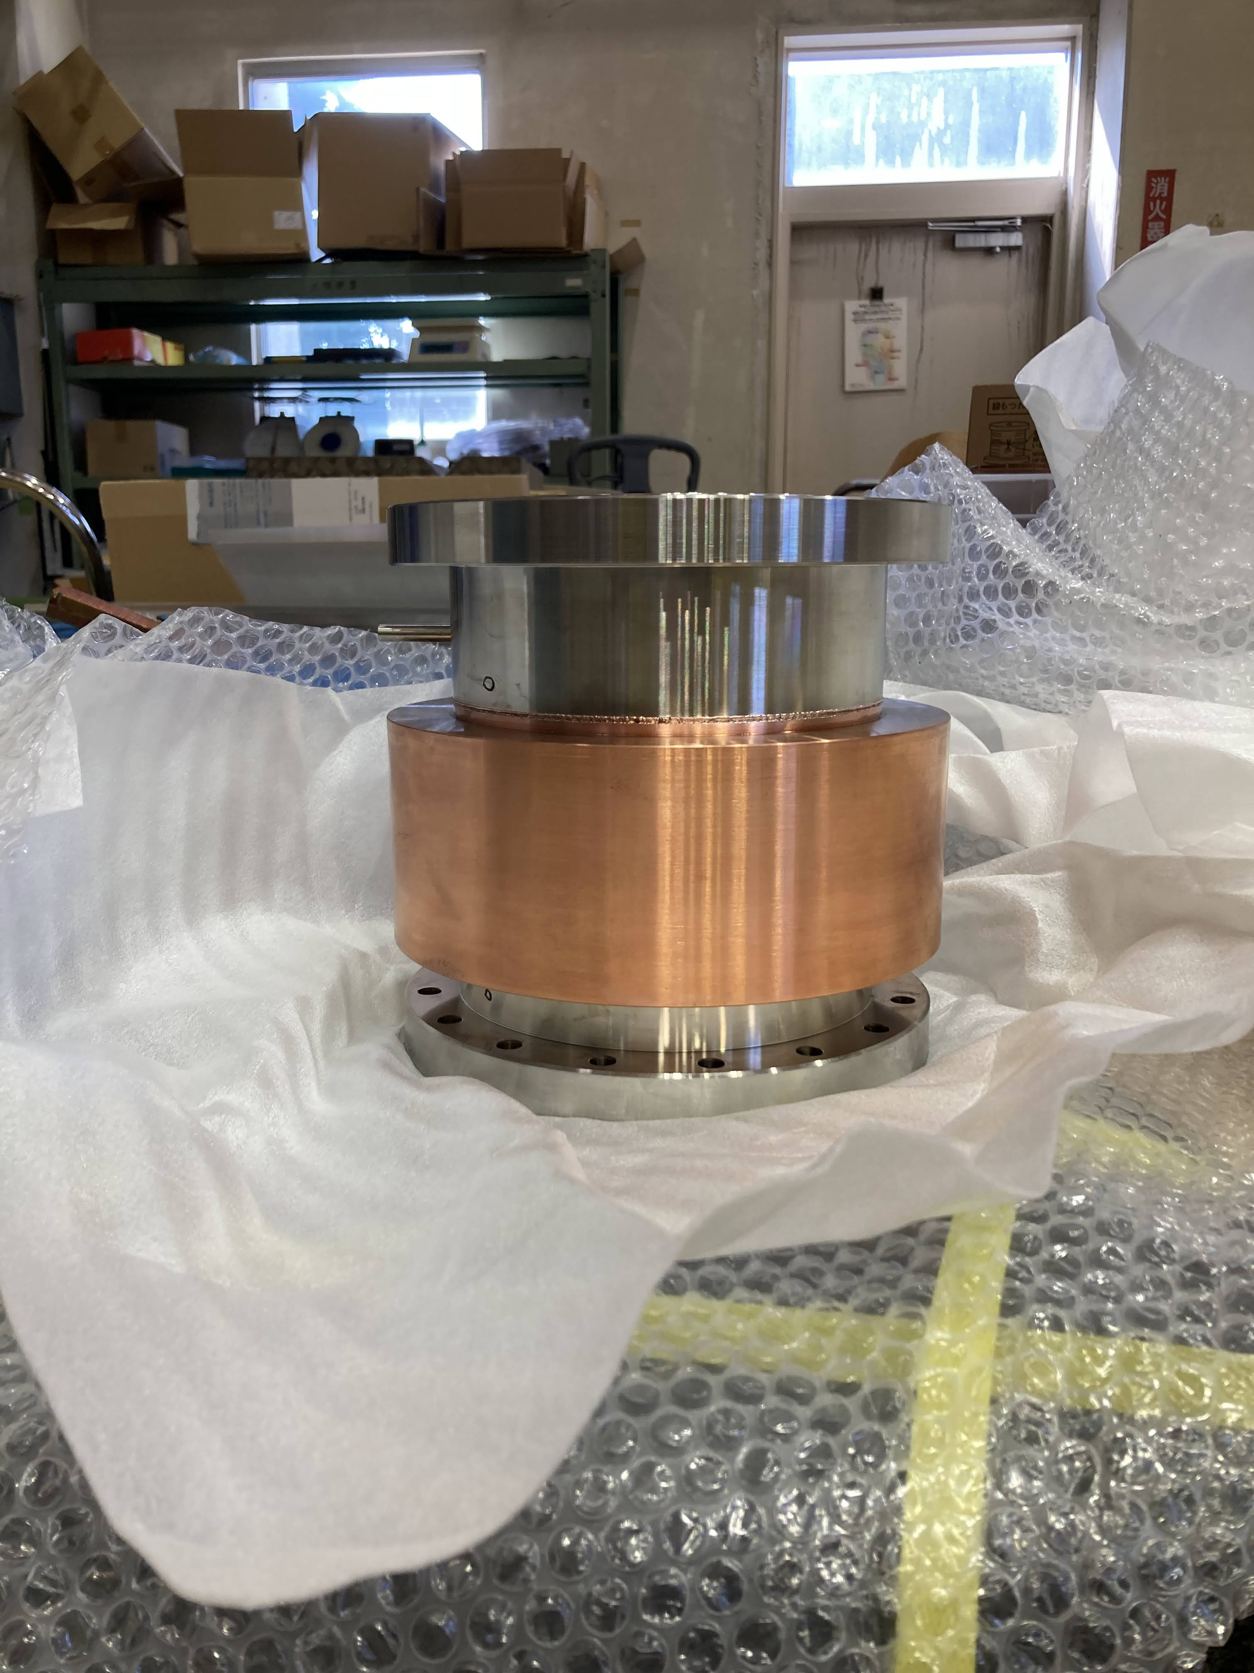
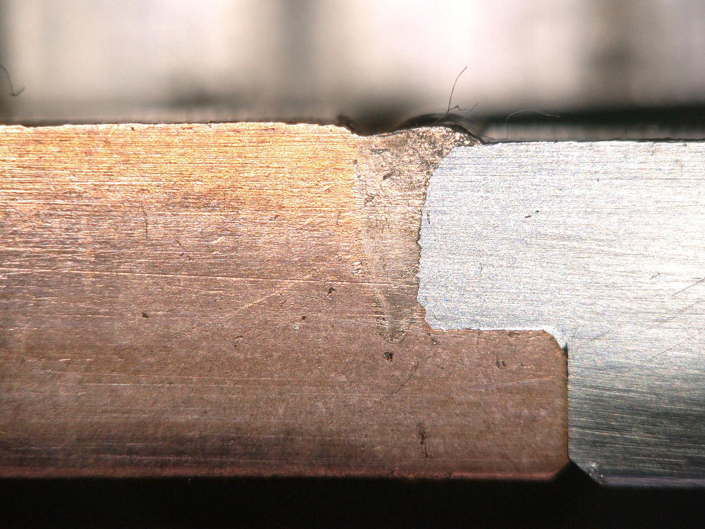
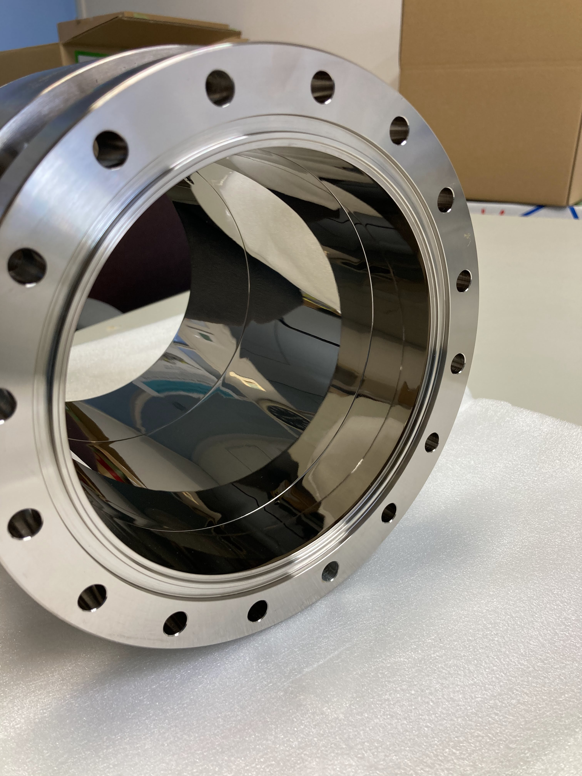
Short Model fabrication
Polishing
EB welding test
flange EB weld
@SUS
Ra = 0.019 μm
Rz = 0.11 μm
@Cu
Ra = 0.020 μm
Rz = 0.14 μm
NiP plating
Thickness
5 μm
P fraction
12.36 %
(X-ray fluorescence analysis)

Slide 23
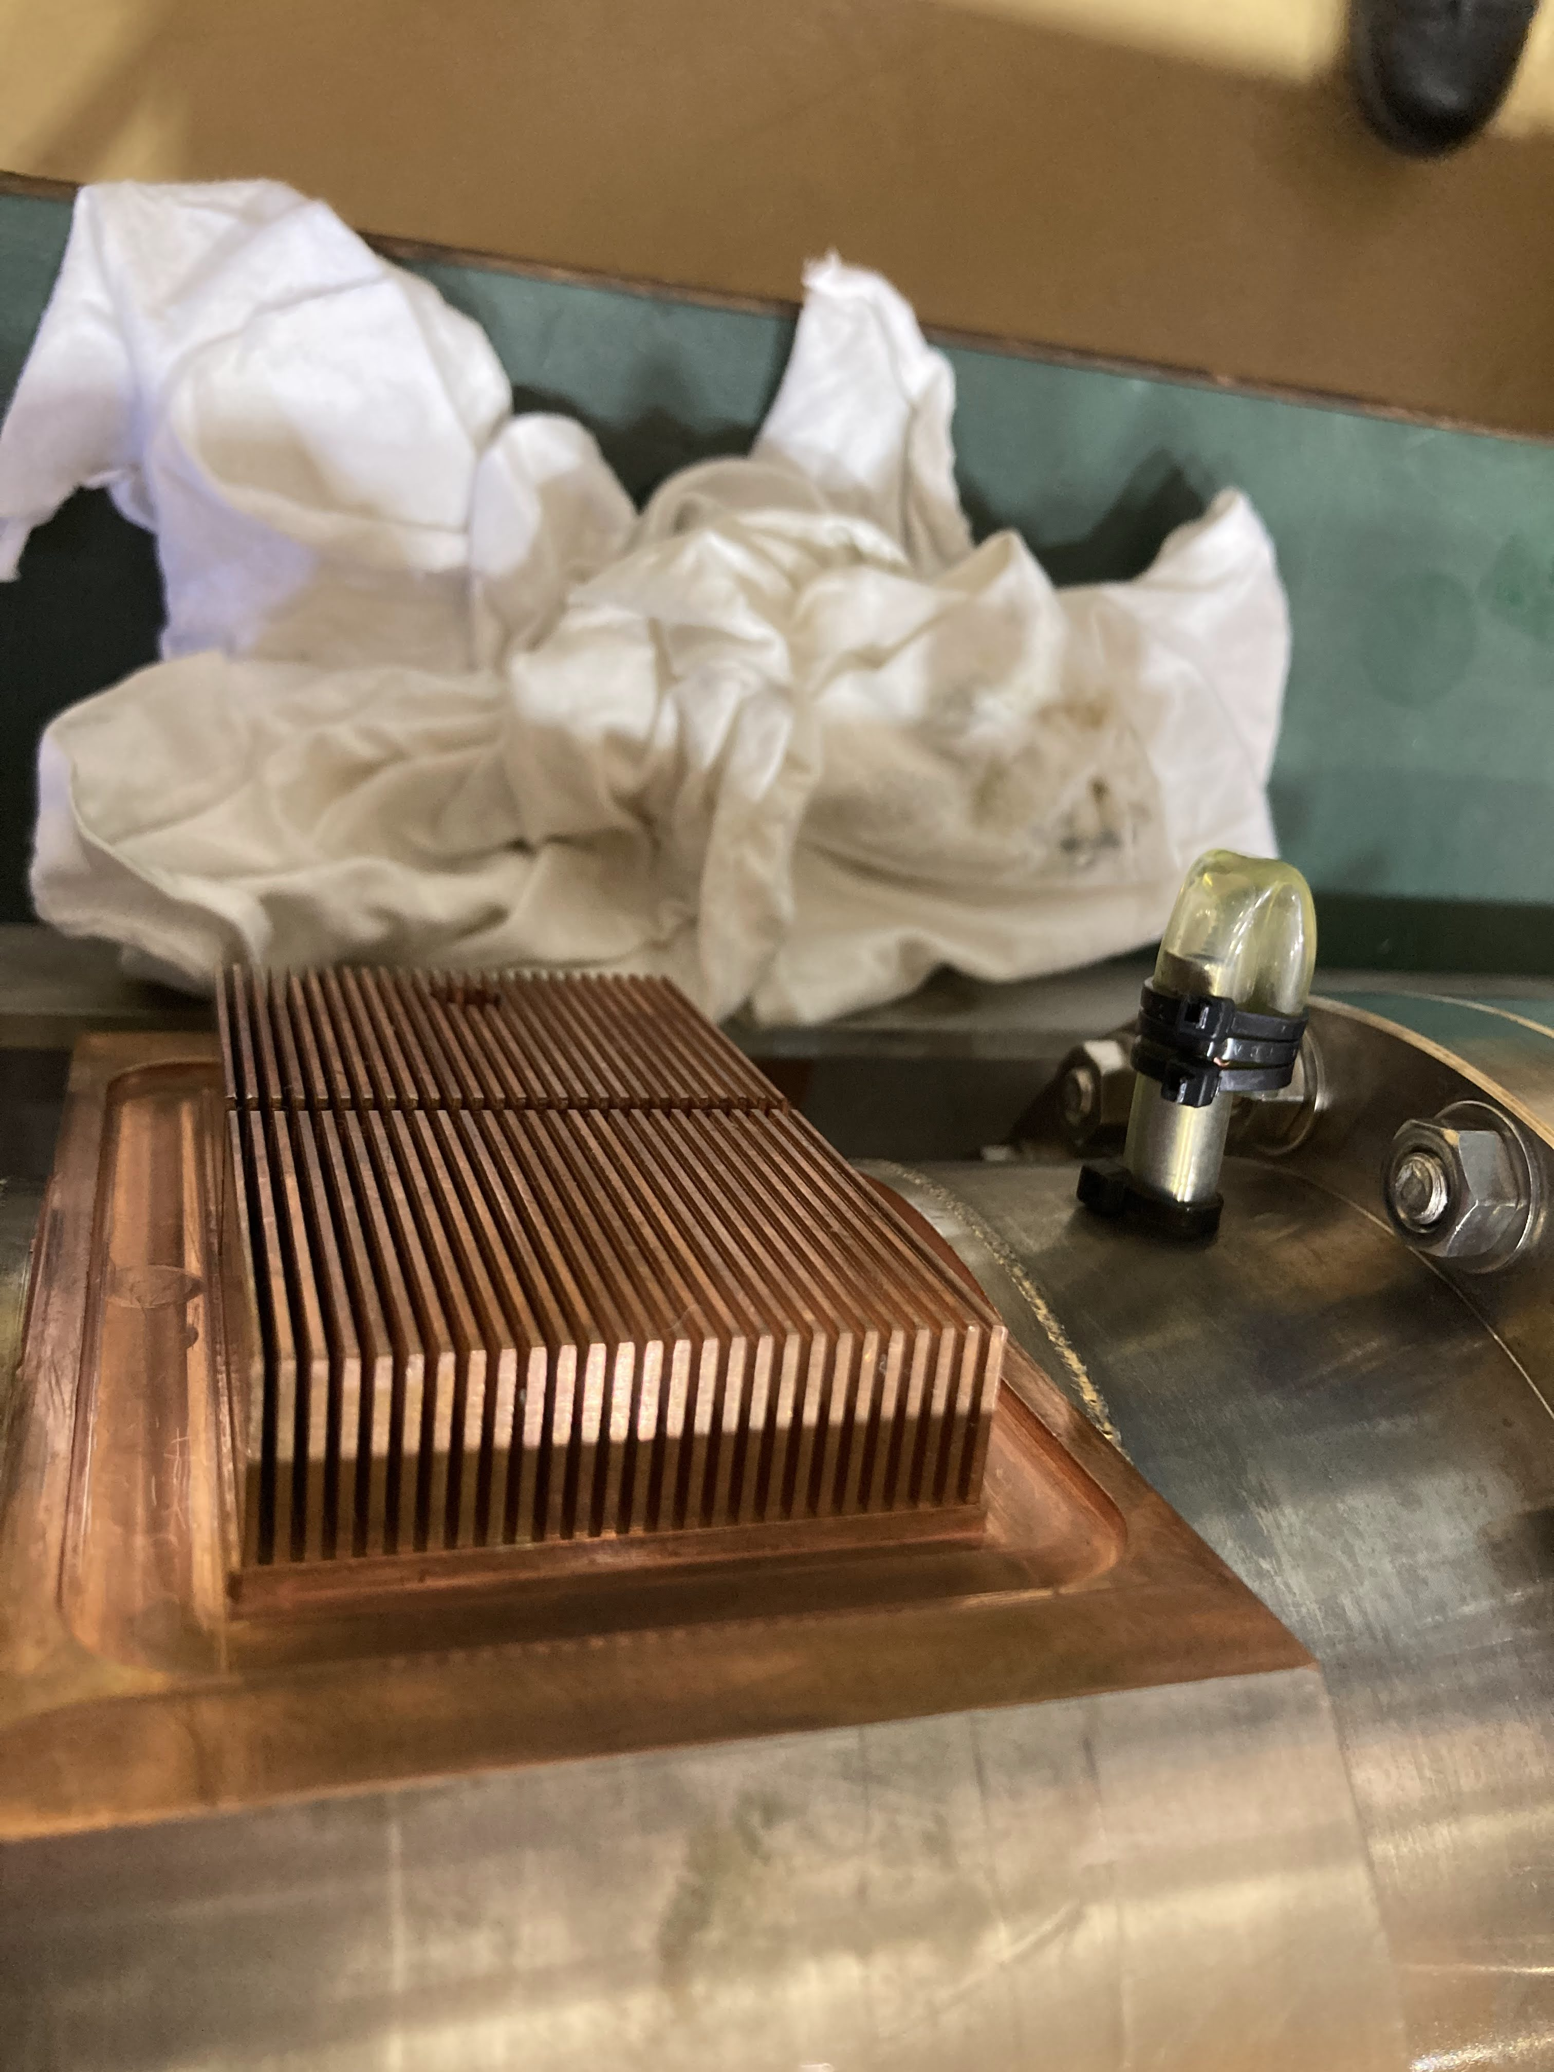
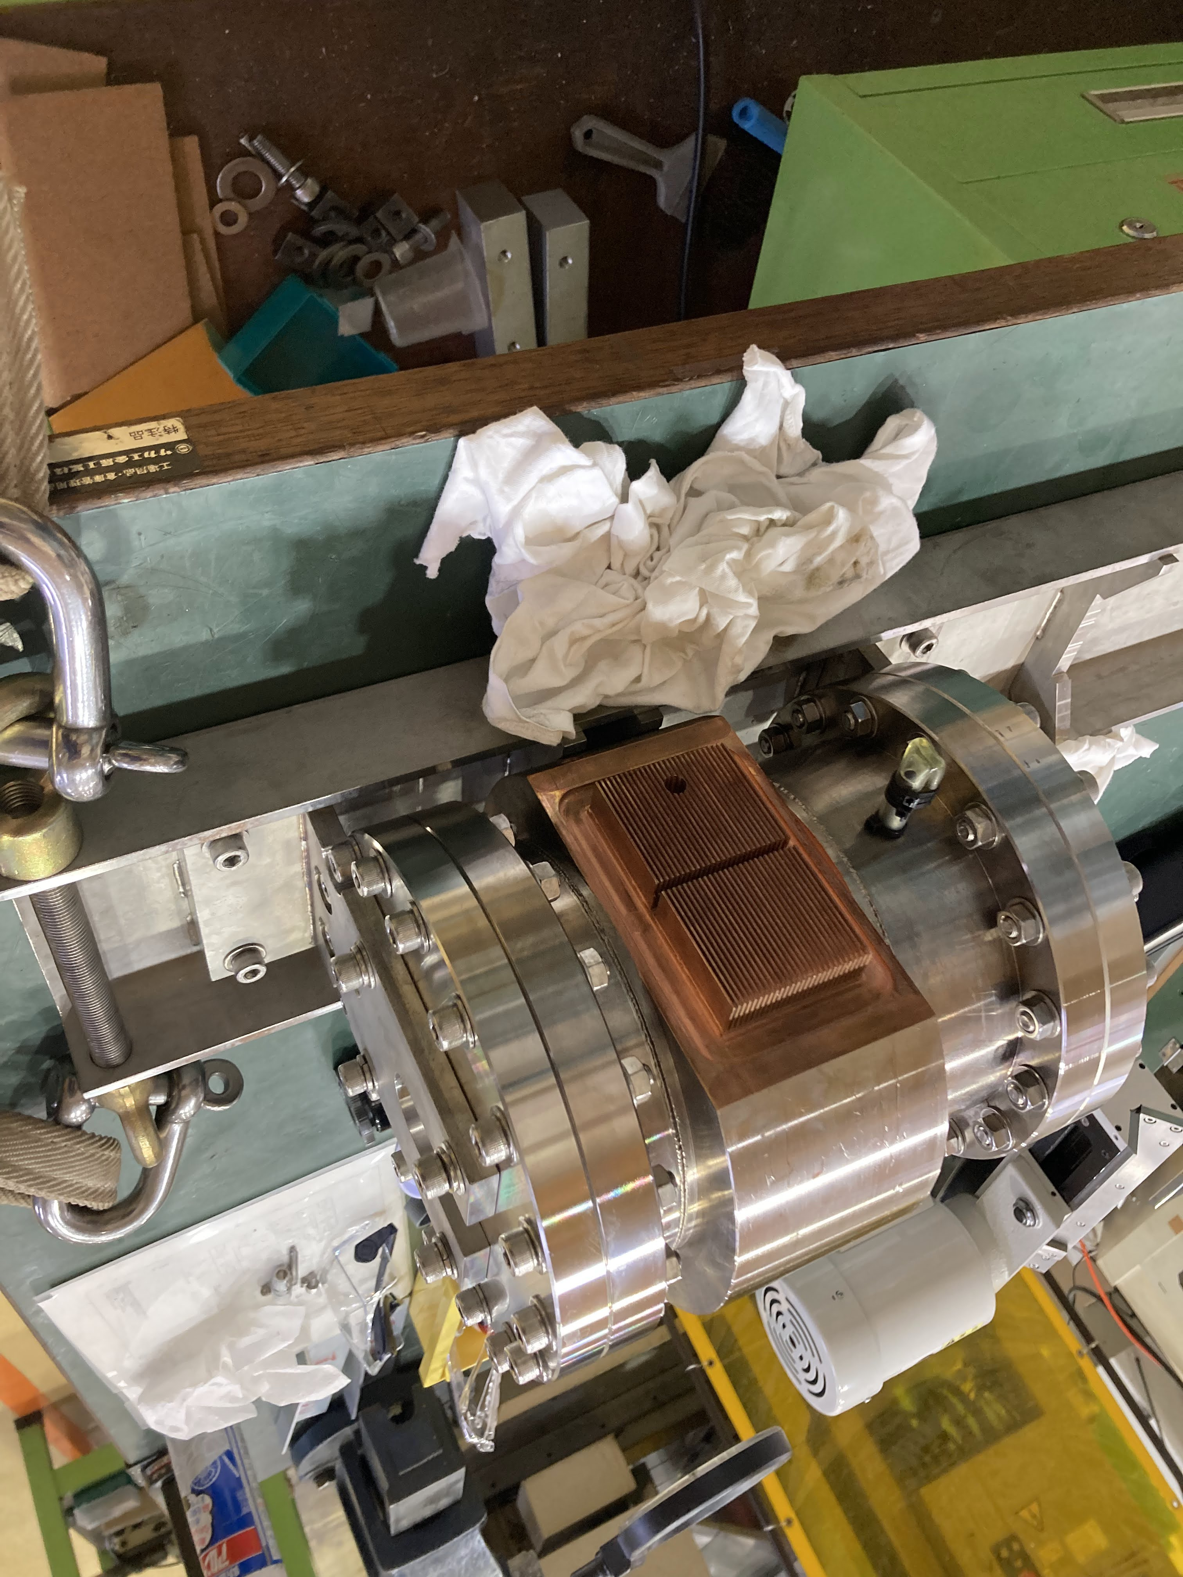
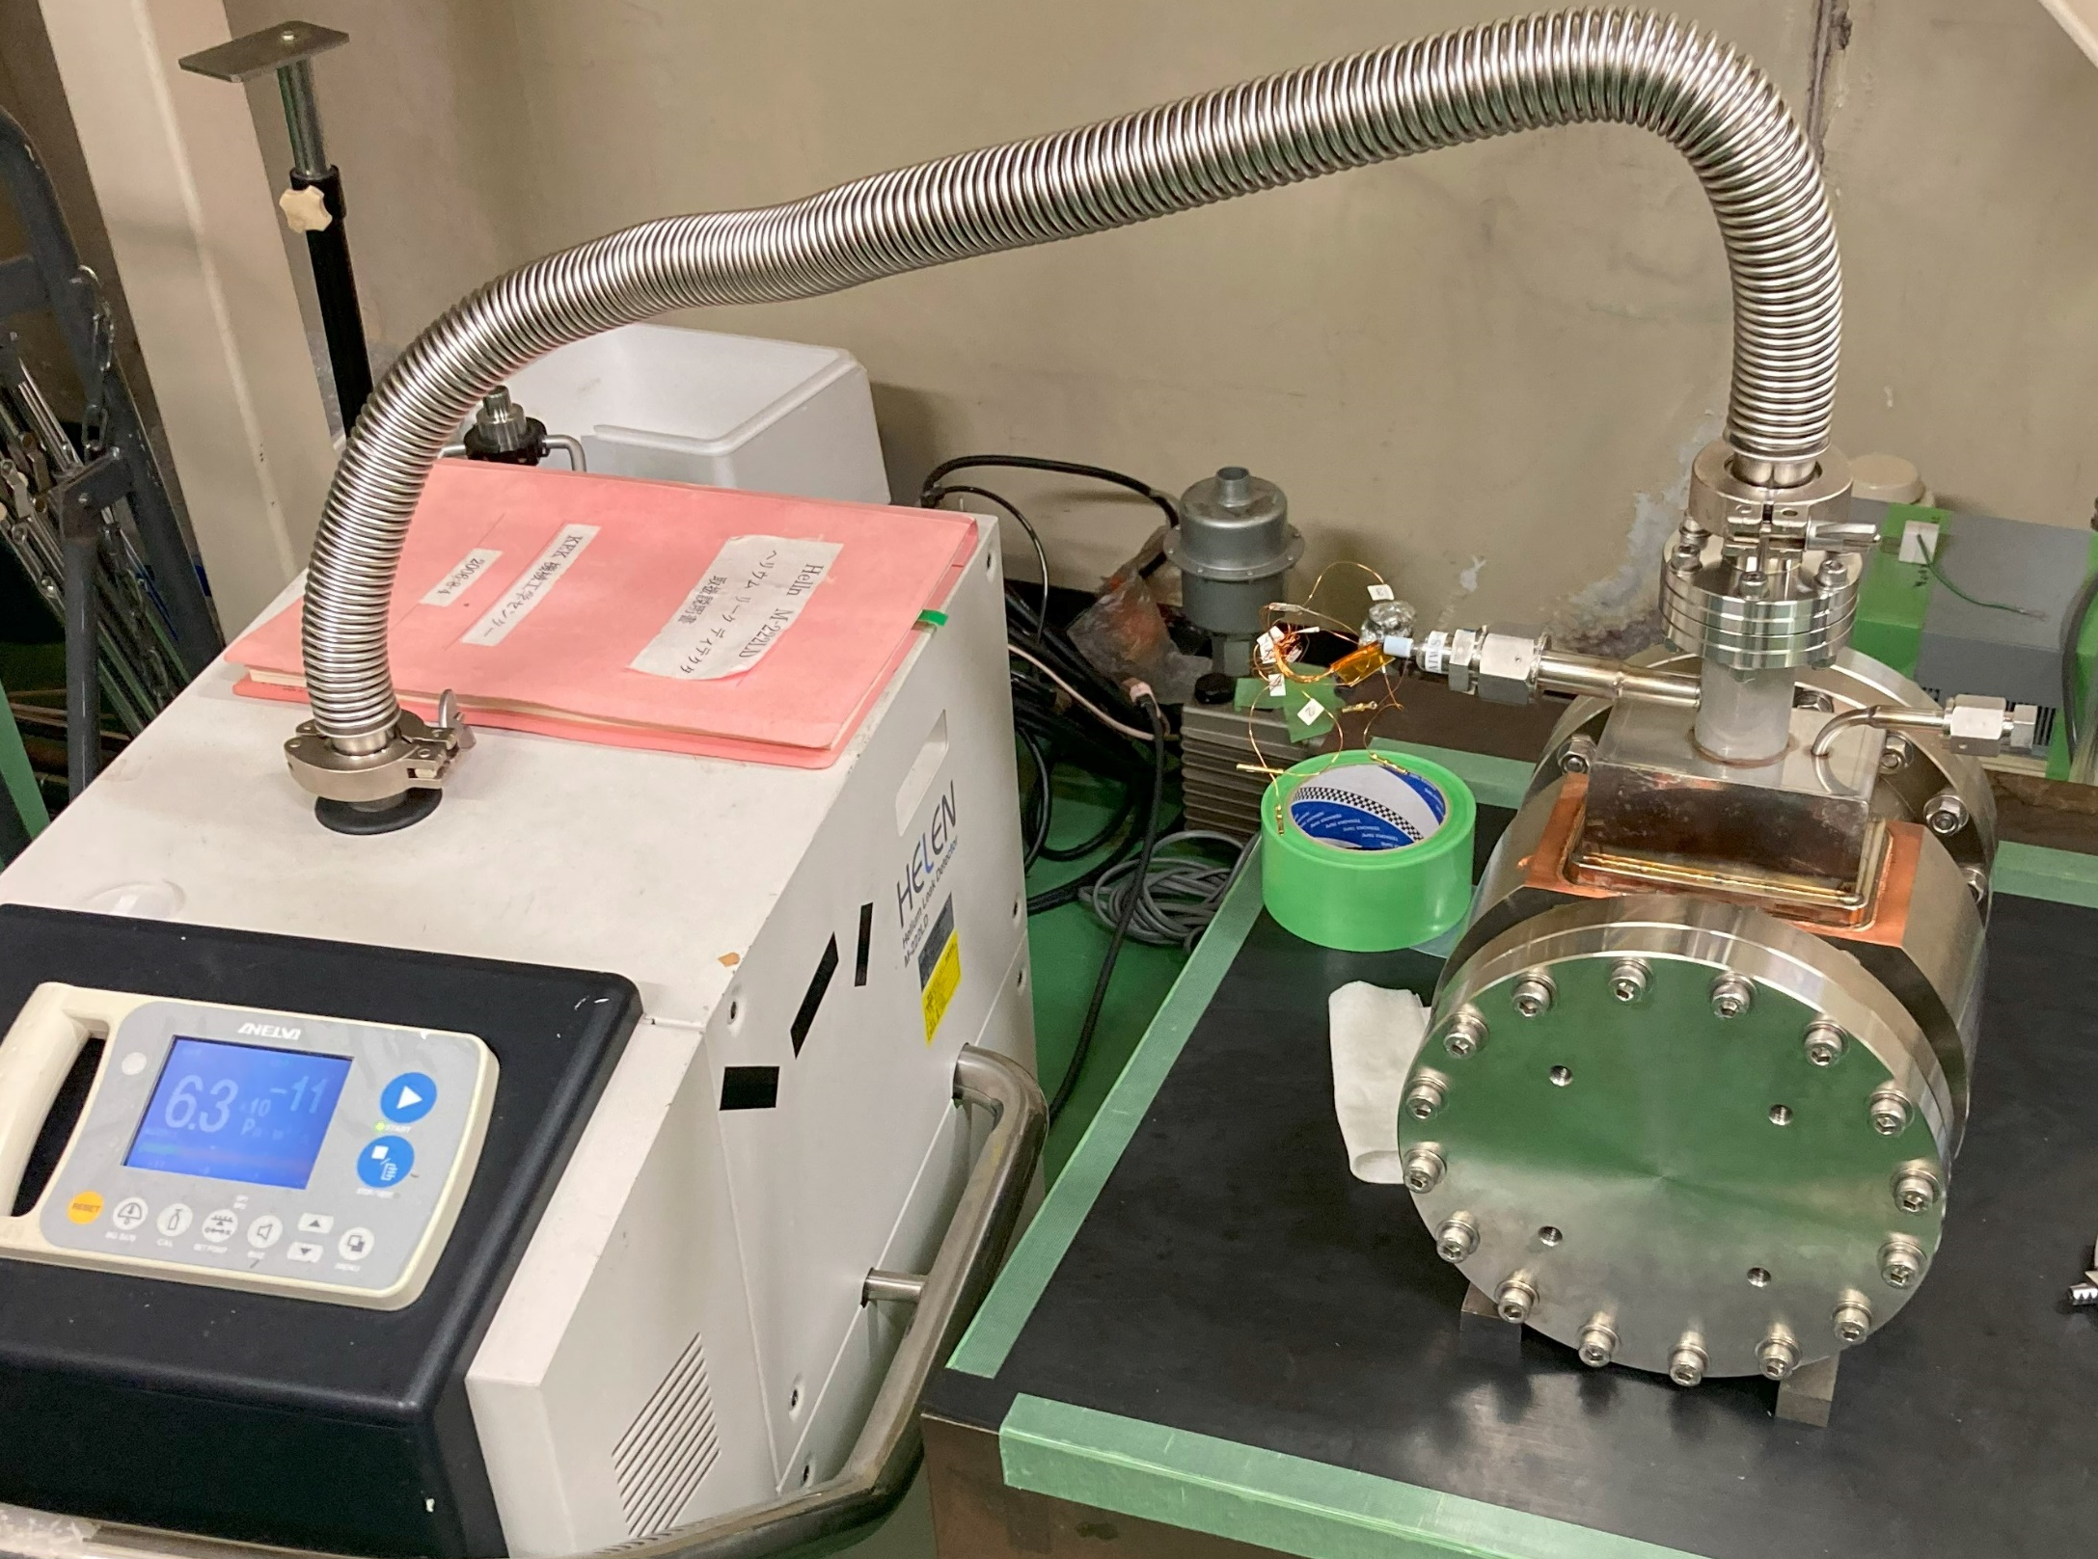
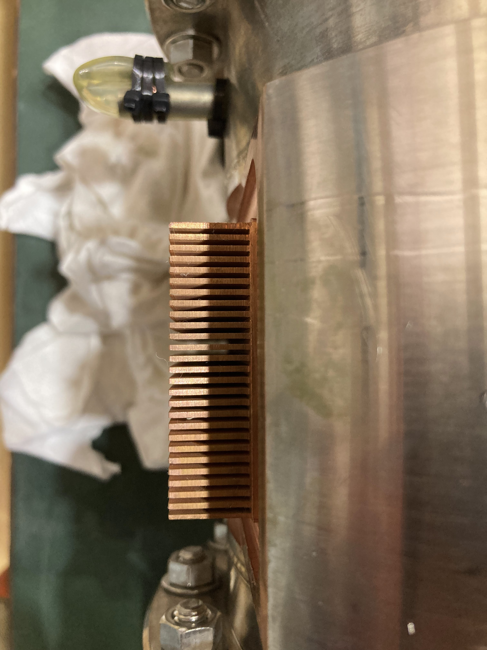
Fin machining of the short prototype
Test of fin machining was done in the KEK machine shop. The fins were fabricated by wire cut.
The fins will be cleaned and send to the jacket EB welding.
The prototype was completed after checking every step of the process.

Slide 24
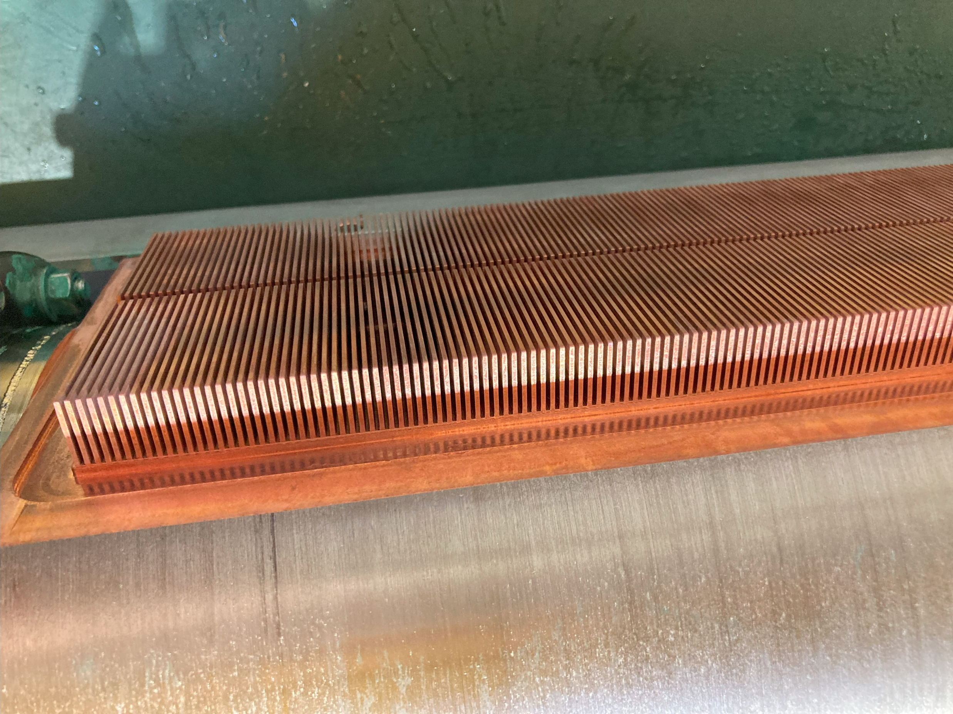
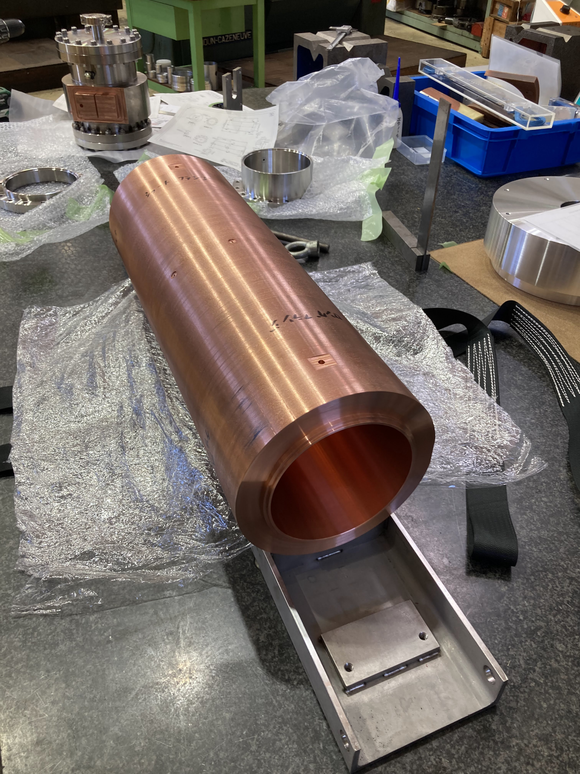
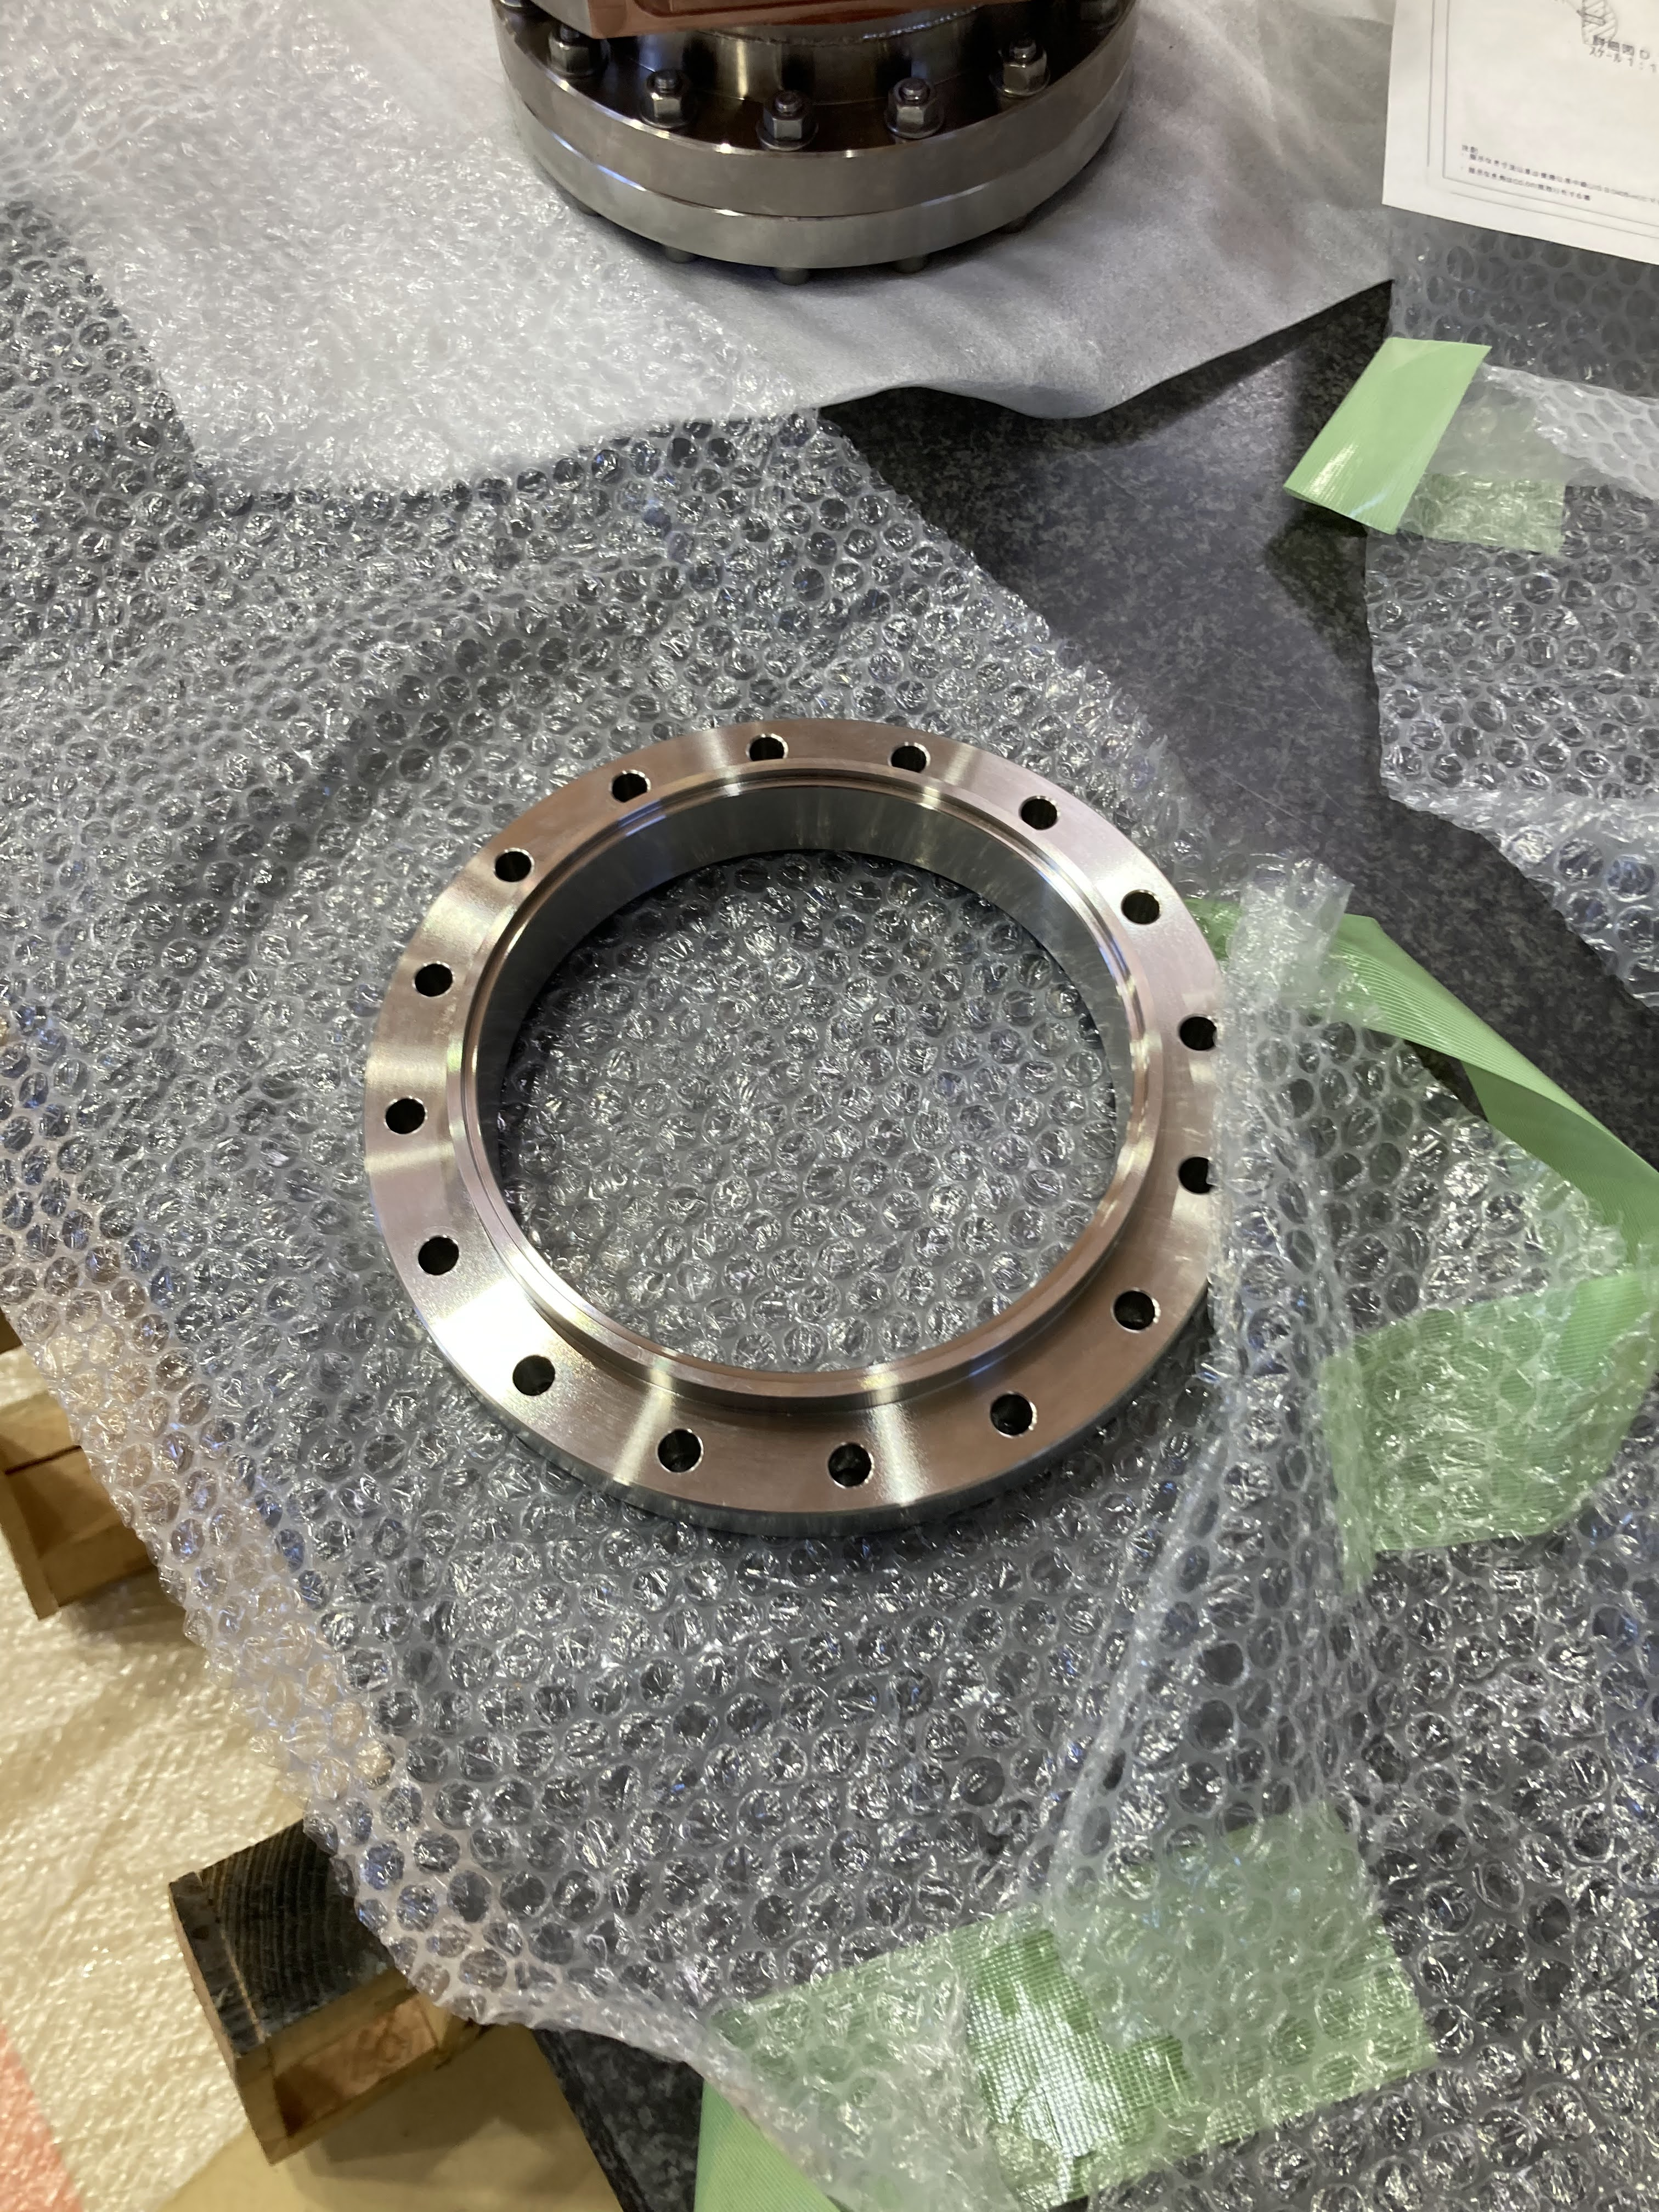
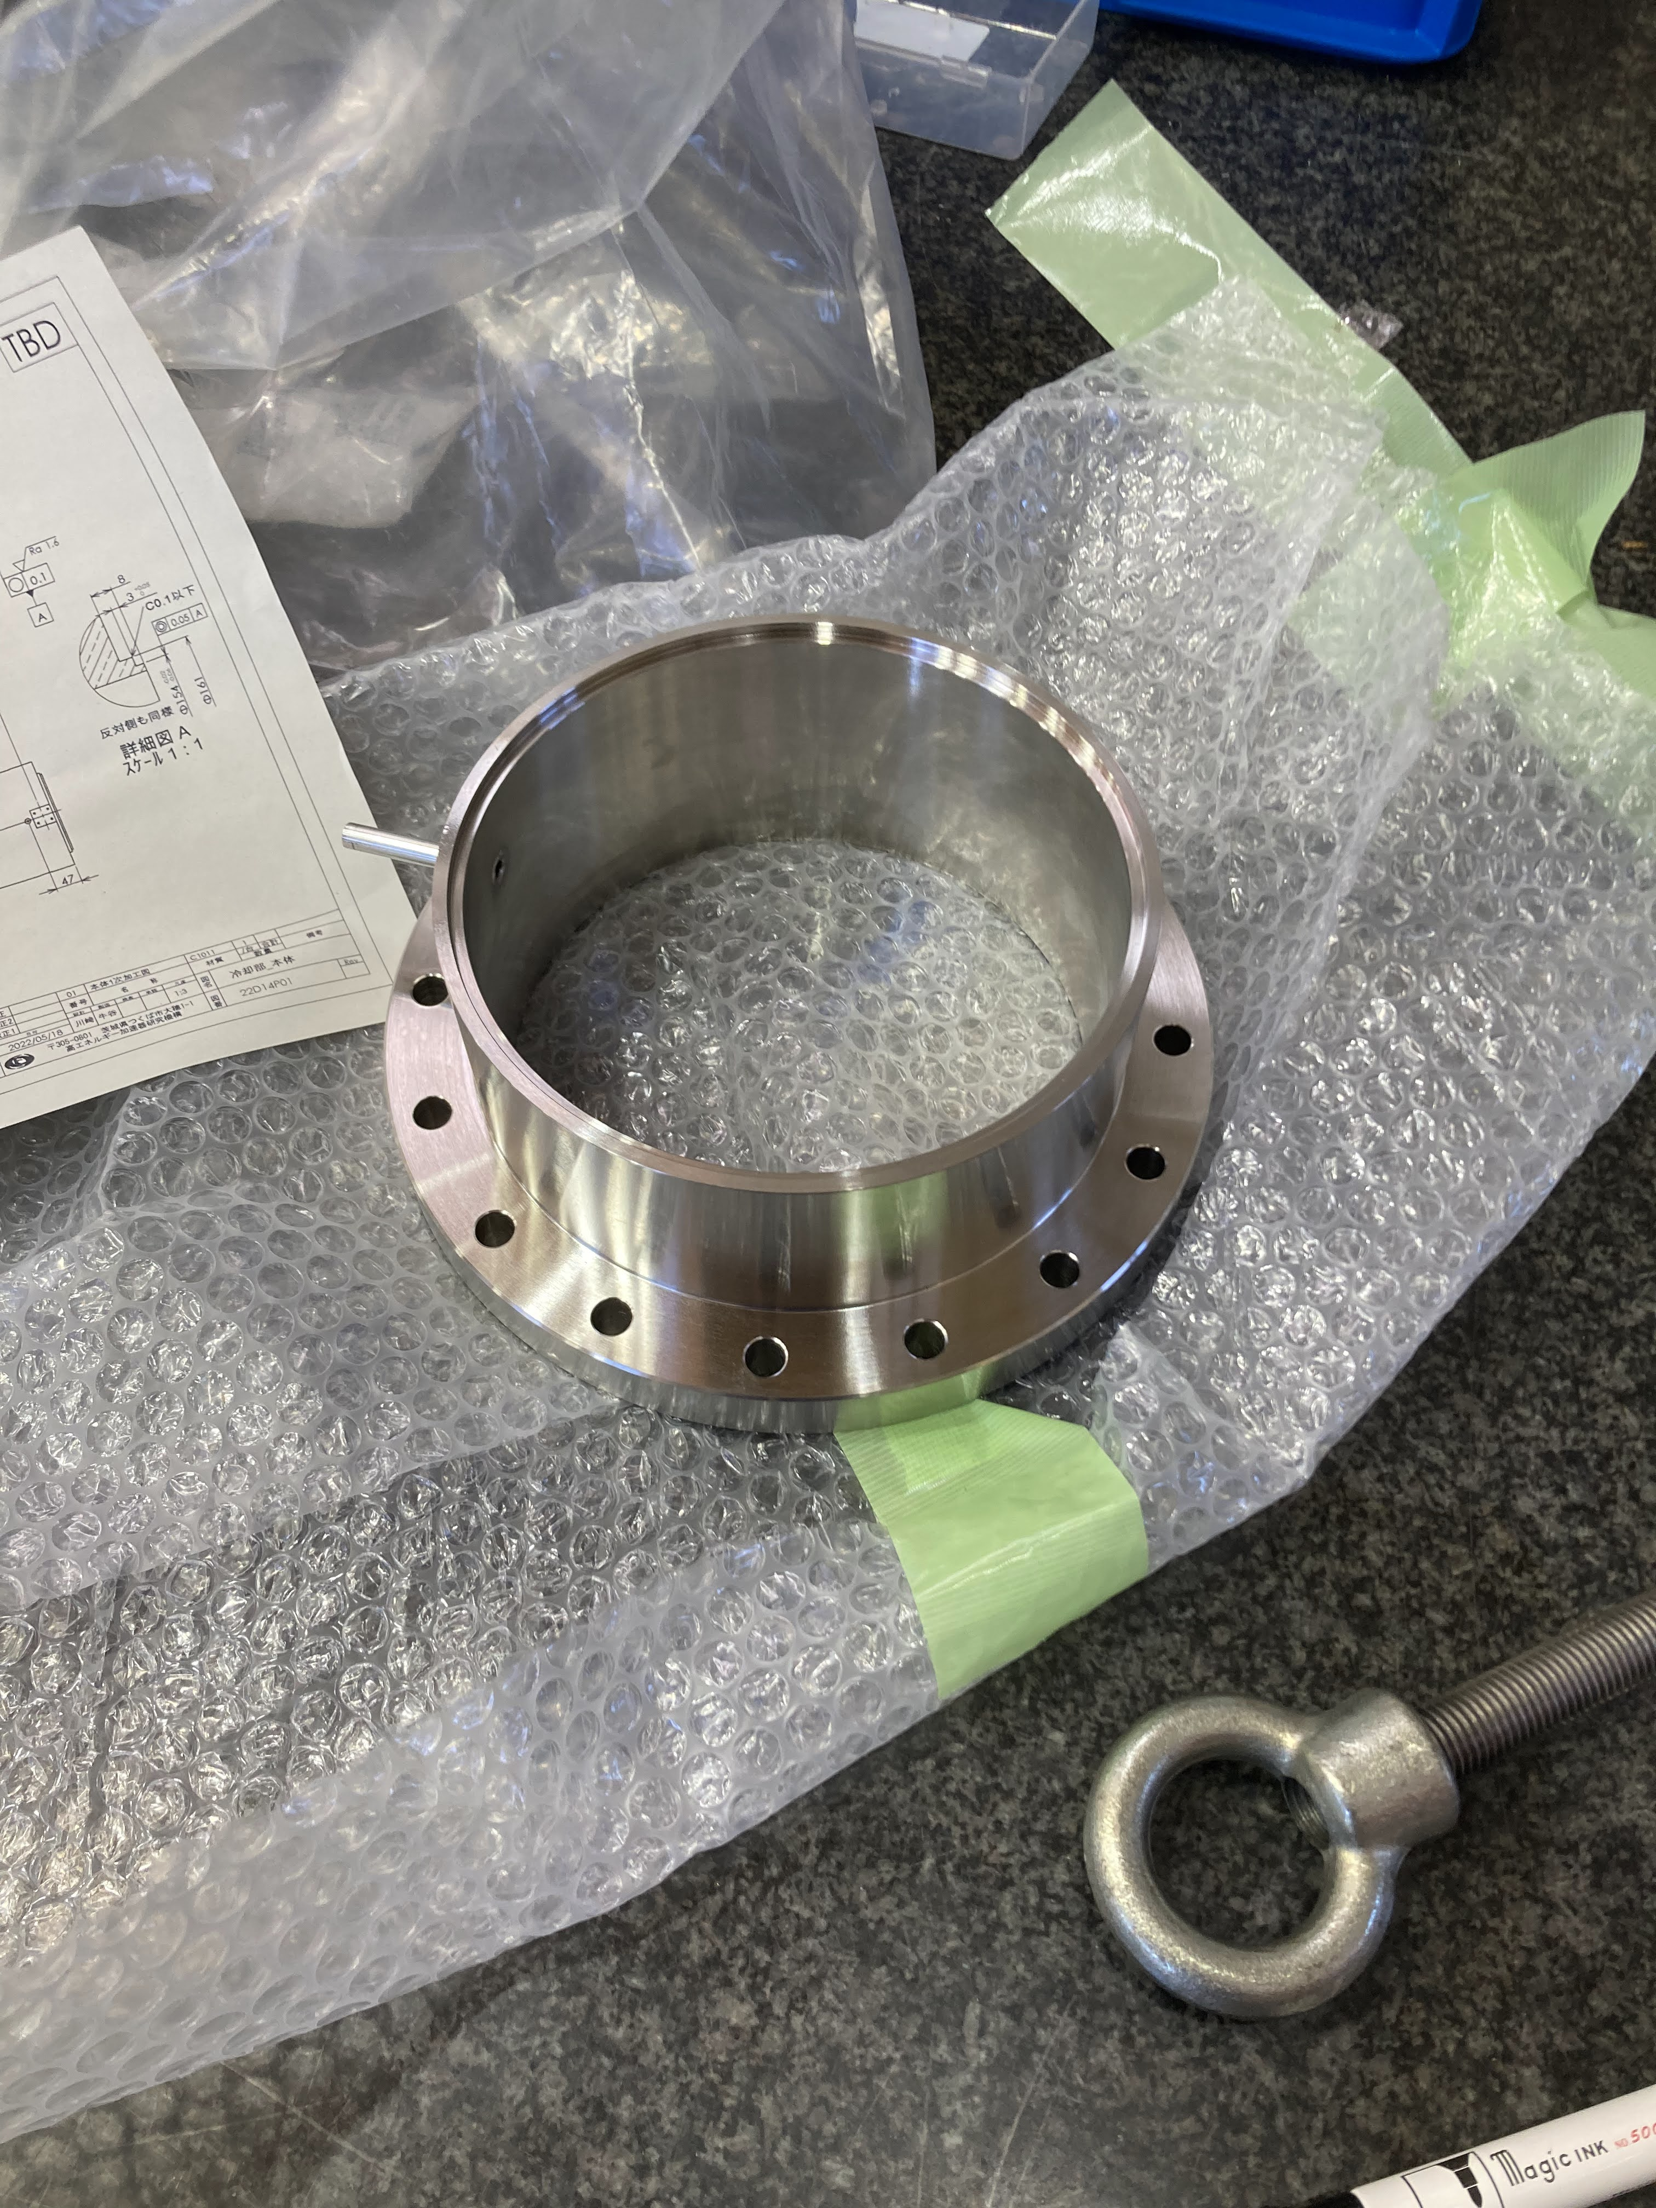
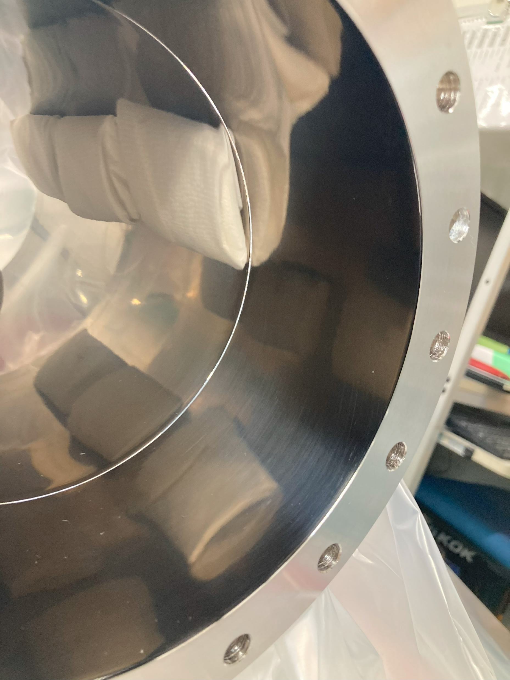
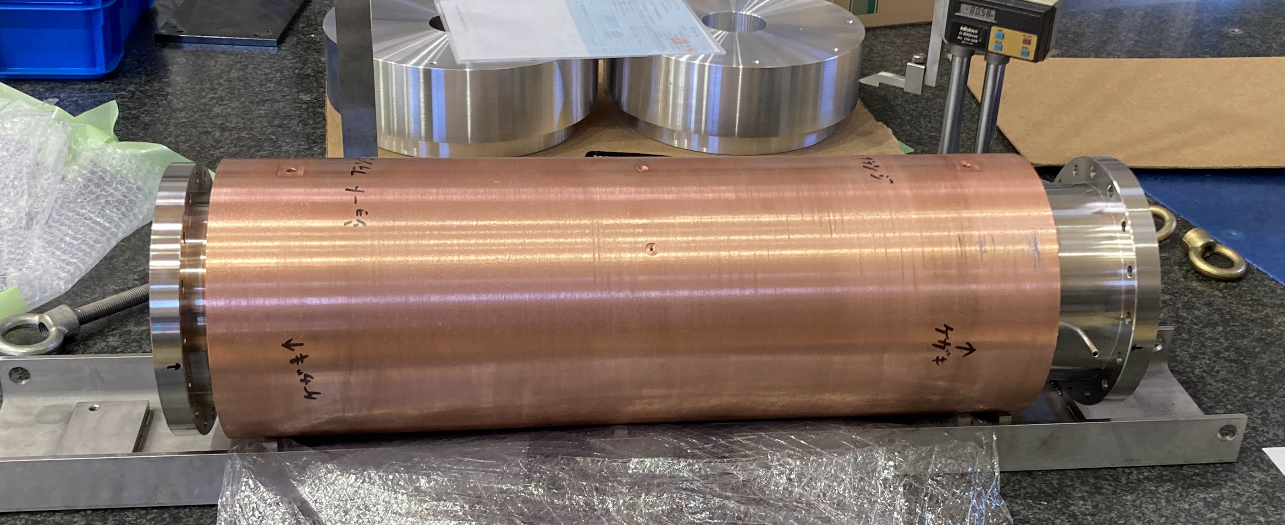
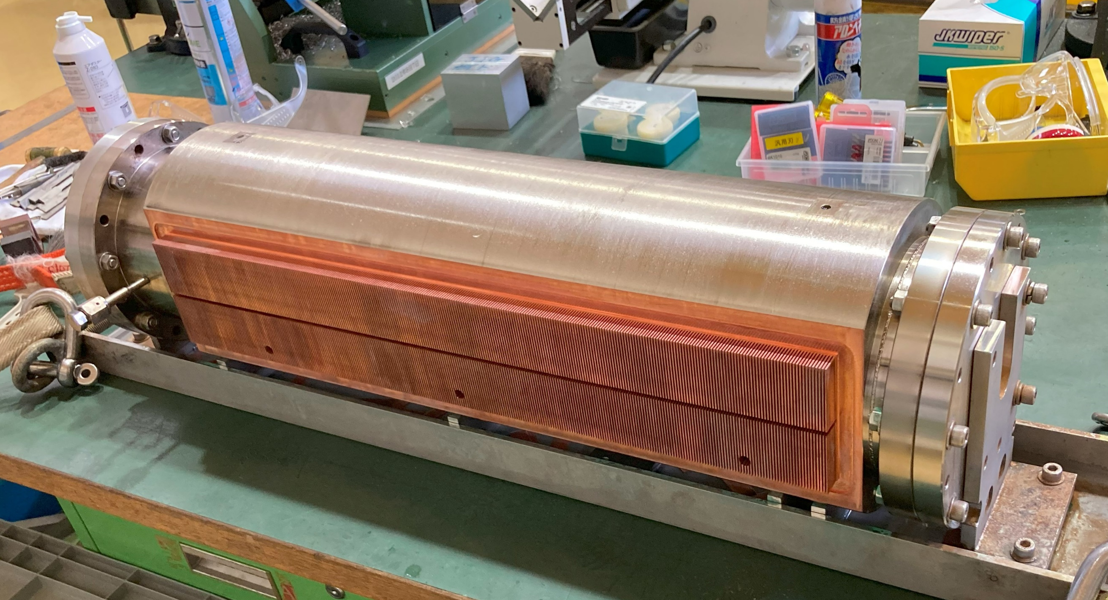
Actual Heat Exchanger Manufacturing
Polishing
&
NiP Plating
Flange Welding
Fin machining

Slide 25
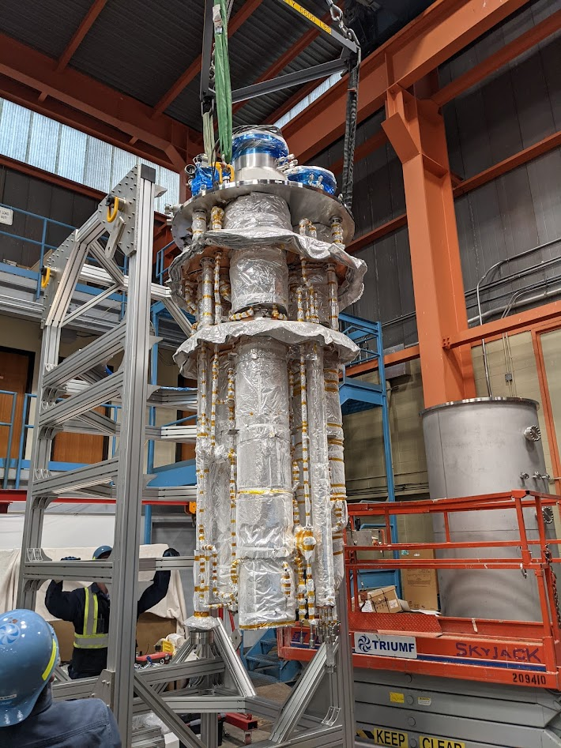
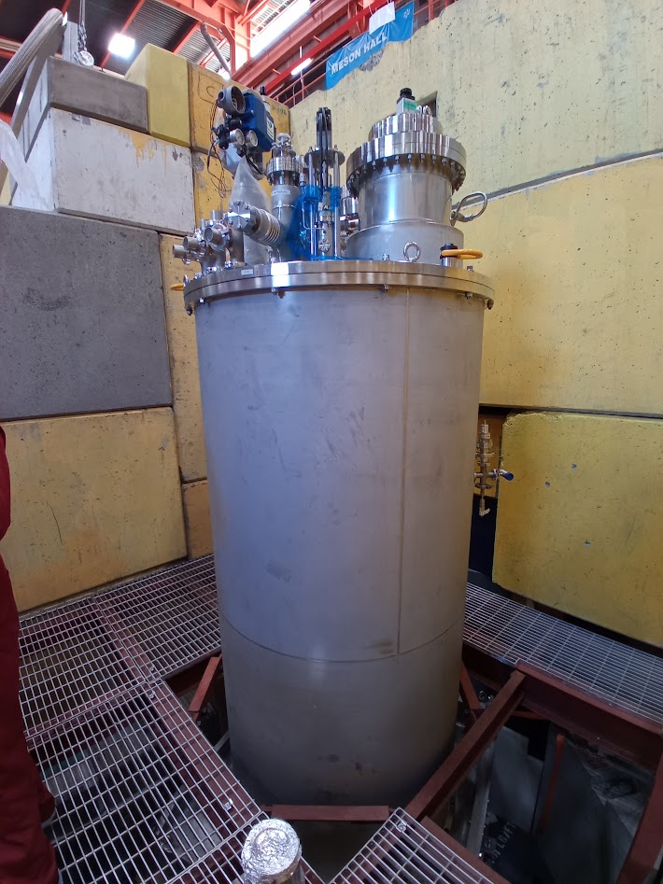
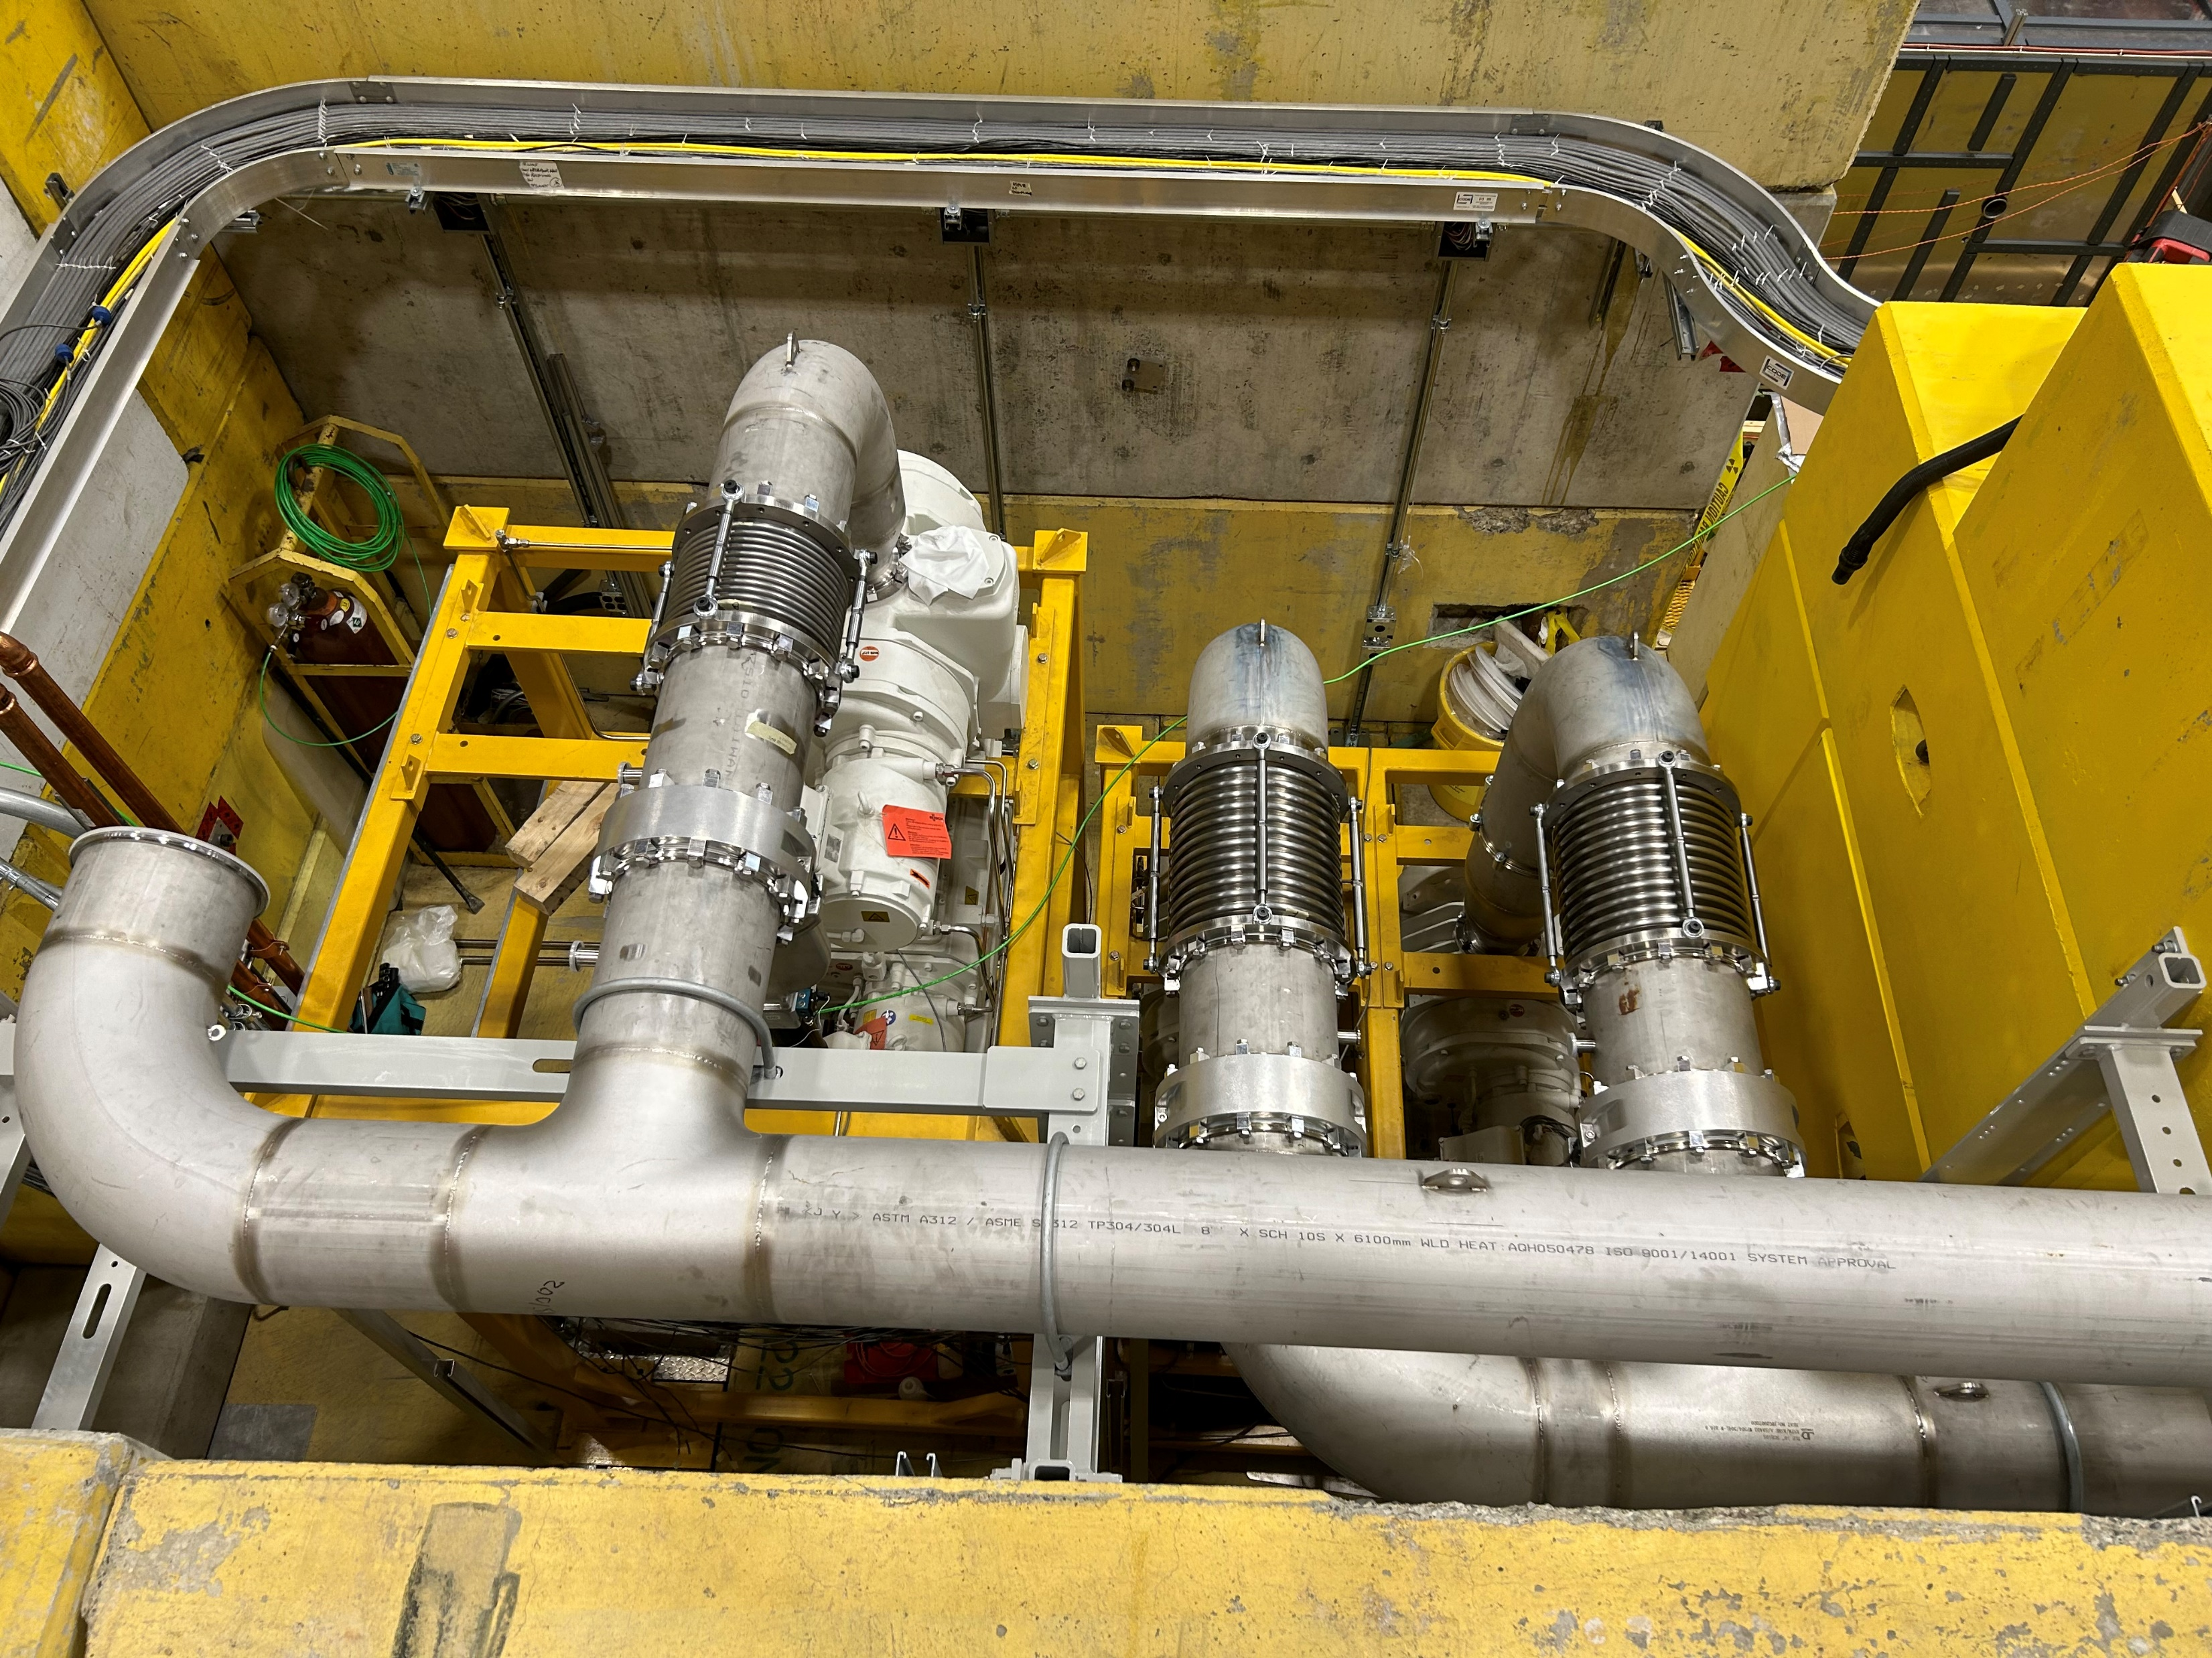
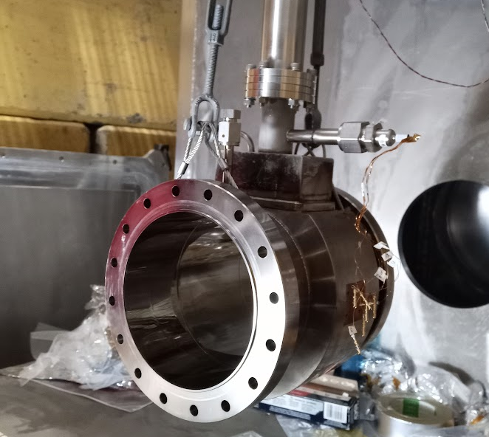
Helium cryostat installation on beamline
helium cryostat internal
Helium pumps
pumping ducts
Short HEX1 (1/10 length model)
Installed on the beamline
Helium cryostat installed at the beamline. Commissioning started.
Cryogenic test with natural ⁴He instead of ³He was successful. The short HEX1 is used for the test.

Slide 26
Temperature distribution in our system
³He pumping
Temperature distribution
³He pot
T_{3He} = 0.800 K
Heat exchanger
T_{HEX} = 0.878 K
He-II at HEX
T_{He-II1} = 0.996 K
He-II at UCN prod.
T_{He-II} = 1.15 K (HEPAK)
= 1.11 K (Van Sciver)
Static heat 1.0 W
Heat transport
D =150㎜
heat deposit
8.1 W
Kapitza conductance
(KG = 40)
Heat exchanger
2,000 mm
W target
GM heat transfer
T_{prod} = T_{3He} + ΔT_{3He-Ni} + ΔT_{Cu-HeII} + ΔT_{HeII}
Current design meets our requirement
Temperature at the production volume < 1.15 K

Slide 27
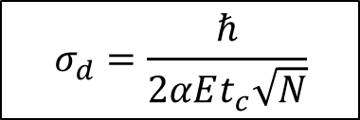
Timeline and Expected sensitivity
Timeline
  Commissioning cryogenic system in 2023/2024
  UCN Production in 2024
  nEDM measurement will start in 2025
Expected sensitivity (statistics only)
UCN production rate | 2×10⁷ UCN/sec
UCN density @ production | 6,400 UCN/cm³
UCN density @ nEDM cell | 250 Pol. UCN/cm³
E = 10kV/cm
t_{c} = 130s
α = 0.8 (visibility)
$$σ_{d}=\frac{ℏ}{2αEt_{c}\sqrt{N}}$$
N : # ofUCN
cell φ 36 cm × H 15 cm (15L)×2 cell
N = 7.8 × 10⁶ UCN/batch
To reach statistic sensitivity of σ_{d} = 1×10⁻²⁷ ecm
400 day(MT)
(1 cycle : 8 fill to determine the resonant frequency)
assume stable running of 14 hours/day

Slide 28
Summary
Helium cryogenic system is necessary to keep the superfluid helium temperature around 1.0 K
  TUCAN decided to use ³He cryostat
    Kapitza conductance of heat exchanger
    G-M heat transfer
³He cryostat and the main heat exchanger (HEX1) was developed and installed at TRIUMF
  cryogenic tests with natural ⁴He was successfully conducted
  preparing cryogenic tests with ³He
    the short HEX1 is used for the test
Commissioning is on going and the first UCN production is expected in 2024!

Slide 30

TUCAN Source Overview
TUCAN source
Combination of spallation neutron source and superfluid helium (He-II)UCN converter
Estimated Heat Load : 9.6 W
  8.1 W (beam) + 1.5 W (static)
Challenge: to keep superfluid helium temperature around 1.0K
Main heat exchanger is the heat exchanger between He-II and liquid ³He
Requirements for Heat Exchanger
³He temperature : 0.8K
  maintained by helium-3 cryostat
keep He-II temperature below ～1.0 K
inner surfaces must be UCN friendly
  smooth surface
  coated by NiP plating
Heat Exchanger

Slide 31
Contents
Requirements
Two choice
  Isopure ⁴He direct pumping
  ³He cryostat with a heat exchanger
Performance comparison of the two schemes

Slide 32
Requirements
UCN converter
  Isotopically pure ⁴He
    Purity ³He/⁴He < 10⁻¹¹
    available from Lancaster University
    Purifier in the circulation loop
Temperature
  < 1.4 K (1.2 K is preferable) for 5 – 10W heat load from proton beam
    Static heat load < 0.5 W
      Estimated from old cryostat data
Liquid helium consumption
  < 50 liter/hour

Slide 33
Two options
Isopure ⁴He direct pumping
  +Simpler
    Without a heat exchanger
³He pumping with a heat exchanger
  +Higher cooling power
³He cryostat
LD₂ cryostat
Pumping duct
He-II
He-II
Heat exchanger
LD₂
D₂O

Slide 34
Performance comparison of the two schemes
Cooling power
  ∝P(T_{liq})×L(T_{liq})
  P(T_{liq}): Saturated vapor pressure
  L(T_{liq}): Latent heat
  Ideally, ³He cryostat has larger cooling power
  35 times higher at 1.0K
  100 times higher at 0.8K
In reality , Two effect reducing cooling power of ³He cryostat
  Kapitza resistance
    Heat exchanger is necessary
  Heat conductivity in the isopure helium-4
    Heat exchanger should be placed in low radiation area
P(T_{liq})×L(T_{liq}) as a function of liquid
temperature
Detail of two options will be discussed from now

Slide 35
Superfluid helium cooling
Requirements
T_{He-II} < 1.15 K
Heat Load: 9.6 W
  8.1 W from beam
    Beam duty 25%
      1 min: production
      3 min: measurement
  1.5 W from static
Components
Heat transport in superfluid helium
  helium-3 cryostat has to be placed behind radiation shield (L = 2,000 mm)
  Superfluid turbulent
    Gorter-Millink heat transfer
Heat Exchanger (HEX1)
  made by Oxygen-Free High conductivity Copper (OFHC)
  Kapitza conductance dominates temperature gap between 3He and isopure ⁴He
Helium-3 cryostat
  Cooling power :11 W @ T_{3He} = 0.8 K
³He pumping
Heat transport
heat deposit
D =150㎜
Heat exchanger (HEX1)
2,000 mm
³He pumping
Kapitza cond.
G-M Heat transfer
T_{prod} = T_{3He} + ΔT_{HEX1}+ ΔT_{HeII} < 1.15 K

Slide 36

Helium-3 cryostat
cool down superfluid helium UCN converter by decompressed liquid ³He
  cooling power: 11 W @ 0.8 K
    8.1 W + 1.5 W + α
    beam duty 25% (typ. 1 min ON, 1 min OFF)
  Liquid helium consumption rate
    < 40 L/hour
Helium-3 flow
  Heat exchangers
    Counter flow type
      HEX-7: 300 K -> 10 K
      HEX-5: 4.2 K -> 2.8 K (4He)
      HEX-4: 4.2 K -> 2.8 K (3He)
    Cooling bath
      HEX-6
        4.2 K: ⁴He in ambient pressure
      HEX-2
        1.6 K: ⁴He in 750 Pa after JT expansion
      HEX-1 (Main Heat Exchanger）
        0.8 K: ³He in 380 Pa after JT expansion
  mass flow rate of ³He
    1.14 g/sec for 11 W cooling power
    necessary pumping speed: > 9,000 m³/hour
10K
4.2 K
2.8 K
2.8 K
liquid ³He
1.6 K
0.8 K
Super-fluid helium
Flow diagram

Slide 37
1. Superfluid Helium Heat transport
Two Fluid Model
Flow pattern
  Normal fluid component is dilute around 1.0 K region
  Knudsen number
    $K_{n}=\frac{λ}{D_{UCN}}<1$,
$λ\sim 0.5 mm$, $D_{UCN}=150 mm$
continuum flow
  laminar or turbulent ？
    Reynolds number of normal fluid component
$R_{e_{n}}=\frac{{|v}_{n}−v_{s}|D_{UCN}}{υ_{n}}\sim {10}^{6}$
$≫1200\sim 2600$
  superfluid turbulent
 | Normal fluid | Superfluid
Viscosity | Η_{n} | η_{s} = 0
Entropy | S_{n} | S_{s} = 0
Ratio of super/normal component depends on temperature
fraction of normal mode become small in low temperature.
10.1103/Physics.3.5
Heat transport
Since superfluid has no entropy, heat is transported only by normal fluid.
Heat transport in low temperature (< 1K) become small because of small fraction of normal fluid
velocity of normal component become fast
v_{n}
v_{s}
Heat source

Slide 38
Gorter - Mellink Equation
Temperature difference in superfluid turbulence can be calculated numerically
using following Gorter-Mellink equation
T_{L} : He-II temperature at the heat exchanger
T_{H} : He-II temperature at the UCN production volume
A : cross section of He-II
diameter = 150 mm
L : distance of heat transfer (L = 2.0 m)
Uncertainty
from f(T)
Large ambiguity
・lack of data at low temperature
f(T) : Heat transfer function
temperature gradient in superfluid helium
Q = 10 W, Cooling point temperature T_{L} = 1.0 K
HEPAK: code to calculate thermophysical property of 4He
Van Sciver: empirical fit of experimental data

Slide 39


2. Main heat exchanger (HEX1)
Kapitza conductance depends on sample quality
³He liq.
He-II
Kapitza conductance of Cu
Van Sciver, Helium Cryogenics
ex) h_{K} = 800 T³ [ W/m² K] (our sample)
T_{3He} = 0.80 K, Q = 11 W
junction between ³He and Cu
  ΔT_{Cu-3He} = 0.078 K
  T _{Cu} = 0.878 K
junction between Cu and He-II
  ΔT_{Ni-HeII} = 0.118
  T _{He-II} = 0.996 K
Temperature difference in the heat exchanger can be neglected
Material : OFHC (RRR=100)
Cylindrical shape
  inside: He-II
  outside: ³He
inner surface: flat
  avoid UCN loss
  NiP coated
outer surface: annular fin
  increase surface area

Slide 40


HEX1 development
alternative design
Prototype test
1/10 length model
no He-II volume inside
measure temperature difference of the Cu and liquid with different heater power
use ⁴He instead of ³He
Boiling curve was taken
  Heat input vs. temperature gap between Cu and helium bath
  fill position
    bottom/top
  detail analysis ongoing
³He
prototype model
annular fins
vertical fins
minimize ³He volume to fill
He-II
top fill
alternative design prototype
bottom fill
boiling curve of bottom fill

Slide 41
3. Helium-3 cryostat
cool down superfluid helium UCN converter by decompressed liquid ³He
  cooling power: 11 W @ 0.8 K
    8.1 W + 1.5 W + α
Helium-3 flow
  Heat exchangers
    Counter flow type
      HEX-7: 300 K -> 10 K
      HEX-5: 4.2 K -> 2.8 K (4He)
      HEX-4: 4.2 K -> 2.8 K (3He)
    Cooling bath
      HEX-6
        4.2 K: ⁴He in ambient pressure
      HEX-2
        1.6 K: ⁴He in 750 Pa after JT expansion
      HEX-1
        0.8 K: ³He in 380 Pa after JT expansion
  mass flow rate of ³He
    1.14 g/sec for 11 W cooling power
    necessary pumping speed: > 9,000 m³/hour
10K
4.2 K
2.8 K
2.8 K
liquid ³He
1.6 K
0.8 K
Super-fluid helium
Flow diagram

Slide 42



Bath cooling heat exchangers
4K reservoir (HEX-6)
  4.2 K natural ⁴He
  coil: SS304,φ12.7 mm – 12 m
  Supply ³He: 10 K -> 4.2 K
1K pot (HEX-2)
  1.6 K decompressed ⁴He
  coil: Cu,φ9.53 mm – 8m
  Supply ³He: 4.2 K (gas) -> 1.6 K (liq.)
³He pot
  0.8 K decompressed ³He
  connect to HEX1
coils inside 4K vessel (from bottom)
condensation
simulation results

Slide 43
4K reservoir
Volume
  260 L: total volume
  200 L : maximum liquid level
    Need space for cooling coil at gas phase
  150 L : minimum liquid level
    with beam (11 W heat load)
      Helium consumption
        At 1K pot : 1.2 g/sec
        At 4K reservoir: 2.28 g/sec
        Total helium consumption : 3.48 g/sec = 100.2 L/hour
      Last 1.5 hour without filling
    without beam (only static heat load of 1 W)
      Helium consumption
        At 1K pot : 0.11 g/sec
        At 4K reservoir: 0.21 g/sec
        Total helium consumption : 0.32 g/sec = 9.1 L/hour
      Last 16 hour without filling
    Helium saving mode
      T3He = 2.0 K, T_{1KPot}=2.5K
      Helium consumption
        At 1K pot : 0.06 g/sec
        At 4K reservoir: 0.151 g/sec
        Total helium consumption : 0.21 g/sec = 6.0 L/hour
      Last 1day without filling

Slide 44
1K pot
Volume
  10 L : maximum liquid level
    Need space for cooling coil at gas phase
  8 L : minimum liquid level
    with beam (11 W heat load)
      Helium consumption
        At 1K pot : 1.2 g/sec
      Last 16 min without filling
    without beam (only static heat load of 1 W)
      Helium consumption
        At 1K pot : 0.11 g/sec
      Last 3 hour without filling
    Helium saving mode
      T3He = 2.0 K, T_{1KPot}=2.5K
      Helium consumption
        At 1K pot : 0.06 g/sec
      Last 5 hours without filling

Slide 45



Counter-flow heat exchangers
Pre-cooling before each bath
  cool down return gas from bath
  reduce liquid consumption
HEX7
  ³He: 300 K -> 10 K
    3He enthalpy
      2,074 J/g @ 300 K
      75 J/g @ 10 K
  4 parallel tube in tube coil
    coil length 16 m
    inner: ⁴He return (Φ9.53 mm)
    outer: ³He supply (Φ19.05 mm)
  locate in ³He & ⁴He pumping duct
    use cooling power of pumping gas
HEX4 & HEX5
  same structure
    coil length: 26 m (Φ9.53mm)
    HEX4
      target: ³He 4.2 K -> 2.8 K
      coolant: pumped ³He from 3He pot
    HEX5
      target: ⁴He 4.2 K -> 2.8 K
      coolant: pumped ⁴He from 1K pot
      liquid fraction after JT expansion
        4.2 K -> 1.6 K 59%
        2.8 K -> 1.6 K 79 %
HEX7
HEX5
HEX 4

Slide 46
Cooling test
Two cooling test has been done
  use natural 4He instead of 3He
  Succeed to reach superfluid temperature in both tests
  1st test
    1st cooling down
    confirm no cold leak and superleak
    HEX1 prototype heater has problem
    isopure condensation test
  2nd test
    HEX1 prototype heating test
      dry out issue
    HEX1 prototype level meter has problem
    Minimum temperature: 1.25 K

Slide 47

Pre-Cooling
Liquid helium transfer to 4K reservoir
Helium return goes
  Shield cooling line
  1K pot
    via JT and JT bypass
  HEX7 return
    connects 3He supply
It takes
  2 days
  1000 L liquid helium
to reach 4K reservoir become 4K
Pre-Cooling of 2nd test
liquid helium shortage during weekend

Slide 48


Static Heat load
liquid loss over the long week end
static heat loads are estimated
4K reservoir
  from liquid loss
    17 L/day
  static heat load; 0.6 W
1K pot
  from liquid loss
    1.5 L/day
      2 level sensor has different off set, however, the loss rate is same
  static heat load: 50 mW
3He pot
  from pumping flow at minimum temperature
    1.7 L/min
  static heat load
    5 mW
average

Slide 49



HEX7 performance
1K &3He pot pumping
HEX1 heating
Function of HEX7 is cool down supply 3He down to 10 K in order to reduce 4K consumption
HEX7.1 and HEX7.2 are almost same
Outlet temperature of supply 3He (T3He2_1) is below 10 K during stable operation
  not depend much on 3He flow
3He supply
4K res.
1K pot

Slide 50

Operation procedure
start Helium transfer
  Open JT1 (3He) and JT2 (1K pot) fully
    Never close totally after 3He pot and 1K pot has liquid
      The lines become warm. The warm gas cause sudden boil off of the liquid when 3He pot or 1K pot fill.
  JT bypass open fully
    Close JT bypass valve when 1K pot reach below 15 K
    Never open JT bypass again when 1K pot has liquid
      The line become warm. The warm gas cause sudden boil off of the liquid
4K reservoir fill
  Open 4K reservoir vent
    reduce 4K reservoir pressure to make pressure difference between the dewar and 4K reservoir small
  Keep 1K pot level between 35% to 80%
    80% corresponds 200 L
      not to reach helium level above HEX6G, which is the coil heat exchanger at gas phase
    35% corresponds 87.5 L
      not to dry HEX6L, which is the coil heat exchanger at liquid phase
  Keep 1K pot level above 50% during isopure helium condensation
    not to dry HEX14L, which is the coil heat exchanger for isopure helium,
pump 1K pot
  keep 1K pot level above 60%
    not to dry HEX2
pump 3He pot
Flow diagram during Pre-Cooling for KEK test

Slide 51
Pool boiling heat transfer
critical heat flux
convection
Pool boiling heat transfer
  natural convection
  nucleate boiling
  film boiling
Working condition of the heat exchanger should be below critical heat flux of film boiling transition
Heat Flux of ³He side: 1.1×10⁻³ W/cm²
  critical heat flux must be larger
Based on measurement of 3He boiling curve, it seems the critical heat is larger
However, the critical heat depends on strongly the geometry of the heat exchanger
nucleate
boiling
film boiling
Helium cryogenics,
Steven W. Van Sciver
Film boiling
Nucleate boiling
convection
Boing curve of helium-3 at 0.8 K

Slide 52
Boiling curve measurement
Cylindrical Fin model
top fill
Boiling Curve Measurements
Prototype
  cylindrical fin
    two supply path: bottom & top fill
  vertical fin
measure critical heat flux of film boiling
Condition
use helium-4
heat Cu of heater
See temperature gap (ΔT) between Cu and liq. helium
Results
Cylindrical Fin
  Top Fill: two jump
    first jump : push liquid upward
    0.01 W/cm²
  Bottom Fill:
    critical heat flux: 0.06 W/cm²
Vertical Vin
    critical heat flux: 0.08 W/cm²
bottom fill
Vertical Fin model
heater
boiling curve at 3.0 K
film boiling
2nd jump
1st jump

Slide 53


Critical Heat Flux of ³He
Zuber equation
Van Sciver, Helium Cryogenics
q* : critical heat flux
λ: latent heat of vaporization
σ: surface tension [J/m^2]
g: acceleration of gravity
ρ_{l} : liquid density
ρ_{v}: vapor density
for flat surface, upward
Measurement Results
Cylindrical Fin
  Top Fill: two jump
    first jump : push liquid upward
    0.01 W/cm² -> 1.3×10⁻³ W/cm² (for ³He)
  Bottom Fill:
    critical heat flux:
    0.06 W/cm² -> 8×10⁻³ W/cm² (for ³He)
Vertical Vin
    critical heat flux
    0.08 W/cm² -> 11×10⁻³ W/cm² (for ³He)
Critical Heat flux
⁴He, at 3.0 K: 0.58 W/cm²
our measurement: one order smaller
³He, at 1.0 K: 0.075 W/cm²
Ratio(³He/⁴He) 0.13
relative ratio assume to be same for all geometry
acceptable
Designed Heat Flux : 1.1×10⁻³ W/cm²

