Slide 1
Direct calculation of neutron diffraction on nanodiamonds
Shapiro Dmitrii
Institute of nuclear physics, Almaty, kazakhstan
UCN and VCN Source at the Institute of Nuclear Physics, Kazakhstan and their applications, 09.04.24

Slide 2
Outline
  Nanodiamond application
  Why calculate diffraction on nanoparticles
  Cross-section calculation
  Program verification
  Orientation average

Slide 3
Nanodiamonds application
  Diamond nanoparticles are promising reflectors of slow neutrons
    High albedo for VCN
    High quasispecular reflectivity for CN
  Such reflectors may be used to design a new generation of VCN/UCN sources, significantly increasing their intensity
  May be used at a new VCN/UCN source currently designed at WWR-K reactor of Institute of Nuclear Physics in Almaty, Kazakhstan
  More details in today’s report of Alexander Nezvanov at 14:00 “Nanodiamond reflectors for an intense source of very cold neutrons: properties and applications”

Slide 4
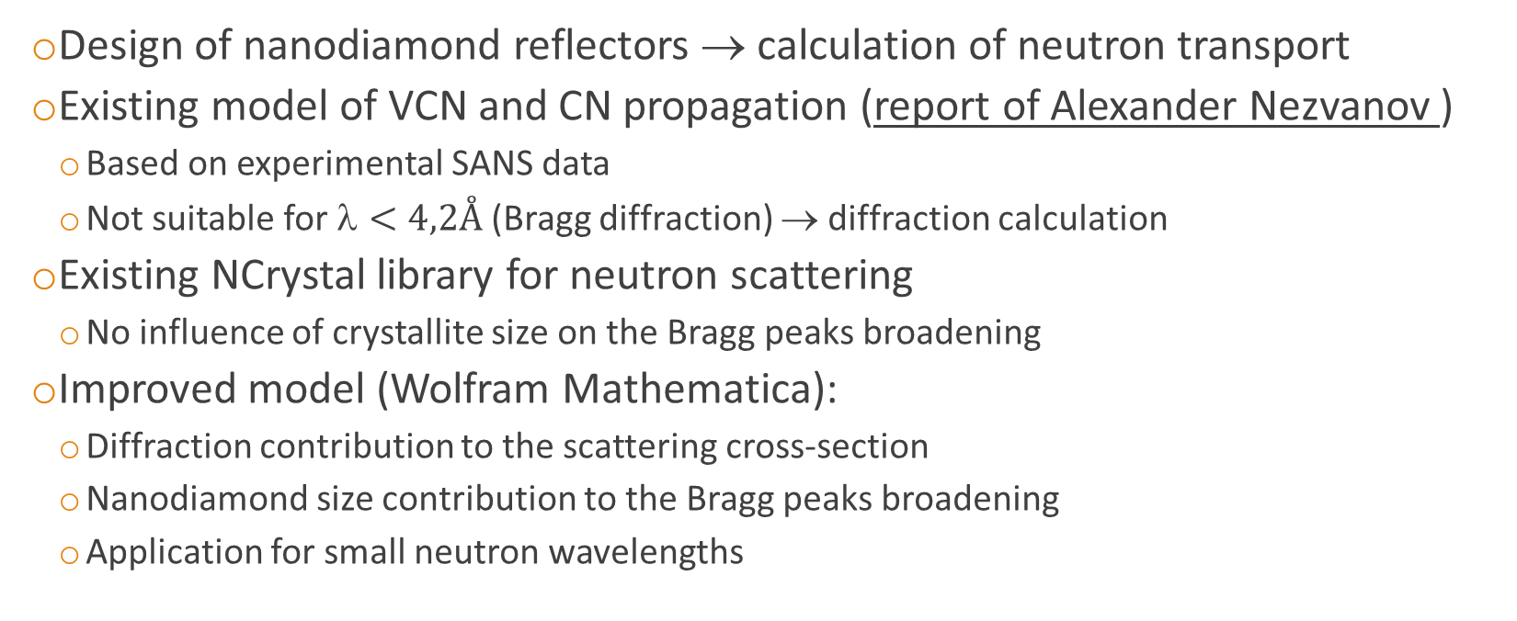
Neutron propagation in nanodiamond powders
  Design of nanodiamond reflectors → calculation of neutron transport
  Existing model of VCN and CN propagation (report of Alexander Nezvanov )
    Based on experimental SANS data
    Not suitable for $<4,2Å$ (Bragg diffraction) → diffraction calculation
  Existing NCrystal library for neutron scattering
    No influence of crystallite size on the Bragg peaks broadening
  Improved model (Wolfram Mathematica):
    Diffraction contribution to the scattering cross-section
    Nanodiamond size contribution to the Bragg peaks broadening
    Application for small neutron wavelengths

Slide 5
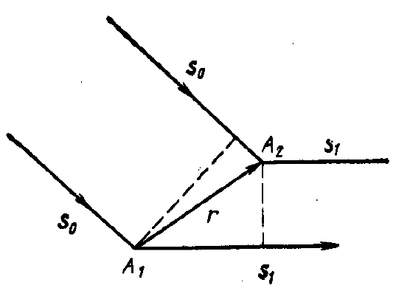
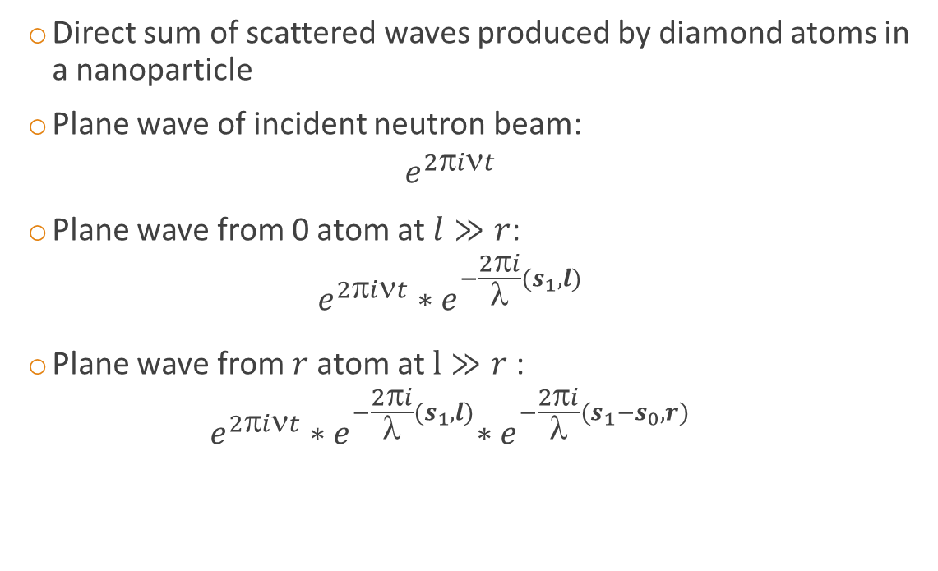

Cross-section calculation
  Direct sum of scattered waves produced by diamond atoms in a nanoparticle
  Plane wave of incident neutron beam:
  $e^{2it}$
  Plane wave from 0 atom at $l≫r$:
  $e^{2πiνt}{∗e}^{−\frac{2πi}{λ}(s_{1},l)}$
  Plane wave from $r$atom at $l≫r$:
  $e^{2πiνt}{∗e}^{−\frac{2πi}{λ}(s_{1},l)}∗e^{−\frac{2πi}{λ}(s_{1}−s_{0},r)}$
Incident beam
Scattered beam
To the detector at $l≫r$→

Slide 6
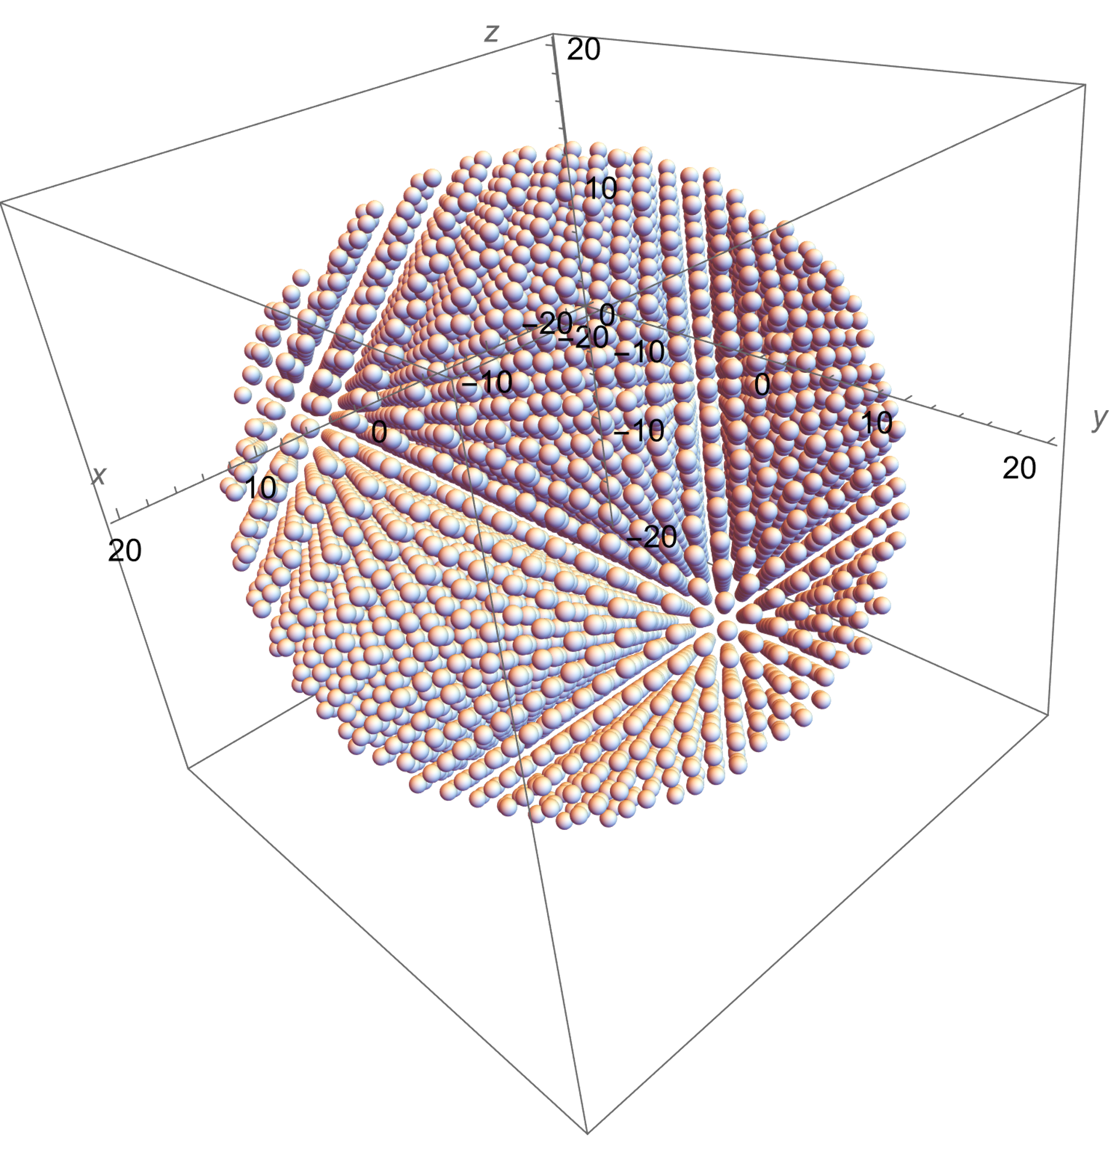
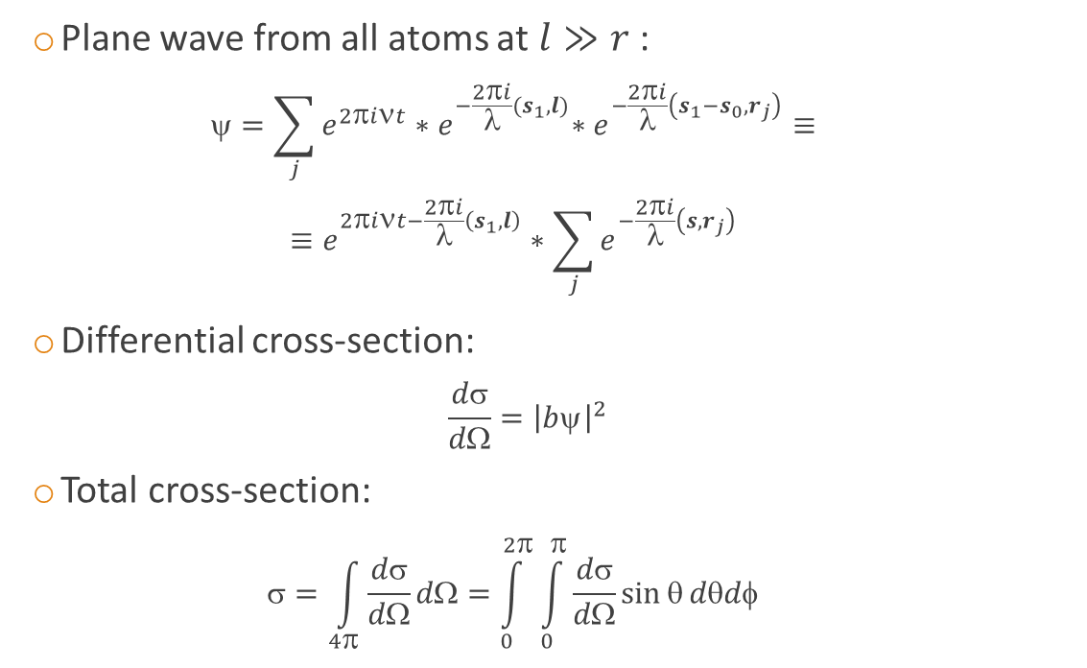
Cross-section calculation
  Plane wave from all atoms at $l≫r$:
  $=\sum_{j}{e^{2πiνt}{∗e}^{−\frac{2πi}{λ}(s_{1},l)}{∗e}^{−\frac{2πi}{λ}\left(s_{1}−s_{0}, r_{j}\right)}}≡$
  $≡e^{2πiνt−\frac{2πi}{λ}\left(s_{1},l\right)}∗\sum_{j}{e^{−\frac{2πi}{λ}\left(s, r_{j}\right)}}$
  Differential cross-section:
  $\frac{dσ}{dΩ}={\left|bψ\right|}^{2}$
  Total cross-section:
  $=\int_{4π}^{ }{\frac{dσ}{dΩ}}dΩ=\int_{0}^{2π}{\int_{0}^{π}{\frac{dσ}{dΩ}}\sin{θ}dθdφ}$
n
n
n
n

Slide 7
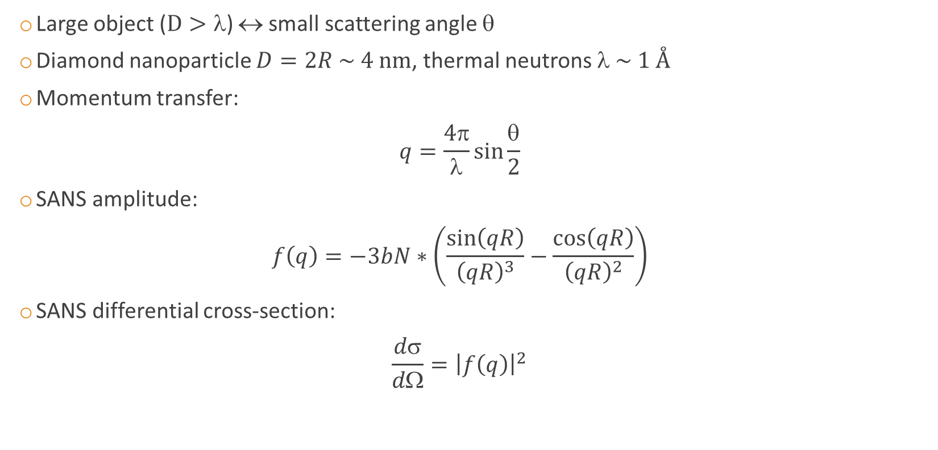
Program verification: SANS
  Large object ($D>$) ↔ small scattering angle $$
  Diamond nanoparticle $D=2R \sim 4 nm$, thermal neutrons $ \sim 1 Å$
  Momentum transfer:
  $q=\frac{4π}{λ}\sin{\frac{θ}{2}}$
  SANS amplitude:
  $f\left(q\right)=−3bN∗\left(\frac{\sin\left(qR\right)}{{\left(qR\right)}^{3}}−\frac{\cos\left(qR\right)}{{\left(qR\right)}^{2}}\right)$
  SANS differential cross-section:
  $\frac{dσ}{dΩ}={\left|f\left(q\right)\right|}^{2}$

Slide 8
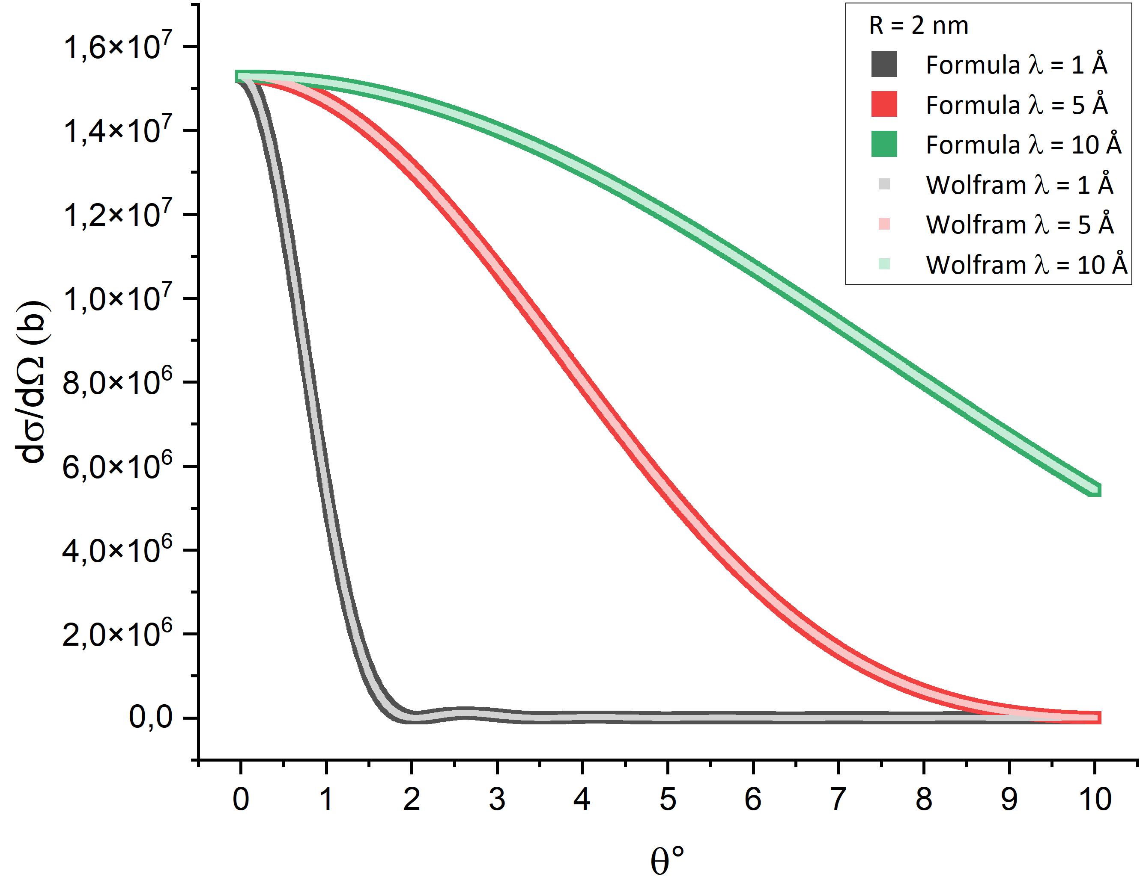
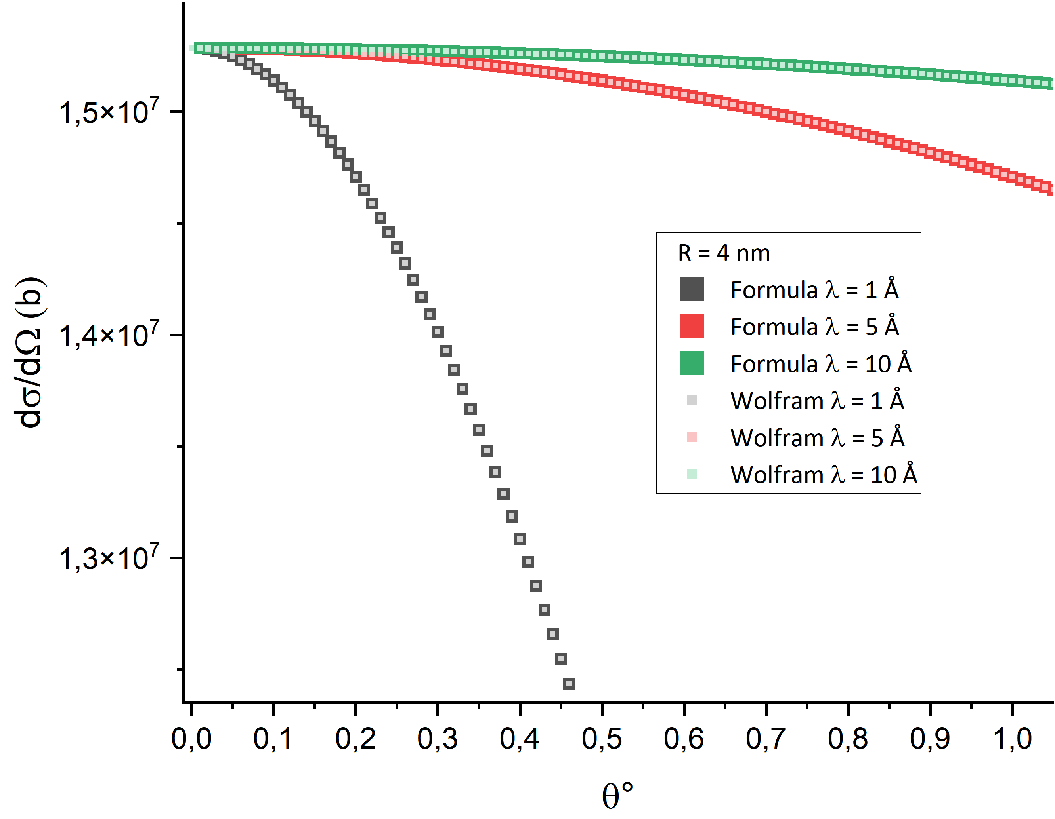

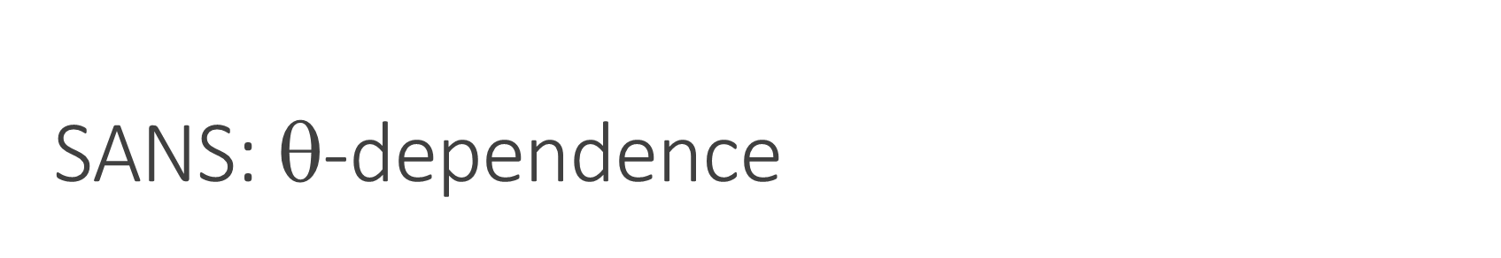
SANS: $$-dependence
  Spherical nanoparticle with $R=2 nm$
  Neutron wavelengths $=\left\{1, 5, 10\right\} Å$

Slide 9
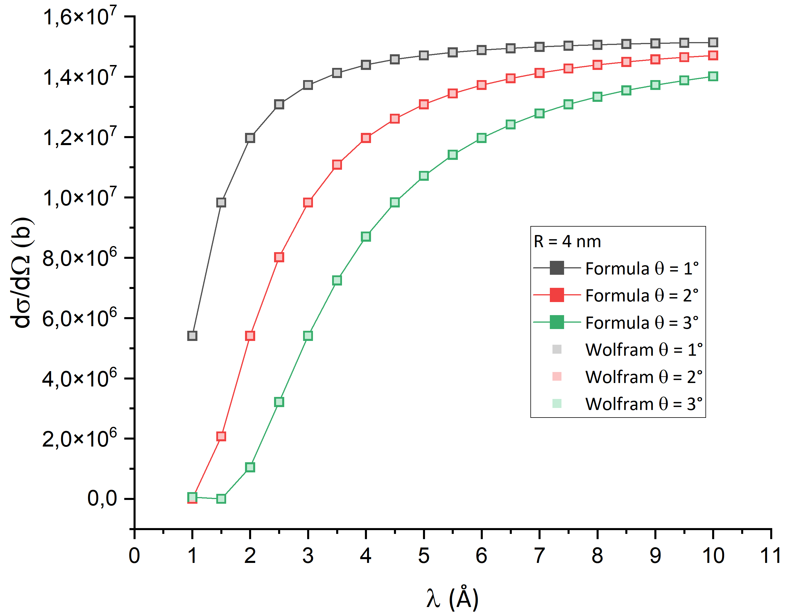
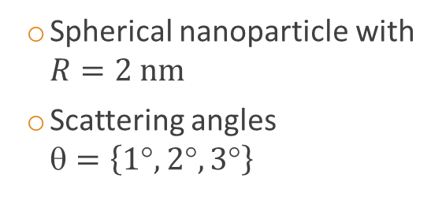
SANS: λ-dependence
  Spherical nanoparticle with $R=2 nm$
  Scattering angles
  $=\left\{1°, 2°, 3°\right\}$

Slide 10
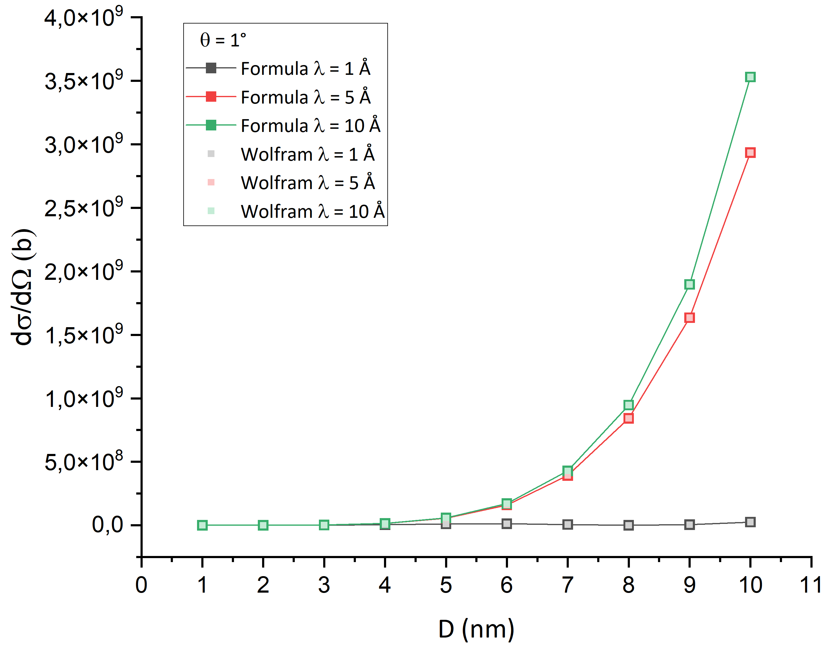
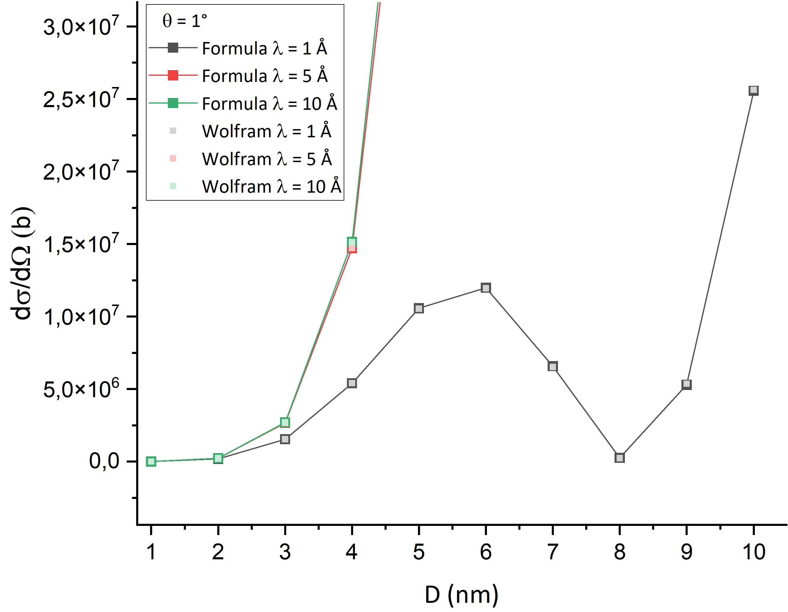
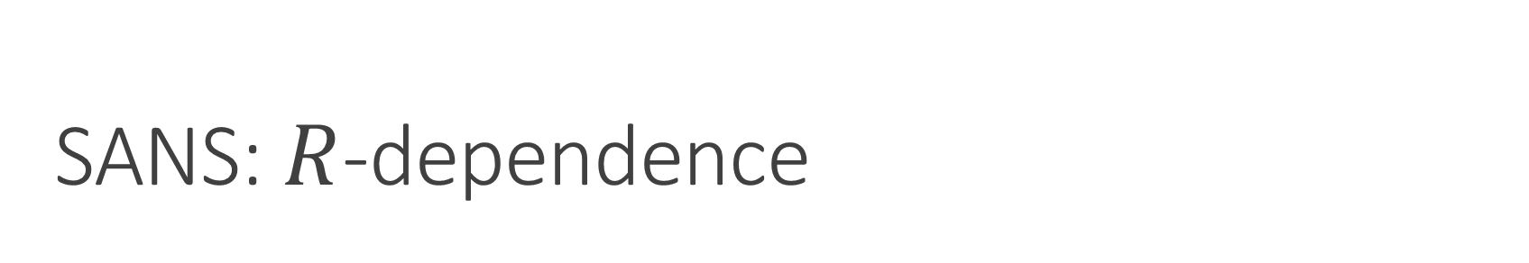
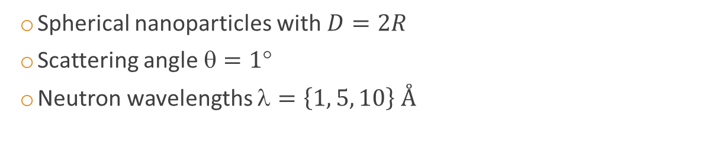
SANS: $R$-dependence
  Spherical nanoparticles with $D=2R$
  Scattering angle $=1$
  Neutron wavelengths $=\left\{1, 5, 10\right\} Å$

Slide 11
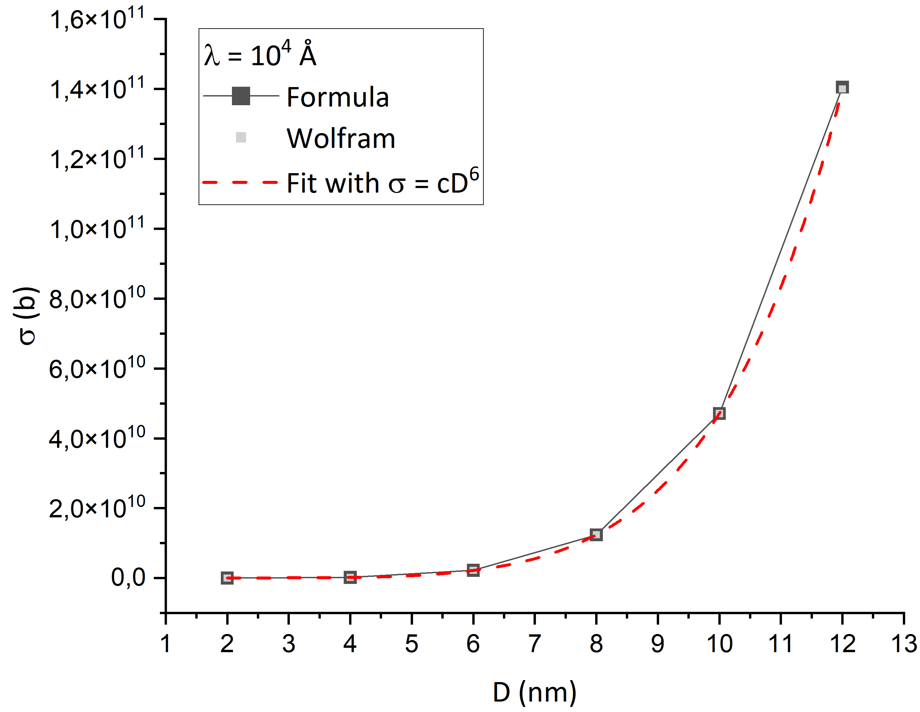

Program verification: large wavelength
  Total cross-section with $≫D$:
  $=4π{\left(\sum_{i=1}^{N}{ b}\right)}^{2}= 4πb^{2}N^{2} \sim D^{6}$

Slide 12
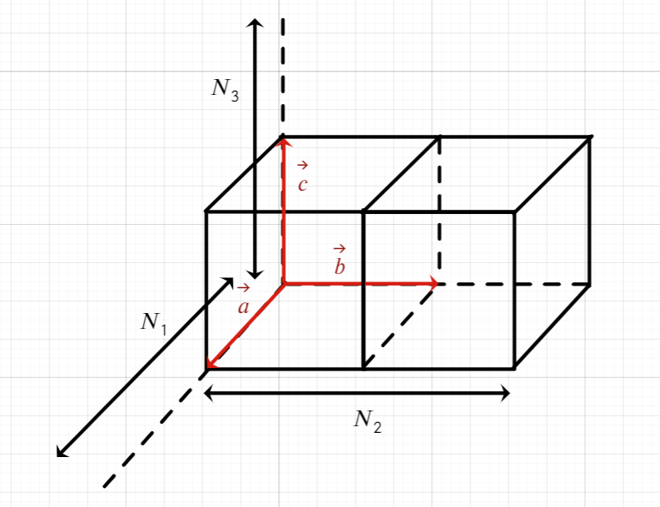
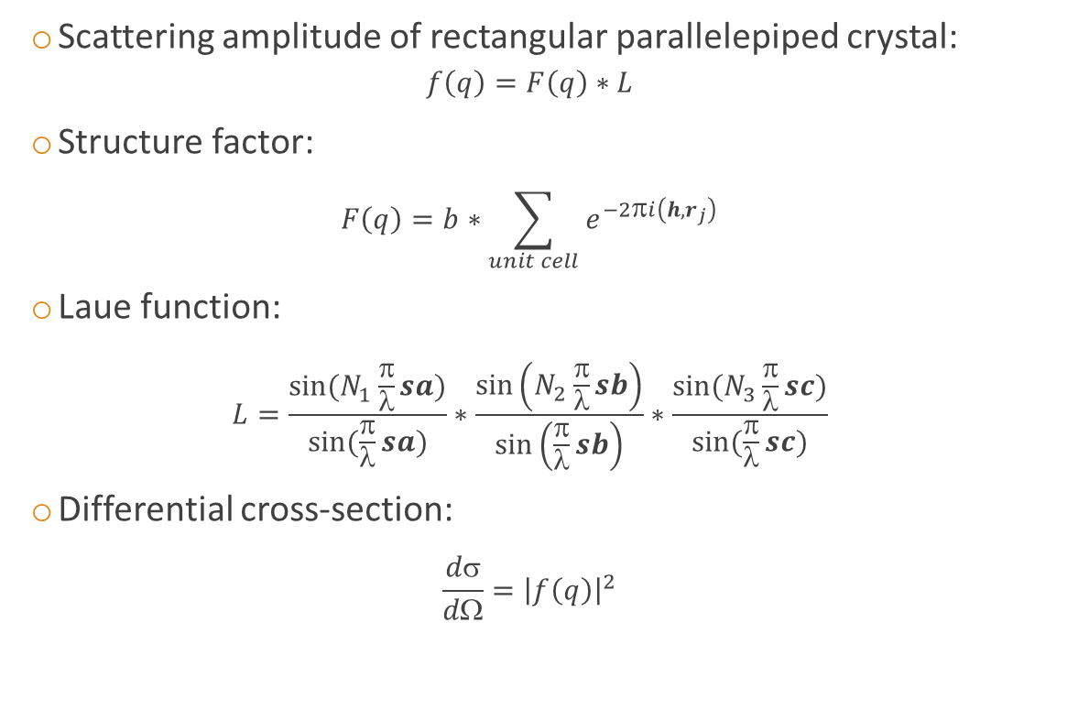
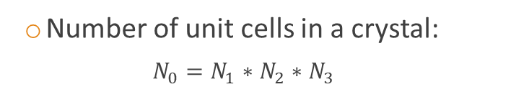
Program verification: Laue function
  Scattering amplitude of rectangular parallelepiped crystal:
  $f\left(q\right)=F\left(q\right)∗L$
  Structure factor:
  $F\left(q\right)=b∗\sum_{unit cell}{e^{−2πi\left(h, r_{j}\right)}}$
  Laue function:
  $$L=\frac{\sin{(N_{1}\frac{}{}sa)}}{\sin{(\frac{}{}sa)}}∗\frac{\sin\left(N_{2}\frac{}{}sb\right)}{\sin\left(\frac{}{}sb\right)}∗\frac{\sin{(N_{3}\frac{}{}sc)}}{\sin{(\frac{}{}sc)}}$$
  Differential cross-section:
  $$\frac{dσ}{dΩ}={\left|f\left(q\right)\right|}^{2}$$
  Number of unit cells in a crystal:
  $$N_{0}=N_{1}∗N_{2}∗N_{3}$$

Slide 13
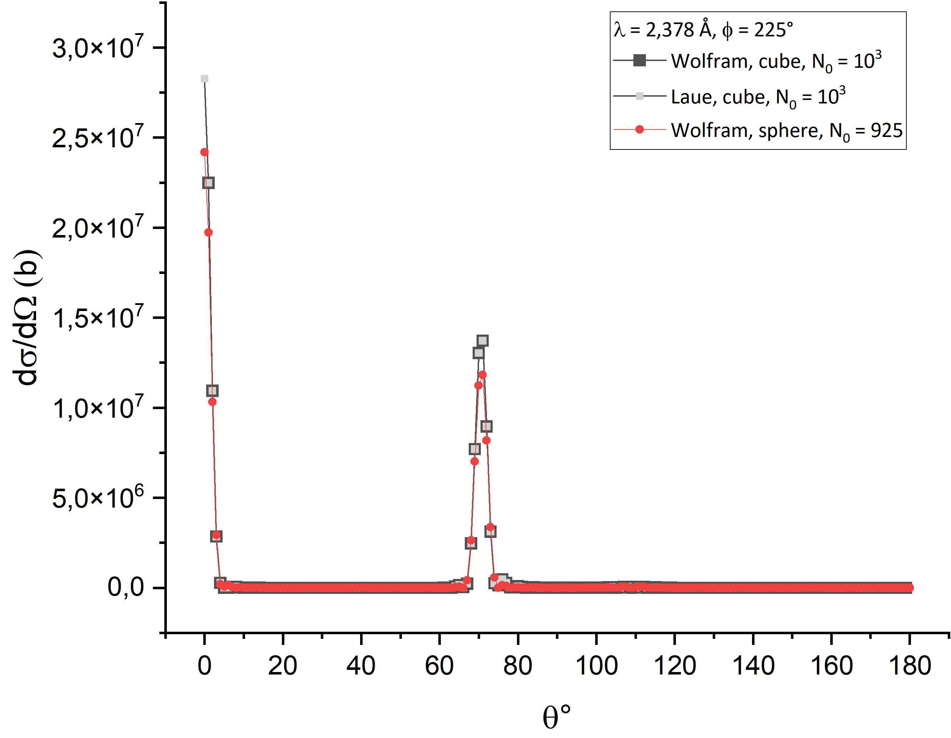
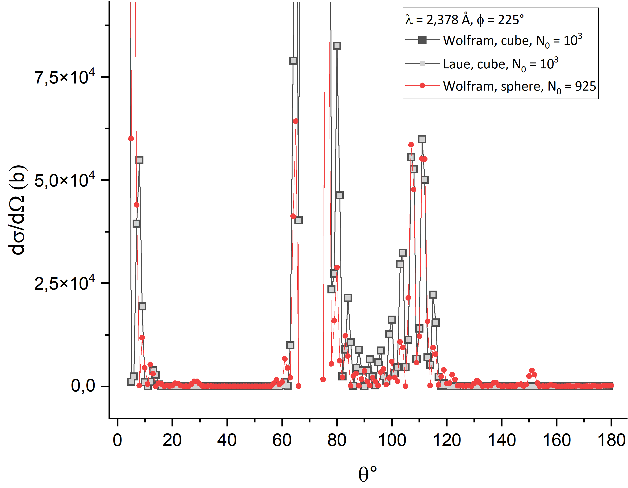

Program verification: Laue function
  Cubic nanoparticle with $N_{0}={10}^{3}$ ($D\sim 3,6 nm$)
  Diffraction on (111): $=2,378 Å,$
  $=71, =225$

Slide 14
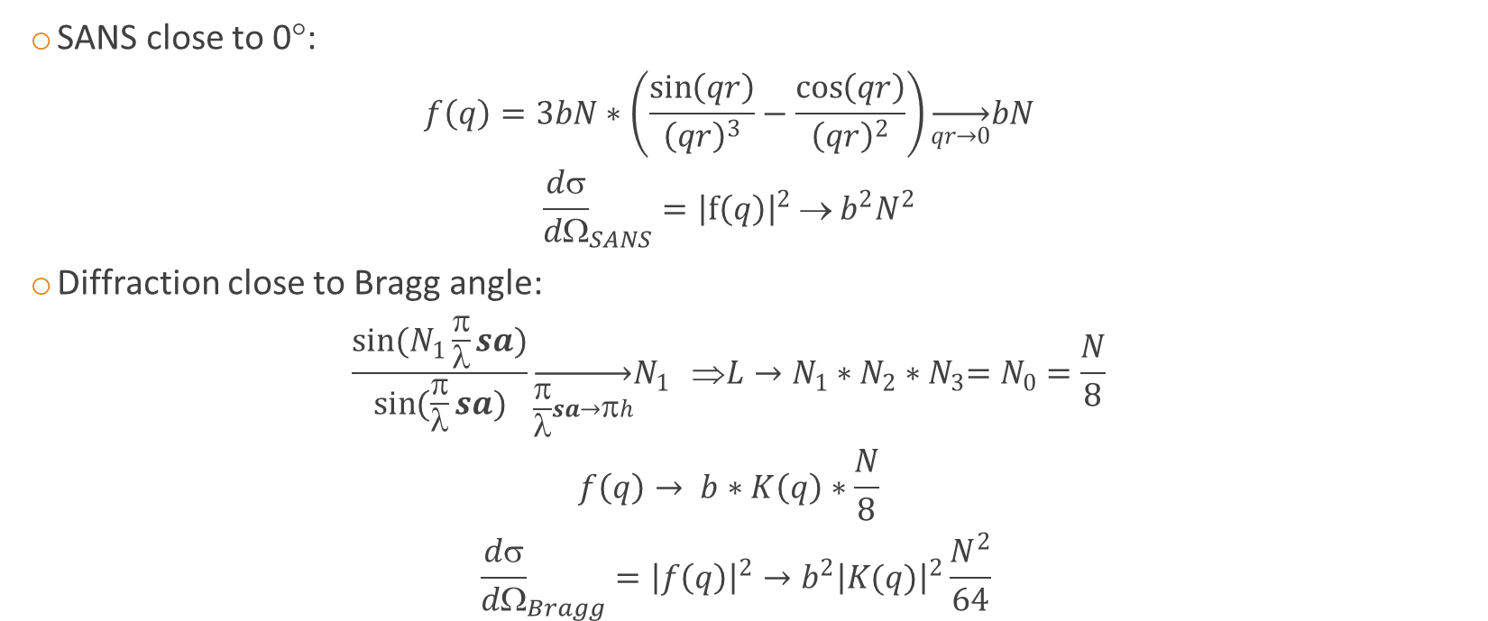
Program verification: peak amplitudes
  SANS close to 0°:
  $$f\left(q\right)=3bN∗\left(\frac{\sin\left(qr\right)}{{\left(qr\right)}^{3}}−\frac{\cos\left(qr\right)}{{\left(qr\right)}^{2}}\right)\overset{→}{qr→0}bN$$
  $${\frac{dσ}{dΩ}}_{SANS}={\left|f\left(q\right)\right|}^{2} → b^{2}N^{2}$$
  Diffraction close to Bragg angle:
  $$\frac{\sin{(N_{1}\frac{π}{λ}sa)}}{\sin{(\frac{π}{λ}sa)}}\overset{→}{\frac{π}{λ}sa→πh}N_{1} ⇒L→N_{1}∗N_{2}∗N_{3}=N_{0}=\frac{N}{8}$$
  $$f\left(q\right)→ b∗K\left(q\right)∗\frac{N}{8}$$
  $$���{\frac{dσ}{dΩ}}_{Bragg}={\left|f\left(q\right)\right|}^{2}→b^{2}{\left|K(q)\right|}^{2}\frac{N^{2}}{64}$$

Slide 15
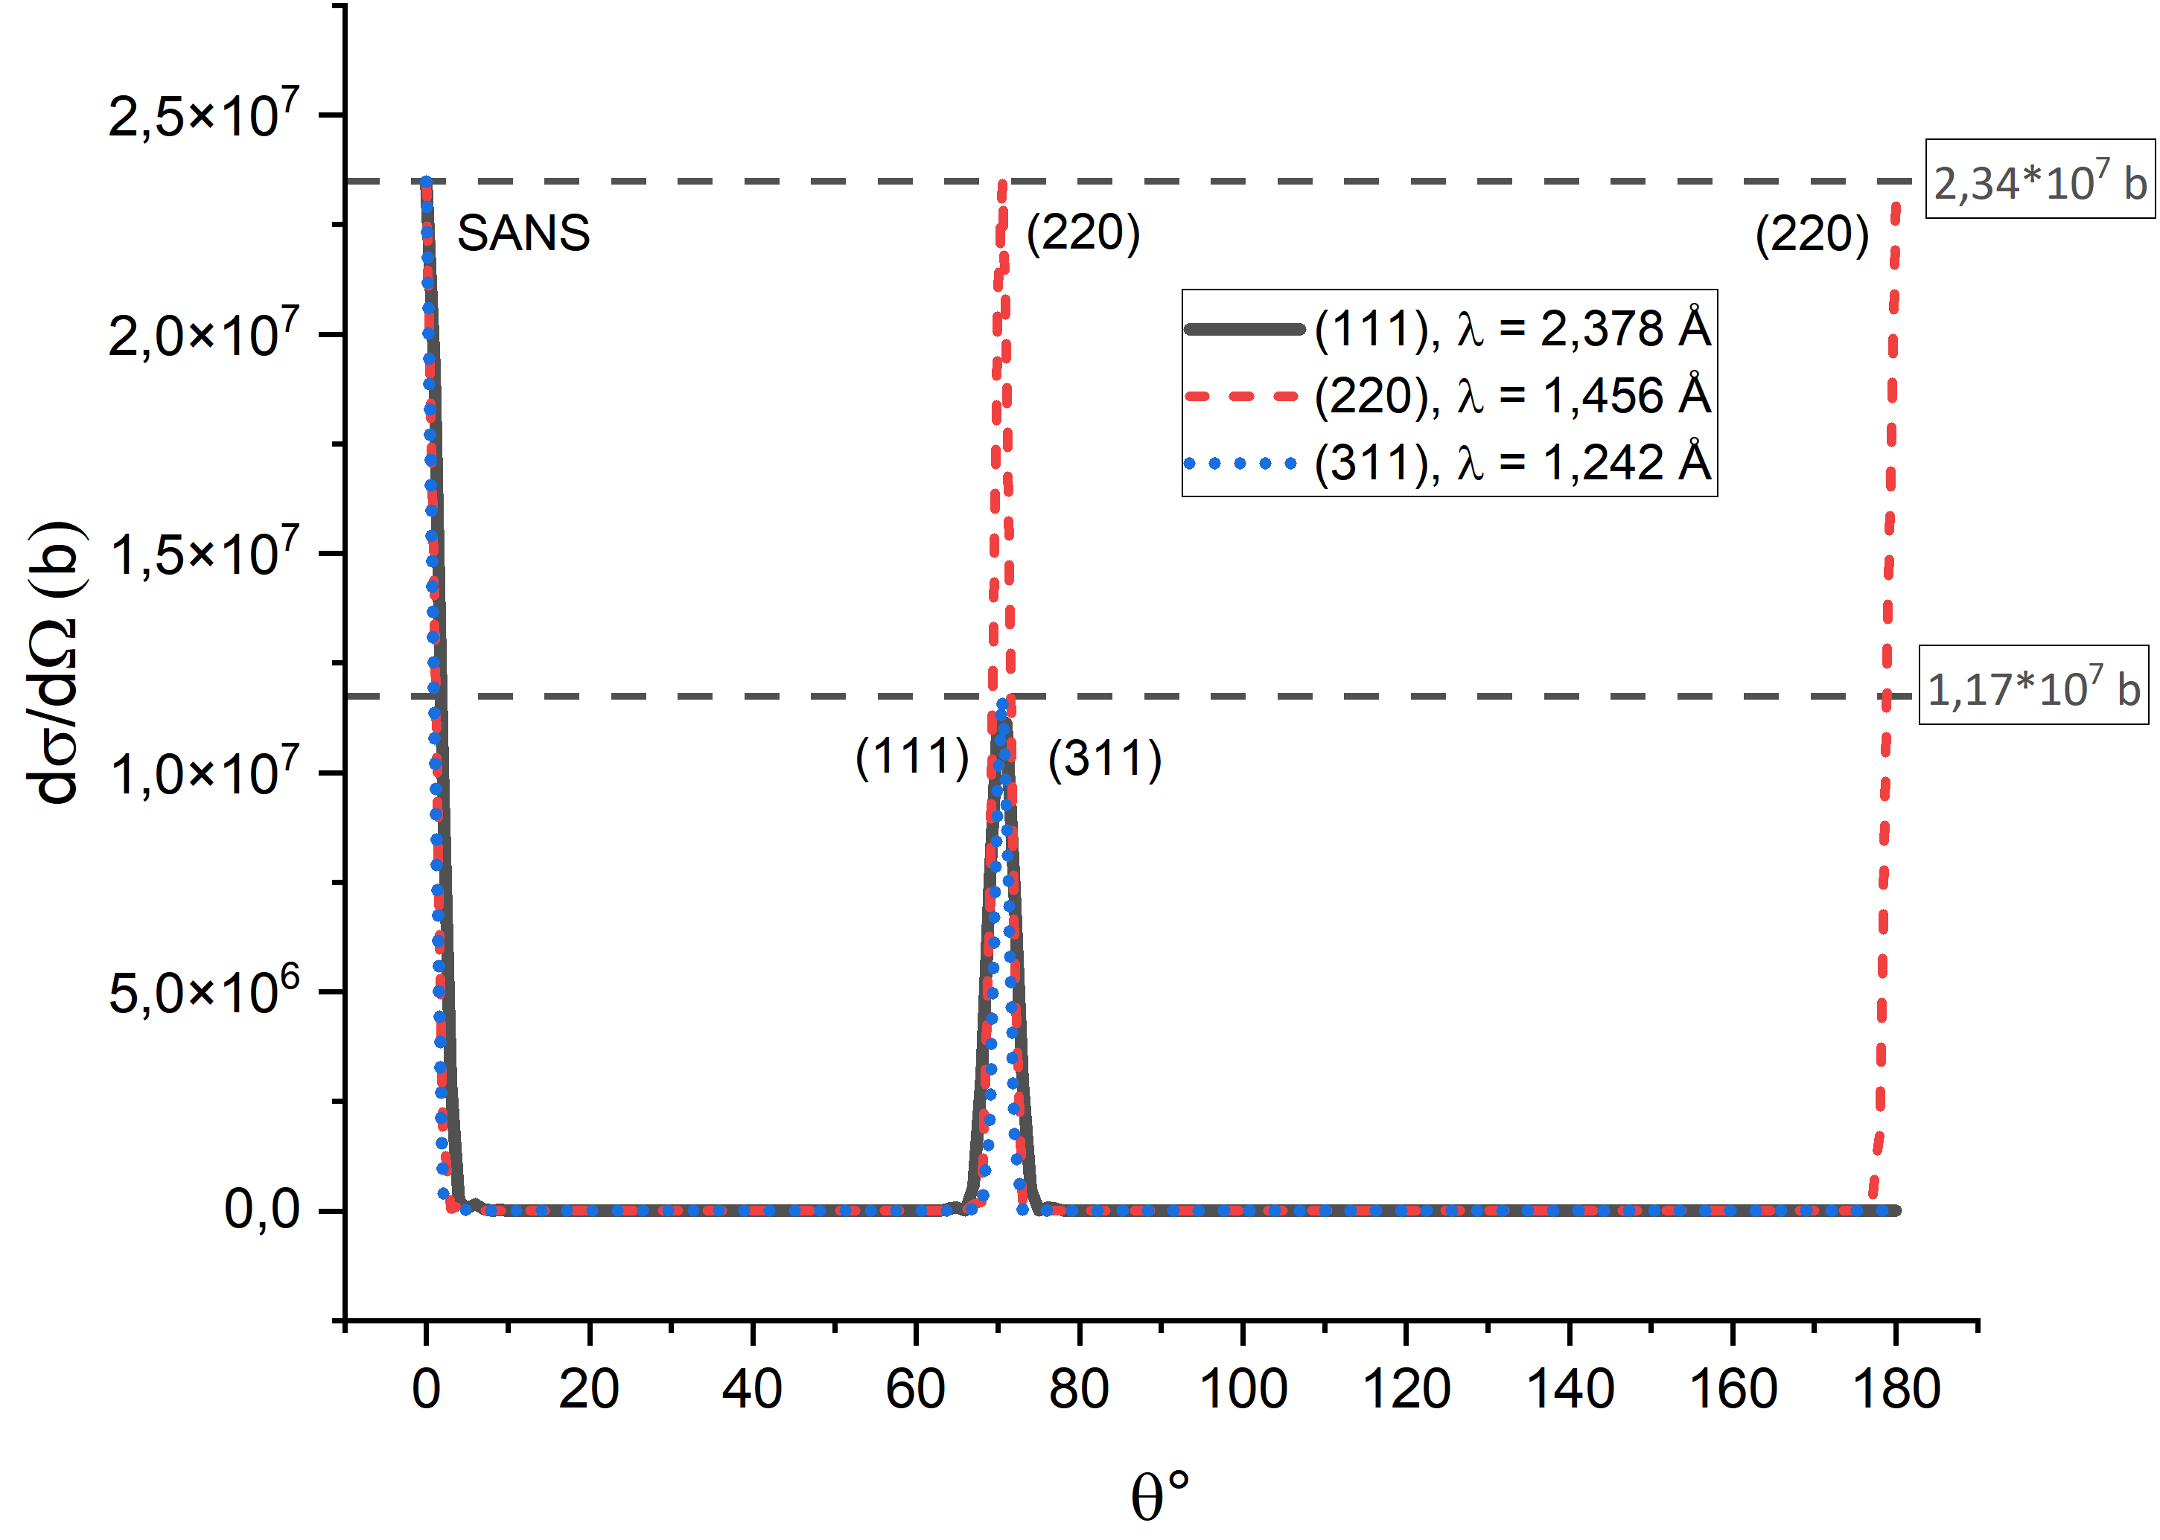
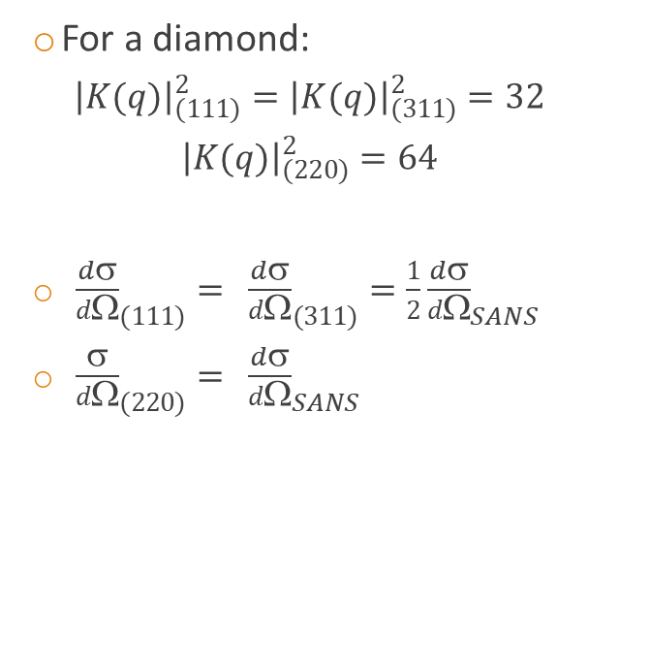
Program verification: peak amplitudes
  For a diamond:
  $${\left|K(q)\right|}_{(111)}^{2}={\left|K(q)\right|}_{(311)}^{2}=32$$
  $${\left|K(q)\right|}_{(220)}^{2}=64$$
  ${���\frac{���dσ}{dΩ}}_{(111)}={���\frac{���dσ}{dΩ}}_{(311)}=\frac{1}{2}{\frac{���dσ}{dΩ}}_{SANS}$
  ${���\frac{���σ}{dΩ}}_{(220)}={���\frac{���dσ}{dΩ}}_{SANS}$

Slide 16
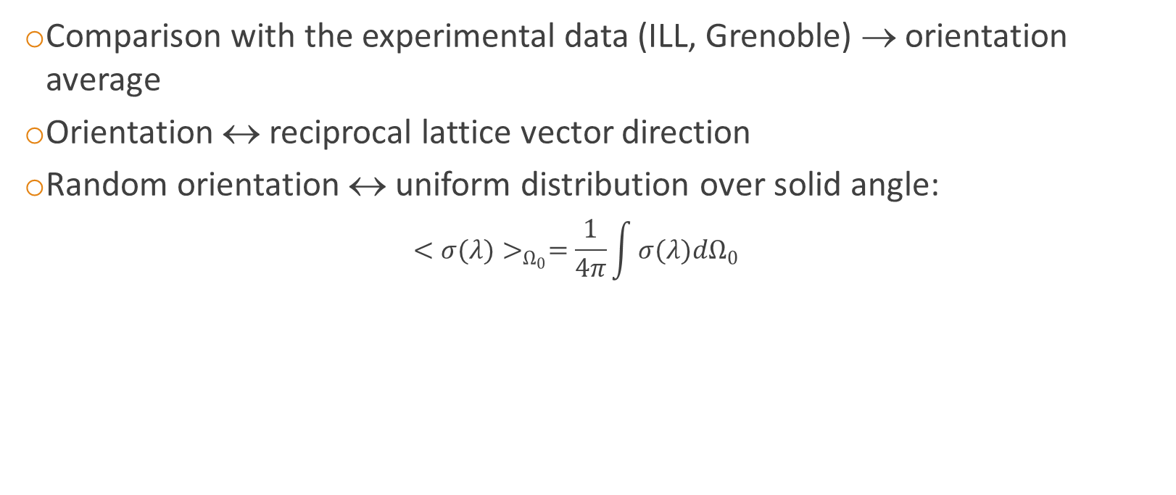
Work in progress: orientation average
  Comparison with the experimental data (ILL, Grenoble) → orientation average
  Orientation ↔ reciprocal lattice vector direction
  Random orientation ↔ uniform distribution over solid angle:
  $${<σ(λ)>}_{Ω_{0}}=\frac{1}{4π}\int{σ(λ)dΩ_{0}}$$

Slide 17
Conclusions
  Accounting for diffraction and finite nanoparticle size is essential for modeling of neutron transport in nanopowders
  The developed program allows to calculate scattering cross-section on the stationary nanoparticle
  So far the program has passed all the verification tests
  The next necessary step is nanoparticle orientation average

Slide 18
Thank you for attention!

