Slide 1
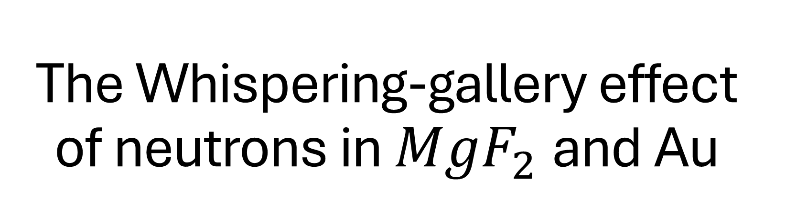
The Whispering-gallery effect of neutrons in ${MgF}_{2}$and Au
Katharina Schreiner, Laboratoire Kastler-Brossel

Slide 2
Something is missing – short range forces?
Possible extension of the standard model with extra dimensions/additional bosons mediating short range forces (SRF) etc., see talk of Stefan Baeßler
Neutrons do not have false effects from electric charge – good candidate for searches of SRF, but generally low statistics for cold neutrons
Matter waves of cold neutrons give a good tool to probe such forces → interferences can be measured and are sensitive for probing SRFs
SRF between neutrons (SRF-charge 1) and nuclei of material, the effect will be biggest for
  Long interaction times: We want cold neutrons and a setup that allows longer observation times → need for high statistics of slow neutrons
  Fly-through experimental setups have an upper limit for observation time
  Dense materials of heavy nuclei (High SRF charge)
A seemingly perfect candidate: Whispering gallery type measurements of neutrons (preferably over a dense, heavy element, e.g. Au)

Slide 3
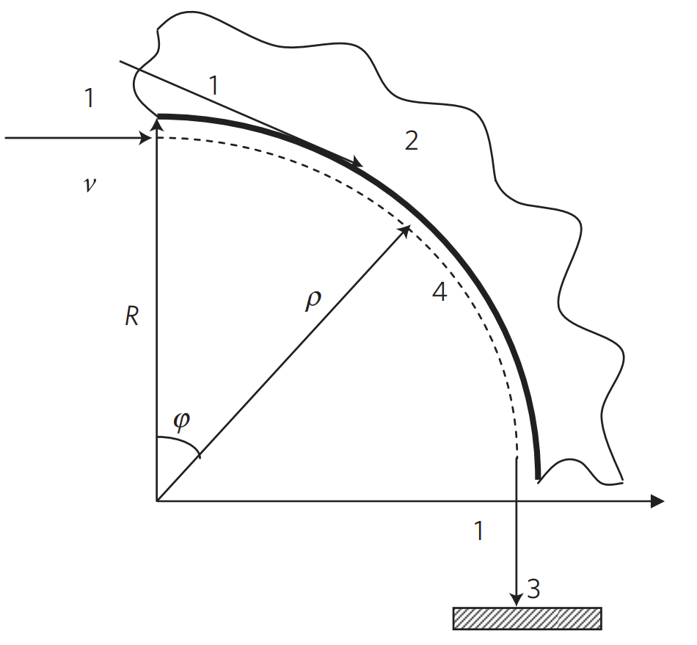
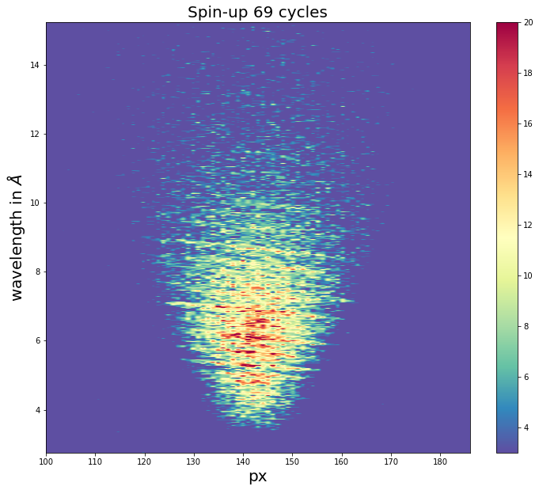
The whispering gallery - Overview
Whispering gallery: Particles propagating in a curved wave guide, forming “quasistationary” states (finite lifetime, parts tunnel through the waveguide)
First discovered in sound waves
Curved waveguide
  many “reflections” for particles passing through the whole waveguide
  By increasing the opening angle we can increase observation time
Neutron Whispering gallery: Search for spin (in) – dependent short range forces (SRF) acting on the neutrons, eperiments done at Institute Laue-Langevin (ILL) in Grenoble
Future experiments: WG with longer observation time, with hydrogen and potentially also antihydrogen
Figure taken from (1)

Slide 4
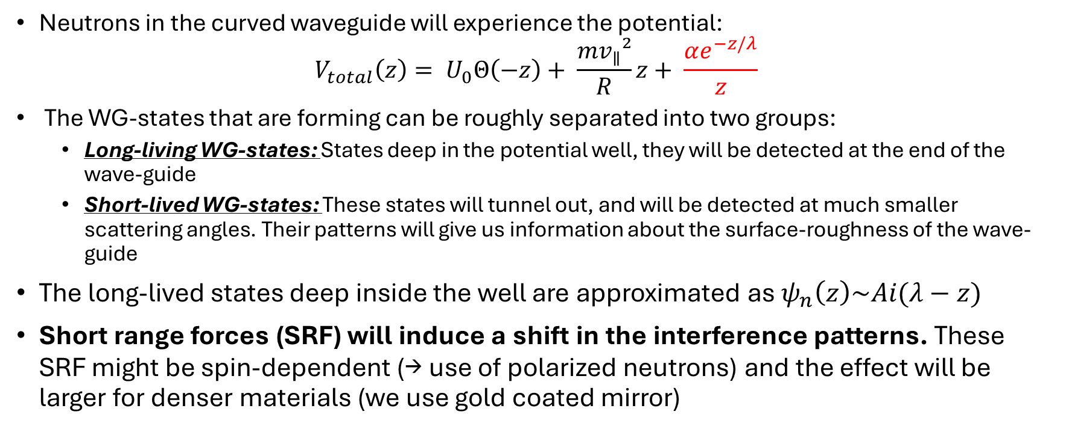
Neutron WG - Motivation
Neutrons in the curved waveguide will experience the potential:
$$V_{total}\left(z\right)= U_{0}Θ\left(−z\right)+ \frac{mv_{∥}²}{R}z+ \frac{αe^{−z/λ}}{z}$$
The WG-states that are forming can be roughly separated into two groups:
  Long-living WG-states: States deep in the potential well, they will be detected at the end of the wave-guide
  Short-lived WG-states: These states will tunnel out, and will be detected at much smaller scattering angles. Their patterns will give us information about the surface-roughness of the wave-guide
The long-lived states deep inside the well are approximated as $ψ_{n}\left(z\right)\sim Ai(λ−z)$
Short range forces (SRF) will induce a shift in the interference patterns. These SRF might be spin-dependent (→ use of polarized neutrons) and the effect will be larger for denser materials (we use gold coated mirror)

Slide 5
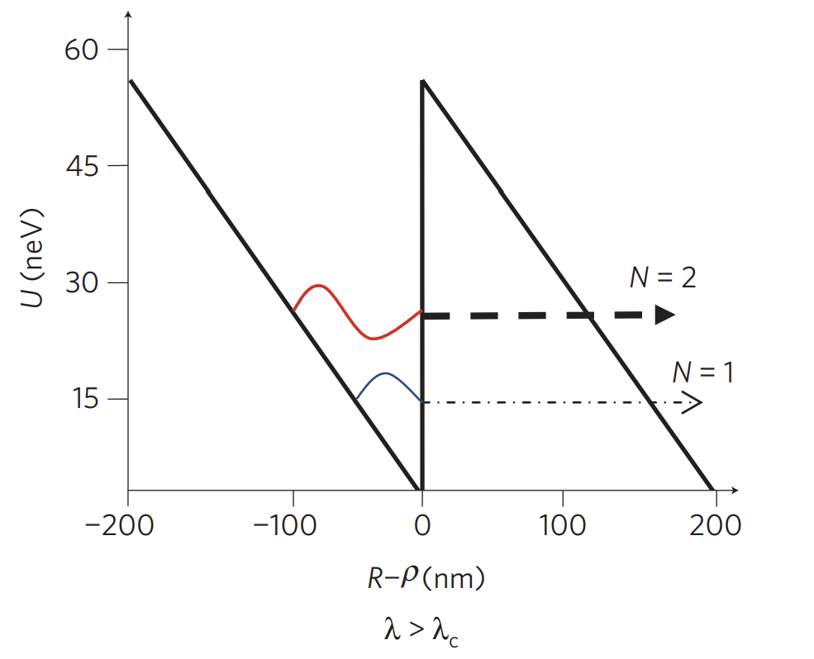
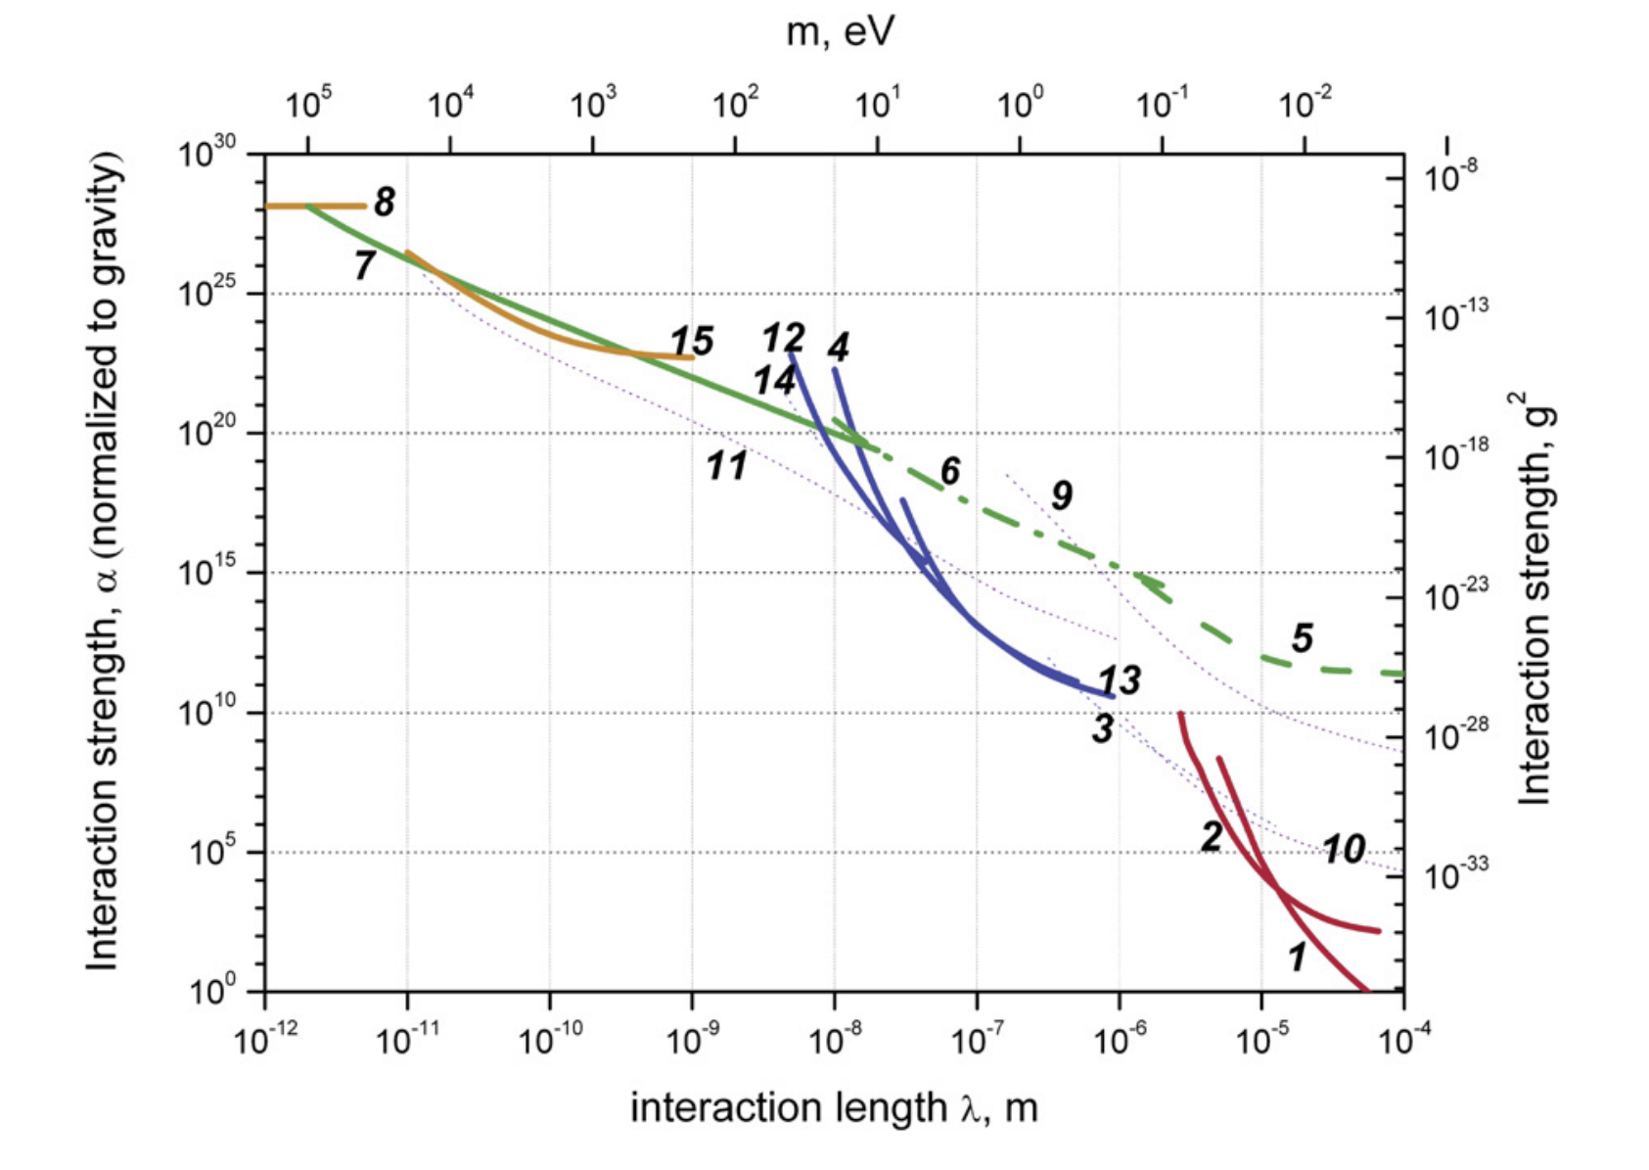
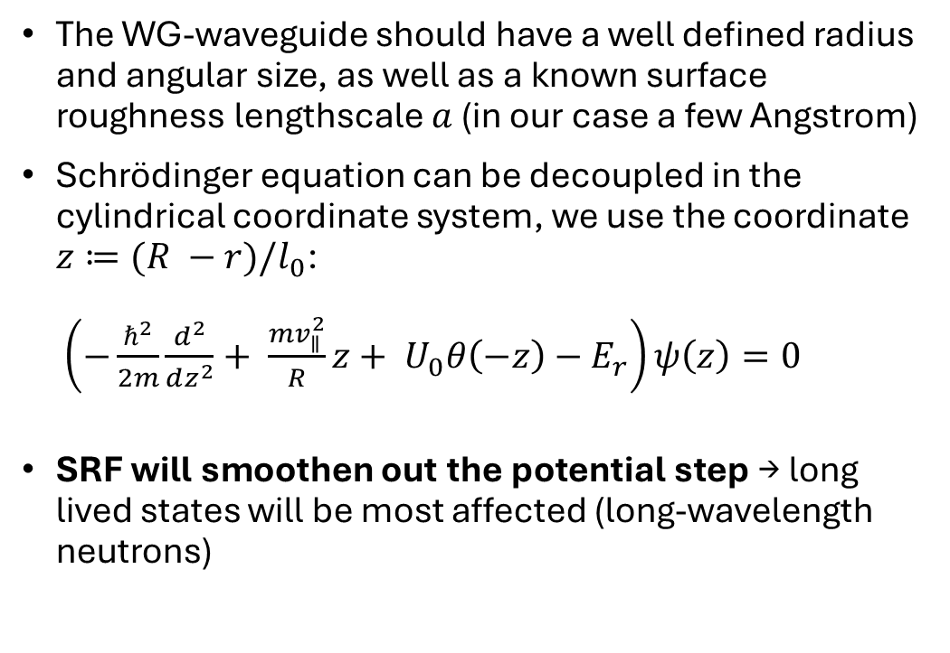
Neutron WG - Theory
The WG-waveguide should have a well defined radius and angular size, as well as a known surface roughness lengthscale $a$ (in our case a few Angstrom)
Schrödinger equation can be decoupled in the cylindrical coordinate system, we use the coordinate $z≔(R −r)/l_{0}$:
$\left(−\frac{ℏ^{2}}{2m}\frac{d^{2}}{dz^{2}}+ \frac{mv_{∥}^{2}}{R}z+ U_{0}θ\left(−z\right){ − E}_{r}\right)ψ\left(z\right)=0$
SRF will smoothen out the potential step → long lived states will be most affected (long-wavelength neutrons)
Figure taken from (1)
Figure taken from (2)

Slide 6
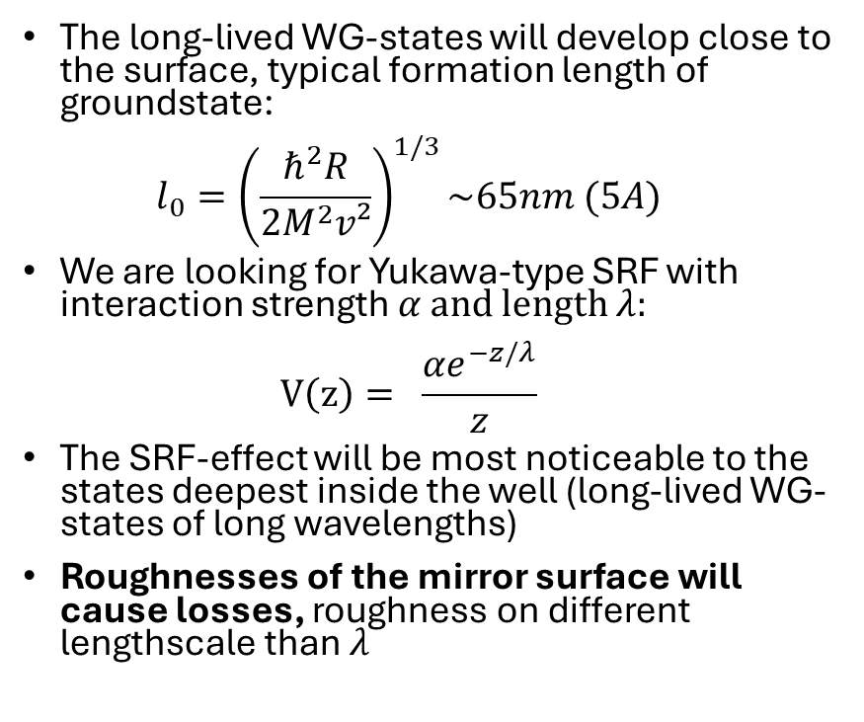
Constraining short range forces
The long-lived WG-states will develop close to the surface, typical formation length of groundstate:
$l_{0}={\left(\frac{ℏ^{2}R}{2M^{2}v²}\right)}^{1/3}\sim 65nm (5A)$
We are looking for Yukawa-type SRF with interaction strength $α$ and length $λ$:
$V\left(z\right)= \frac{αe^{−z/λ}}{z}$
The SRF-effect will be most noticeable to the states deepest inside the well (long-lived WG-states of long wavelengths)
Roughnesses of the mirror surface will cause losses, roughness on different lengthscale than $λ$
Figure taken from (2)

Slide 7
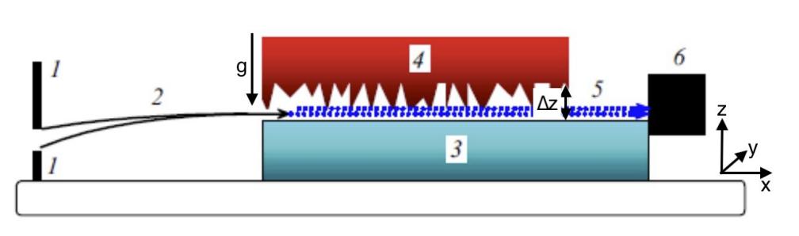
Previous experiments: QGS vs. WG
QGS-experiment: Particle-wave guided over a flat mirror, with an absorber/scatterer on top the transmission can be regulated
QGS-states probe the surface, but potentially there might be only one classical “bounce”, whereas all WG trajectories undergo at least one interaction with the surface
WG-experiments allow us to tune the effective acceleration easier by adjusting the radius of the waveguide – for QGS we would need at least another force-field (e.g. B-field)
We can study also short-lived states in an easy way (tunneling through of states), and get information on the surface roughness
With slow enough neutrons we can in principle extend the observation time by increasing the turning angle, improving the possible energy resolution
Figure taken from (1)
Figure taken from (3)

Slide 8
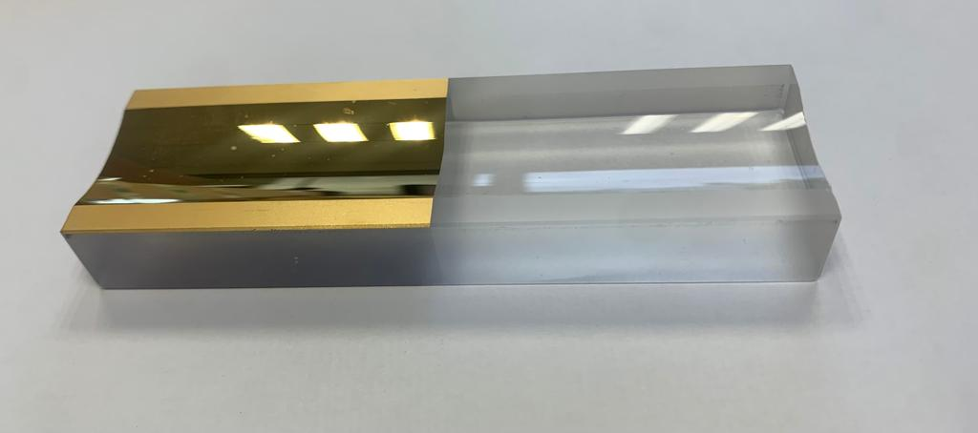
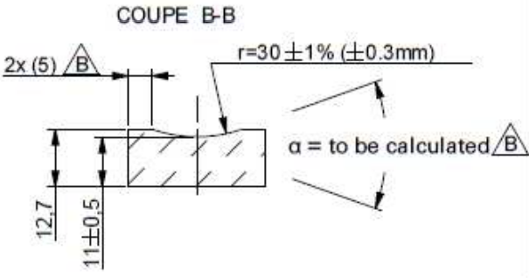
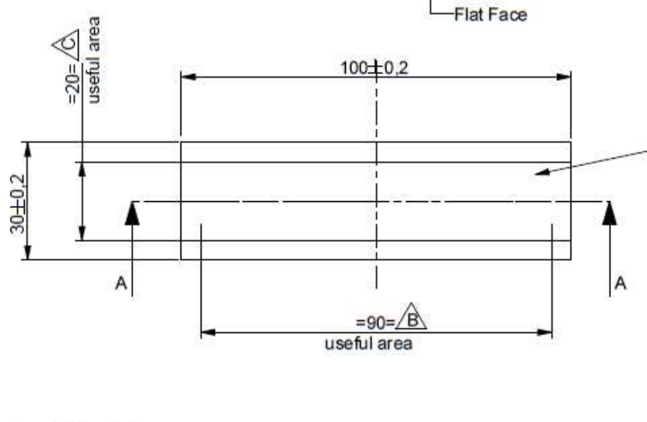
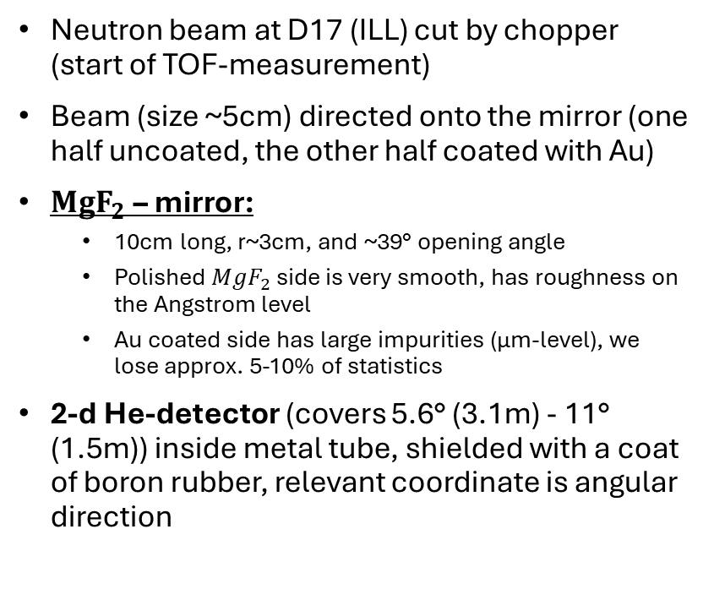
Experimental setup
Neutron beam at D17 (ILL) cut by chopper (start of TOF-measurement)
Beam (size ~5cm) directed onto the mirror (one half uncoated, the other half coated with Au)
${MgF}_{2}$ – mirror:
  10cm long, r~3cm, and ~39° opening angle
  Polished ${MgF}_{2}$ side is very smooth, has roughness on the Angstrom level
  Au coated side has large impurities (μm-level), we lose approx. 5-10% of statistics
2-d He-detector (covers 5.6° (3.1m) - 11° (1.5m)) inside metal tube, shielded with a coat of boron rubber, relevant coordinate is angular direction

Slide 9
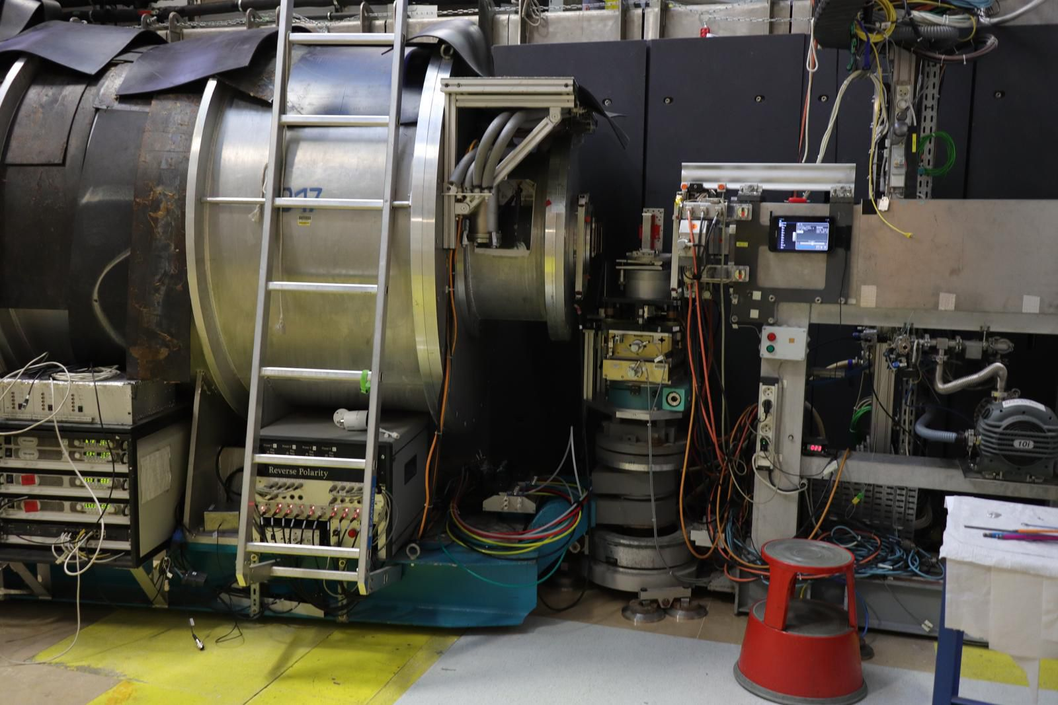
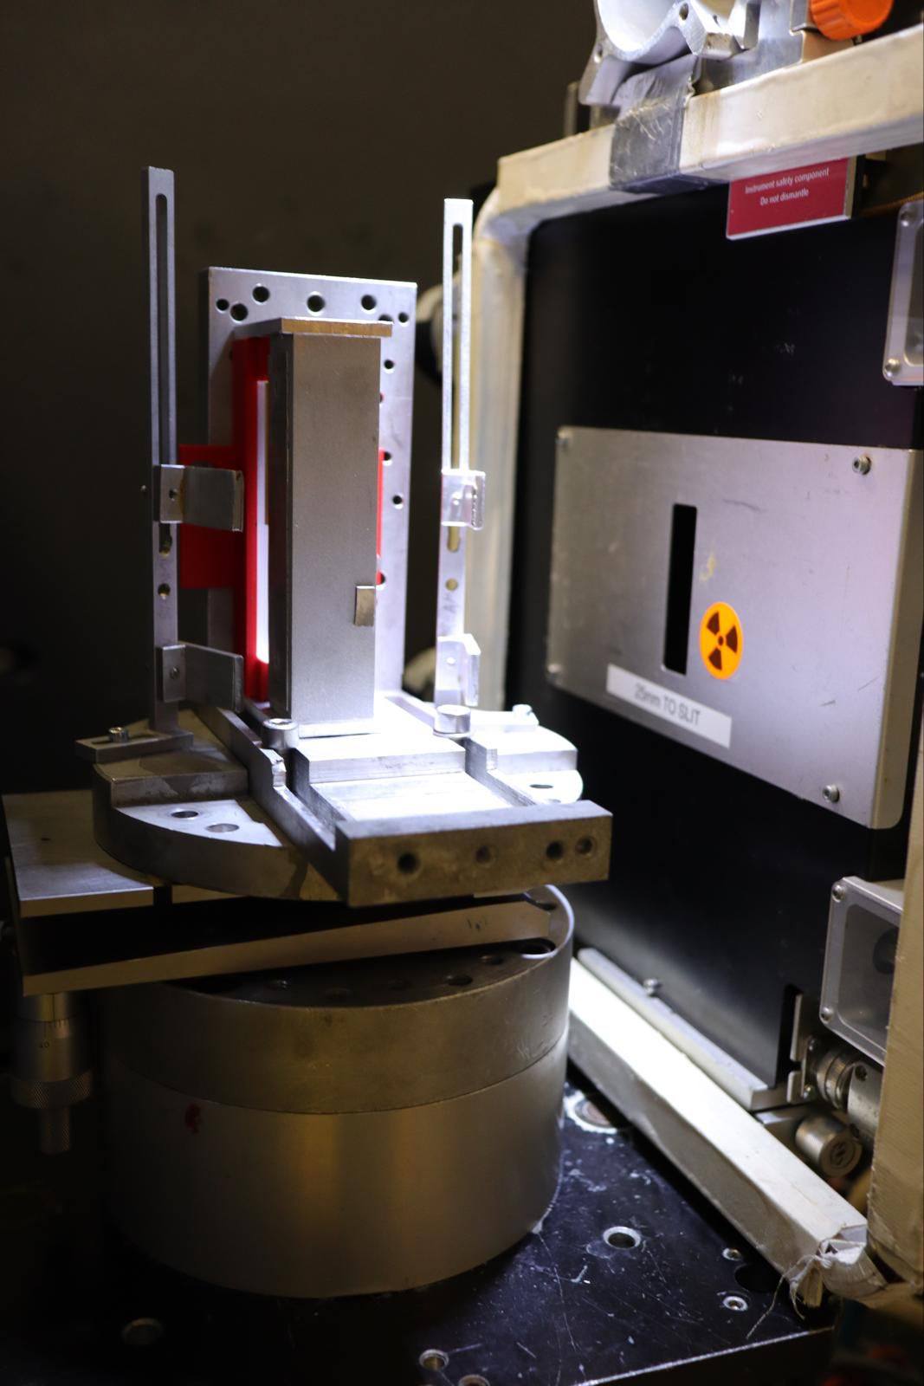

Slide 10
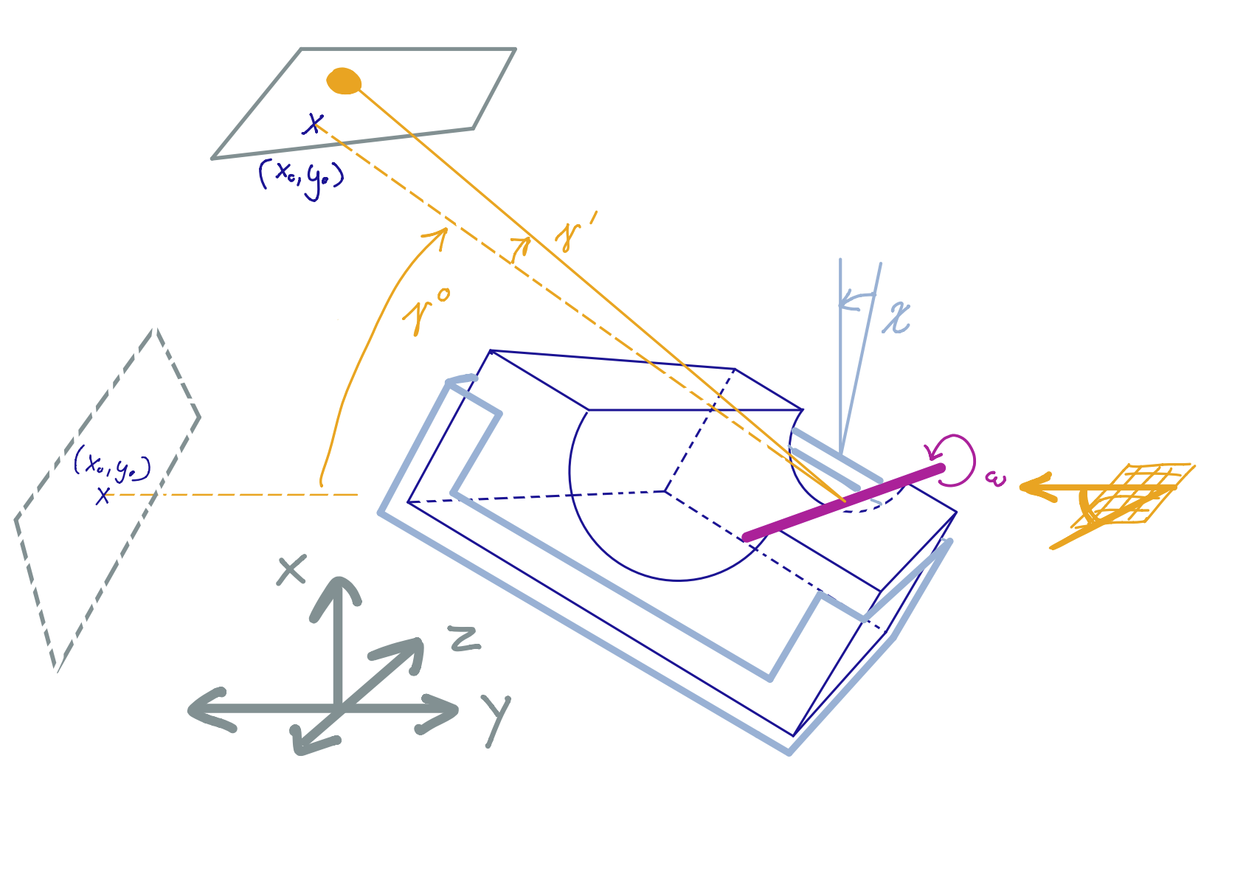
Measurement principle
We measure the turning angle of the neutrons as a wavelength-dependent function
Wavelength is determined by the TOF-measurement, resolution determined (mostly) by chopper opening
Turning angle: Angle between in/outgoing beam tangent to the surface of both edges of the mirror
Angular alignment crucial for measurement: angular accuracy related to accuracy of position of interference lines
The background can change over time (timescale smaller than one cycle), therefore we measure it regularly

Slide 11
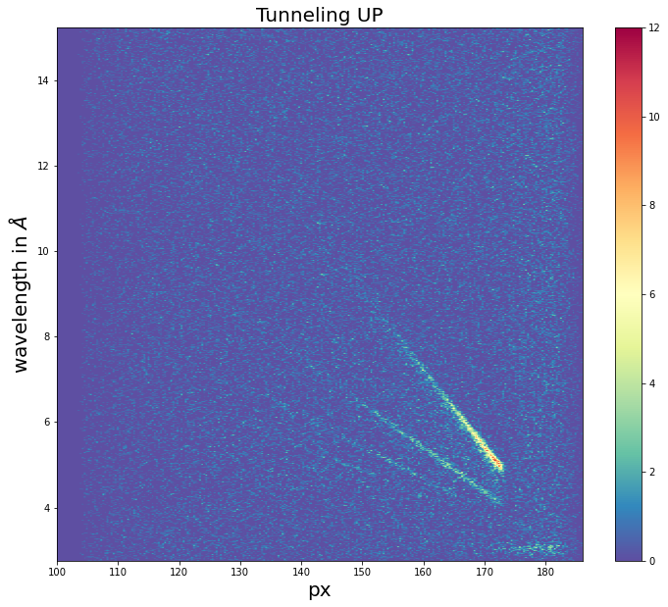
The interference pattern
Interference of long living states will be centered around the opening angle of the mirror (determined as the COM of the interference pattern)
At high angles (~opening angle of the mirror) we measure interferences of the long-living WG states
  Pattern spans ~1°
  Inclined interference lines
  Bottom of V-shape is due to maximal angle of reflection for faster neutrons
At small angles (just after direct beam through sample) we measure the short-lived states
  Angular distribution gives lifetime of WG-states
  Lifetime depends on roughness of the mirror surface

Slide 12
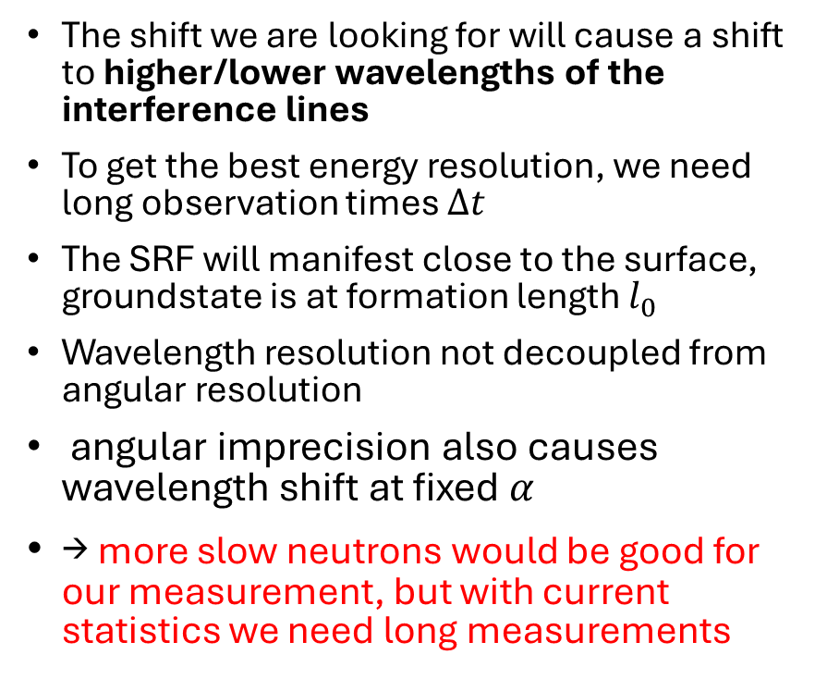
The interference pattern – SRF constraints
The shift we are looking for will cause a shift to higher/lower wavelengths of the interference lines
To get the best energy resolution, we need long observation times $Δt$
The SRF will manifest close to the surface, groundstate is at formation length $l_{0}$
Wavelength resolution not decoupled from angular resolution
angular imprecision also causes wavelength shift at fixed $α$
→ more slow neutrons would be good for our measurement, but with current statistics we need long measurements

Slide 13
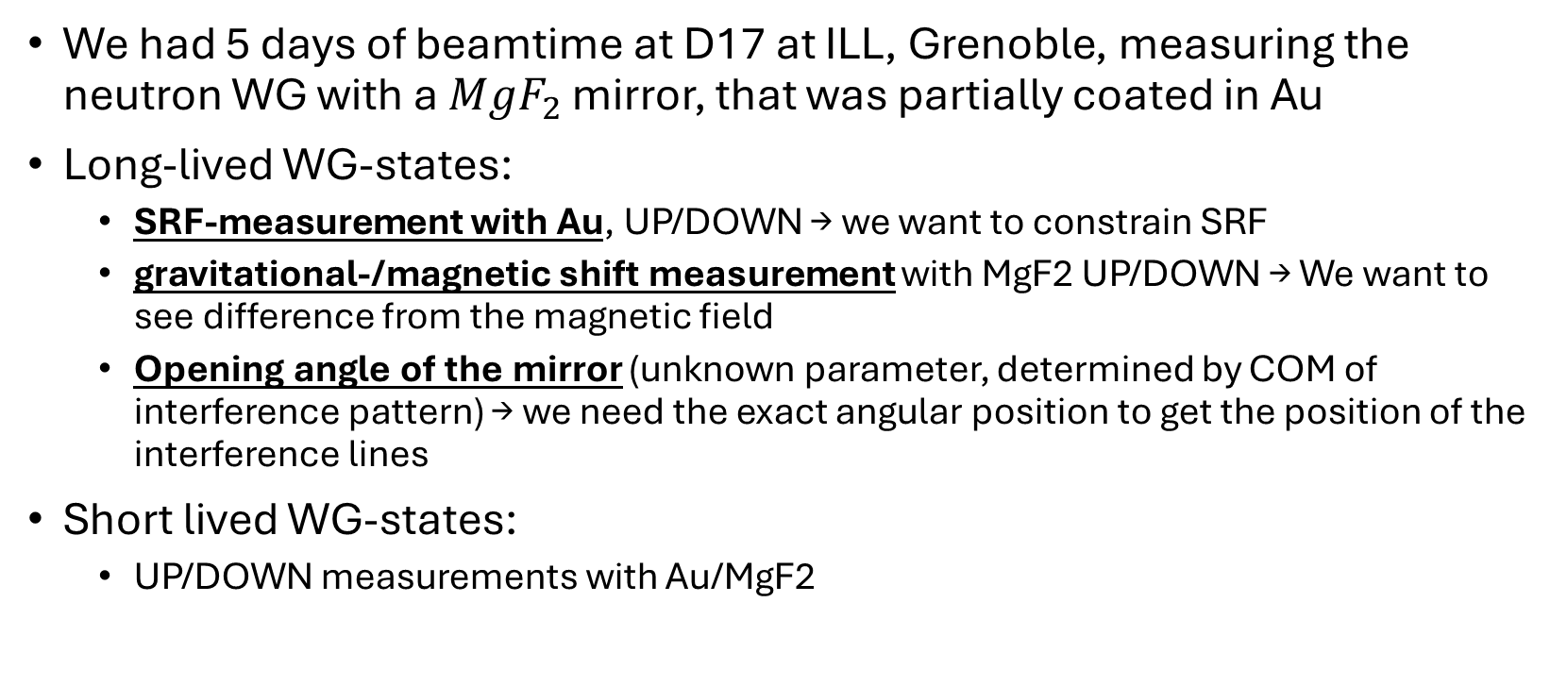
Measurements of March 2024
We had 5 days of beamtime at D17 at ILL, Grenoble, measuring the neutron WG with a ${MgF}_{2}$ mirror, that was partially coated in Au
Long-lived WG-states:
  SRF-measurement with Au, UP/DOWN → we want to constrain SRF
  gravitational-/magnetic shift measurement with MgF2 UP/DOWN → We want to see difference from the magnetic field
  Opening angle of the mirror (unknown parameter, determined by COM of interference pattern) → we need the exact angular position to get the position of the interference lines
Short lived WG-states:
  UP/DOWN measurements with Au/MgF2

Slide 14
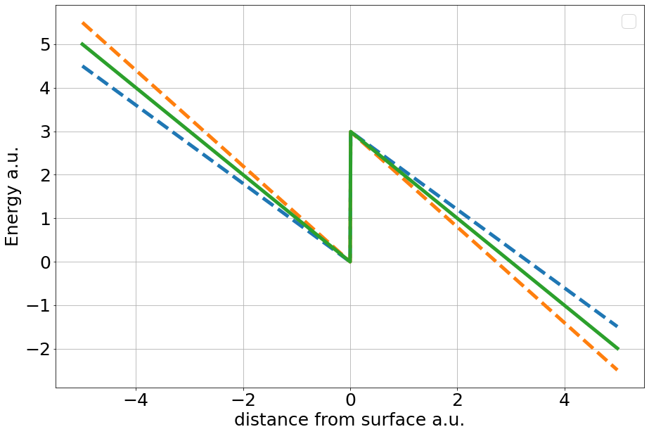
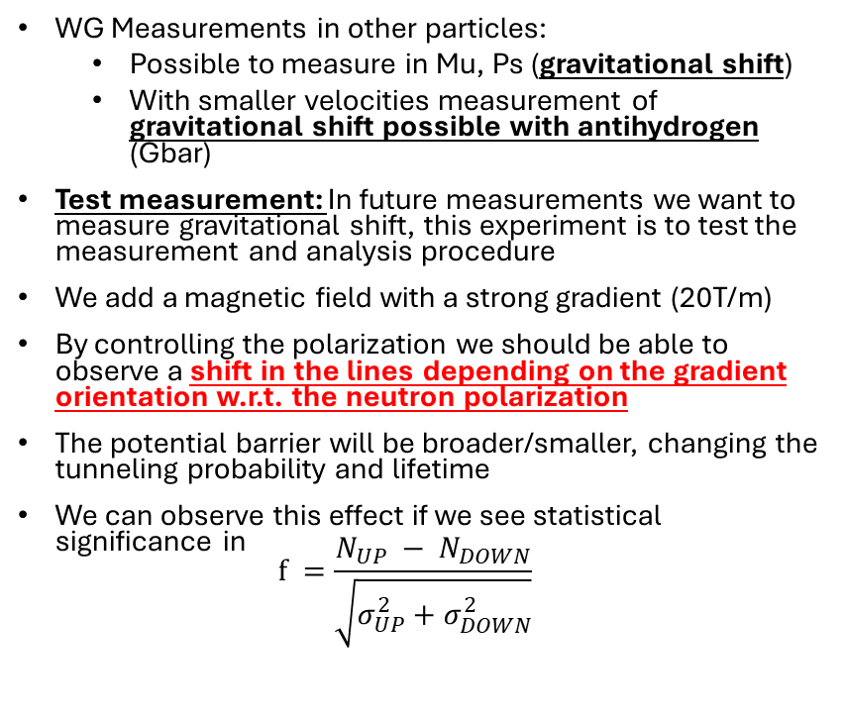
Gravitational/magnetic shift of the whispering gallery
WG Measurements in other particles:
  Possible to measure in Mu, Ps (gravitational shift)
  With smaller velocities measurement of gravitational shift possible with antihydrogen (Gbar)
Test measurement: In future measurements we want to measure gravitational shift, this experiment is to test the measurement and analysis procedure
We add a magnetic field with a strong gradient (20T/m)
By controlling the polarization we should be able to observe a shift in the lines depending on the gradient orientation w.r.t. the neutron polarization
The potential barrier will be broader/smaller, changing the tunneling probability and lifetime
We can observe this effect if we see statistical significance in
$f =\frac{N_{UP} − N_{DOWN}}{\sqrt{σ_{UP}^{2}+σ_{DOWN}^{2}}}$

Slide 15
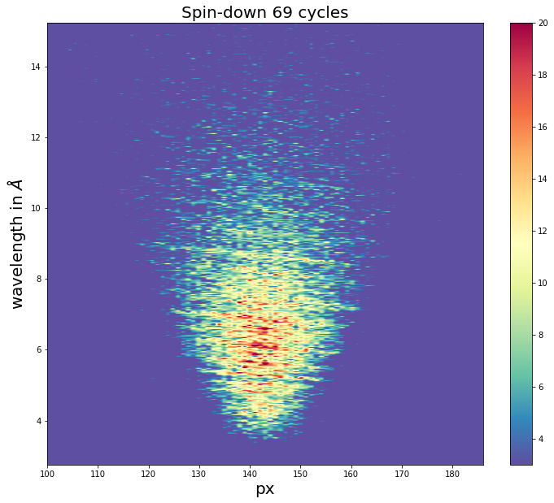
Gravitational/magnetic shift of the whispering gallery
Results of overall 1035min measurement for both polarization directions.

Slide 16
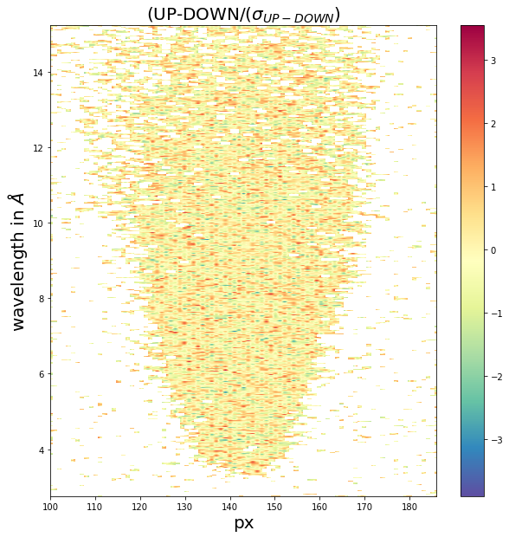
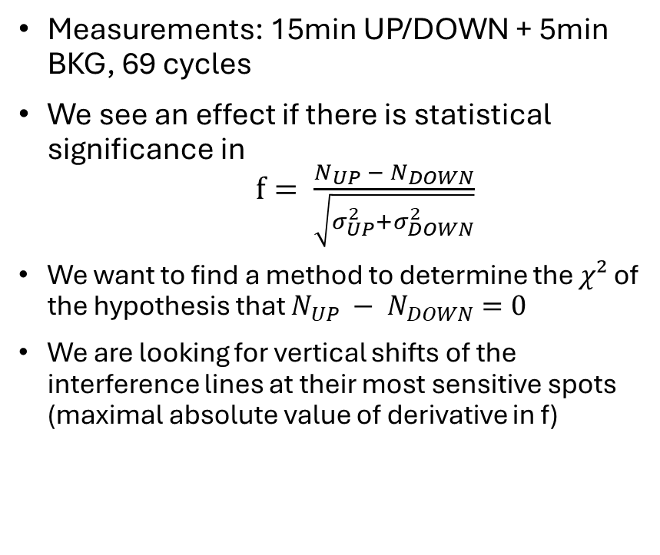
Preliminary results – WG with MgF2
Measurements: 15min UP/DOWN + 5min BKG, 69 cycles
We see an effect if there is statistical significance in
$f= \frac{N_{UP} − N_{DOWN}}{\sqrt{σ_{UP}^{2}+σ_{DOWN}^{2}}}$
We want to find a method to determine the $χ²$ of the hypothesis that $N_{UP} − N_{DOWN}=0$
We are looking for vertical shifts of the interference lines at their most sensitive spots (maximal absolute value of derivative in f)

Slide 17
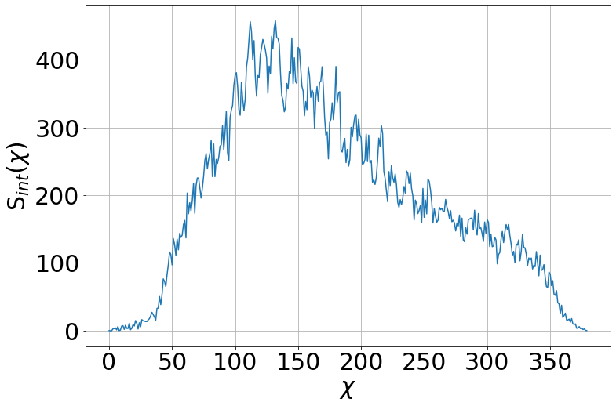
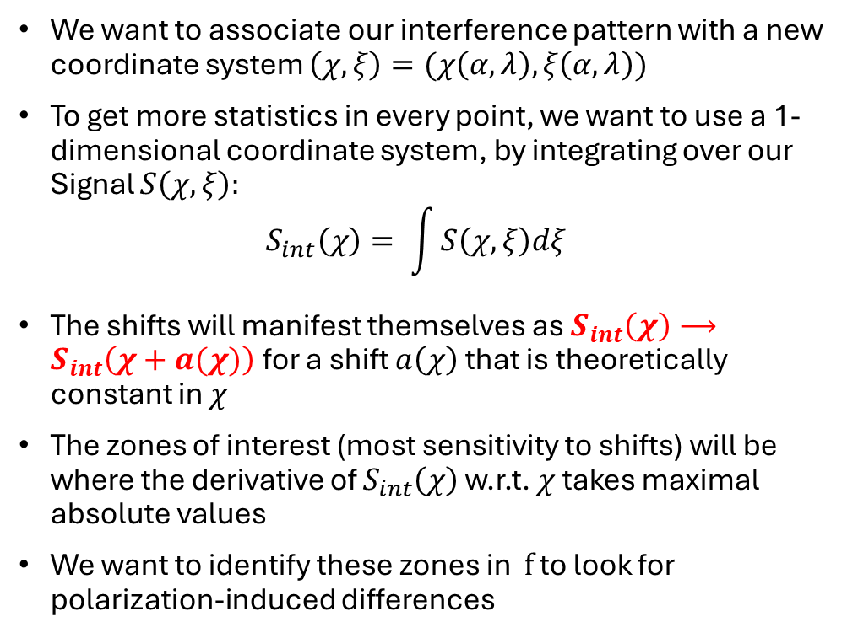
Preliminary results – WG with MgF2
We want to associate our interference pattern with a new coordinate system $\left(χ, ξ\right)=(χ\left(α,λ\right),ξ\left(α,λ\right))$
To get more statistics in every point, we want to use a 1-dimensional coordinate system, by integrating over our Signal $S\left(χ,ξ\right):$
$S_{int}\left(χ\right)= \int{S\left(χ,ξ\right)dξ}$
The shifts will manifest themselves as $S_{int}\left(χ\right)⟶S_{int}\left(χ+a(χ)\right)$ for a shift $a\left(χ\right)$ that is theoretically constant in $χ$
The zones of interest (most sensitivity to shifts) will be where the derivative of $S_{int}\left(χ\right)$w.r.t. $χ$ takes maximal absolute values
We want to identify these zones in $f$ to look for polarization-induced differences

Slide 18
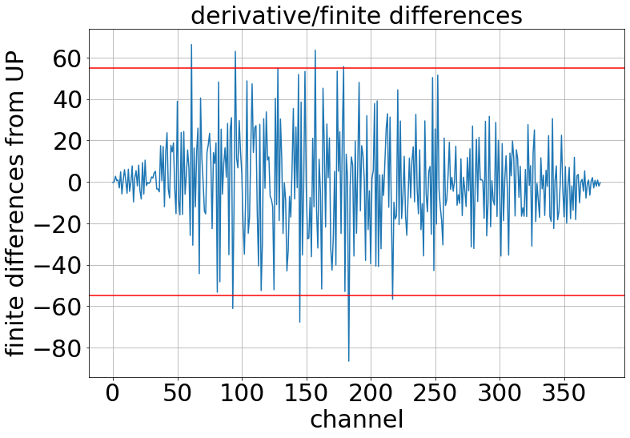
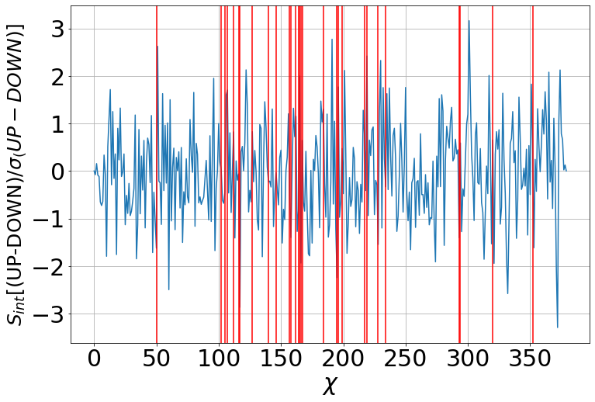
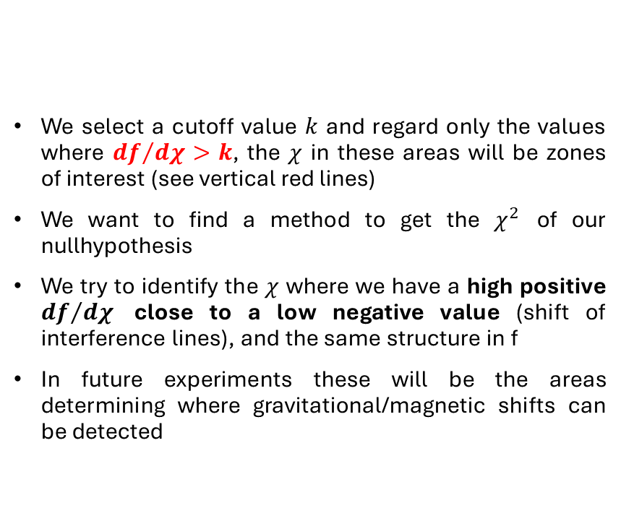
Preliminary results – WG with MgF2
We select a cutoff value $k$ and regard only the values where ${df}/{dχ}>k$, the $χ$ in these areas will be zones of interest (see vertical red lines)
We want to find a method to get the $χ^{2}$ of our nullhypothesis
We try to identify the $χ$ where we have a high positive ${df}/{dχ}$ close to a low negative value (shift of interference lines), and the same structure in f
In future experiments these will be the areas determining where gravitational/magnetic shifts can be detected

Slide 19
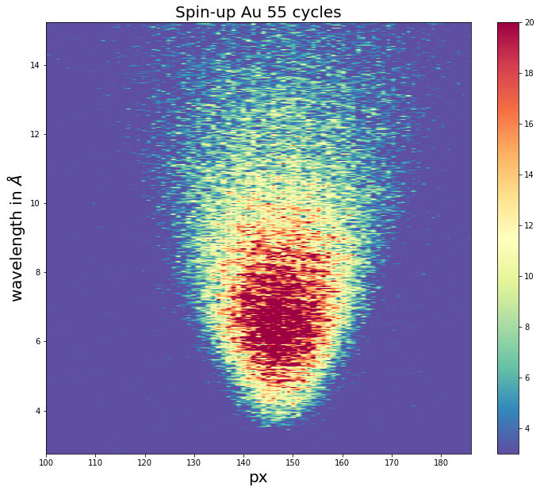
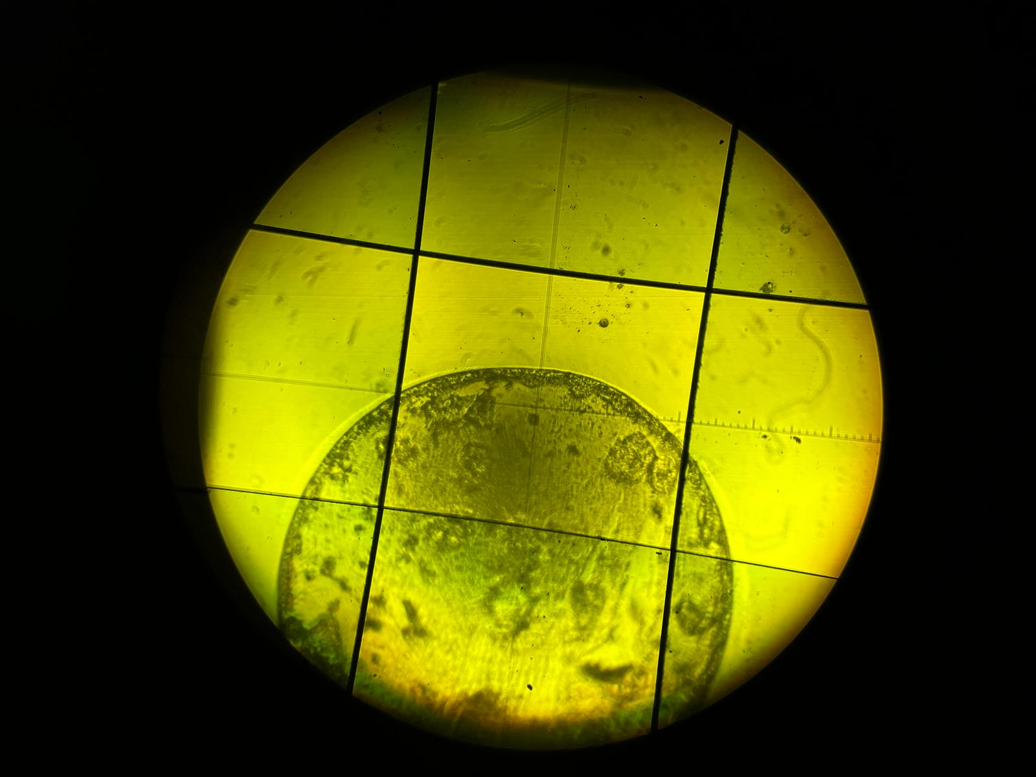
Short range forces: WG of neutrons with Au
We selected Au, a high-density material of heavy nuclei (SRF-charge 197)
We measured again Spin UP/DOWN 15min, BKG for 5min for 55 cycles
Gold surfaces are very dirty (which we also confirmed while examining the coated mirror)
  Impurities spanning 10mum in diameter lead to losses
  Approx. 5-10% of axial length of gold coating useless → we loose a lot of statistics from these impurities
  We are considering having the Au-coating redone for future experiments

Slide 20
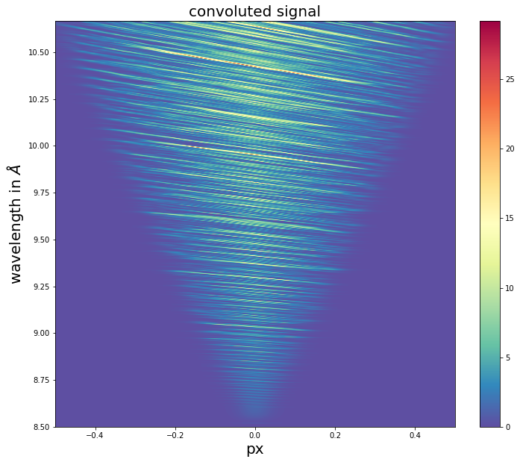
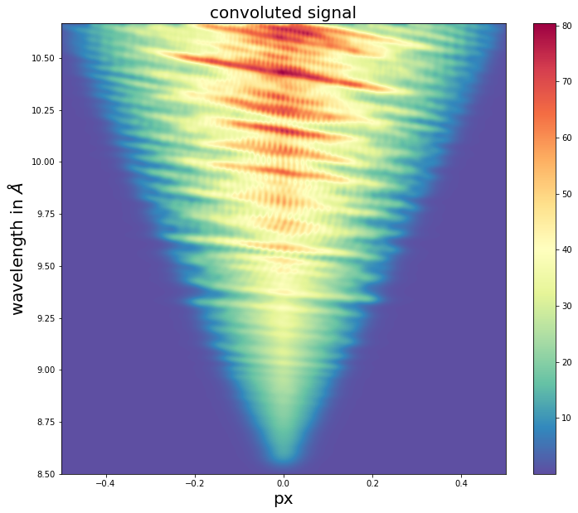
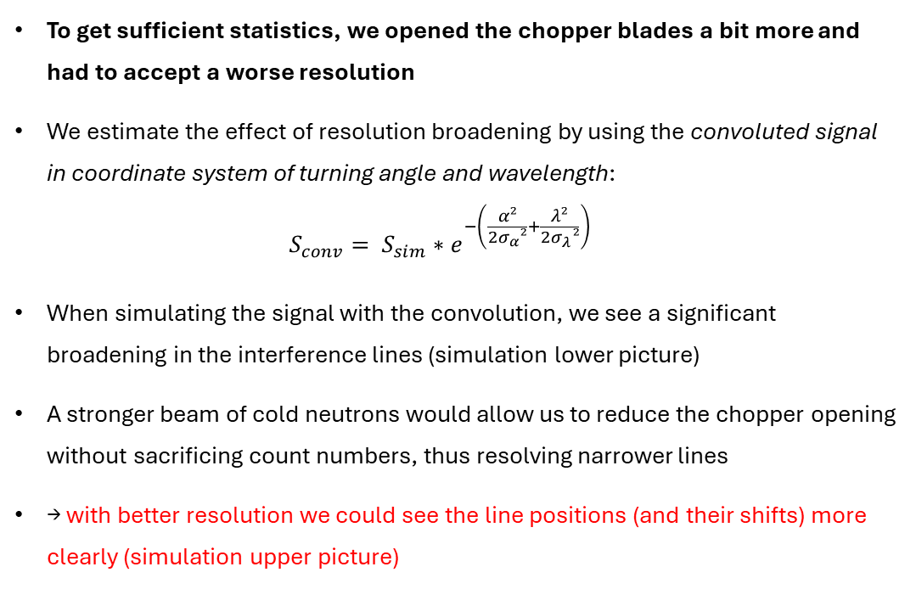
Cold-neutrons for current WG-experiments
To get sufficient statistics, we opened the chopper blades a bit more and had to accept a worse resolution
We estimate the effect of resolution broadening by using the convoluted signal in coordinate system of turning angle and wavelength:
$S_{conv}= S_{sim}∗e^{−\left(\frac{α²}{2σ_{α}²}+\frac{λ²}{2σ_{λ}²}\right)}$
When simulating the signal with the convolution, we see a significant broadening in the interference lines (simulation lower picture)
A stronger beam of cold neutrons would allow us to reduce the chopper opening without sacrificing count numbers, thus resolving narrower lines
→ with better resolution we could see the line positions (and their shifts) more clearly (simulation upper picture)

Slide 21
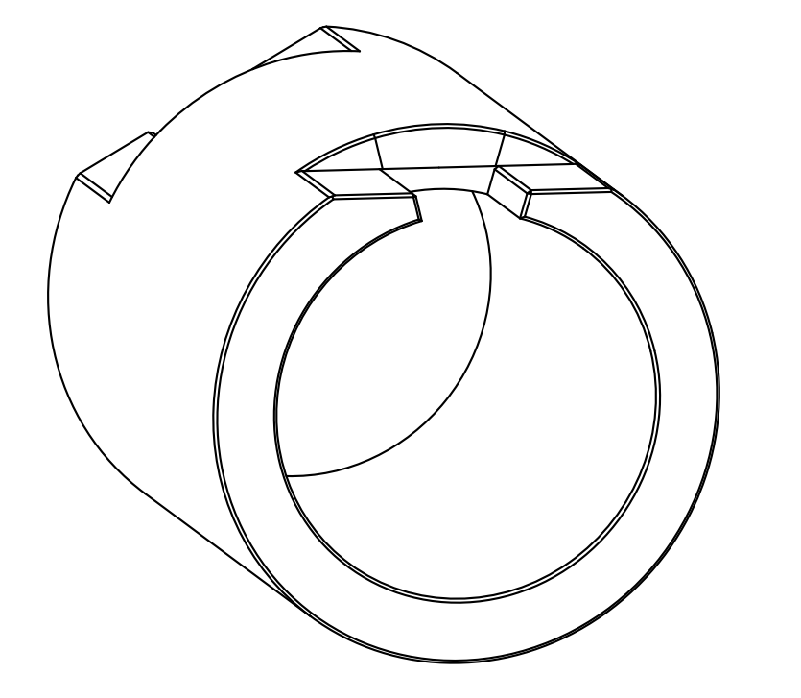
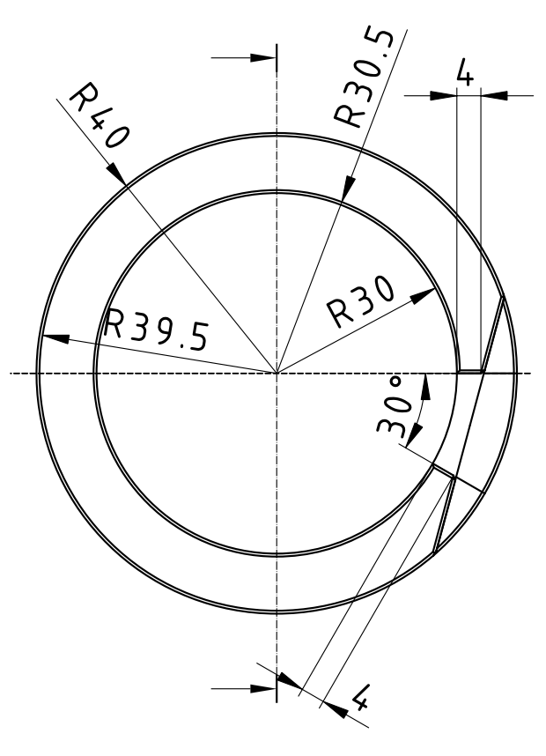
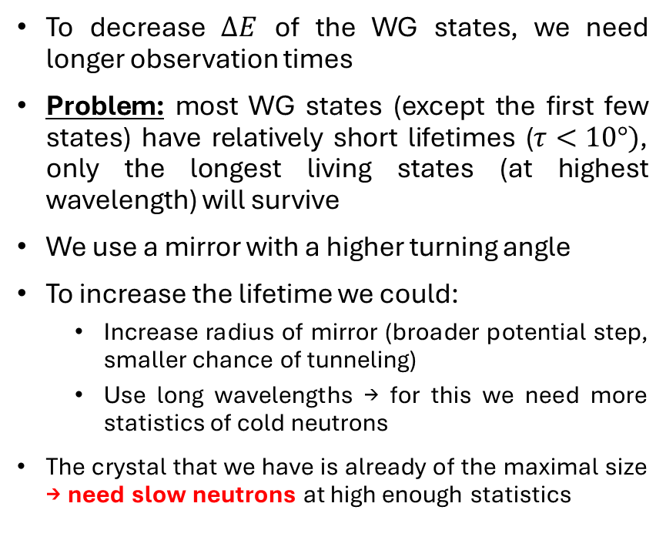
Planned future experiments: WG with long observation times
To decrease $ΔE$ of the WG states, we need longer observation times
Problem: most WG states (except the first few states) have relatively short lifetimes ($τ<10°)$, only the longest living states (at highest wavelength) will survive
We use a mirror with a higher turning angle
To increase the lifetime we could:
  Increase radius of mirror (broader potential step, smaller chance of tunneling)
  Use long wavelengths → for this we need more statistics of cold neutrons
The crystal that we have is already of the maximal size → need slow neutrons at high enough statistics
Drawings by J. Pioquinto

Slide 22
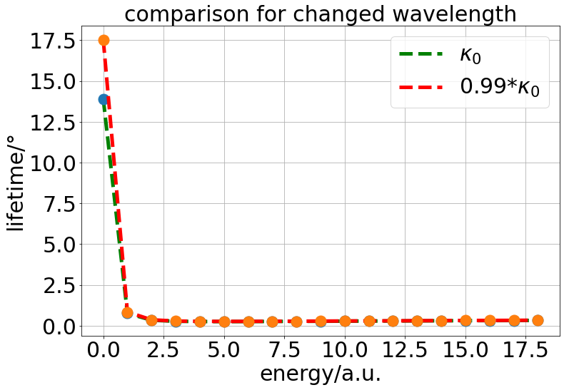
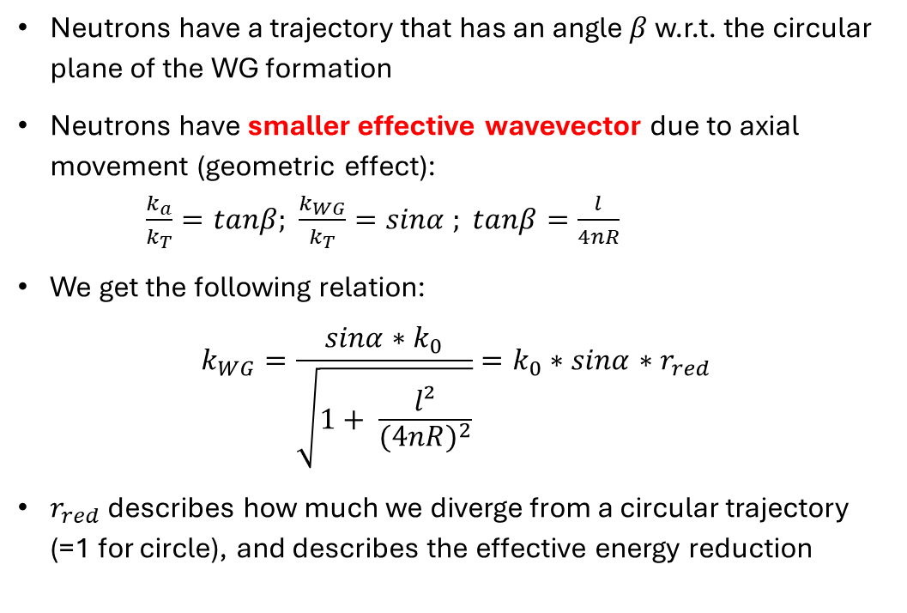
Planned future experiments: WG with long observation times
Neutrons have a trajectory that has an angle $β$ w.r.t. the circular plane of the WG formation
Neutrons have smaller effective wavevector due to axial movement (geometric effect):
$\frac{k_{a}}{k_{T}}=tanβ;$ $\frac{k_{WG}}{k_{T}}=sinα ; tanβ=\frac{l}{4nR}$
We get the following relation:
$k_{WG}=\frac{sinα∗k_{0}}{\sqrt{1+ \frac{l²}{{(4nR)}^{2}}}}=k_{0}∗sinα∗r_{red}$
$r_{red}$ describes how much we diverge from a circular trajectory (=1 for circle), and describes the effective energy reduction

Slide 23
Conclusion/Summary
The WG is a powerful tool to measure SRF of neutrons acting from the waveguide
Further WG measurements with other particles could even resolve the gravitational shift of the WG (antihydrogen, Ps)
Long-observation-time WG measurements could allow an improved energy-resolution of WG-states (need long enough lifetimes = slow enough neutrons)
With a source of cold neutrons we could:
  Increase the wavelength resolution without having unreasonably long times to measure because of higher statistics
  Higher statistics in slow neutrons allow us to increase the observation time

Slide 24
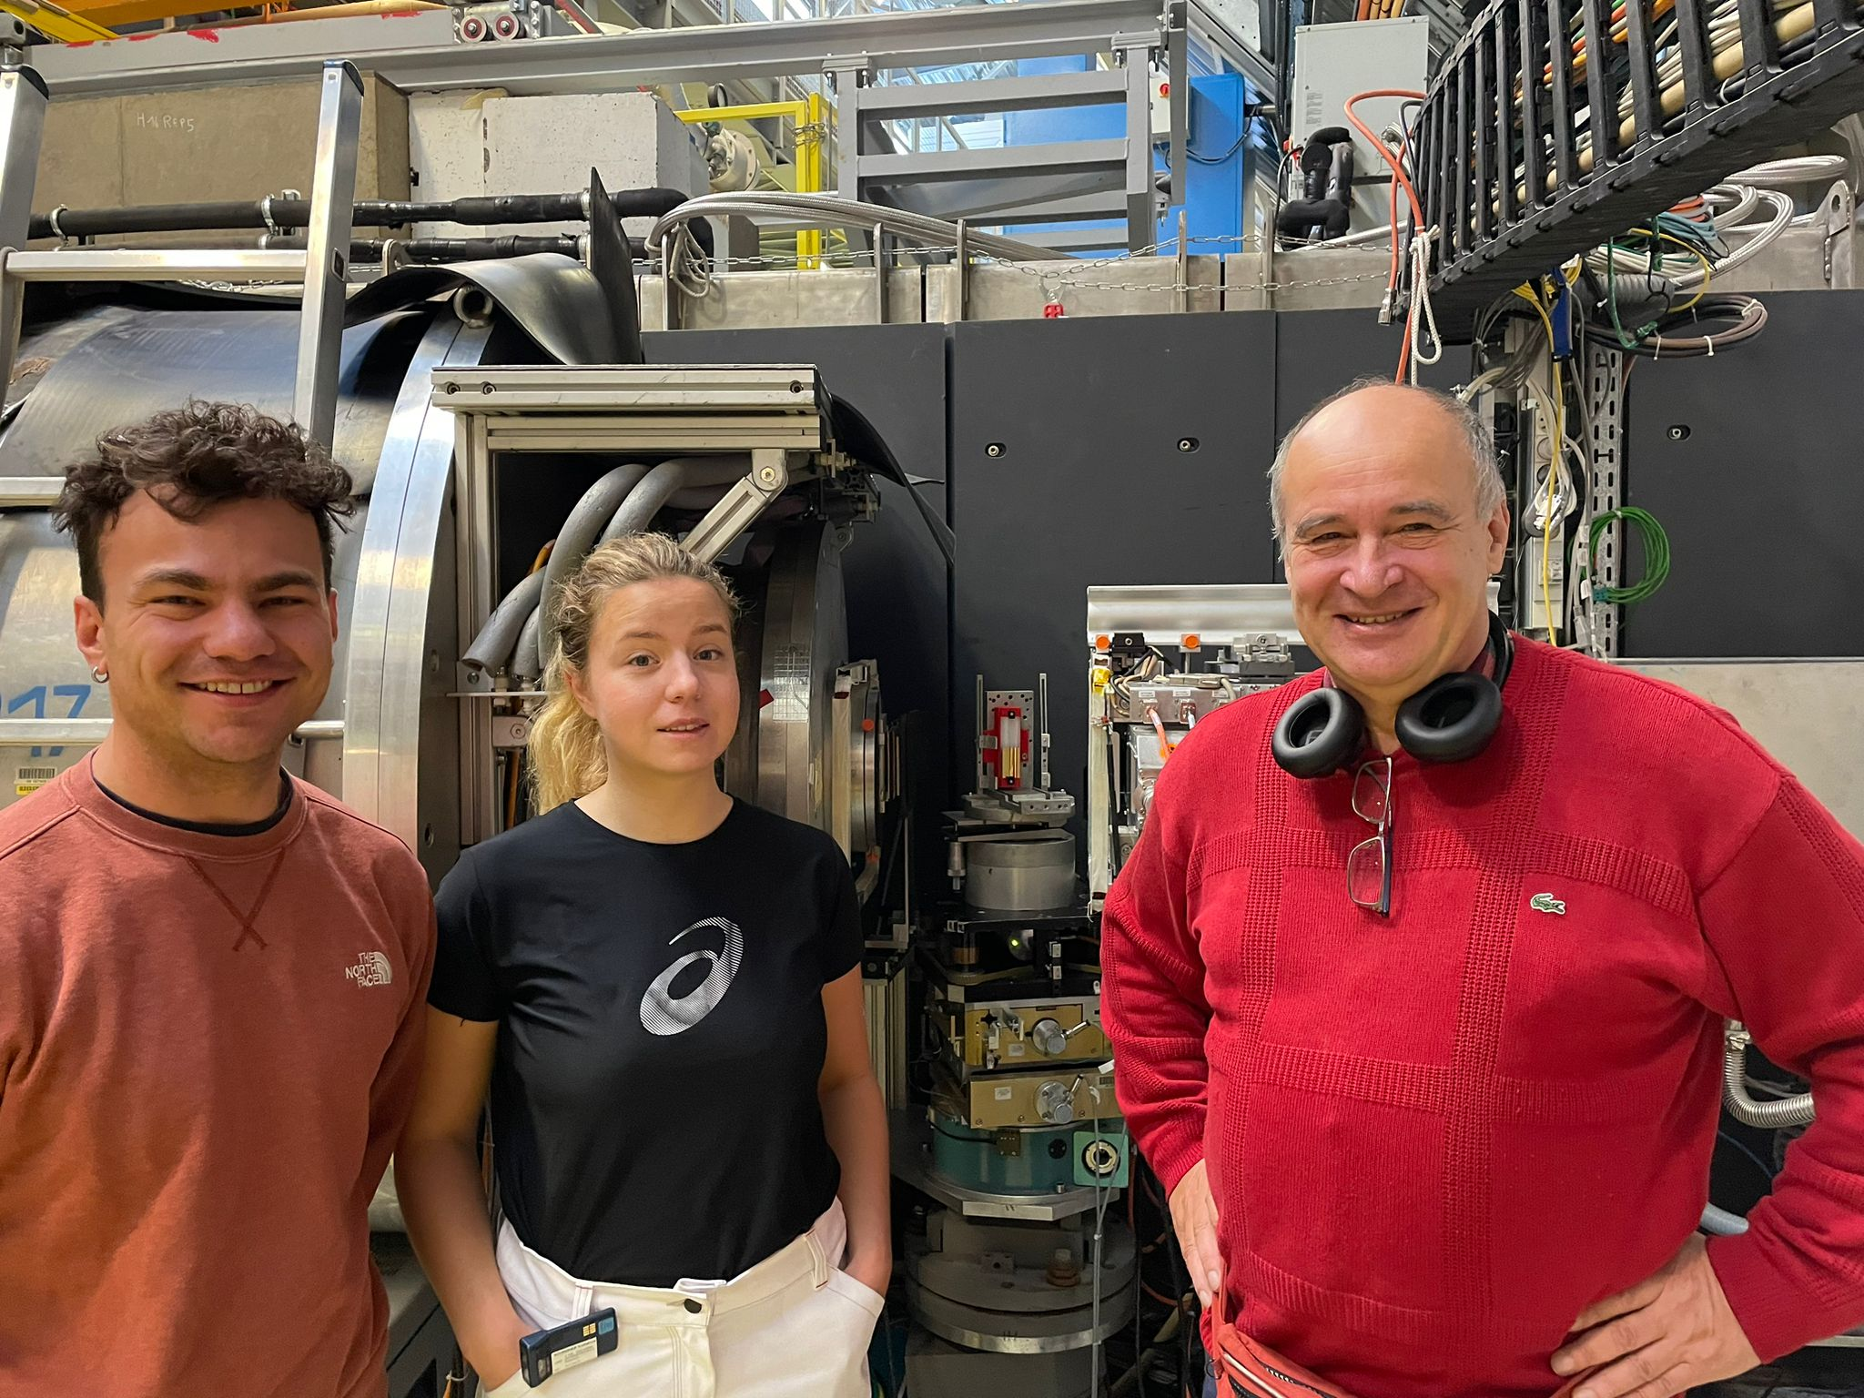
Thank you for your attention!
People who contributed,
and are not in the picture:
Stefan Baeßler (UVA)
Mingyu Shi (ETH)
Serge Reynaud (LKB)
Robert Cubitt (ILL)
Thomas Saerbeck (ILL)

Slide 25
References
Nesvizhevsky, V., Voronin, A., Cubitt, R. et al. Neutron whispering gallery. Nature Phys 6, 114–117 (2010). https://doi.org/10.1038/nphys1478
Antoniadis et al., 2011: Short-range fundamental forces. Comptes Rendus, Physique. Volume 12 (2011) no. 8, pp. 755-778
C. Killian et al., 2023: GRASIAN: towards the first demonstration of gravitational quantum states of atoms with a cryogenic hydrogen beam, The European Physical Journal D volume 77, Article number: 50 (2023)

Slide 26
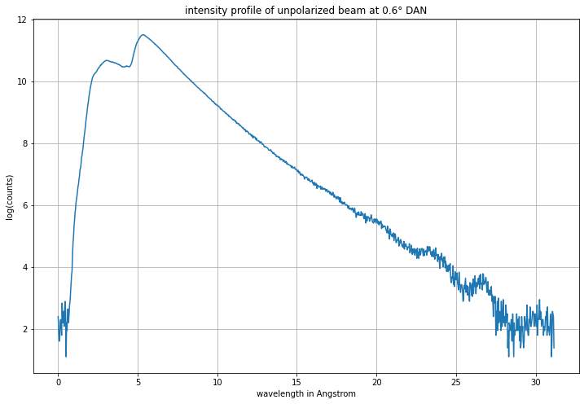
Additional material – spectrum at D17

