Slide 1
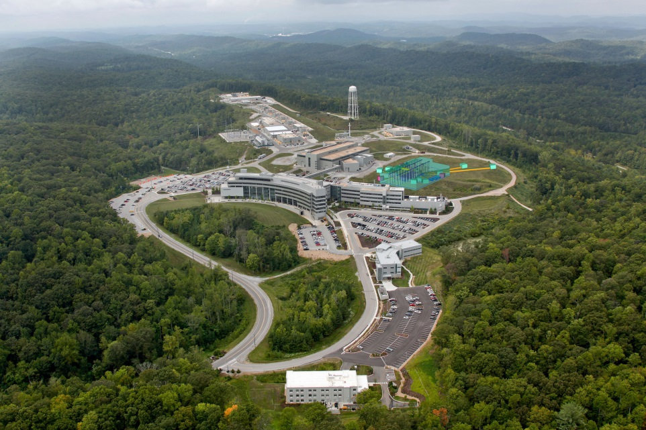



The GRANIT experiment and the search for new short range forces
Stefan Baeßler
Inst. Nucl. Part. Phys.

Slide 2
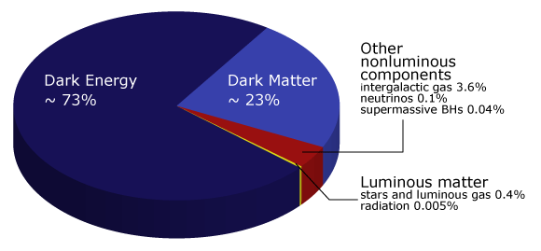
Theoretical motivation
We believe (and are often told) that the Standard Model of Elementary Particle Physics is incomplete. One of the major issues is the existence of Dark Matter and Dark Energy, where “Dark” means we don’t know what it is.
New physics may include new interactions. The reason for non-appearance of Dark Matter in the outcomes of past experiments motivates to say that that coupling to matter is weak.
Range of interest for experiments I am discussing is nanometers to micrometers. In this range, the Yukawa masses ($m=ℏc/λ$) are meV to eV.
I. Antionadis et al., Compt. Rend. Phys. 12, 755-778 (2011)
J. Jaeckel and A. Ringwald, Ann. Rev. Nucl. Part. Sci. 60, 405 (2010).

Slide 3
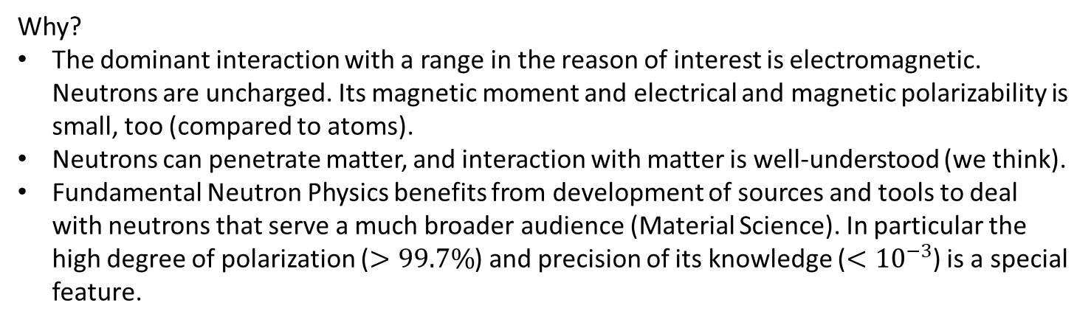
Usage of neutrons as a probe
Why?
The dominant interaction with a range in the reason of interest is electromagnetic. Neutrons are uncharged. Its magnetic moment and electrical and magnetic polarizability is small, too (compared to atoms).
Neutrons can penetrate matter, and interaction with matter is well-understood (we think).
Fundamental Neutron Physics benefits from development of sources and tools to deal with neutrons that serve a much broader audience (Material Science). In particular the high degree of polarization ($>99.7\%$) and precision of its knowledge ($<{10}^{−3}$) is a special feature.
Why not?
Need to go to large facilities to carry out experiments.
Even so, number (or density) of neutrons available seems always too small.
Number of tools to manipulate atoms, macroscopic test bodies is still much richer.
Neutron detection is usually accompanied with its destruction.
J. Nico, W.M. Snow, Ann. Rev. Nucl. Part. Sci. 55, 27-69 (2005)
H. Abele, Prog. Part. Nucl. Phys. 60, 1-81 (2008)
D. Dubbers, M. Schmidt, Rev. Mod. Phys. (2011)

Slide 4
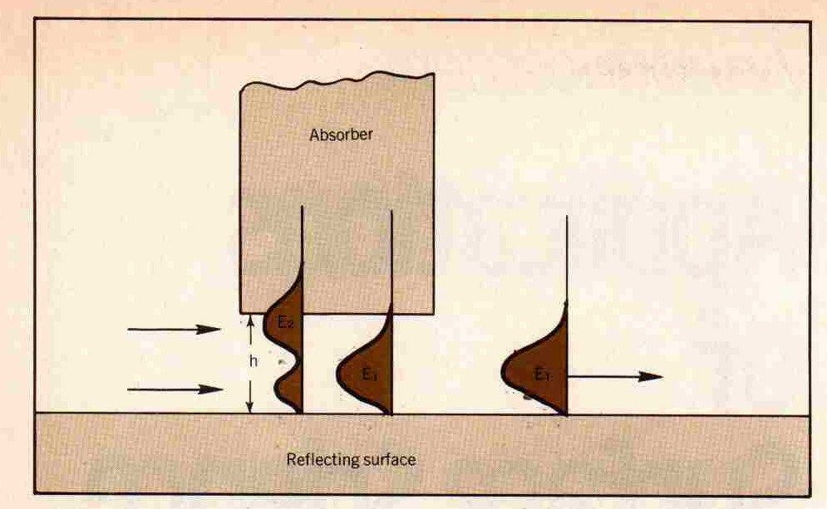

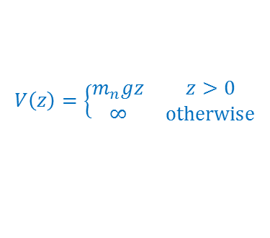
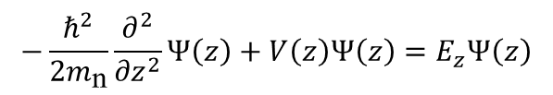



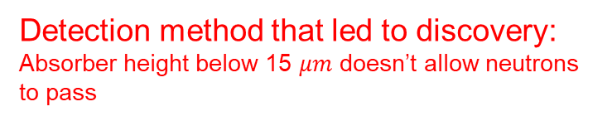



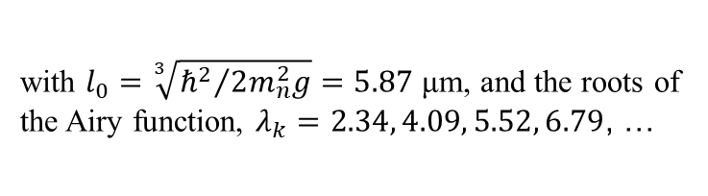
Gravitationally Bound Quantum States – The idea
$$−\frac{ℏ^{2}}{2m_{\text{n}}}\frac{∂^{2}}{{∂z}^{2}}Ψ\left(z\right)+V\left(z\right)Ψ\left(z\right)=E_{z}Ψ\left(z\right)$$
neutron
g
n
e
$Ψ_{k}\left(z\right)∝\text{Ai}\left(\frac{z−z_{k}}{l_{0}}\right)$; $z_{k}=l_{0}∙λ_{k}\text{;}$ $E_{z,k}=m_{n}gl_{0}∙λ_{k}$
with $l_{0}=\sqrt[3]{{ℏ^{2}}/{2m_{n}^{2}g}}=5.87$ μm, and the roots of the Airy function, $λ_{k}=2.34, 4.09, 5.52, 6.79$, …
Detection method that led to discovery:
Absorber height below 15 $μm$ doesn’t allow neutrons to pass
Lowest quantum states for neutrons
Ψ₄
New, more precise method: Study transitions between states
4
$E_{z,4}=4.08$peV
Ψ₃
3
$E_{z,3}=3.32$peV
Ψ₂
Energy [peV]
$E_{z,2}=2.46$peV
2
ΔE ~ h·kHz
Ψ₁
15 $μ$m
1
$E_{z,1}=1.41$peV
$$∆$$
$$V\left(z\right)=\left\{\begin{matrix}m_{n}gz & z>0 \\ ∞ & \text{otherwise}\end{matrix}\right.$$
0
0
10
20
30
40
Distance above mirror [µm]
Proposal: V.I. Lushikov, Physics Today, June 1977
Discovery: V. Nesvizhevsky, S.B., et al., Nature 2002

Slide 5
The setup to detect magnetically induced resonance transitions in flow-through mode
Magnetic holding field B₀
2. Induce transitions in periodic magnetic field gradient
4. Measure horizontal velocity in position-sensitive detector
1. Prepare initial state,
ground state suppressed
3. Filter ground state
1 cm
New UCN
Source
1 mm
Position-sensitive Detector
Bottom mirror
Horizontal UCN velocity v_{hor}
Mag. Field oscillation freq. ω
Prepare initial state (mostly the 3rd), ground state suppressed
Induce Transitions 3→1 in time-dependent magnetic field gradient
  Two modes of operation: DC mode and AC mode
  DC-Mode: static magnetic field gradient in lab
  AC-Mode: oscillating current, change holding field to a much smaller one perpendicular to paper plane.
Filter ground state. If no transition took place, no neutron would pass filter.
Detect Neutrons (In DC-Mode: Detect neutrons in dependence of free fall height)
AC-Mode with results will be discussed by J. Pioquinto later today.

Slide 6


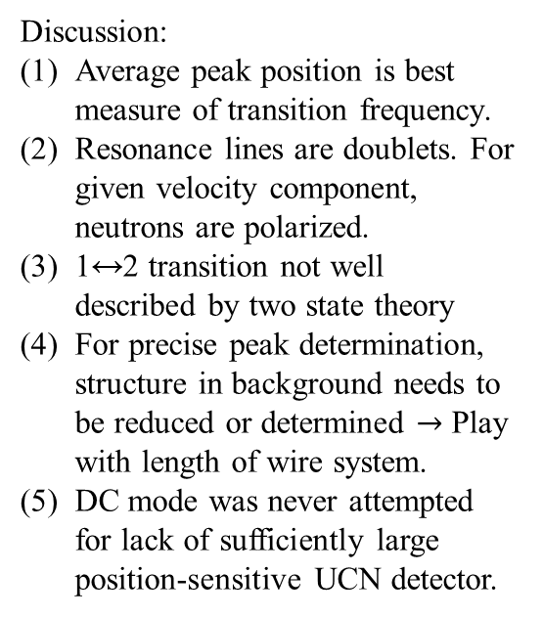

Simulated signal in DC mode
λ
New
•
• •
UCN
D
e
t
Horizontal UCN velocity $v_{x}$
Mag. Field oscillation freq. $ω$
Source
e
c
t
Bottom mirror
Free fall
o
r
Discussion:
Average peak position is best measure of transition frequency.
Resonance lines are doublets. For given velocity component, neutrons are polarized.
1↔2 transition not well described by two state theory
For precise peak determination, structure in background needs to be reduced or determined $→$ Play with length of wire system.
DC mode was never attempted for lack of sufficiently large position-sensitive UCN detector.
0.4
0.4
1↔3(↓)
0.4
1↔3(↑)
0.3
1↔3(↓)
1↔3(↑)
0.0
4.0
4.2
4.4
0.0
4.8
5.0
5.2
0.2
1↔2(↑)
0.4
Count rate [a.u.]
1↔4(↓)
1↔4(↓)
0.1
0.0
5.6
6.0
0.0
3
4
5
6
7
$v_{x}$ [m/s]

Slide 7

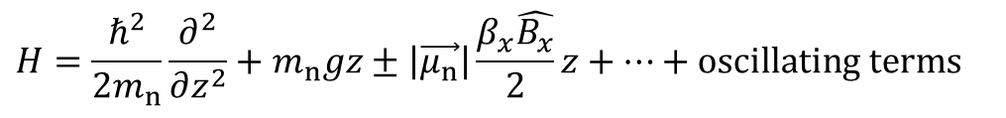


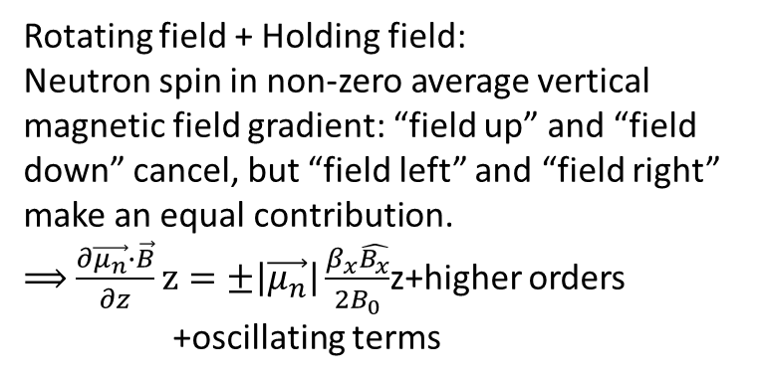
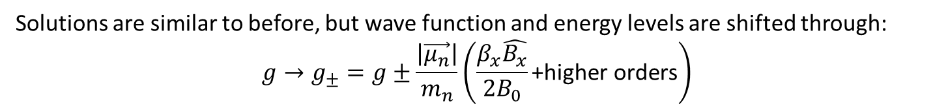
Stern-Gerlach Shift
Rotating field from wires $B(t)$
$$β_{x}$$
•
0.5
•
z
dB_{x}/dz
0.0
Field gradient from wires
dBz/dz
x
Magnetic holding
-0.5
field B₀
Rotating field + Holding field:
Neutron spin in non-zero average vertical
magnetic field gradient: “field up” and “field down” cancel, but “field left” and “field right” make an equal contribution.
$⟹$ $\frac{∂\vec{μ_{n}}∙\vec{B}}{∂z}z=±\left|\vec{μ_{n}}\right|\frac{β_{x}\hat{B_{x}}}{2B_{0}}$z+higher orders +oscillating terms
1.0
$$\hat{B_{x}}$$
0.5
B
[mT]
x
0.0
B
[mT]
Magnetic Field from wires
z
-0.5
-1.0
-0.13
-0.12
-0.11
-0.10
-0.09
-0.08
Position x [m]
$$H=\frac{ℏ^{2}}{2m_{n}}\frac{∂^{2}}{∂z^{2}}+m_{n}gz±\left|\vec{μ_{n}}\right|\frac{β_{x}\hat{B_{x}}}{2}z+…+\text{oscillating} \text{terms}$$
Solutions are similar to before, but wave function and energy levels are shifted through:
$${g→g}_{±}=g±\frac{\left|\vec{μ_{n}}\right|}{m_{n}}\left(\frac{β_{x}\hat{B_{x}}}{2B_{0}}\text{+}\text{higher} \text{orders}\right)$$
S.B., PRD 91, 42006 (2015)

Slide 8
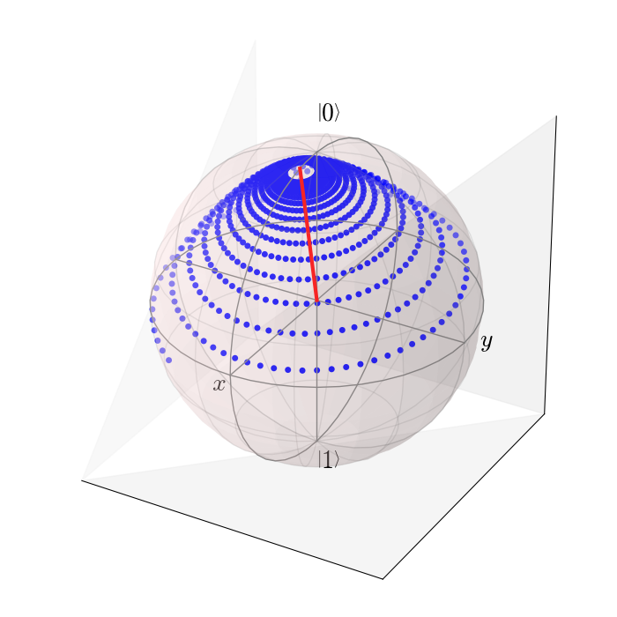
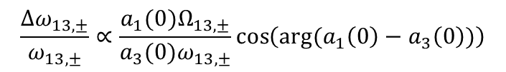
DC-Mode has (small) Interference shift
1. Prepare initial state,
ground state suppressed
λ
New
•
• •
UCN
D
e
t
Source
e
c
t
Bottom mirror
Free fall
o
r
1.0
$$\frac{{Δω}_{13,±}}{ω_{13,±}}∝\frac{a_{1}(0)Ω_{13,±}}{a_{3}(0)ω_{13,±}}\cos\left(\text{arg}(a_{1}\left(0\right)−a_{3}\left(0\right))\right)$$
)
p
0.8
e
t
s
Discussion:
Shift is given for full inversion, will be much bigger if transition probability is not large!
Phase difference is hard to simulate
Interference shift cancels if magnetic field phase is varied.
r
e
a
t
1
f
0.6
a
(
a
a
2
m
a
t
n
3
e
0.4
i
a
c
4
i
f
f
a
e
5
o
c
0.2
l
a
i
t
i
n
i
0.0
-0.2
0
5
10
15
20
25
30
step height [μm]
S.B., PRD 91, 42006 (2015)

Slide 9
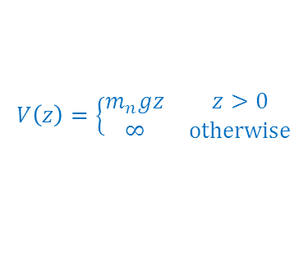










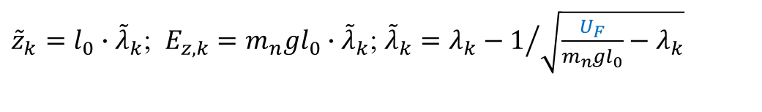
Fermi-potential of glass
$Ψ_{k}\left(z\right)∝\text{Ai}\left(\frac{z−z_{k}}{l_{0}}\right)$
Energy [peV]
Energy [peV]
Glass, we take $U_{F}\sim 100$ neV
Ψ₄
$$Ψ_{k}\left(z\right)∝\left\{\begin{matrix}\text{Ai}\left(\frac{z−{\tilde{z}}_{k}}{l_{0}}\right) & z≥0 \\ \text{exp}\left(\frac{1}{ℏ}\sqrt{2m_{n}U_{F}}z\right) & z<0\end{matrix}\right.$$
4
$E_{z,4}=4.08$peV
Ψ₃
3
$E_{z,3}=3.32$peV
Ψ₂
Ψ₄
$E_{z,2}=2.46$peV
4
2
Ψ₁
Ψ₃
1
$E_{z,1}=1.41$peV
3
Correction not to scale
$$V\left(z\right)=\left\{\begin{matrix}m_{n}gz & z>0 \\ ∞ & \text{otherwise}\end{matrix}\right.$$
Ψ₂
0
2
Ψ₁
0
10
20
30
40
Absorber height Δh [µm]
1
$$V\left(z\right)=\left\{\begin{matrix}m_{n}gz & z>0 \\ ∞ & \text{otherwise}\end{matrix}\right.$$
$Ψ_{k}\left(z\right)∝\text{Ai}\left(\frac{z−z_{k}}{l_{0}}\right)$; $z_{k}=l_{0}∙λ_{k}\text{;}$ $E_{z,k}=m_{n}gl_{0}∙λ_{k}$
0
0
10
20
30
40
with $λ_{k}=2.34, 4.09, 5.52, 6.79$, …
Absorber height Δh [µm]
A.E. Meyerovitch, PRA 73, 063616 (2006)
${\tilde{z}}_{k}=l_{0}∙{\tilde{λ}}_{k}\text{;}$ $E_{z,k}=m_{n}gl_{0}∙{\tilde{λ}}_{k}$; ${\tilde{λ}}_{k}=λ_{k}−1/{\sqrt{\frac{U_{F}}{m_{n}gl_{0}}−λ_{k}}}$
Energies and positions get corrections of about 0.1%
Energy differences experience only a tiny correction (${10}^{−8}$).

Slide 10
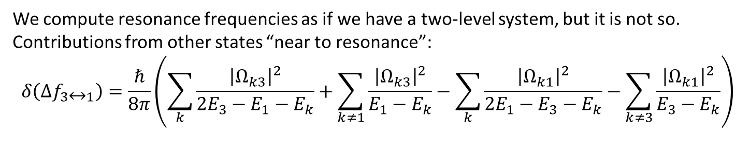
Spectator state shift
We compute resonance frequencies as if we have a two-level system, but it is not so.
Contributions from other states “near to resonance”:
$$δ\left(Δf_{3↔1}\right)=\frac{ℏ}{8π}\left(\sum_{k}{\frac{{\left|Ω_{k3}\right|}^{2}}{2E_{3}−E_{1}−E_{k}}}+\sum_{k≠1}{\frac{{\left|Ω_{k3}\right|}^{2}}{E_{1}−E_{k}}}−\sum_{k}{\frac{{\left|Ω_{k1}\right|}^{2}}{2E_{1}−E_{3}−E_{k}}}−\sum_{k≠3}{\frac{{\left|Ω_{k1}\right|}^{2}}{E_{3}−E_{k}}}\right)$$
This shift was first discovered in Atomic Physics (AC Stark Shift) and is also known in NMR, but:
Many more states (and all shown) contribute, biggest effect for closest state, some cancellation.
Effect depends quadratically on excitation strength, and will likely be negligible for longer observation times in storage experiments. Table below is for fictious setup, the shift is about 9 times higher than shown n our current setup.
6
6
5
5
]
4
V
4
e
3
p
[
y
3
g
r
e
2
n
E
1↔3
2
1
1
0

Slide 11
Resonance transitions ~ Rabi oscillations
Schroedinger equation:
Ansatz:
Insert in Schroedinger equation, restrict to states “1” and “3”:
DELETE?
Neglect self coupling and fast oscillating terms:
Rabi formula:

Slide 12

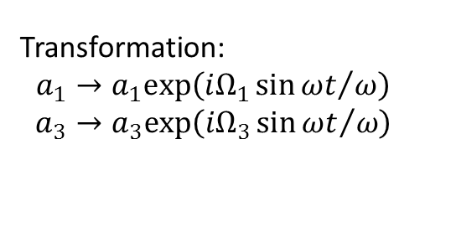
Self-coupling terms
What means: “Neglect self coupling and fast oscillating terms”? Well known is the Bloch-Siegert shift due to the counter-rotating field, but it is tiny here.
Self-coupling; the analogy in a simple spin system would be
to provide an oscillating magnetic field along the holding field direction.
DELETE?
Transformation:
$$a_{1}→a_{1}\text{exp}\left({iΩ_{1}\sin{ωt}}/ω\right)$$
$$a_{3}→a_{3}\text{exp}\left({iΩ_{3}\sin{ωt}}/ω\right)$$
Average value: $1−{\left(\frac{Ω_{3}−Ω_{1}}{2ω}\right)}^{2}$
This correction cannot be observed

Slide 13
Future: The GRANIT spectrometer in storage mode
1. Population of ground state
3. Study transition to “final state”
2. Populate the initial state
4. Neutron Detection
30-50 cm
Challenge:
Strong enough UCN source
Tolerances on storage cell to get a high neutron lifetime in a given state
Discussion in G. Pignol et al.,ArXiV:0708.2541 (2007)

Slide 14
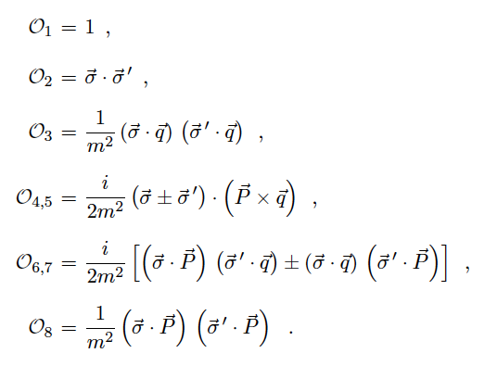
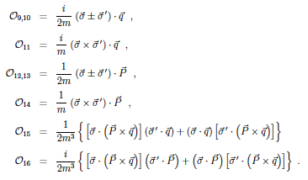
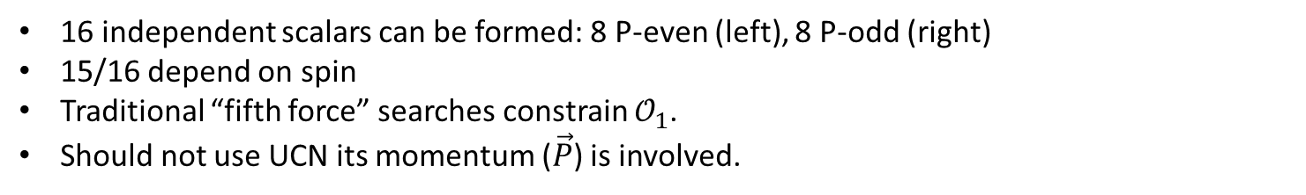
More general short range interactions
B. Dobrescu et al. argue that interaction mediated by any kind of intermediate boson exchange ($\vec{q}$: Momentum transfer, $σ, σ^{′}$ are fermion spins, and $\vec{P}$ is momentum of one fermion)
B. Dobrescu and I. Mocioiu, J. High Energy Phys. 11,005 (2006)
See also:
M. S. Safronova et al, Rev. Mod. Phys. 90, 025008 (2018)
P. Fadeev et al., Phys. Rev. A99, 022113 (2019)
16 independent scalars can be formed: 8 P-even (left), 8 P-odd (right)
15/16 depend on spin
Traditional “fifth force” searches constrain $𝒪_{1}$.
Should not use UCN its momentum ($\vec{P}$) is involved.

Slide 15









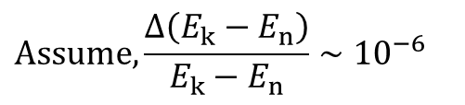






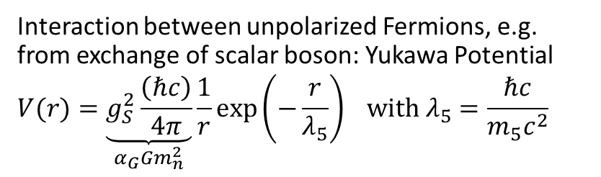



Limits for most simple spin-independent interaction
Interaction between unpolarized Fermions, e.g. from exchange of scalar boson: Yukawa Potential
$$V(r)=\underset{α_{G}Gm_{n}^{2}}{\underbrace{g_{S}^{2}\frac{\left(ℏc\right)}{4π}}}\frac{1}{r}\exp\left(−\frac{r}{λ_{5}}\right) \text{with} λ_{5}=\frac{ℏc}{m_{5}c^{2}}$$
n
N
$$g_{s}$$
X
$$g_{s}$$
n
N
(Operator $𝒪_{1}$ from Dobrescu et al.)
(Use of $α$ compares coupling constant to gravity)
$${10}^{8}$$
GRANIT-STORAGE
initial
final
$${10}^{6}$$
$${10}^{4}$$
Casimir / Chen 2016
$$\left|α\right|$$
${10}^{2}$
$${10}^{0}$$
Pendulum / Lee 2020
$$E_{k}→E_{k}+\left\langle k\right|ΔV_{\text{mirror}}(z)\left|k\right\rangle$$
$${10}^{−2}$$
Pendulum / Tan 2020
$$\text{Assume},\frac{Δ\left(E_{k}−E_{n}\right)}{E_{k}−E_{n}}∼10^{−6}$$
$${10}^{−7}$$
$${10}^{−6}$$
$${10}^{−5}$$
$${10}^{−3}$$
$${10}^{−2}$$
$$λ_{5} [m]$$
$→$ Limit from GRANIT will not be competitive, but see later discussion of models that evade constraints from experiments with macroscopic test bodies including all shown.

Slide 16
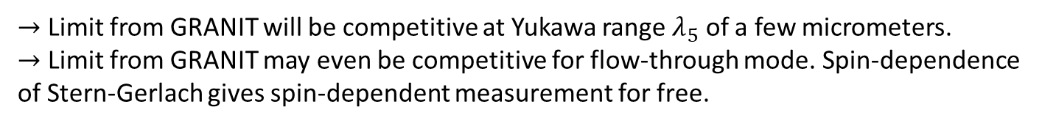


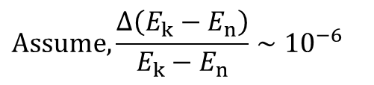










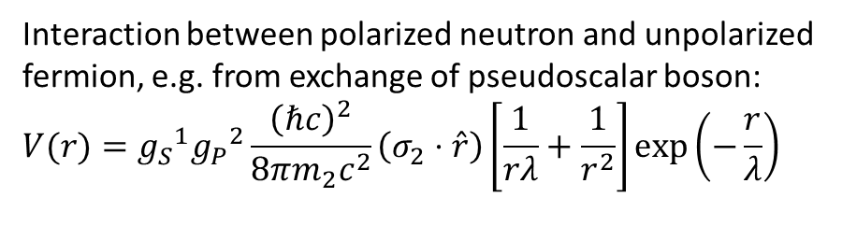


Limits for most simple spin-dependent interaction
Interaction between polarized neutron and unpolarized fermion, e.g. from exchange of pseudoscalar boson:
$$V(r)={g_{S}}^{1}{g_{P}}^{2}\frac{{\left(ℏc\right)}^{2}}{8πm_{2}c^{2}}\left(σ_{2}⋅\hat{r}\right)\left[\frac{1}{rλ}+\frac{1}{r^{2}}\right]\exp\left(−\frac{r}{λ}\right)$$
n
N
$${ig}_{P}$$
X
$$g_{s}$$
n
N
(Operator $𝒪_{9}+𝒪_{10}$ from Dobrescu et al.)
initial
final
$${10}^{−10}$$
$${10}^{−12}$$
n scattering / Voronin 2009
$${10}^{−14}$$
$$\left|g_{s}^{N}g_{p}^{n/e}\right|$$
NV Center / Rong 2018
${10}^{−16}$
$$E_{k}→E_{k}+\left\langle k\right|ΔV_{\text{mirror}}(z)\left|k\right\rangle$$
$T_{1}$ Helium / Guigue 2015
$${10}^{−18}$$
GRANIT-Storage
$$\text{Assume},\frac{Δ\left(E_{k}−E_{n}\right)}{E_{k}−E_{n}}∼10^{−6}$$
Torsion pendulum / Hoedl 2011
$${10}^{−20}$$
$${10}^{−10}$$
$${10}^{−8}$$
$${10}^{−6}$$
$${10}^{−4}$$
$$λ_{5} [m]$$
$→$ Limit from GRANIT will be competitive at Yukawa range $λ_{5}$ of a few micrometers.
$→$ Limit from GRANIT may even be competitive for flow-through mode. Spin-dependence of Stern-Gerlach gives spin-dependent measurement for free.

Slide 17
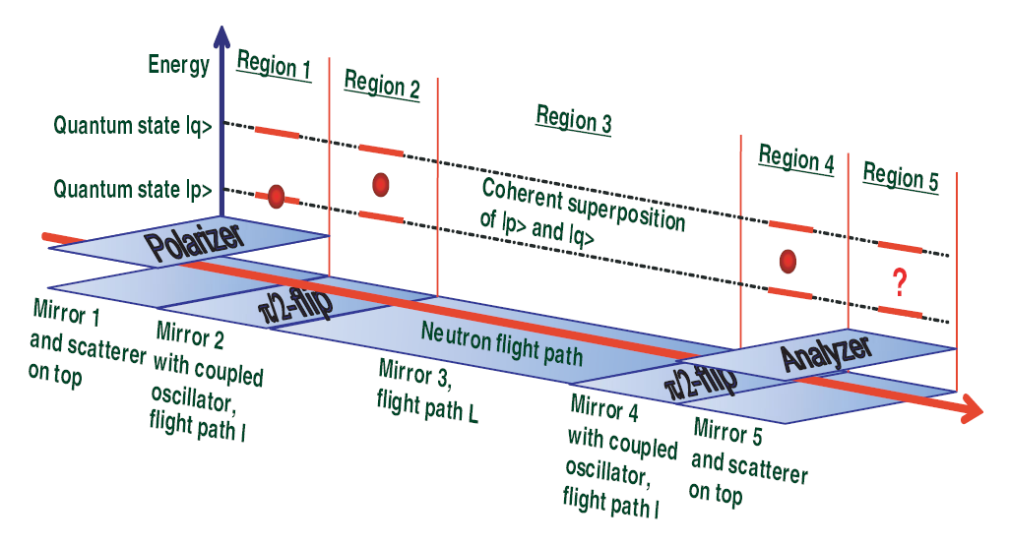
QBounce setup to detect vibration-induced resonance transitions in flow-through mode
H. Abele et al., PRD 81, 065019 (2010)

Slide 18
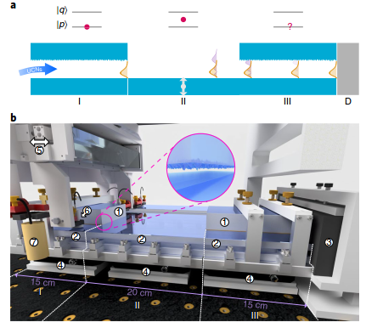
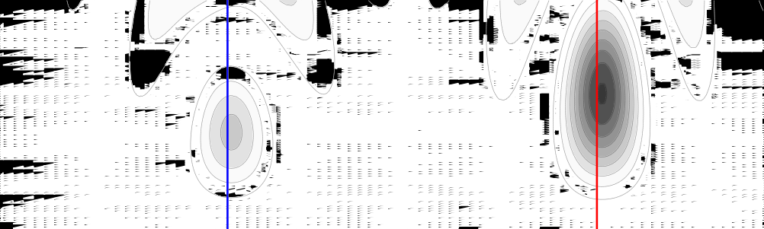
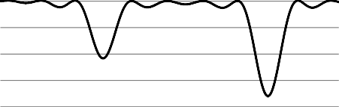
2018 Data from QBounce
Rel. Transmission
a
5
T
1.0
Colour code 2 < _{res}
Oscillation strength (mm s^{–1})
4
1 < _{res} 2
–1 _{res} 1
–2 _{res} < –1
–2 > _{res}
0.8
3
Oscillation amplitude
0.6
2
0.4
1
Point shape
0 < _{stat} 10%
10% < _{stat} 20%
_{stat} > 20%
0.2
0
500 550
Oscillation frequency (Hz)
0
350
400
450
600
650
700
Oscillation frequency
b
1.4
1.2
1.0
0.8
0.6
0.4
0.2
^{c} 1.4
1.2
1.0
0.8
0.6
0.4
0.2
0.0
Relative transmission
a = 2.05 mm s^{–1}
Relative transmission
Transmission
v = 462.6 Hz
1> = 3>
v = 647 Hz
1> = 4>
0.0
350 400 450 500 550 600 650 700
0
1
2 3
Oscillation strength (mm s^{–1})
4
5
Oscillation frequency
Oscillation Amplitude
Oscillation frequency (Hz)
Result for transition frequencies: $ν_{13}={463.74}_{−1.10}^{+1.05}$ Hz, $ν_{14}={648.24}_{−1.53}^{+1.46}$ Hz
G. Cronenberg, H. Abele, T. Jenke et al., Nature Physics 14, 1022 (2018)

Slide 19
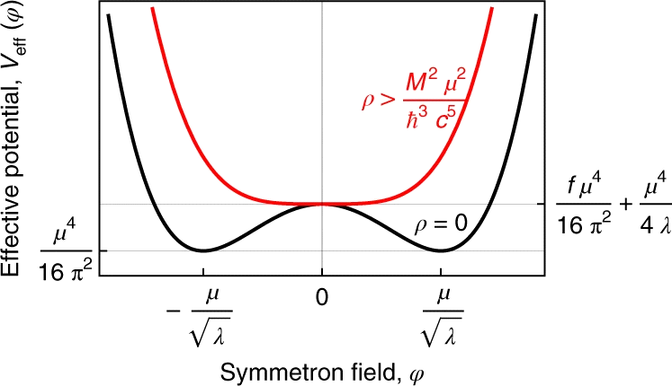
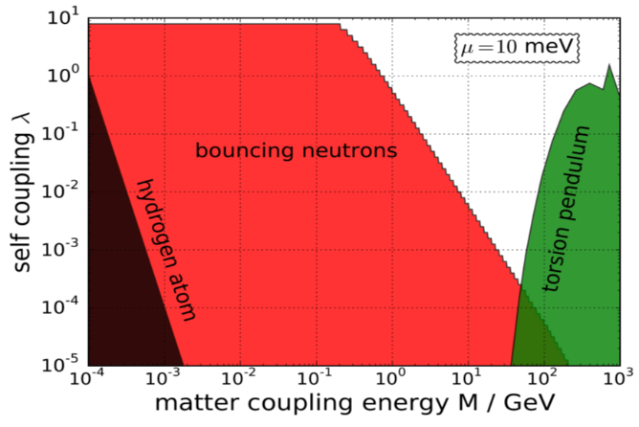
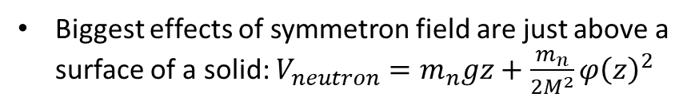
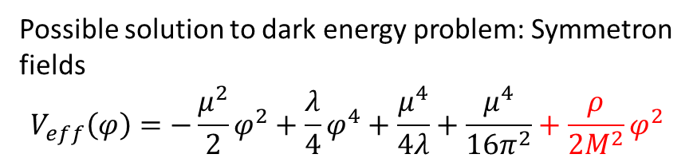

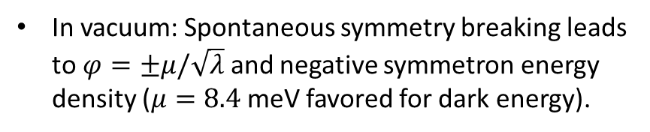

Limit on Symmetron Fields (G. Cronenberg, 2018)
Possible solution to dark energy problem: Symmetron fields
$$V_{eff}\left(φ\right)=−\frac{μ^{2}}{2}φ^{2}+\frac{λ}{4}φ^{4}+\frac{μ^{4}}{4λ}+\frac{μ^{4}}{16π^{2}}+\frac{ρ}{2M^{2}}φ^{2}$$
In vacuum: Spontaneous symmetry breaking leads to $φ=±μ/\sqrt{λ}$ and negative symmetron energy density ($μ=8.4$ meV favored for dark energy).
In dense medium (solids): Coupling term renders symmetron field zero, no potential variation. Therefore, invisible in many experiments.
Biggest effects of symmetron field are just above a surface of a solid: $V_{neutron}=m_{n}gz+\frac{m_{n}}{2M^{2}}φ{\left(z\right)}^{2}$
Limits on Symmetron Fields from qBounce
$$\text{φ}\left(\text{z}\right)\text{ [}\text{MeV}\text{]}$$
K. Hinterbichler, J. Khoury, Phys. Rev. Lett. 104, 231301 (2010)
P. Brax, M. Pitschmann, Phys. Rev. D 97, 064015 (2018)
$$z [{\text{MeV}}^{−1}]$$
G. Cronenberg, H. Abele, T. Jenke et al., Nature Physics 14, 1022 (2018)

Slide 20
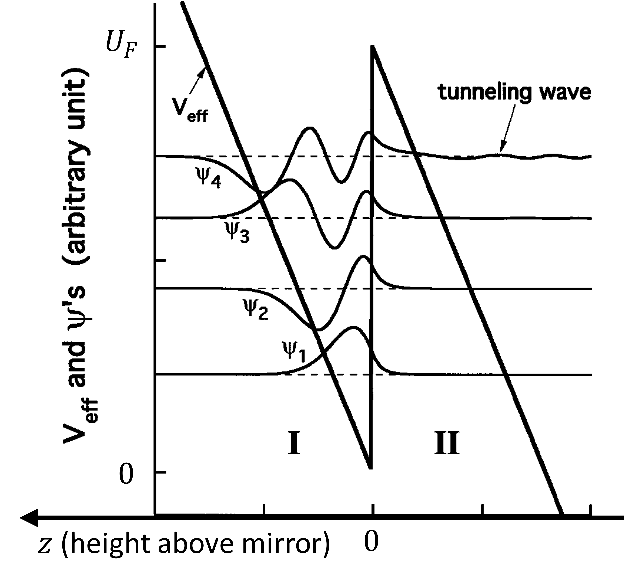
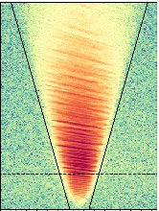
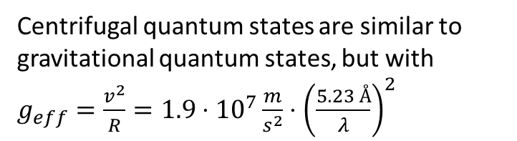
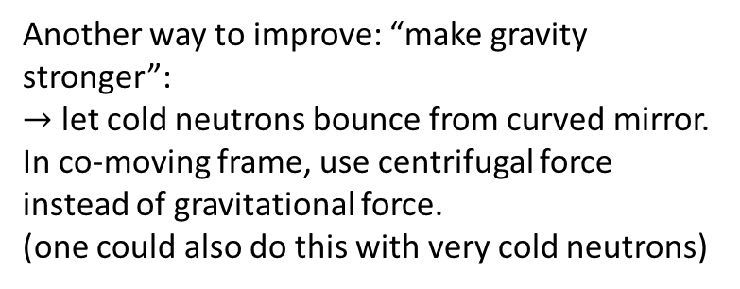
Whispering gallery experiment
Another way to improve: “make gravity stronger”:
$→$ let cold neutrons bounce from curved mirror. In co-moving frame, use centrifugal force instead of gravitational force.
(one could also do this with very cold neutrons)
Centrifugal quantum states are similar to gravitational quantum states, but with $g_{eff}=\frac{v^{2}}{R}=1.9⋅{10}^{7}\frac{m}{s^{2}}⋅{\left(\frac{5.23 Å}{λ}\right)}^{2}$
MgF₂ mirror
High quantum states are not stable, neutrons can tunnel into mirror material.
Complication: There is no quantum state selector. One always gets a multipath interference pattern at exit. In a standard diffractometer (D17@ILL) or reflectometer (SuperADAM@ILL), neutrons are recorded as a function of takeoff angle and wavelength.
Adapted from V.V. Nesvizhevsky et al., Nature Physics 6, 114 (2010)

Slide 21
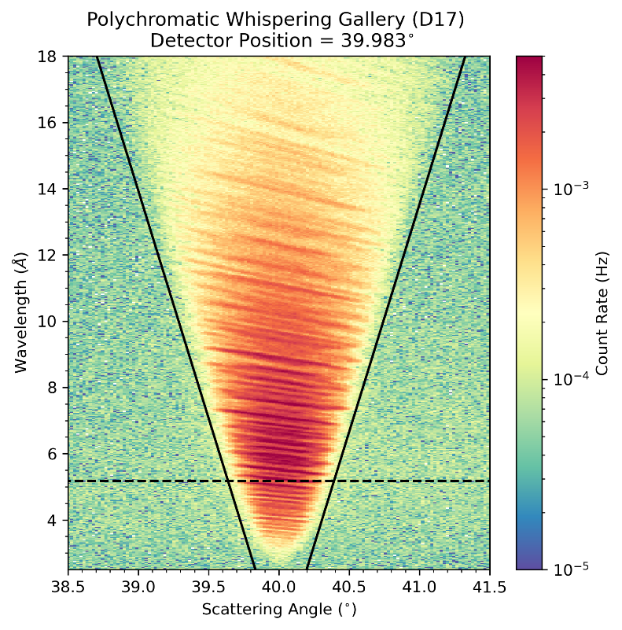
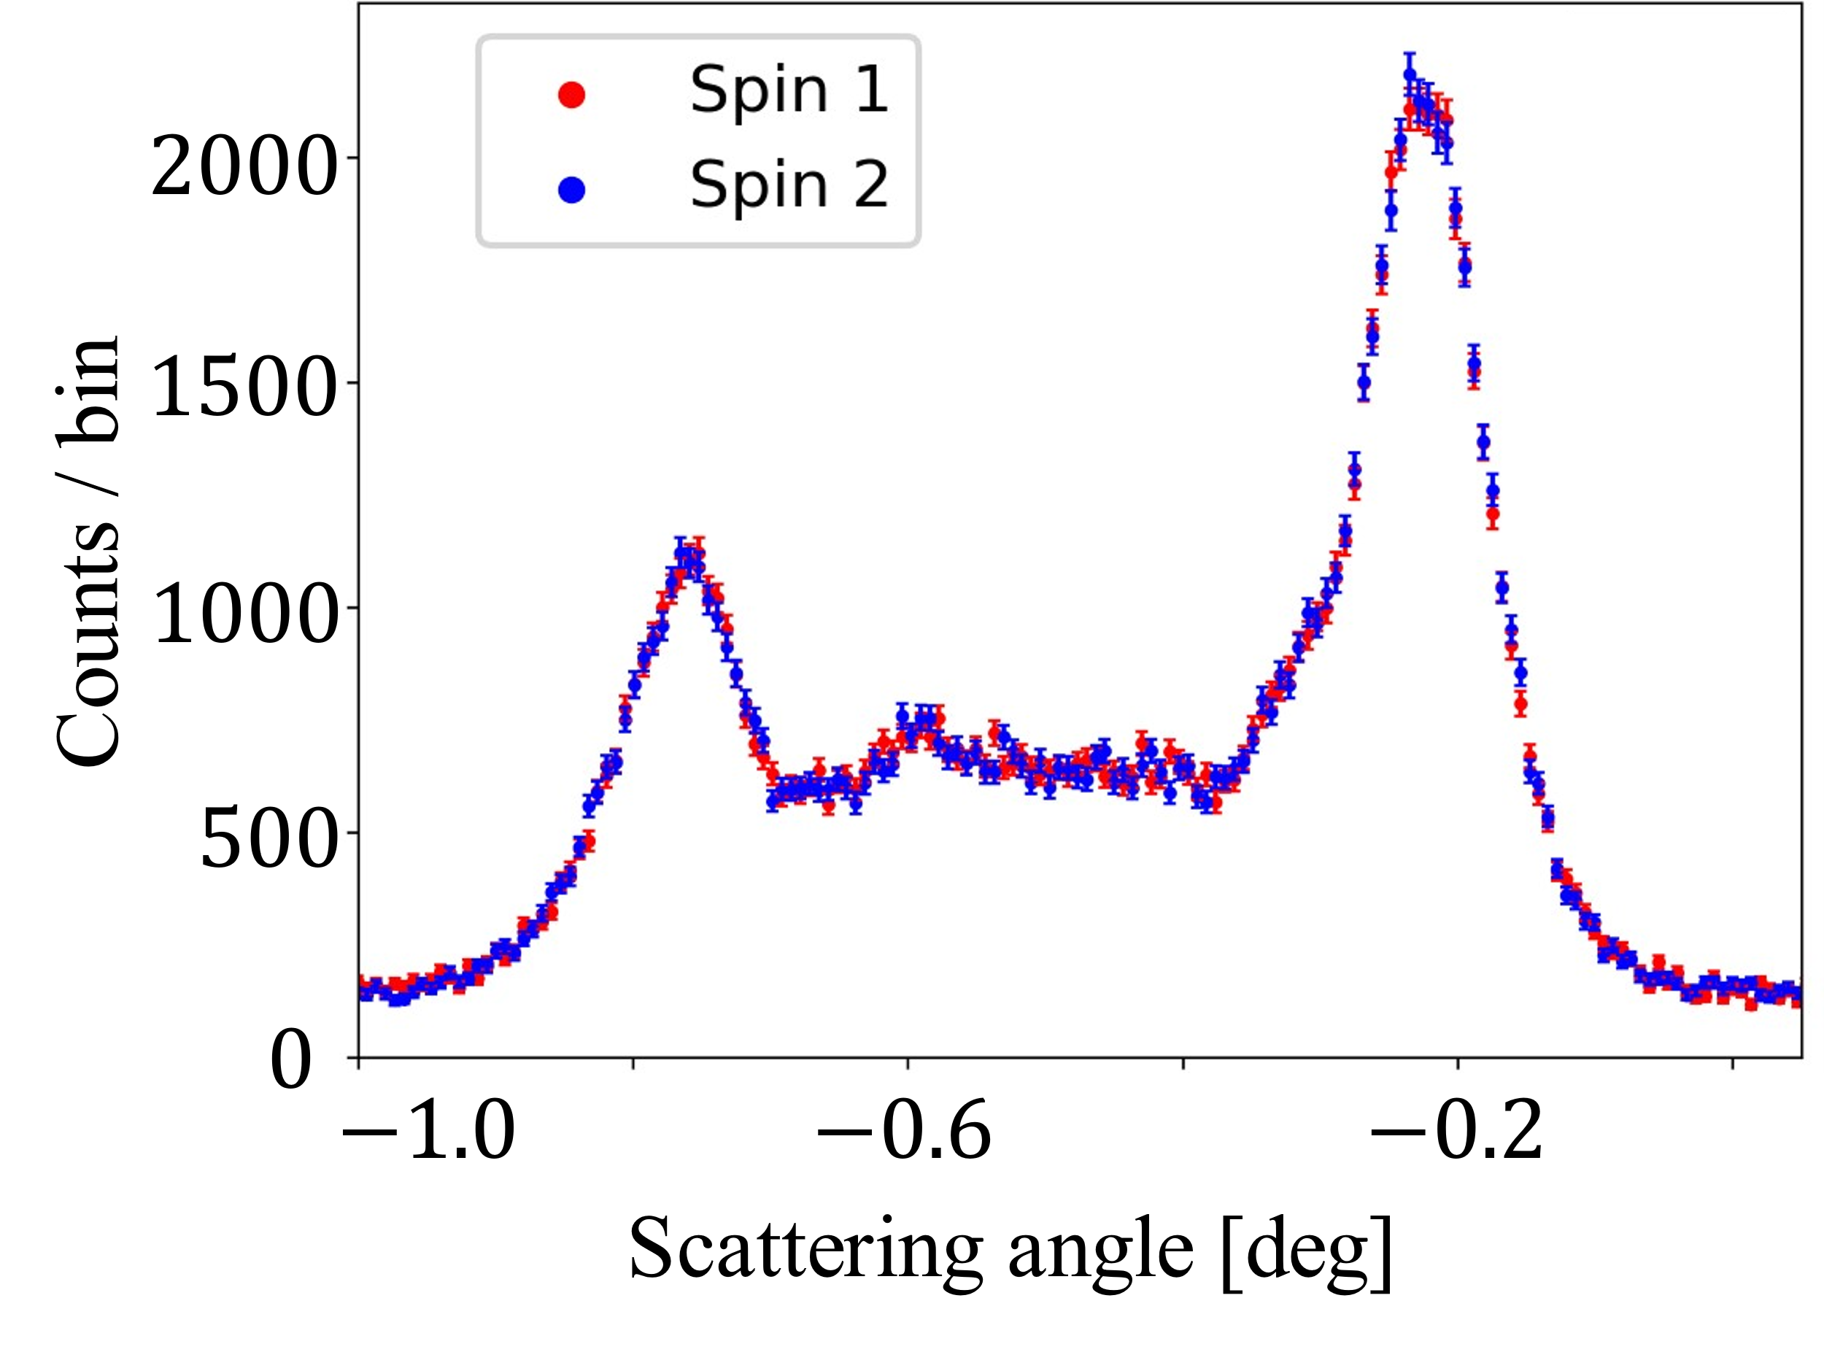


(Near-to) latest data from whispering gallery experiment
Focus on a particular wavelength and vary spin direction at Super-ADAM:
$λ→$
$$\text{angle}→$$
Raw interference pattern as measured at D17.
From J. Pioquinto et al.
More information about status and results with neutrons and X-rays will be discussed by K. Schreiner tomorrow.

Slide 22
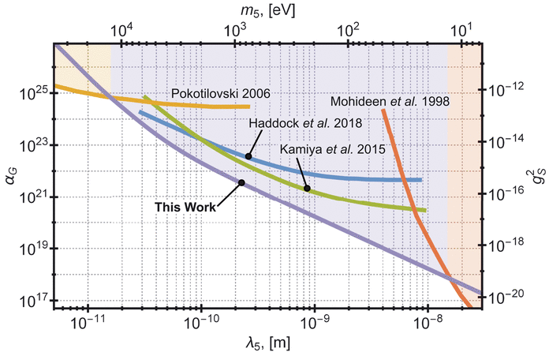


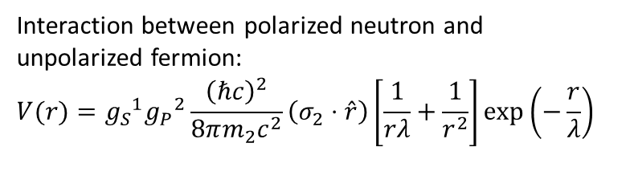
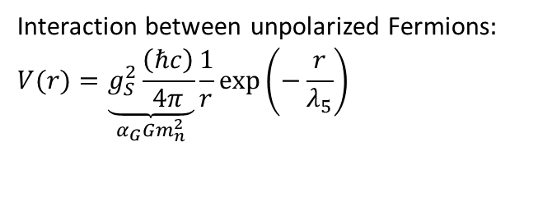

Potential sensitivity from whispering gallery experiment
Interaction between unpolarized Fermions$:$
$$V(r)=\underset{α_{G}Gm_{n}^{2}}{\underbrace{g_{S}^{2}\frac{\left(ℏc\right)}{4π}}}\frac{1}{r}\exp\left(−\frac{r}{λ_{5}}\right)$$
Interaction between polarized neutron and unpolarized fermion:
$$V(r)={g_{S}}^{1}{g_{P}}^{2}\frac{{\left(ℏc\right)}^{2}}{8πm_{2}c^{2}}\left(σ_{2}⋅\hat{r}\right)\left[\frac{1}{rλ}+\frac{1}{r^{2}}\right]\exp\left(−\frac{r}{λ}\right)$$
Whispering Gallery States
$${10}^{−10}$$
$${10}^{−12}$$
n scattering / Voronin 2009
$${10}^{−14}$$
$$\left|g_{s}^{N}g_{p}^{n/e}\right|$$
NV Center / Rong 2018
${10}^{−16}$
$T_{1}$ Helium / Guigue 2015
$${10}^{−18}$$
Torsion pendulum / Hoedl 2011
Adapted from B. Heacock et al., Science 373, 1239 (2021)
$${10}^{−20}$$
$${10}^{−10}$$
$${10}^{−8}$$
$${10}^{−6}$$
$${10}^{−4}$$
$$λ_{5} [m]$$
Expectation for WGS from E.A. Perry, Masters thesis
(This is to show we are in the range of interest. This is not a result. Result can move upwards or downwards.
Expectation for WGS from J. Pioquinto / S. B. (upper end: data in hand, lower end: dedicated run)

Slide 23
Summary
Neutrons are a useful tool to study new short-range interaction in the nanometer and low micrometer range.
New short range interactions could uncover Beyond Standard Model Physics that explains dark matter or dark energy.
They haven’t (yet).
The study of gravitational bound quantum states with QBounce and/or GRANIT and or the study of whispering gallery states can uncover new short range forces (both spin-dependent and spin-independent).

