Slide 1




UCN and VCN source workshop
Institute of nuclear physics
Kazakhstan
The n2EDM experiment at
the Paul Scherrer institute
(PSI) Switzerland
Lejuez Anthony
For the nedm collaboration
LPC Caen
April 8 2024

Slide 2
Motivation and goal of the n2EDM experiment:
Explain the matter-antimatter asymmetry in the universe
Sakharov Condition:
Thermal equilibrium breaking
Baryon number violation
CP violation ≡ T violation via the CPT theorem
  Neutron EDM involve CP violation
  Standard model prediction (≃10⁻³²e.cm)
Goal:
Set the nEDM value/limit at 10⁻²⁷ e.cm level
  500 days of data taking

Slide 3
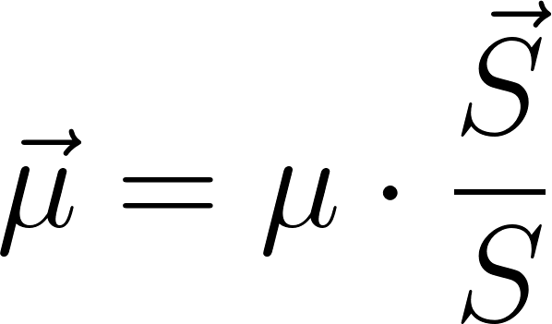
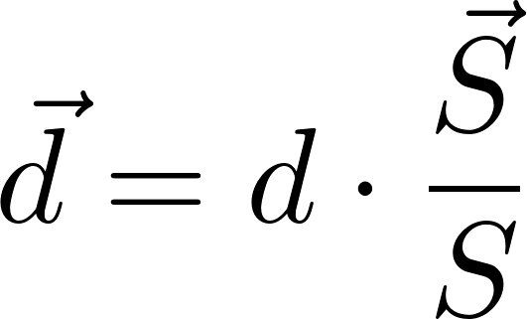

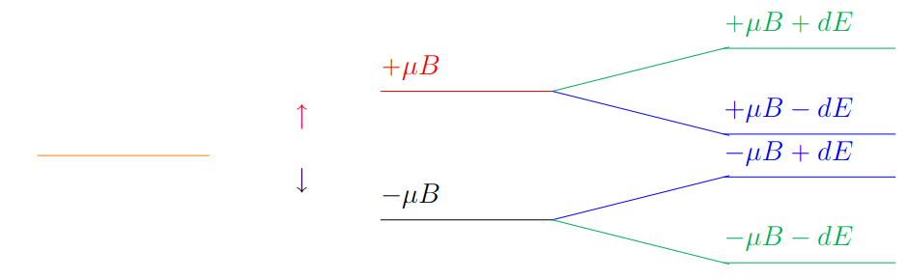
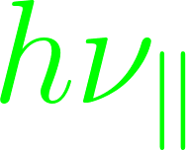
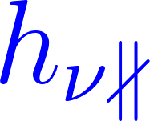
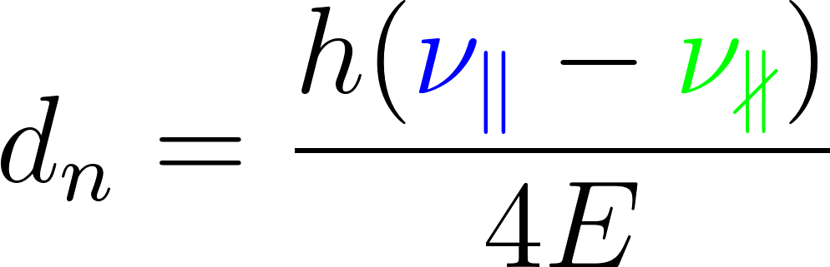
How to access to EDM ?
Measure frequencies
Count neutrons
Get nEDM

Slide 4

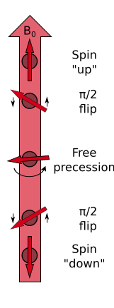
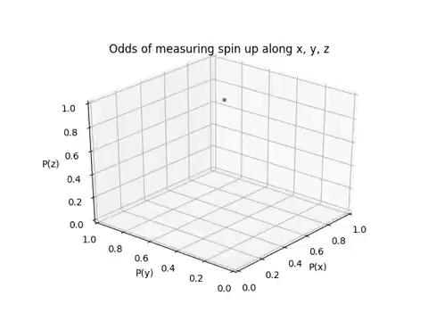
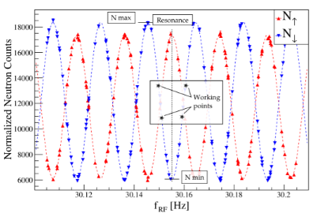
In practice we count neutrons (N↑↓) and use the Ramsey oscillating field method!

Slide 5
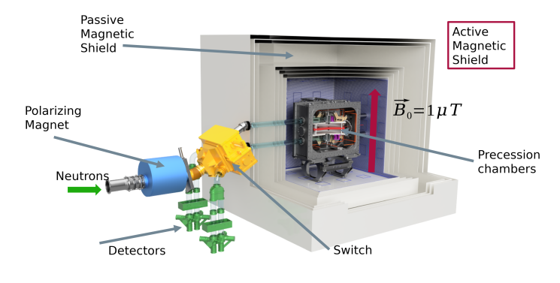
n2EDM overview
5 meters
nEDM collaboration:The design of the n2EDM experiment. Eur. Phys. J. C 81, 512 (2021).

Slide 6
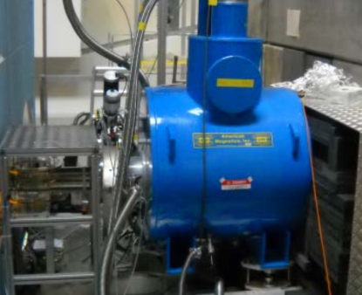
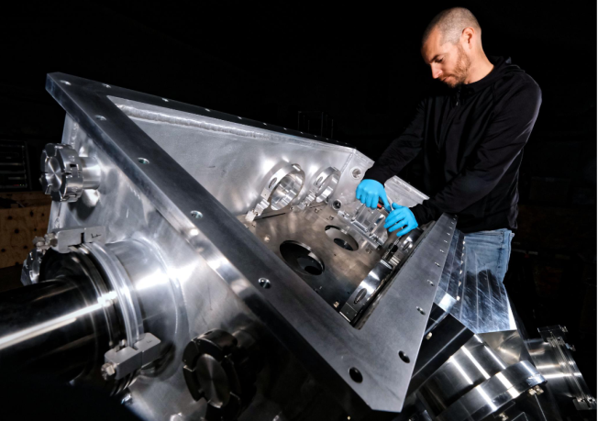
Superconducting Magnet UCN Switch
SCM 5T
UCN direction
polarizer
100% polarized

Slide 7
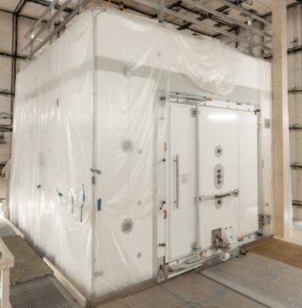
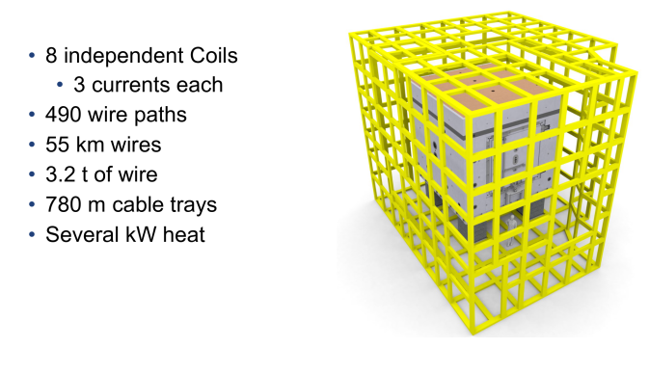
Magnetic Shielded Room Active Magnetic Shield
MSR AMS
Weight = 50T
Shielding factor = 100,000 at 0.01 Hz

Slide 8
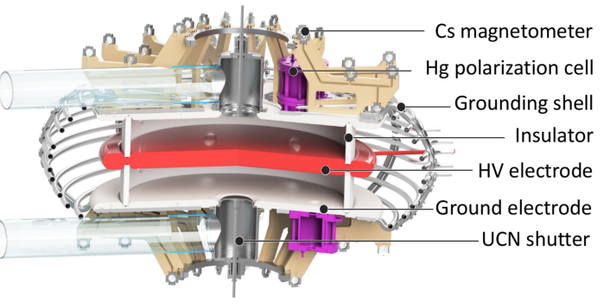
Precession chambers
(112)
B0
1𝜇T
E//
2x12cm
E∦
80 cm diameter

Slide 9
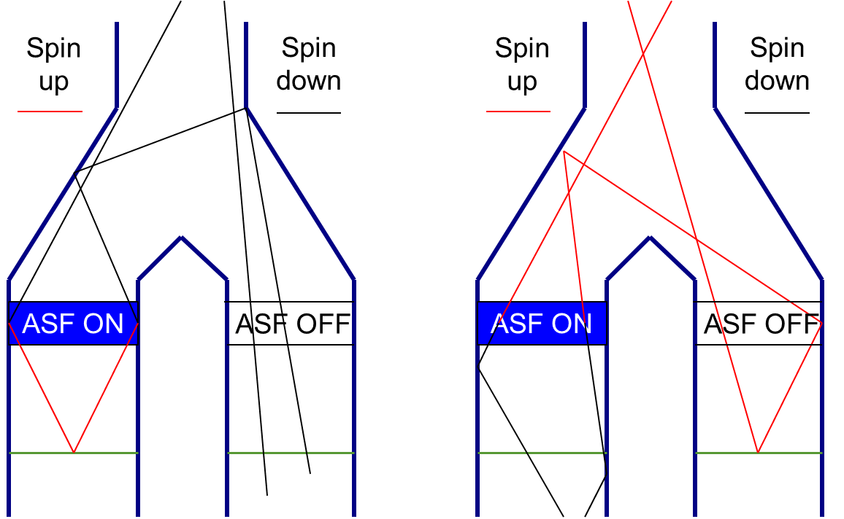
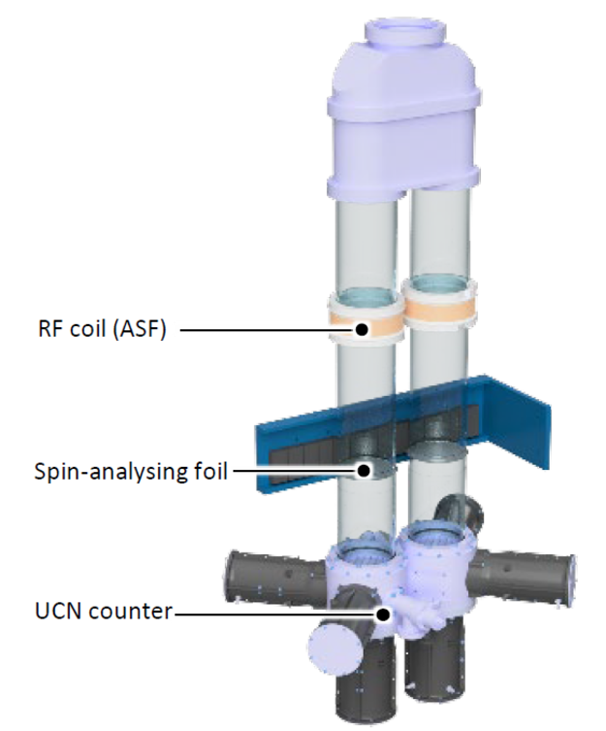
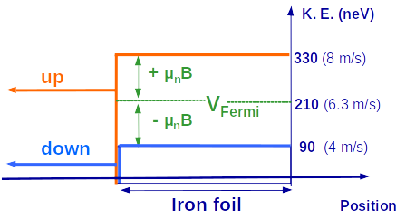
U Shape Simultaneous spin Analyzer (USSA)
UCN
x2
Top &
bottom
— Analysing foil
ASF = Adiabatic Spin Flipper

Slide 10
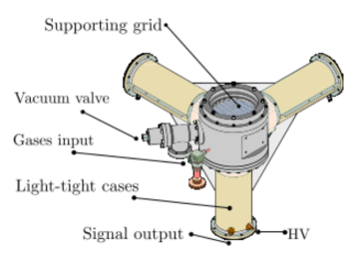
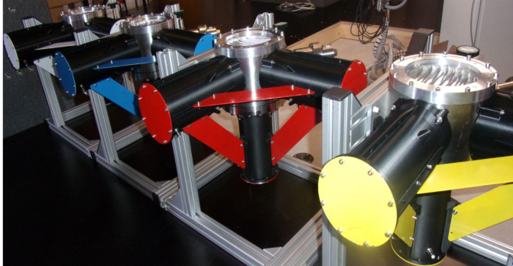
UCN detector (GADGET)
25 mbar ³He
1015 mbar CF₄
Step 1 n + ³He → ¹H + ³H (Q=764 keV )
Step 2 ¹H +CF₄→ CF₄*
³H +CF₄→ CF₄*
Step 3 CF₄* → CF₄ + photon (UV )
Step 4 Collection of photons by 3 PMT’s in coincidence
Step 6 Signal analysis

Slide 11
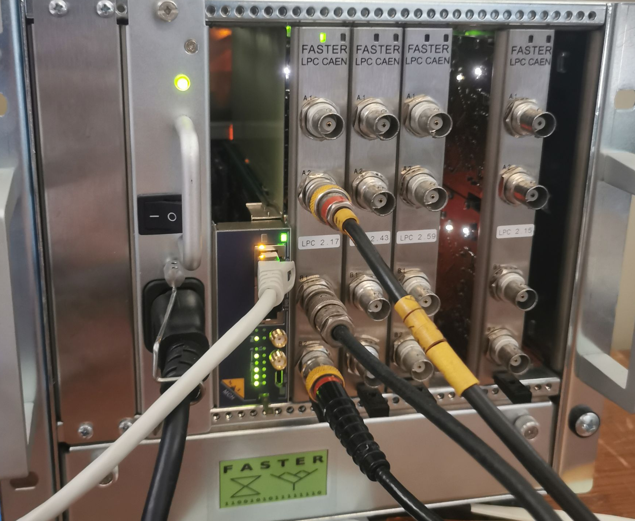
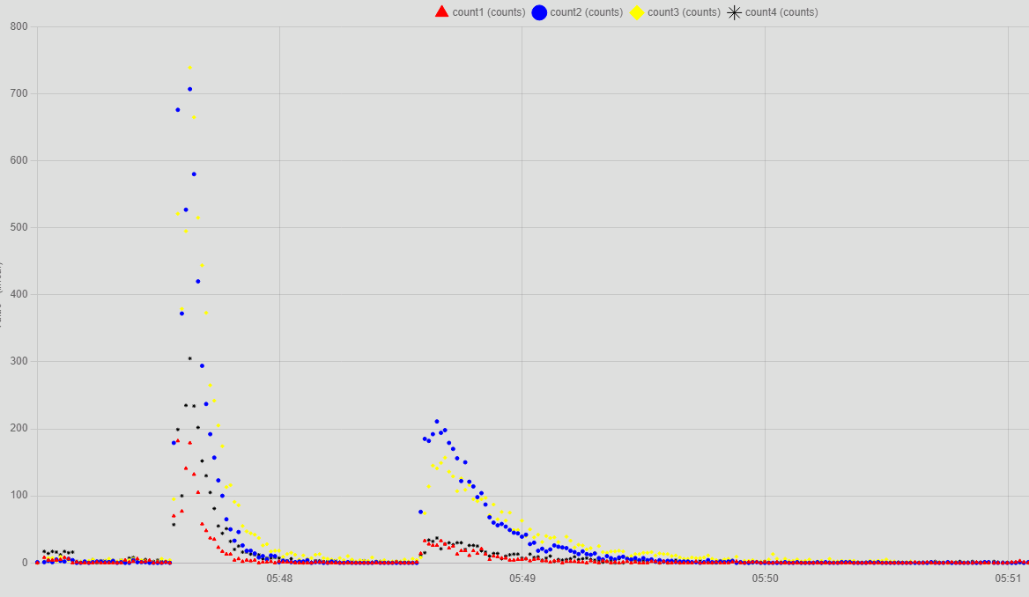
FASTER DMI
All data types are stored and plottable
datas are available in live!
Storage/
emptying guides
Filling
Chambers emptying/
neutrons counting
Detector signal acquisition
Detect more than 10⁶ events per seconde
2ns time resolution
Give the information of charge, amplitude of pulses …
Number of neutrons as a function of time (date)

Slide 12
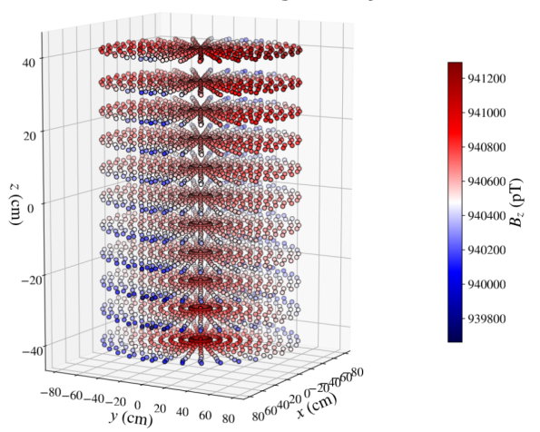
Field homogeneity Mapping campaign (2022)
Requirements
Field uniformity in chambers
  σ(Bz) < 170 pT
Top-Bottom gradient:
  -0.6pTcm-1<G1,0<0.6pTcm-1
Reproducibility of order 5 gradient
  σ(G5)<20 fT.cm-1
Measurements
Field uniformity in chambers
  σ(Bz) = 49 pT ✅
Top-Bottom gradient:
  G1,0= (0.35±0.25) pT.cm-1 ✅
Reproducibility of order 5 gradient
  σ(G5) = (3.5±4.3) fT.cm-1 ✅

Slide 13
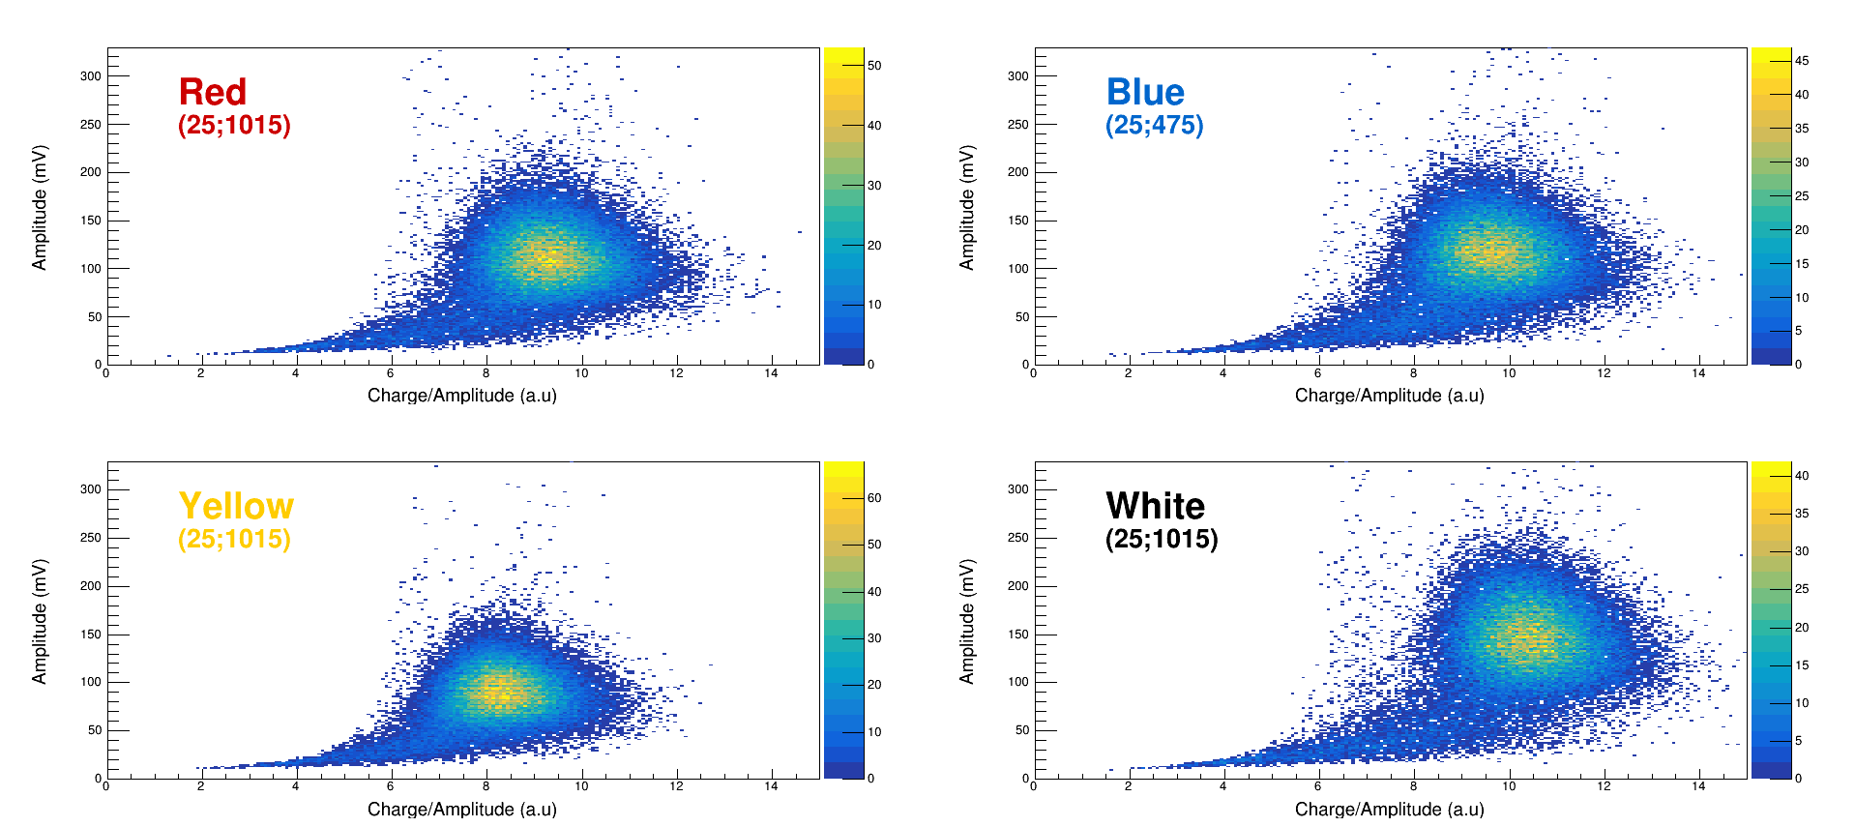
Neutron detection:
Pulse Shape Analysis: A= f(Q/A)
UCN
  Full energy deposition
  90% of all events
Gamma ray
  Background due to cosmic particles
Edge Event
  Protons or tritons stopped in the wall
Cherenkov
  Occurs in the PMT glass
Cherenkov
UCN spot
Gamma ray
Edge Event

Slide 14
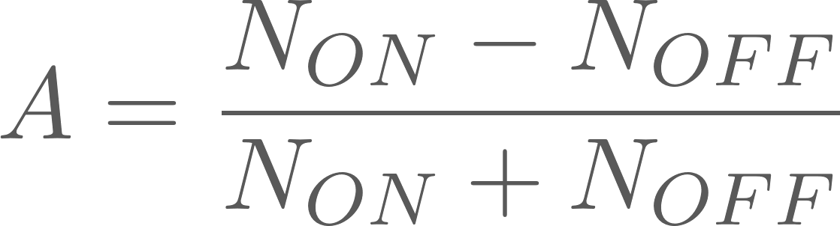
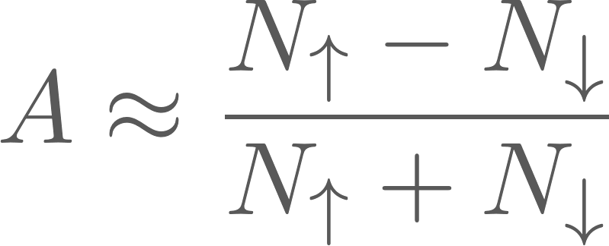
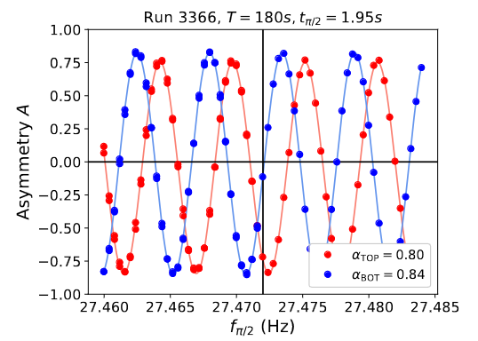
Spin analysis Performances
Asymmetry is defined as:
 | Bottom |  | Top
Detector | Red | Blue | Yellow | White
Frequency(kHz) | 80 | 70 | 90 | 90
Analyzing power (%) | 91.5±0.15 | 92.3 ±0.15 | 90.8±0.15 | 89.9±0.15
We are able to measure the neutron polarisation
⇨
Allow us to obtain our first Ramsey curve! (12/2023)

Slide 15
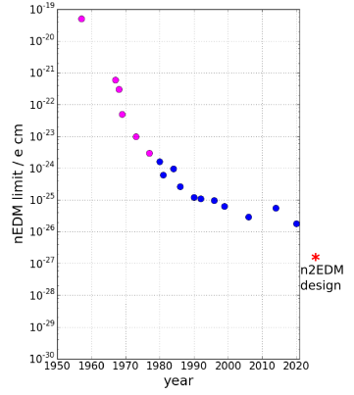
Current Status
n2EDM is in commissioning phase with UCN
Neutron optics / switch / shutters, DAQ / control, spin analysing, detectors, spin transport coils already operational
Next: high voltage, Cs and Hg magnetometry
Optimization still on going for the other components
PSI
(2020)
Stay tuned!

Slide 16
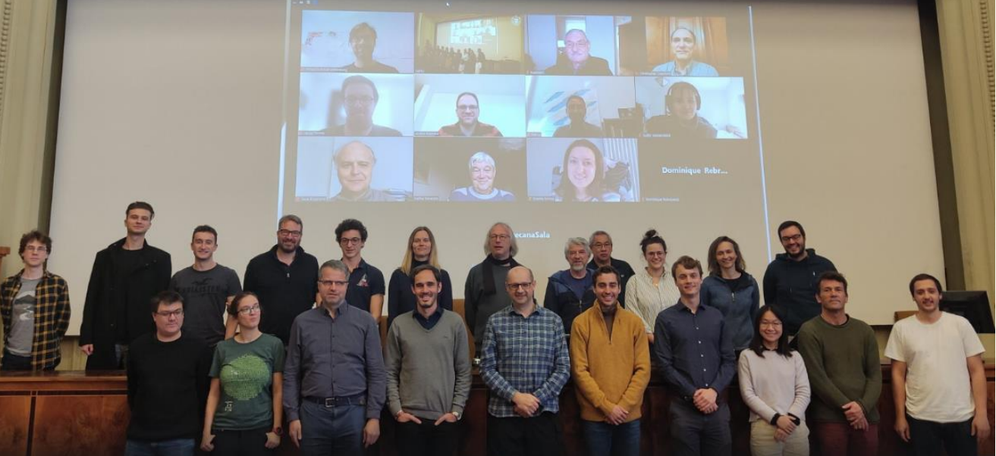
Thank you for your attention!

