Slide 1
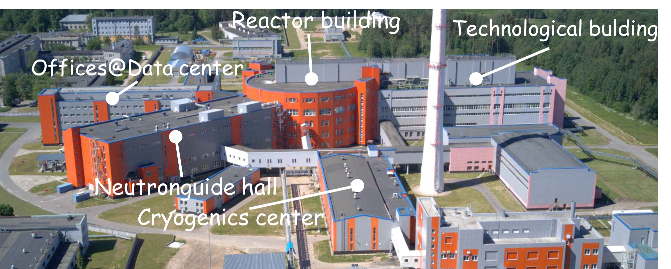
International center for neutron research based on the PIK reactor
Vladimir Voronin, NRC “Kurchatov intitute” - PNPI
Notes:
1
1

Slide 2
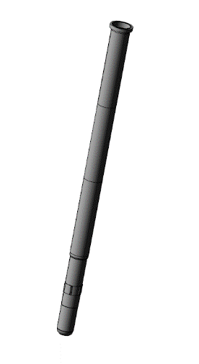
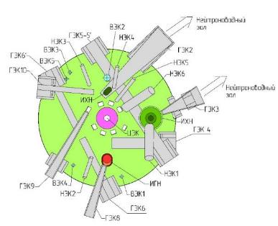
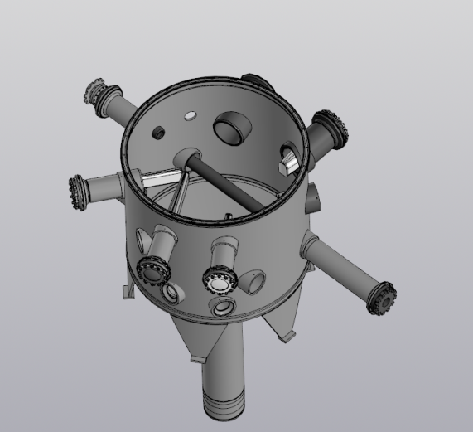
Reactor PIK is one of the most powerful permanent neutron source
 | Value
Power | 100 MW
Reactor core volume | 50 l
Core height | 500 mm
Coolant | Н₂О
Reflector | D₂О
Maximal thermal neutron flux in moderator | 1.3х10¹⁵ n/cm²c
Maximal neutron flux in central trap | 5х10¹⁵ n/cm²c
Operation cycle | ~30 day
Experimental channels - Horizontal (HEC) - Vertical (VEC) Inclined (IEC) Central (CEC) | 10 6 6 1
Facilities | Year of commissioning | Power, MW | Maximal neutron flux, 10¹⁵ n/cm²·c | Beam positions
PIK, Russia | Under commissioning | 100 | 5.0 | Up to 50
HFR , France | 1971 | 58 | 1.5 | 40
HFIR , USA | 1965 (2007 upgrade) | 85 | 3.0 | 15
FRM-2 , Germany | 2005 | 20 | 0.8 | 27
HANARO, S. Korea | 1995 | 30 | 0.45 | 7
OPAL , Australia | 2006 | 20 | 0.4 | 10
IBR-2, Dubna, Russia | 1984 | 2 | 0.01 (10 in pulse) | 14
Heavy water tank

Slide 3
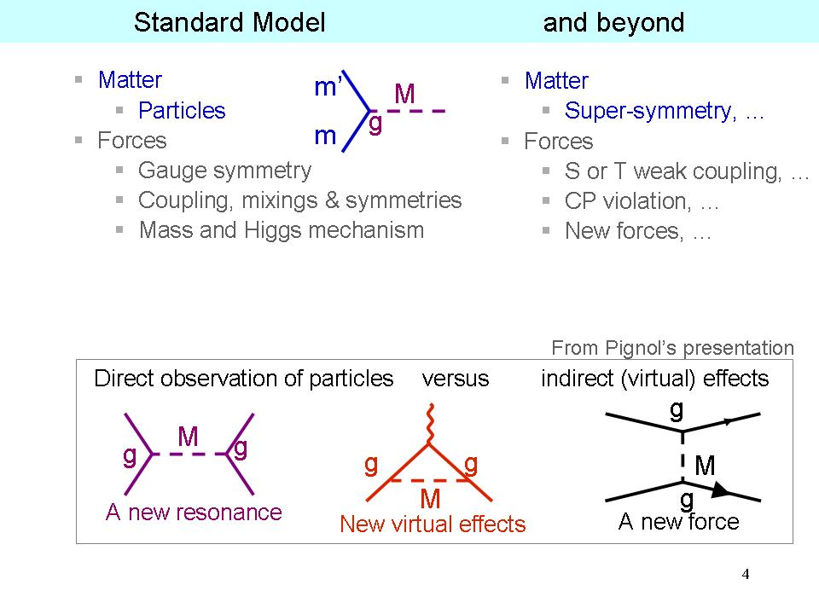
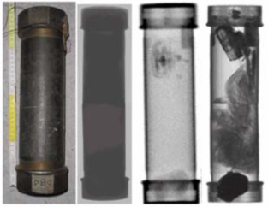
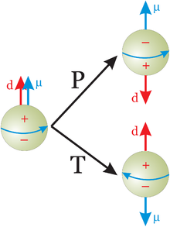
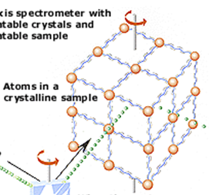
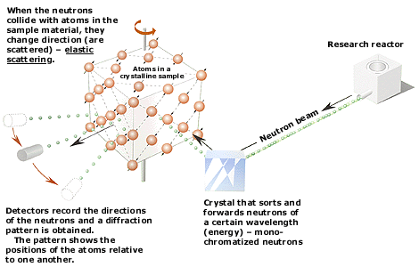
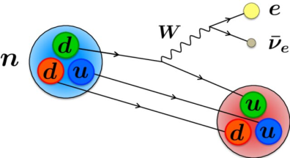
Why we need neutron
Experiments with neutron
Neutron as instrument
Neutron as an object of research
Property of fundamental interactions
Structure and dynamics of matter
Industrial application

Slide 4
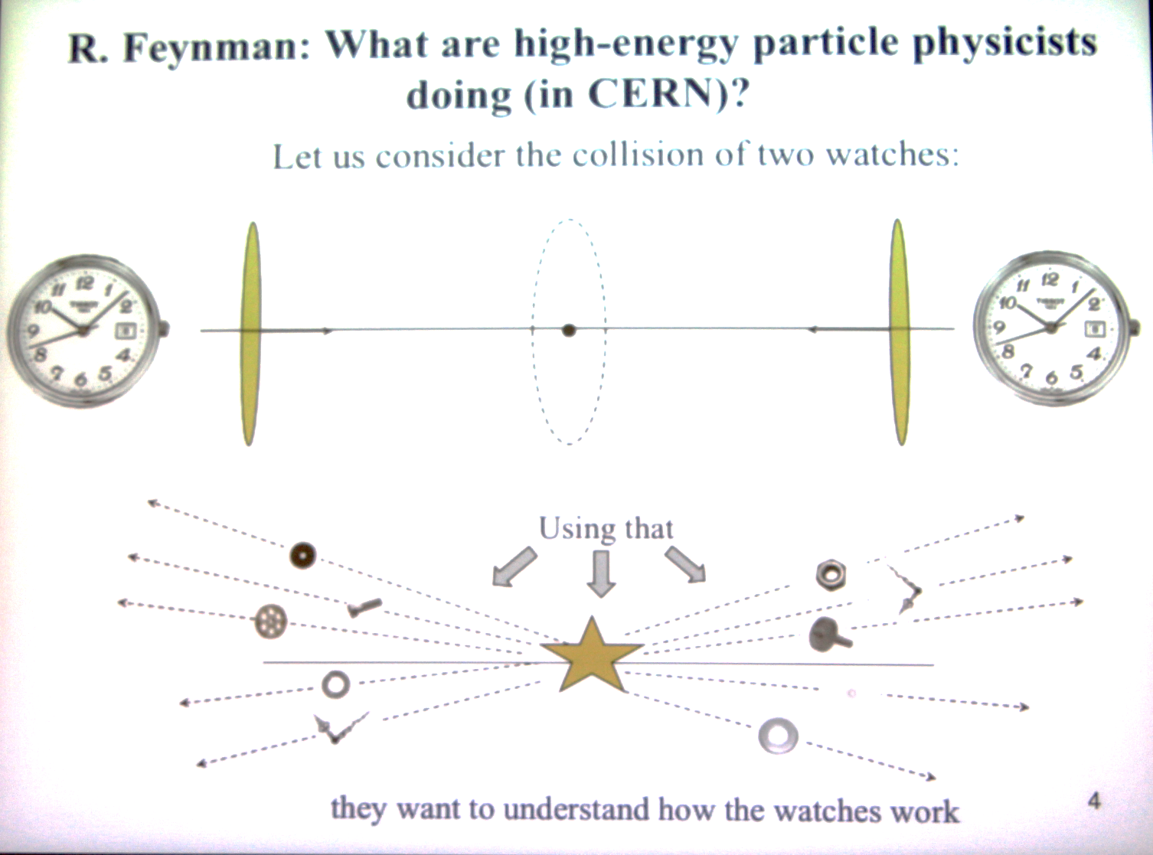

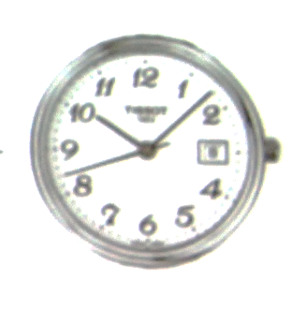

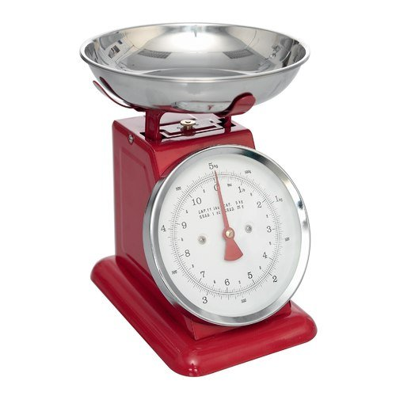
Neutron as an object of research
Collider (high energy) and neutron (low energy) experiment

Slide 5
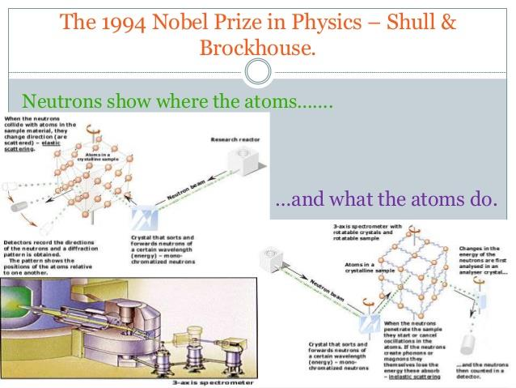
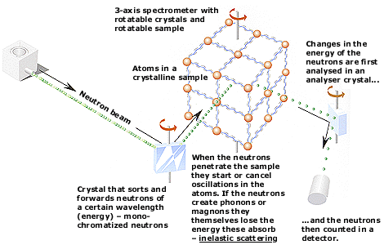
Neutron as instrument
Advantages of Neutron::
The wavelength of thermal neutrons corresponds to the interatomic distances,
The energies of thermal and cold neutrons are comparable to the energies of collective excitation modes
Unique tool to study magnetic materials,
Sensitivity to isotopic composition and light elements
Deep penetration into matter
Sensitive to all fundamental interactions
Low impact on the sample. Non-destructive method

Slide 6
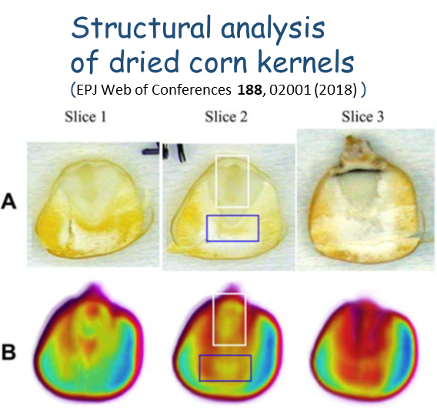
Neutron as instrument
Applications
Materials science (stress, strain, structure, elemental composition)
Study of cultural heritage sites, artefacts
Neutron radiography and
tomography
Element and isotopic analysis (neutron activation and radiation analysis)

Slide 7
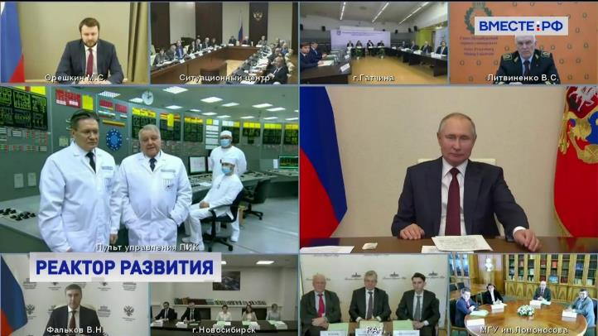
M.V. Kovalchuk, S.L. Smolsky, K.A. Konoplev, Research Reactor PIK,
Crystallography report. 2021. 66. № 2. p. 183
8 February 2021.
The energetic regime was started by Russia president Vladimir Putin
1975 – Start construction
1986 – Completed at 80% but Chernobyl accident
1991 – Continuation of construction but revolution
1991-1999 – stagnation
1999 – Continuation of construction but low funding
2009 – “First day” complex for 100W
2010 – PNPI join to program NRC KI
2011 – Physical run (100W)
2013 – Complex for 100kW
Commissioning
2018 – 100kW
2020 – license for 10MW
2022 – 7 MW
2023 – Р2 project commissioning
________________
2025 – start program to reach 100 MW

Slide 8
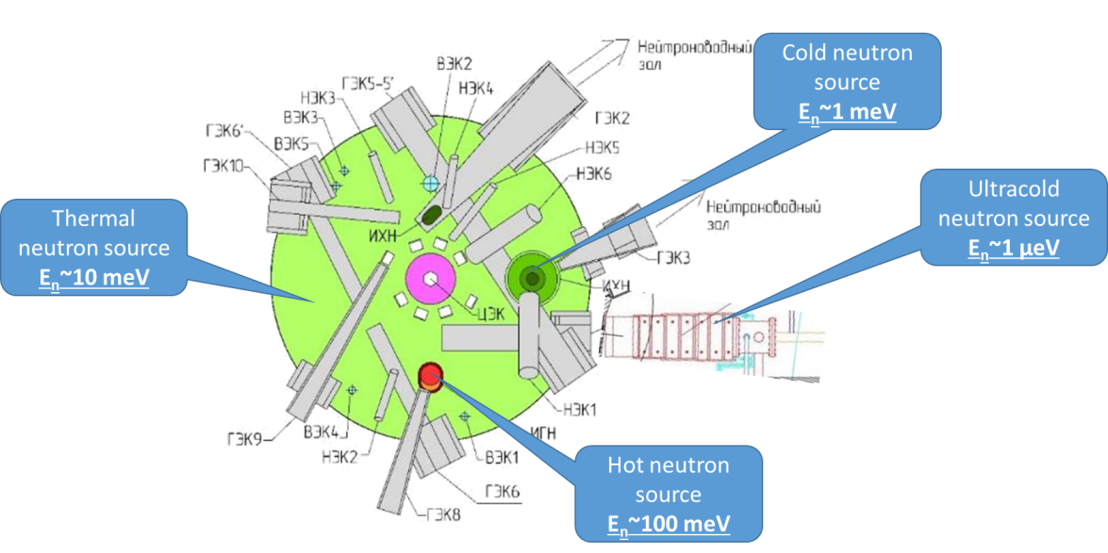
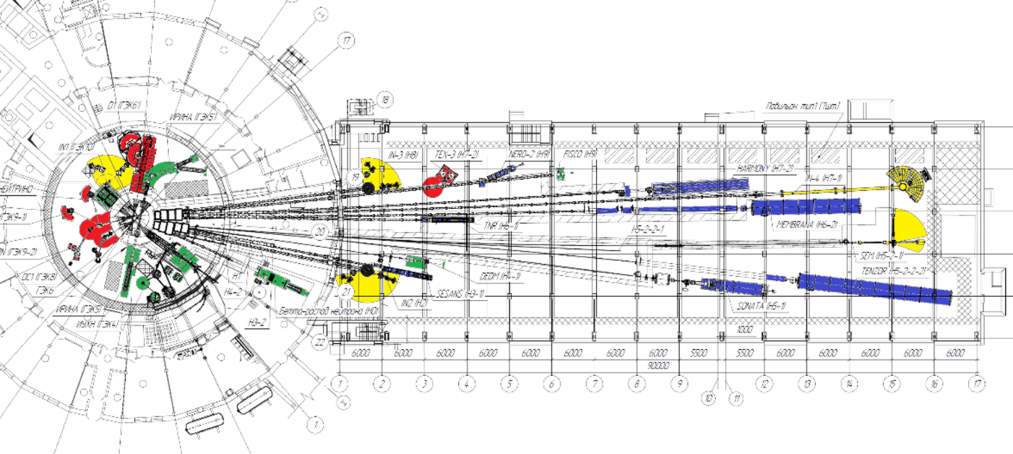
Reactor PIK instrumental program (2020-2025)
Cold neutron source - HEC 3
Hot neutron source – HEC 8
Ultra cold neutron source – HEC 4
Instruments (20 stations)
  Experimental stations for
  condensed matter (13)
Diffractometers (3)
Spectrometers of inelastic scattering (4)
SANS machines (3)
Reflectometers (2)
Neutron tomography (1)
  2. Experimental stations for nuclear
  and particle physics (7)
Commissioning all instruments - 2024-2025

Slide 9

Roadmap of instruments commissioning
M.V. Kovalchuk, V.V. Voronin, S.V. Grigoriev, A.P. Serebrov, Instrument Suite of the PIK Reactor,
Crystallography report. 2021. 66. № 2. p. 191.
# |  |  | 2019 |  | 2020 |  |  |  | 2021 |  |  |  | 2022 |  |  |  | 2023 |  |  |  | 2024 |  |  |  | 2025
 |  |  | III | IV | I | II | III | IV | I | II | III | IV | I | II | III | IV | I | II | III | IV | I | II | III | IV
0 |  | Reactor PIK commissioning | 100 kW |  |  |  |  |  | 10MW |  |  |  |  |  |  |  | 10MW |  |  |  | 10MW
1 |  | Project of instruments
2 |  | Experimental channel
3 |  | HNC HEC-8
4 |  | UCNS HEC-4
5 |  | CNS HEC-3
 |  | CNS HEC-3 prototype
6 |  | Neutronguide system |  |  |  |  |  |  |  | Optical and vacuum elements fabrication |  |  |  |  |  |  |  |  |  |  | Mounting
 |  | Neutron stations
1 |  | SESANS |  |  |  |  |  |  |  |  |  |  |  |  |  |  |  |  |  |  |  |  |  | Ready for commissioning | COMMISSIONIGN
2 |  | INAA |  |  |  |  |  |  |  | Phase 1
3 |  | «Нейтрино» (Neutrino)
4 |  | D1
5 |  | DC-1
6 |  | D3
7 |  | IN-1
8 |  | IN-2 |  |  |  |  |  |  |  |  |  |  | Phase 2
9 |  | ИРИНА (IRINA)
10 |  | DEDM
11 |  | FISCO
12 |  | Tenzor
13 |  | Мембрана – 2 (Membrane – 2)
14 |  | IN-3
15 |  | NT1
16 |  | SONATA
17 |  | SEM |  |  |  |  |  |  |  |  |  |  |  |  |  |  | Phase 3
18 |  | Harmony
19 |  | PROGRAS
20 |  | «Бета-распад нейтрона» (neutron beta decay)

Slide 10

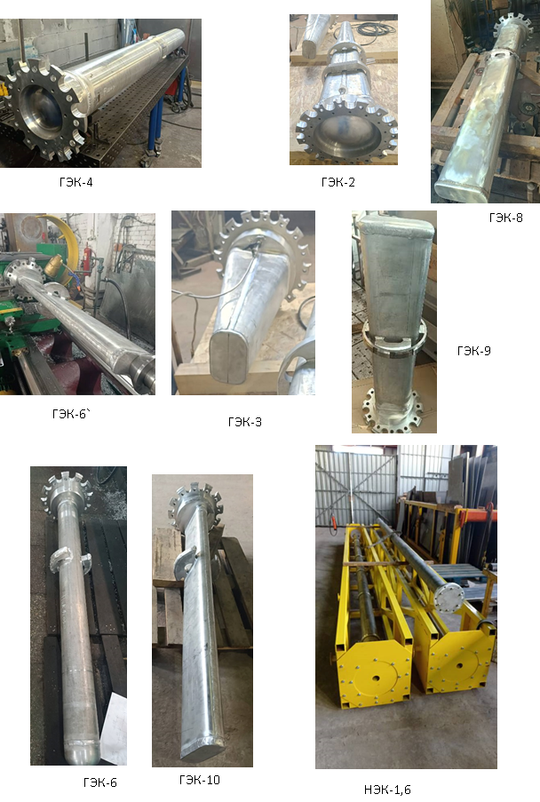

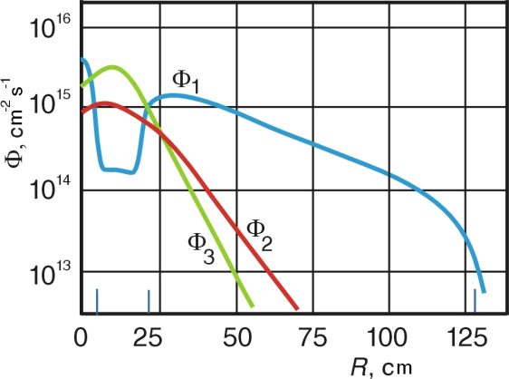

Experimental channels
are ready for mounting this year (2024)
The new design of the chanel and the use of helium as a filler makes it possible to increase the neutron flux at the channel output
by 15-20%

Slide 11
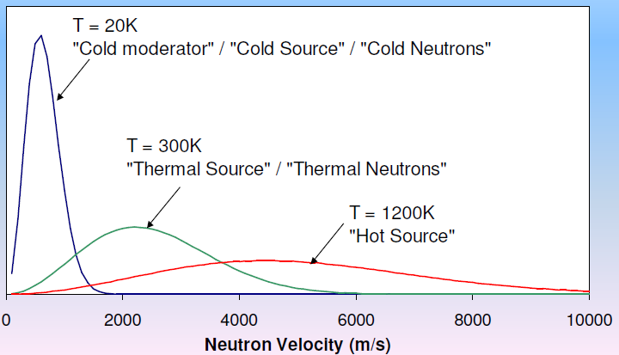
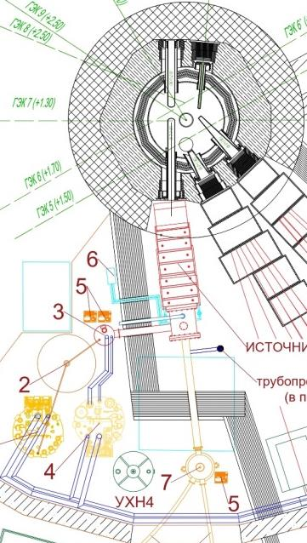
Secondary neutron source
Thermal neutron source
E_{n}~10 meV
Cold neutron source
E_{n}~1 meV
Ultracold neutron source
E_{n}~0.0001 meV
Hot neutron source
E_{n}~100 meV

Slide 12
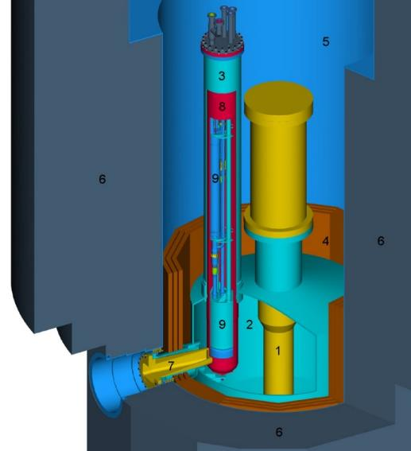
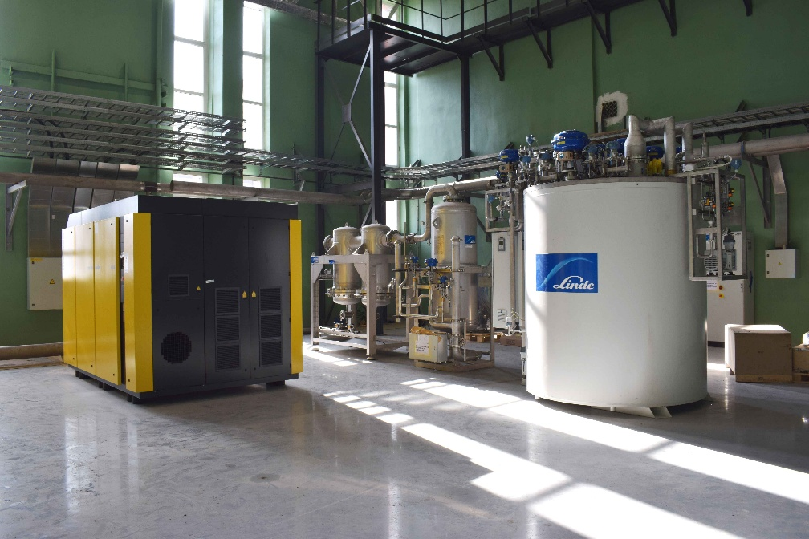
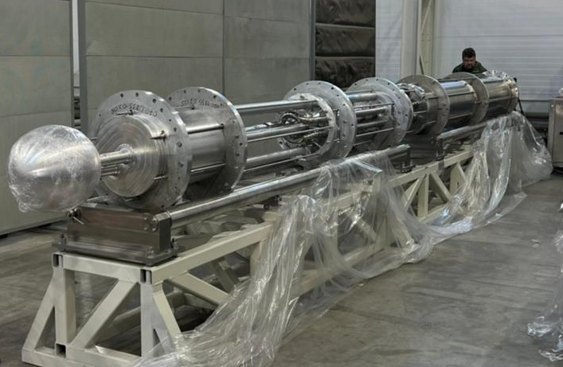
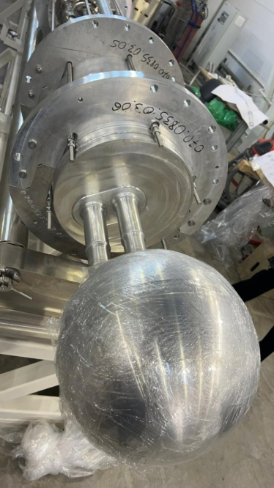
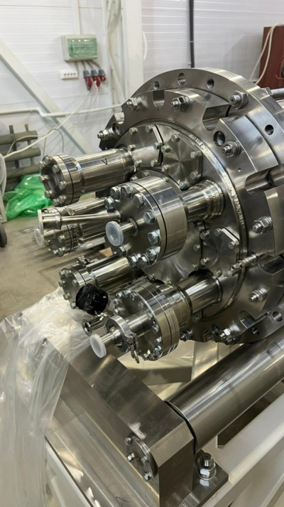
Cold neutron source HEC-3
Commissioning - 2025
A prototype has been created and tested, key elements have been manufactured and purchased – Thermosyphon, cryogenic equipment (Linde)
ГЭК-3
CN source parameters
Liquid deuterium - 25 L, T = 20 K
The distance from the active zone
of the reactor-60cm
Heat release – 5-6 kW.

Slide 13
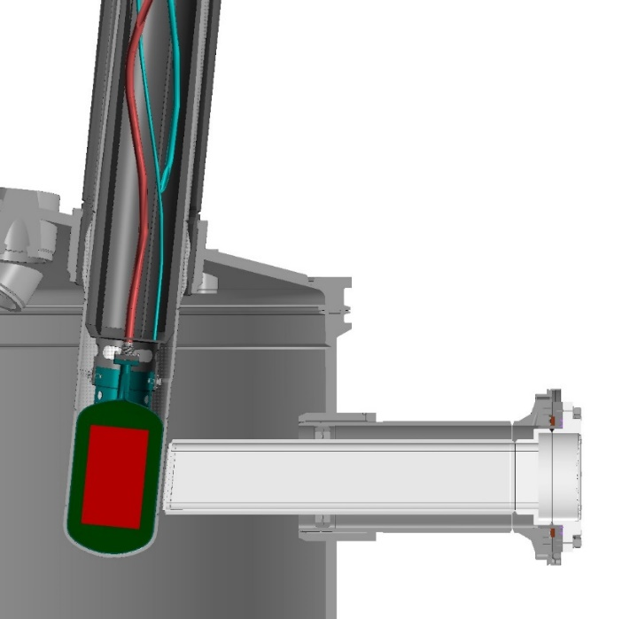
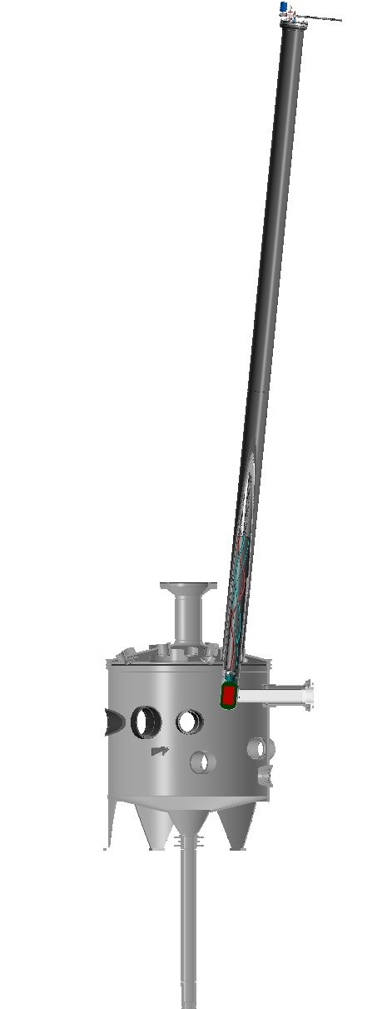
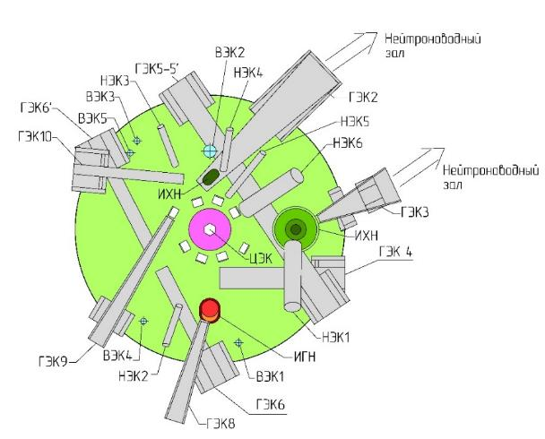
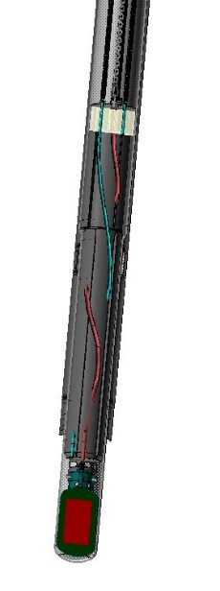
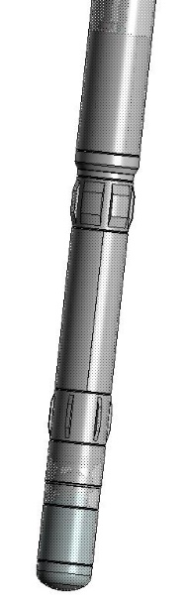
Hot neutron source (HEC-8)
Commissioning - 2025
Graphite
(radiation heating)
T=1500-2000 K
V ~ 5 l
The non-reactor equipment has been manufactured and delivered. The design of the in-reactor part has been developed
100

Slide 14
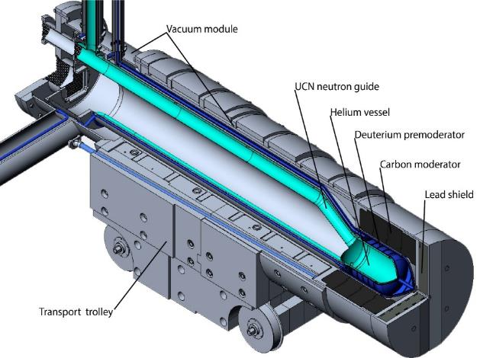
ULTRACOLD NEUTRON SOURCE
Commissioning - 2025
E < 10⁻⁷ eV
UCN source parameters:
Parameter | Value
UCN converter temperature, K | 1,15
Thermal neutron flux, cm⁻²s⁻¹ | 2,8∙10¹⁰
9Å flux density, cm⁻²s⁻¹Å⁻¹ | 5∙10⁸
UCN density in UCN source, cm⁻³ | 1,3∙10³
UCN density in the EDM trap, cm⁻³ | 3,5∙10²
Energy release in the helium chamber, W | 3,85
Energy release in the pre-moderator chamber, W | 10,7
Energy release in the lead shield, W | 267
Superfluid ⁴Не convertor at HEC-4
Т-1.15К
V~35 litre
И.Я.Померанчук, А. Ахиезер

Slide 15
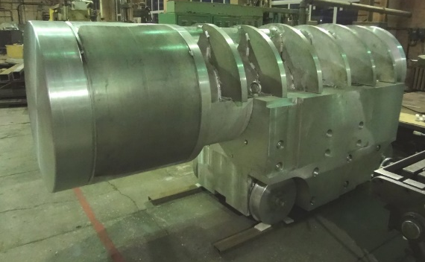
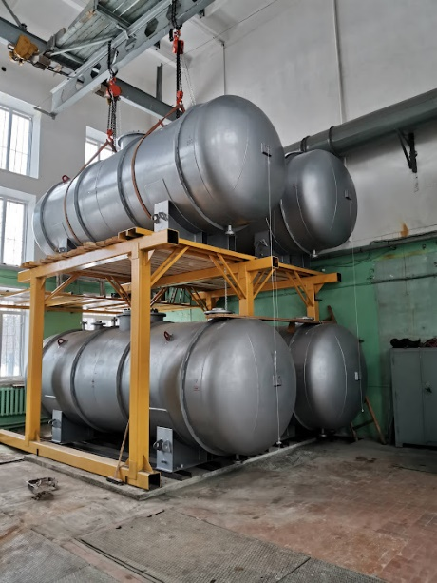
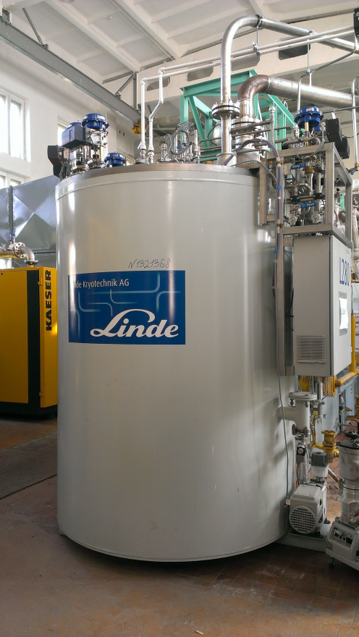
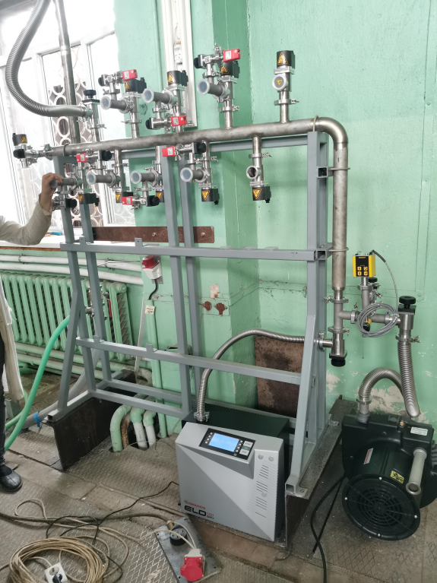
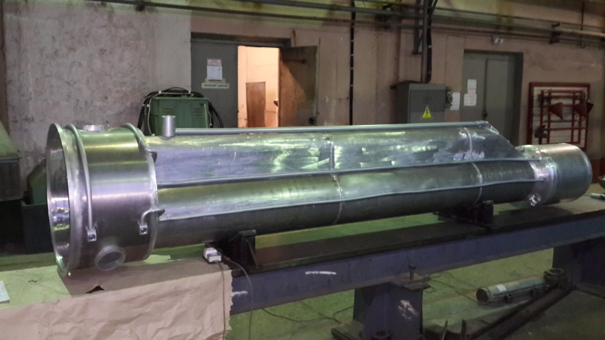
UCNS is ready for mounting

Slide 16
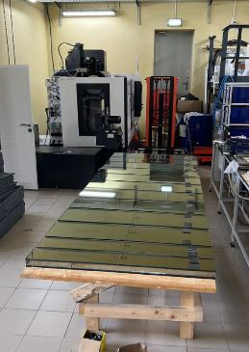
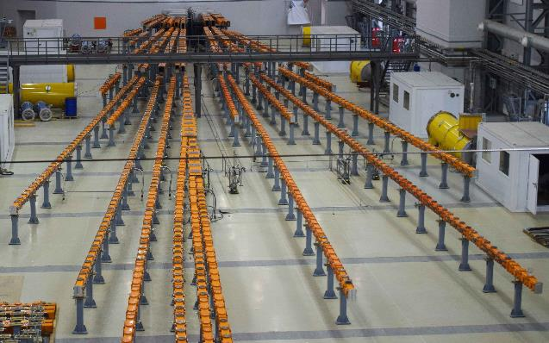
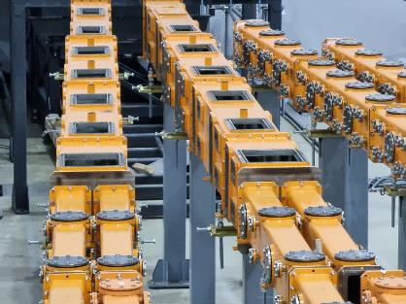
Neutronguides
Neutronguide elements and optics completed by 100%. Ready for mounting – 600 m
Vacuum tubes for
neutronguides

Slide 17
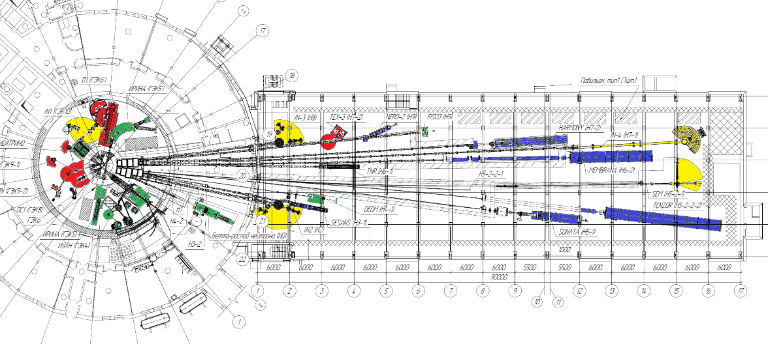
Layout of the Instruments
Spectroscopy
Diffraction
Large scale
Nuclear and particle physics
Hall of HEC
Neutronguide hall
Neutronguide length is about 600m

Slide 18
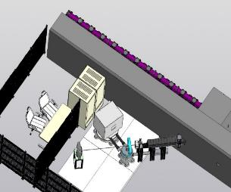
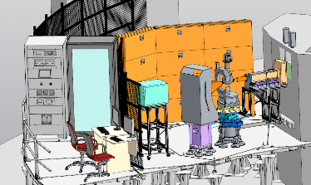
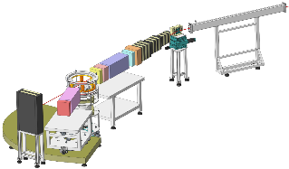
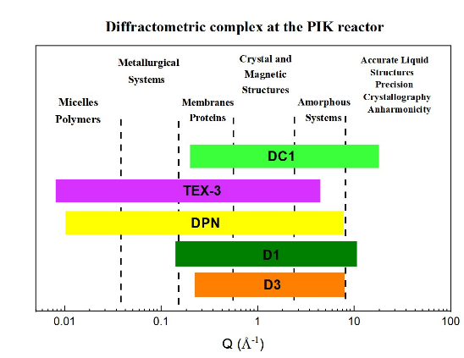
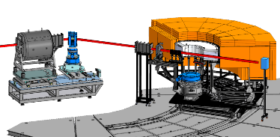
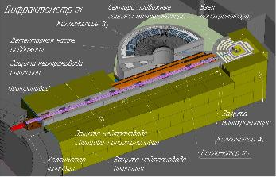
Complex of diffractometers
Four-circle diffractometer DC1
TEX-3 – texture
diffractometer
DPN – monocrystalline
polarized diffractometer
Powder high flux thermal neutron diffractometer D3
D1 – High-resolution
powder diffractometer

Slide 19
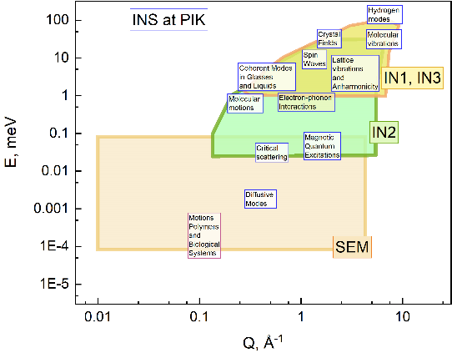




Complex of spectrometers
Triple-axis cold neutron
spectrometer IN-2
Triple-axis thermal neutron
spectrometer IN-1
Triple-axis polarized neutron
spectrometer IN-3
Spin-echo neutron
spectrometer SEM

Slide 20





Small angle scattering machines
SESANS –
Spin echo small-angle
diffractometer
Tenzor – Small angle polarized diffractometer
Membrane – Small angle diffractometer

Slide 21





Reflectometers
HARMONY – Reflectometer with vertical scattering plane
SONATA – High flux reflectometer
NERO-2 – High resolution reflectometer

Slide 22








Particle and nuclear physics
Neutron beta-decay
NEUTRINO-4
DEDM Setup for Crystal
Diffraction Experiments
Prospect - Study the (n,γ)-reaction
by thermal neutron
INAA - Neutron activation analysis
FISsion COrrelations
Investigation Radioactive Isotopes with Neutron (IRINA) facility
5, 6
4
2
3
1

Slide 23




International Association of Scientific Organizations “Interdisciplinary Center for Synchrotron, Neutron and Laser Research”
Members:
NRC “Kurchatov Institute”
NRC “Kurchatov Institute”- PNPI
Institute of Nuclear Physics of the
AS of the Republic of Uzbekistan
National Academy of Sciences of
Belarus (NAS of Belarus),
Atomic Energy Organization of Iran (AEOI)
NRC "Kurchatov Institute" – IHEP
Candidates:
JINR (Dubna)
INP SO RAS (Novosibirsk)
"Far Eastern Federal University" (FEFU)

Slide 24



Thank you
Welcome to neutron world

